Slide 1
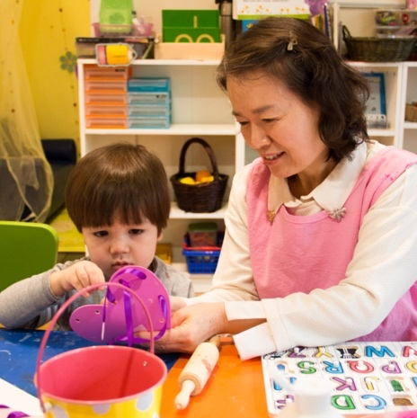

Family Engagement in
Early Care and Education
Gathering and Sharing Child Assessment Data

Slide 2
Overview
This module will focus on ways to:
Gather and share information with families to support children’s learning and development.
Have meaningful conversations with families about child assessment data.
Join families in using the information collected to guide children’s learning and development.

Slide 3
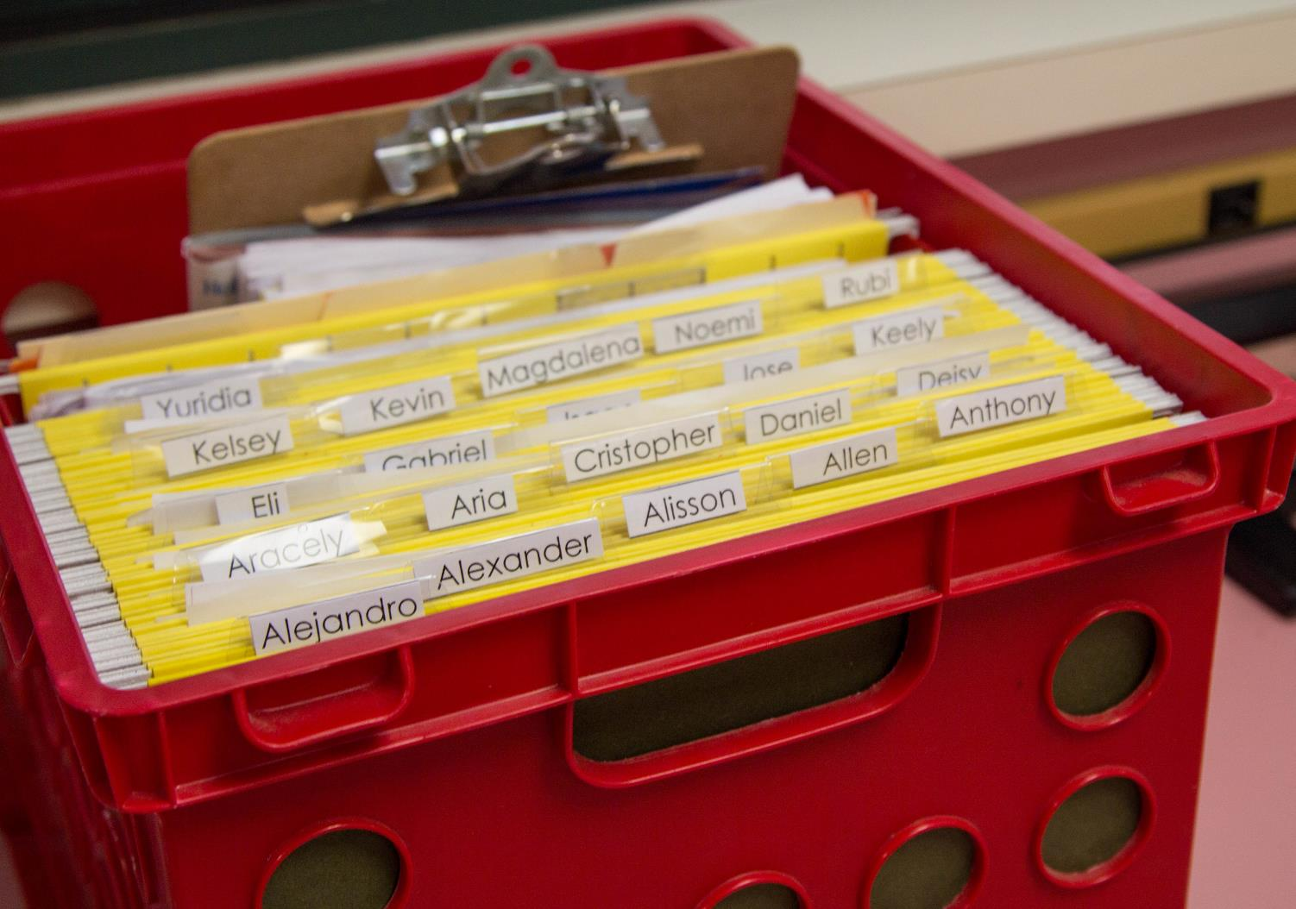
Data = Information
  Image credit: EarlyEdU

Slide 4
By the end of this module, you should be able to:
Explain ongoing childhood assessment.
Identify ways to partner with families in gathering and sharing information about children.
Describe ways that early childhood educators and families can use information to guide children’s learning and development.

Slide 5
Ongoing Child Assessment

Slide 6
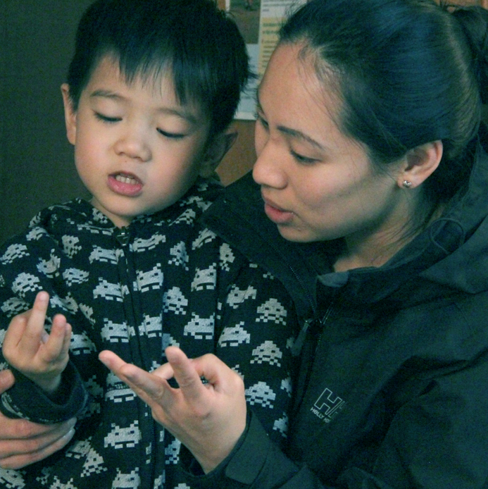
“Systematic, ongoing child assessment provides information on children’s development and learning.”
(U.S. Department of Health and Human Services, Administration for Children and Families, Office of Head Start, n.d.)
Image credit: EarlyEdU

Slide 7
Ongoing Child Assessment: Partnering With Families
The upcoming video focuses on gathering and sharing child assessment information
with families.
After watching the video, share three highlights with a partner.

Slide 8

VIDEO: Ongoing Child Assessment: Partnering With Families

Slide 9
Video Debrief
Family engagement promotes children’s learning.
Families are children’s first and primary teachers.
It is important to hear from families first.
Knowing what children do at home helps educators.
Families can help develop collaborative learning goals
for children.

Slide 10
Ongoing Assessment: A Definition
Ongoing assessment is the continuing process of gathering information, observing, documenting, interpreting progress, and deciding when to adjust practices to better support children’s development and learning.

Slide 11

The Assessment-Teaching Cycle
Observe
Teach
Document
Interpret
Image credit: EarlyEdU

Slide 12
Goals in Sharing Data with Families
Families have access to information about their children.
Information is understandable and meaningful.
Parents have opportunities to share about their children’s needs.
Families and program staff can act on shared information.

Slide 13
Gathering and Sharing Information

Slide 14
How Would You?
Invite families to share information about their children’s earliest experiences, interests, growth, and development?
Share information with families about their children’s program experiences, interests, growth, and development?

Slide 15
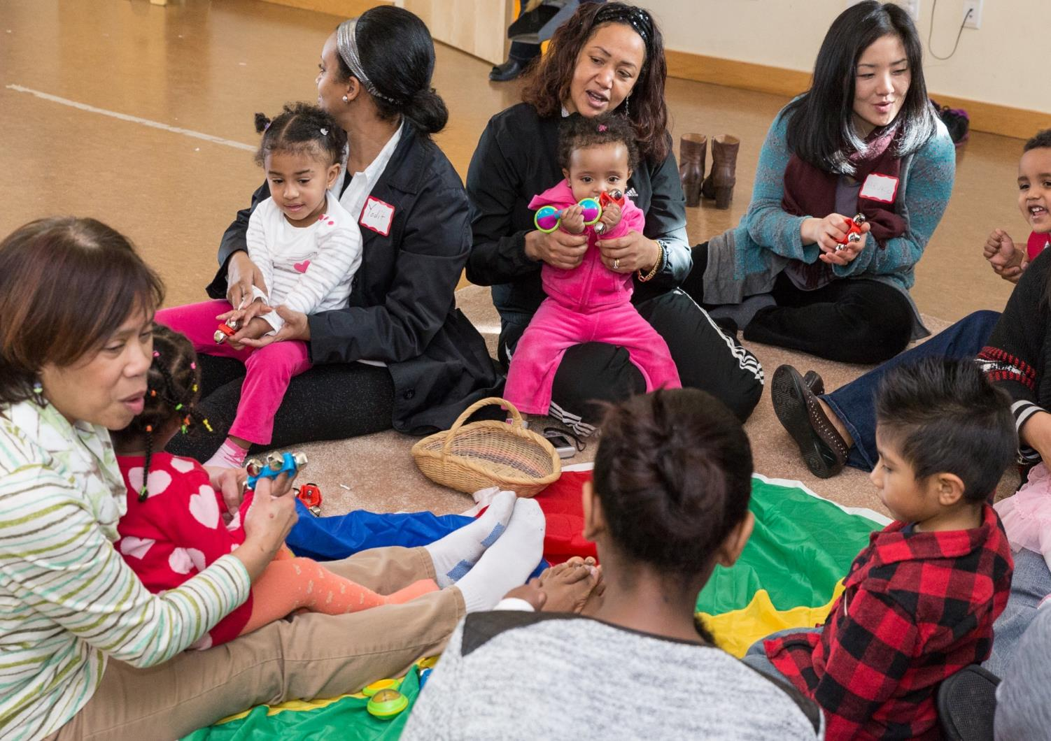
Sharing data is everyone’s responsibility.
Image credit: EarlyEdU

Slide 16
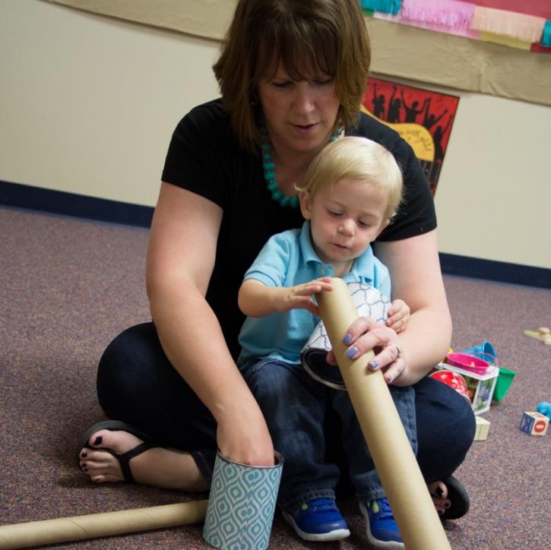
Positive Relationships Are Key
Partnerships with families that are based on positive, goal-oriented relationships support family and child progress.
Image credit: EarlyEdU

Slide 17
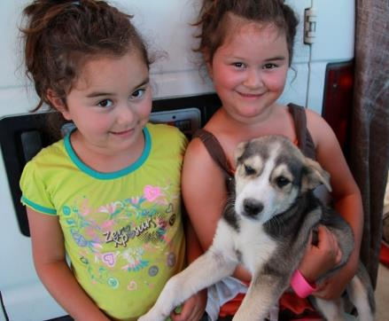
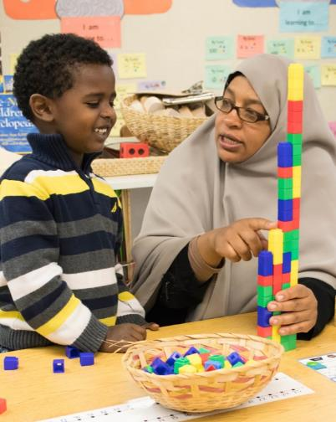
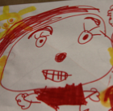
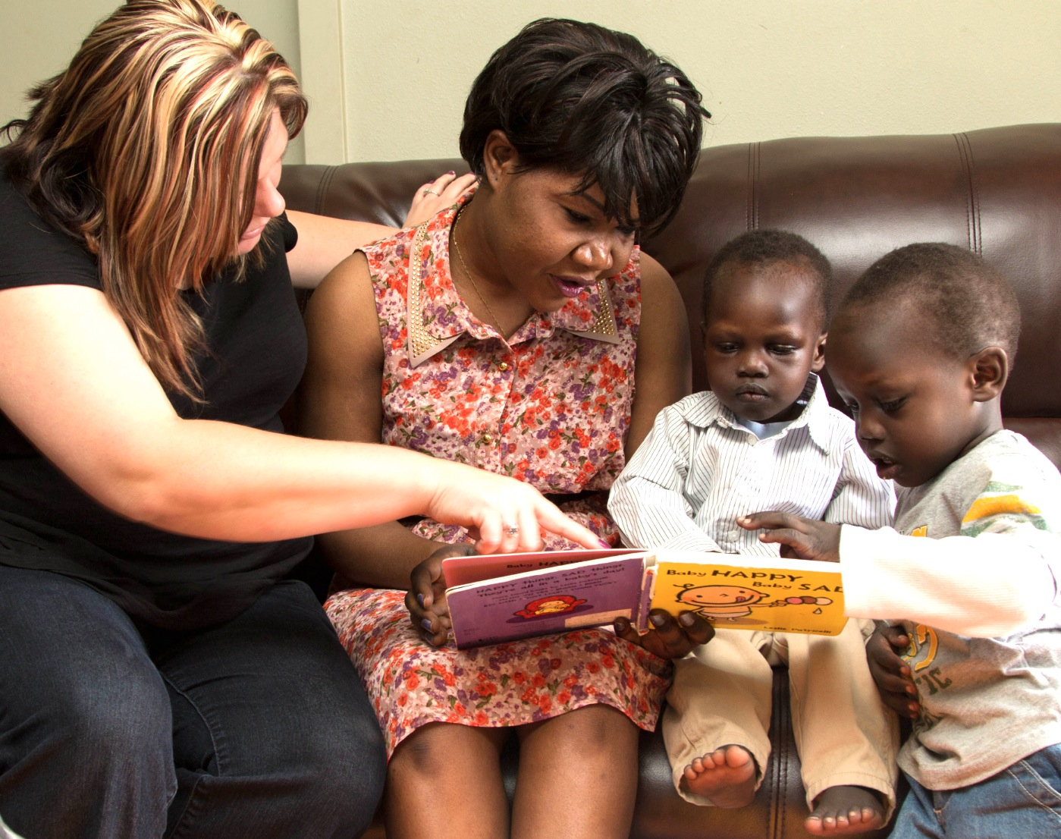
Sharing information
can help families and educators guide children’s learning and development.
WHY?
Image credit: EarlyEdU

Slide 18
Inviting and Responding
Some strategies to ensure access to information are:
Inviting families to share observations.
Using multiple methods to reach families.
Communicating with families in their preferred languages and with sensitivity
to their individuality and cultures.
Regularly sharing observations and children’s portfolios.

Slide 19
Impact of Shared Information
When parents and early childhood educators share information, this can:
Guide and inspire learning activities
at home and in the early learning setting.
Increase consistency throughout environments to reinforce children’s learning.
Create opportunities for educators to show respect for parent views and adjust their comments about children’s abilities.

Slide 20
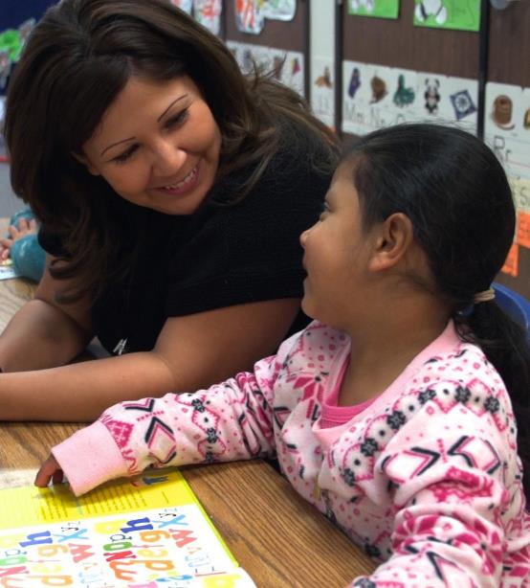
Benefits of Partnership
When parents have positive relationships with educators and
are involved in their children’s early learning environment,
their children’s school readiness and success can improve.
Image credit: EarlyEdU

Slide 21
Perspectives

Slide 22
Expectations of Parents and Educators
Divide into two groups—
one will take the educator role and the other, the parent role.
Each group will make a list of what they expect of the other.
Be ready to compare lists.

Slide 23

When gathering and sharing information with families, early childhood educators may need to see through another lens or in a different way.
Image credit: EarlyEdU

Slide 24
Taking Another’s Perspective
Share a time when you tried
to set aside your expectations and beliefs to see another perspective.

Slide 25
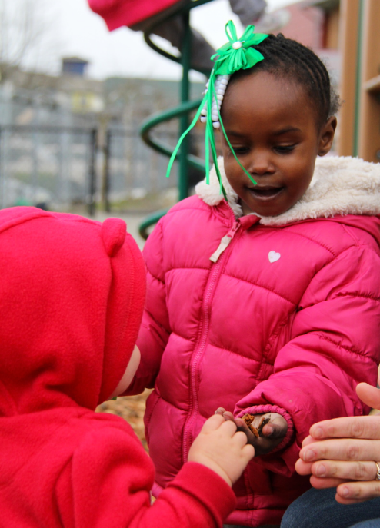
Sharing Perspectives
Early childhood educators, other program staff,
and families bring:
  Information
  Feelings
  Beliefs
  Expectations
Image credit: EarlyEdU

Slide 26
Wondering Together
With a partner or in a small group:
Read the statements and questions in the handout.
Discuss how wondering helps us better understand families’ perspectives and leads to a
stronger partnership.
Then, discuss the types of questions and statements you use in conversations with families to invite them to share.

Slide 27
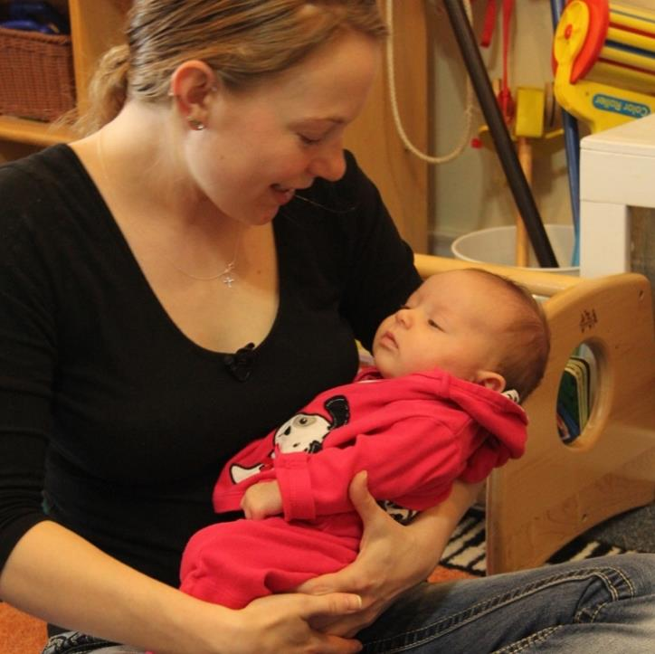
Start With Family Perspectives
Example questions
for families:
What is important
to you?
What would you like to share?
What would you like to know?
What does this mean to you?
Image credit: EarlyEdU

Slide 28
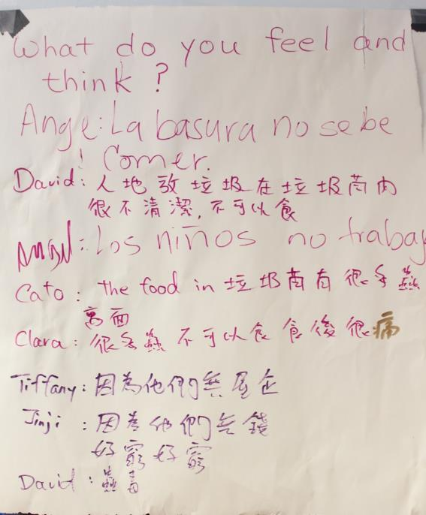
Sensitivity to Family Individuality
Cultural
Linguistic
Emotional
Image credit: EarlyEdU

Slide 29

When educators understand family perspectives, they learn to see children as their parents do.
Image credit: EarlyEdU

Slide 30
Approaches to Communication

Slide 31
Strategies for Conversations
Start with the parents’ perspectives.
Be positive and specific.
Be descriptive and share interpretations.
Focus on the parent-child relationship.
Support parental competence.
Be open to parents’ emotions.

Slide 32
What to Share
What can parents and
educators share with each other about children?
This may change over time
as relationships between educators and families deepen.

Slide 33
Making Information Meaningful
y
Do families understand what ongoing assessment is?
Do they know what the next stage of learning and development will be?
Am I using language that is clear and jargon-free?
Am I using families’ preferred languages?

Slide 34

Tips for Sharing Clear Information
Provide specific examples of what children know and can do.
Give context to information.
Pair verbal descriptions with visual examples.
Image credit: EarlyEdU

Slide 35
Ways to Communicate
Times and methods for families and educators to share information:
Arrival or departure
Formal parent-educator conferences
Home visits
Phone conversations
Text, video, and other messages
Email
Shared parent-educator journals

Slide 36
Toddler Assessment Conversation
Think about these questions while watching the video:
What types of information do
the parent and educator share?
What is the balance of educator talk and parent talk?
What types of questions
do you hear?
How do you think the parent feels during the interaction?

Slide 37
VIDEO: Toddler Assessment Conversation

Slide 38
Video Debrief
They share information about the child’s development, goals, and interests.
“What kinds of things is he interested in?”
“I wonder what you’re noticing at home.”

Slide 39
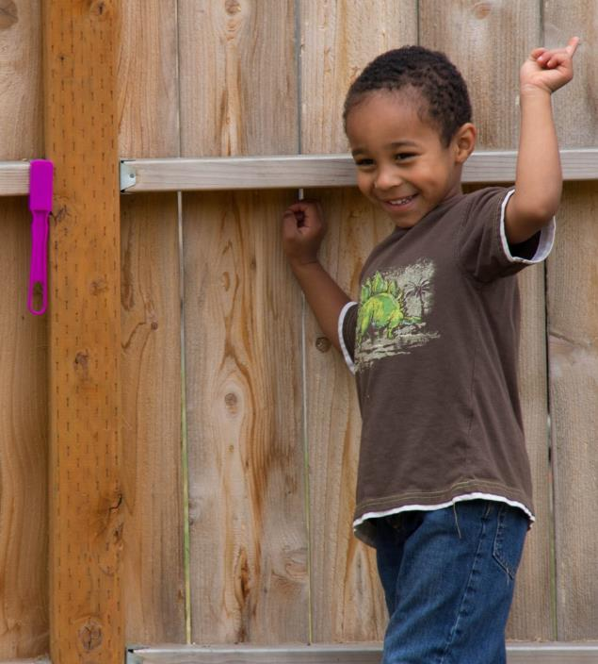
Tools for Sharing Information
In addition to observations,
families and educators can share:
Samples of children’s art, writing, and other work
Photographs of children’s work, activities, and interests
Image credit: EarlyEdU

Slide 40
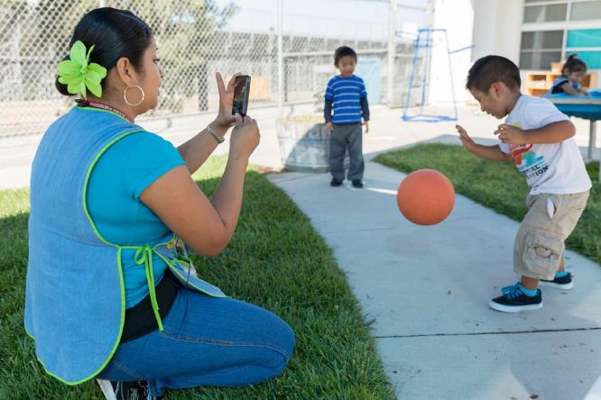
Using Video to Talk About
Child Learning
Video is a powerful tool for observing.
Video helps Keep It REAL.
Video is useful across early learning contexts.
Image credit: EarlyEdU

Slide 41
Using Video to Share With Family Members
Watch Megan Klish Fibbe, physical therapist, share information with families.
How does Megan use video in her work with families?
How does video support their work together? The family?

Slide 42
VIDEO: Using Video to Share With
Family Members

Slide 43
Video Debrief
Megan’s use of video:
Includes important caregivers and family members.
Allows family members
to implement strategies.
Highlights family competence.
Offers the child multiple
learning opportunities.

Slide 44
Keep It REAL
Relaxed
Equal
Accessible
Learning-focused

Slide 45
Acting on Shared Information

Slide 46
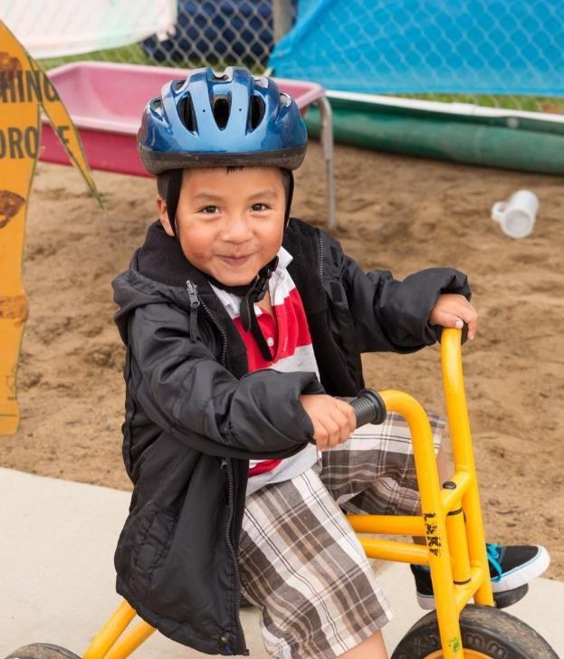
Co-Designing Activities
Families and educators can collaborate to design activities to foster children’s learning and development at home and in the early learning environment and community.
Image credit: EarlyEdU

Slide 47
Action Steps
Steps that family-educator partnerships
can take include:
Translating information into everyday activities.
Finding community resources to support children’s learning.
Describing children’s accomplishments, strengths, and challenges as they transition to new learning environments.

Slide 48
Role Play: Keep It REAL
Read Jonathan’s case study.
In groups of two or three,
role play a learning-focused conversation.
  One member should take on
  the role of the educator.
  The remaining members should be Jonathan’s family.
Discuss the experience.

Slide 49
Learning in Partnership: Using Data and Reflective Practice in Programs
Listen for key principles about how families, educators, and other program staff use information
they gather.

Slide 50
VIDEO: Learning in Partnership: Using Data and Reflective Practice in Programs

Slide 51
Video Debrief
Key principles you may have heard include:
Collaboration
Learning from families
Families as experts and decision makers

Slide 52
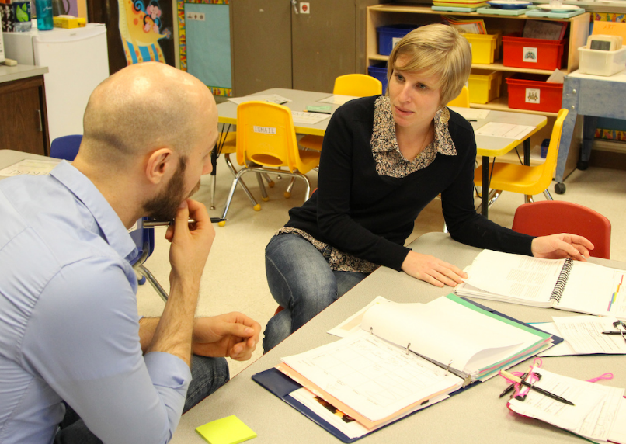
Improving Practices
Professional development
Coaching
Mentoring
Image credit: EarlyEdU

Slide 53
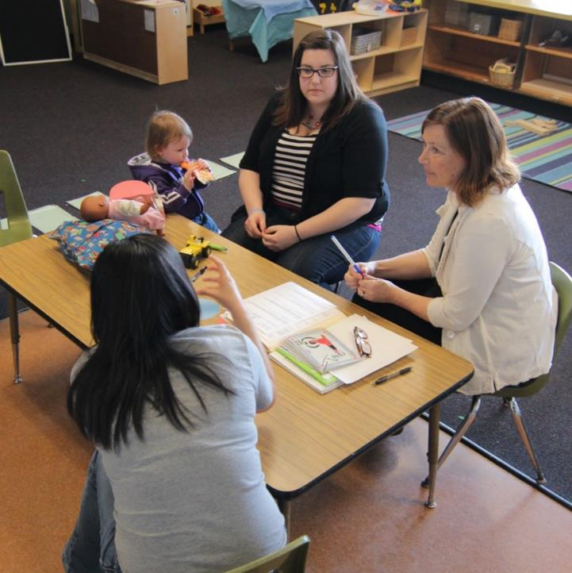
“We know that training alone, according to the research, is not enough. They need the opportunity to put that into practice.”
Dr. Dathan Rush, associate director of the Family, Infant and Preschool Program (FIPP)
Image credit: EarlyEdU

Slide 54
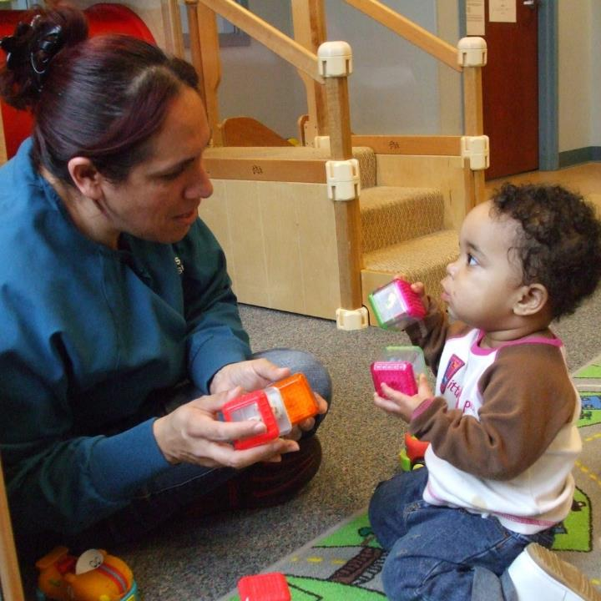
Reflective Practice
Families can think about their goals and progress.
Educators and other program staff can reflect on their practices and think about what would be most effective.
Image credit: EarlyEdU

Slide 55
Bringing It All Together

Slide 56
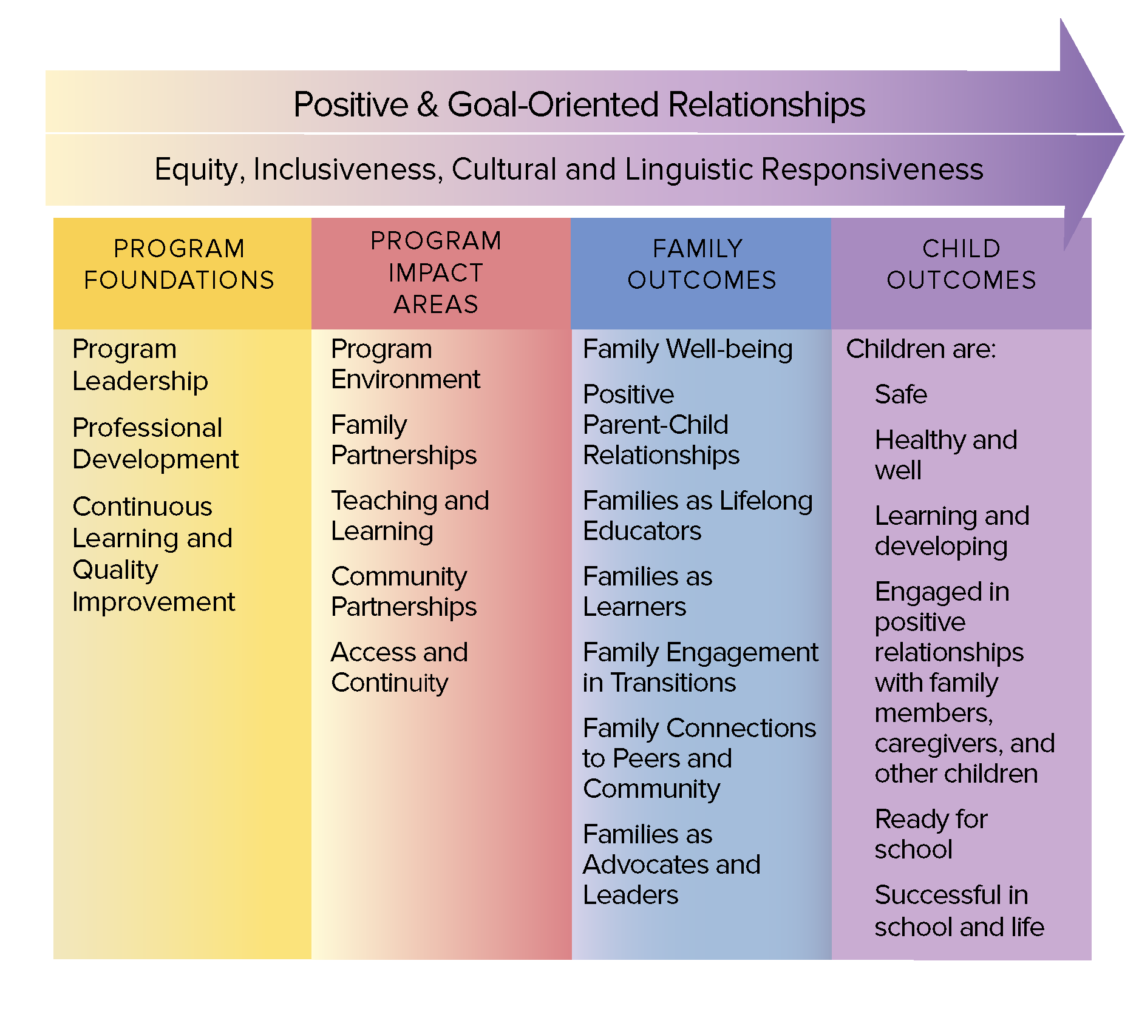
The Head Start Parent, Family, and Community Engagement Framework
Image credit: Office of Head Start

Slide 57
Where Does It Fit?
Which part of the Framework
does this topic relate to?
Form a small group and share ideas.
Be ready to share your thoughts with the whole group.

Slide 58
Gathering and sharing information with families supports children’s learning and development.
Starting with parents’ perspectives and sharing clear and meaningful information helps build trusting relationships that boost children’s progress.
Families and educators can co-design activities for children’s learning.

