Slide 1
BEHAVIOR GUIDANCE:
STATING BEHAVIORAL EXPECTATIONS
FALL 2012

Slide 2
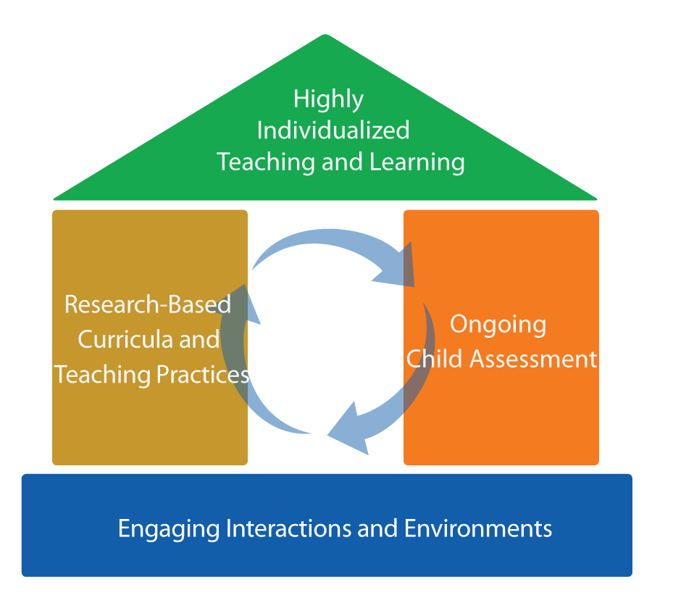
FRAMEWORK FOR EFFECTIVE PRACTICE
SUPPORTING SCHOOL READINESS FOR ALL CHILDREN
FOCUS ON
FOUNDATION

Slide 3
what will I learn?
To define behavioral expectations
To identify benefits of stating behavioral expectations in advance
To learn the steps for developing
and teaching expectations for children’s behaviors

Slide 4
WHAT ARE BEHAVIORAL EXPECTATIONS?
Appropriate behaviors expected
from children during specific activities and routines.
Ongoing moment-to-moment teaching practice
Teachers SAY what they want to SEE

Slide 5
BENEFITS of Behavioral Expectations
Prepare children for success!
Maximize children’s learning time.
Build a common language.
Provide a consistent message
to children.
Set the stage for learning.
Help prevent behavior problems before they happen.

Slide 6
DEVELOPING AND TEACHING EXPECTATIONS
STEPS:
Anticipate unfamiliar activities.
Plan for appropriate behaviors.
Prepare children for what you want to see.
Recognize children’s appropriate behavior.

Slide 7

Step One:
Anticipate unfamiliar activities
Teachers anticipate by:
Thinking through daily activities that may be unfamiliar
for children.

Slide 8
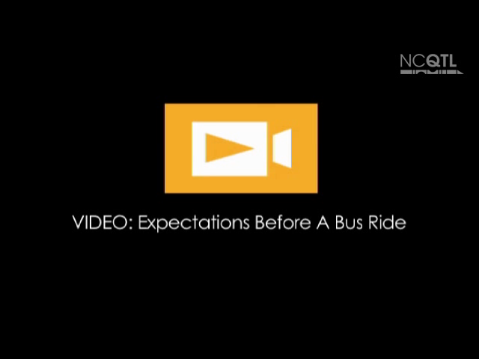

Slide 9
Step Two: PLANNING
Teachers plan by:
Writing out expectations in positive terms.
  “Say what you want to see”
Preparing needed materials.

Slide 10


Slide 11
Step Three: Preparing children
Teachers prepare children by:
Stating expected behaviors in advance.
Posting expectations:
  At children’s eye level.
  With simple words and pictures.
Repeating expectations often.

Slide 12
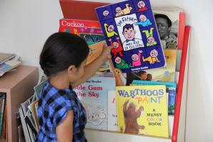

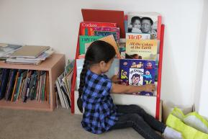
Preparing Children: book area

Slide 13
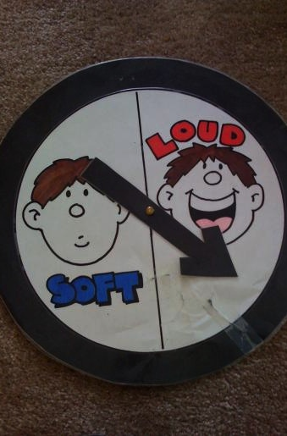
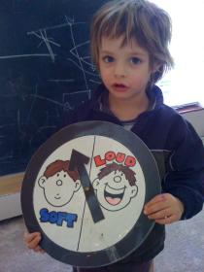
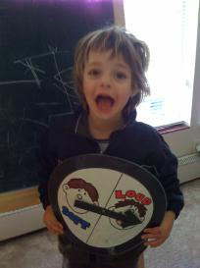
Preparing Children: voice volume

Slide 14
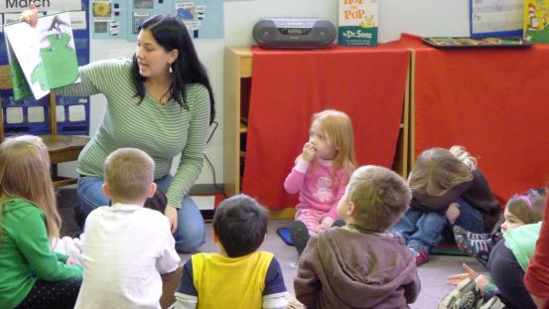
Preparing children
Teachers prepare children by:
Using a variety of strategies

Slide 15

Preparing: Teaching Quiet walking

Slide 16


Slide 17
Step Four: Recognize children’s appropriate behavior
Teachers recognize children’s appropriate behavior by:
Acknowledging appropriate behavior.
Encouraging behavior to continue.

Slide 18


Slide 19
Review:
Stating Behavioral EXPECTATIONS
STEPS:
Anticipate behaviors.
Plan for appropriate behaviors.
Prepare children for what you want to see.
Recognize children’s appropriate behavior.

Slide 20
FALL 2012

