Slide 1
Why Share Math Experiences?
Sharing experiences and backgrounds should include understanding how the other person approaches math and why
Research shows the debilitating effect of math anxiety on adults and on the children they care for
Education staff with more math anxiety feel less confident their math ability
  Teachers who are less confident in their math ability plan to teach less math and are less likely to use developmentally appropriate methods

Slide 2

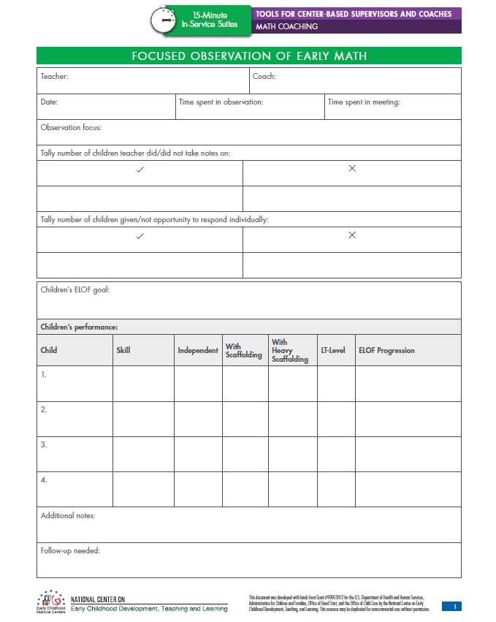
Focused Observation Plan
Take notes using a Focused Observation Form
Other helpful tools include:
  Video
  Coaching supports

Slide 3
Scenario 1
While engaging in counting activities, some children appear not to know the number sequence. Others get mixed up in terms of what objects they’ve counted or skip objects. There are some children who can count accurately to 10. The teacher continues to have children count sets of 6 to 25.
How could you coach this staff member in terms of mathematics teaching and practices?

Slide 4
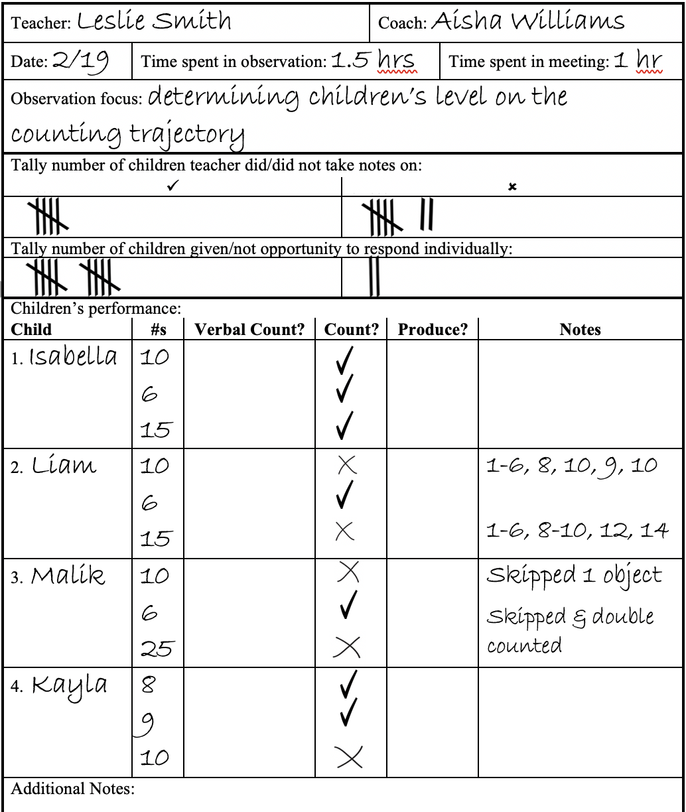
Scenario 1

Slide 5

Scenario 1
What would you ask this teacher to promote reflection?
What positive feedback could you give this teacher?
How could the teacher translate her strengths into improving in other areas? How could you communicate this to the teacher?
THINK
PAIR
SHARE

Slide 6

Scenario 1
Based on the reflection discussed on the prior slide, what goal do you think the teacher should focus on next?
What are the teacher’s strengths and areas for growth related to the goal?
  What questions could you ask the teacher to gauge this?
THINK
PAIR
SHARE

Slide 7


Slide 8
Focused Observation Plan
Action plan goal | Possible observation times and activities | Data collection ideas

Slide 9
Scenario 2
During snack time at a socialization, the parents work to set the table—giving each child one bowl, one spoon, one cup, and one napkin. Two-and-a-half-year-old Tyson notices that there aren’t enough spoons for every child and says, “more spoons!” The home visitor overhears the mother say, “Yes, we need more spoons.” The home visitor whispers to the mother, “Maybe you can tell him we need 2 more spoons. Add in some math language!”
How could you coach this home visitors in terms of supporting the parent’s use of mathematics teaching and practices?

Slide 10
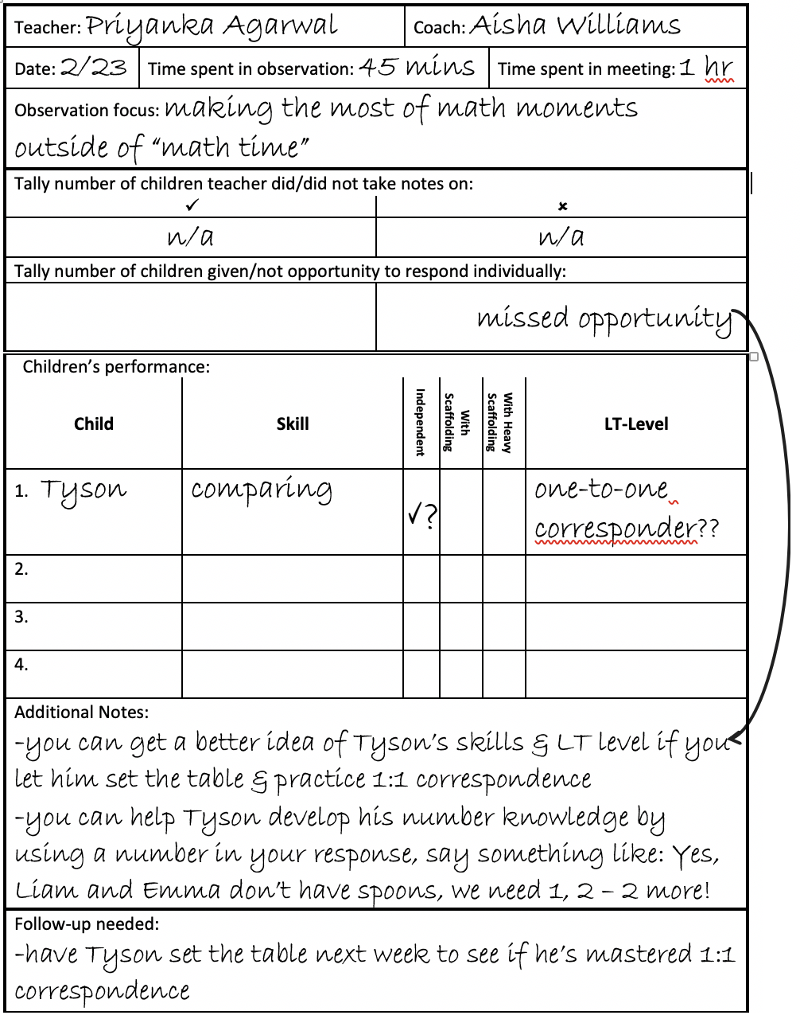
Scenario 2
Parent

Slide 11
Scenario 2
What would you ask this home visitor to promote reflection?
What positive feedback could you give this home visitor?
How could the home visitor translate her strengths into improving in other areas? How could you communicate this to the home visitor?
THINK
PAIR
SHARE

Slide 12
Scenario 2
Based on the reflection discussed on the prior slide, what goal do you think the home visitor should focus on next?
What are the home visitor’s strengths and areas for growth related to the goal?
  What questions could you ask the home visitor to gauge this?
THINK
PAIR
SHARE

Slide 14
Focused Observation Plan
Action plan goal | Possible observation times and activities | Data collection ideas

