Slide 1
ONGOING CHILD ASSESSMENT: COLLECTING AND USING VIDEO
SPRING 2014

Slide 2
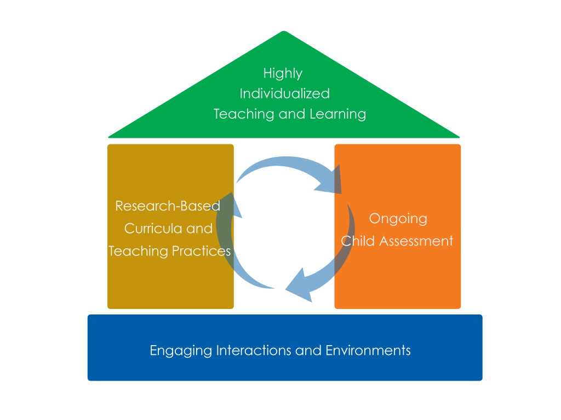
Framework for Effective Practice Supporting school readiness for all children

Slide 3
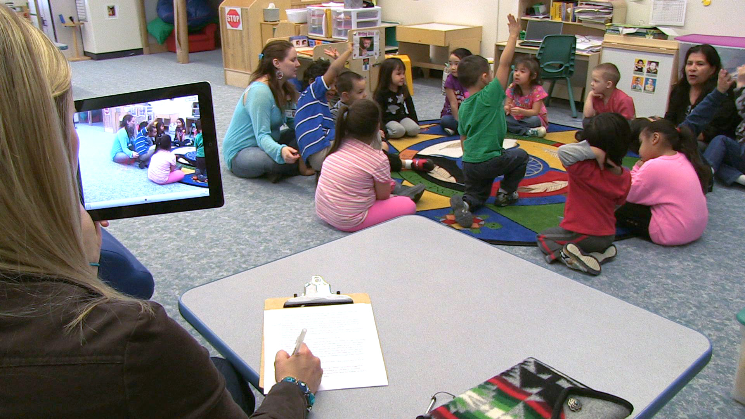
OBJECTIVES
Learn to record, collect, and organize video of children’s behaviors.
Learn to interpret and use information from videos to document children’s progress.

Slide 4
VIDEO: USE OF VIDEO

Slide 5
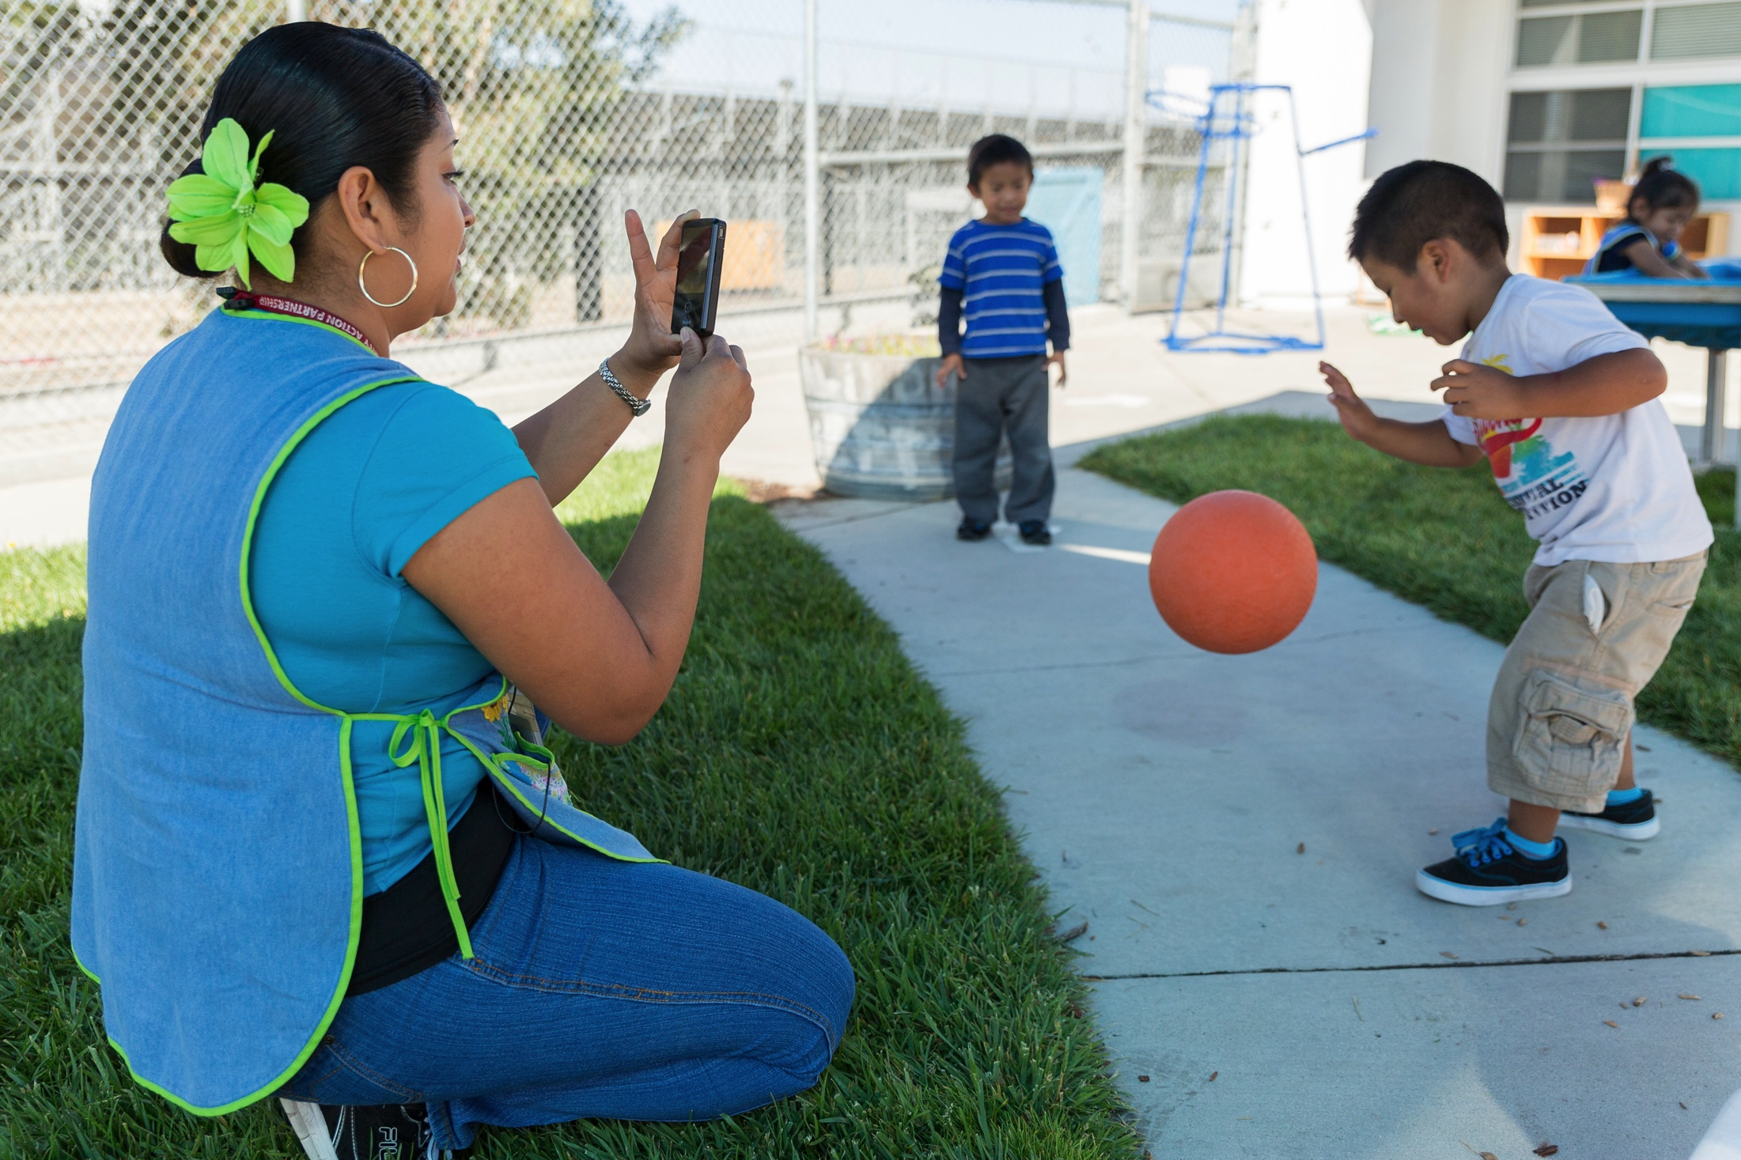
COLLECTING AND USING VIDEO
Know what you want to assess.
Document everyday activities that reflect learning goals.
Use multiple videos that show children’s progress over time.
Collect enough information.

Slide 6
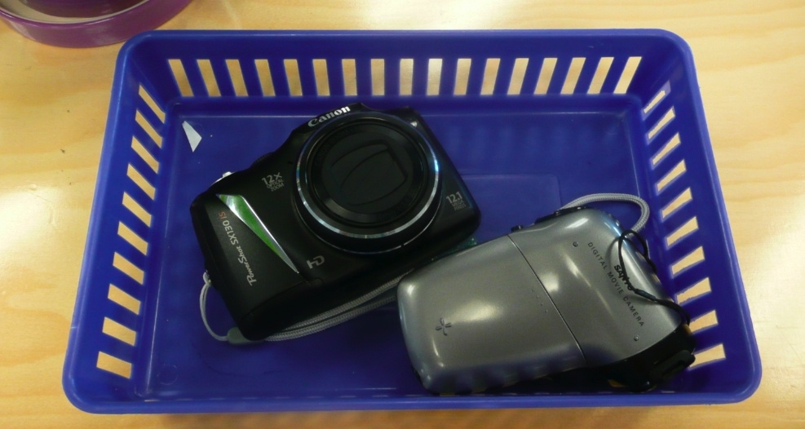
THE BASICS: COLLECTING AND USING VIDEOS
Video cameras are:
Readily available
Relatively inexpensive
Easy to use
Efficient

Slide 7
BENEFITS
Identify strengths and needs of individual children
Inform instruction and improve learning for all children
Collect observations of skills from multiple domains
Enhance team collaboration and family engagement

Slide 8
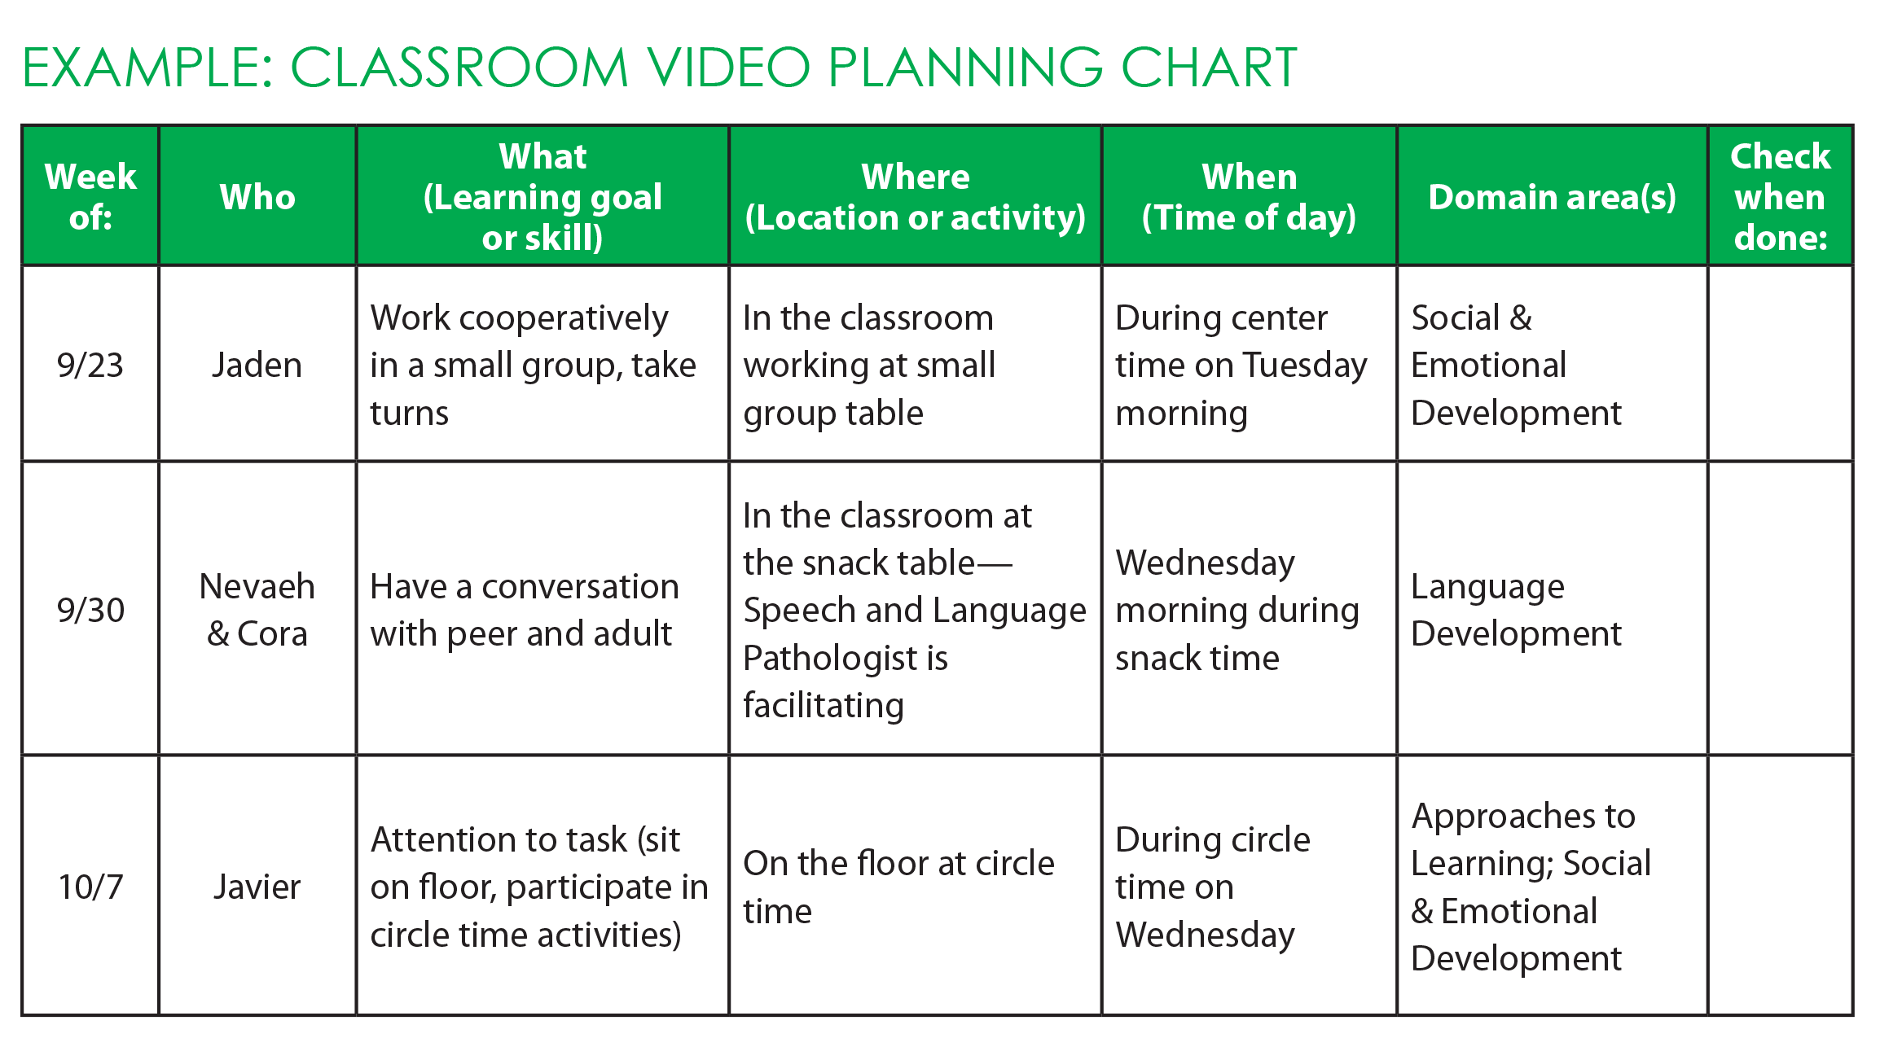
PLANNING FOR VIDEO

Slide 9
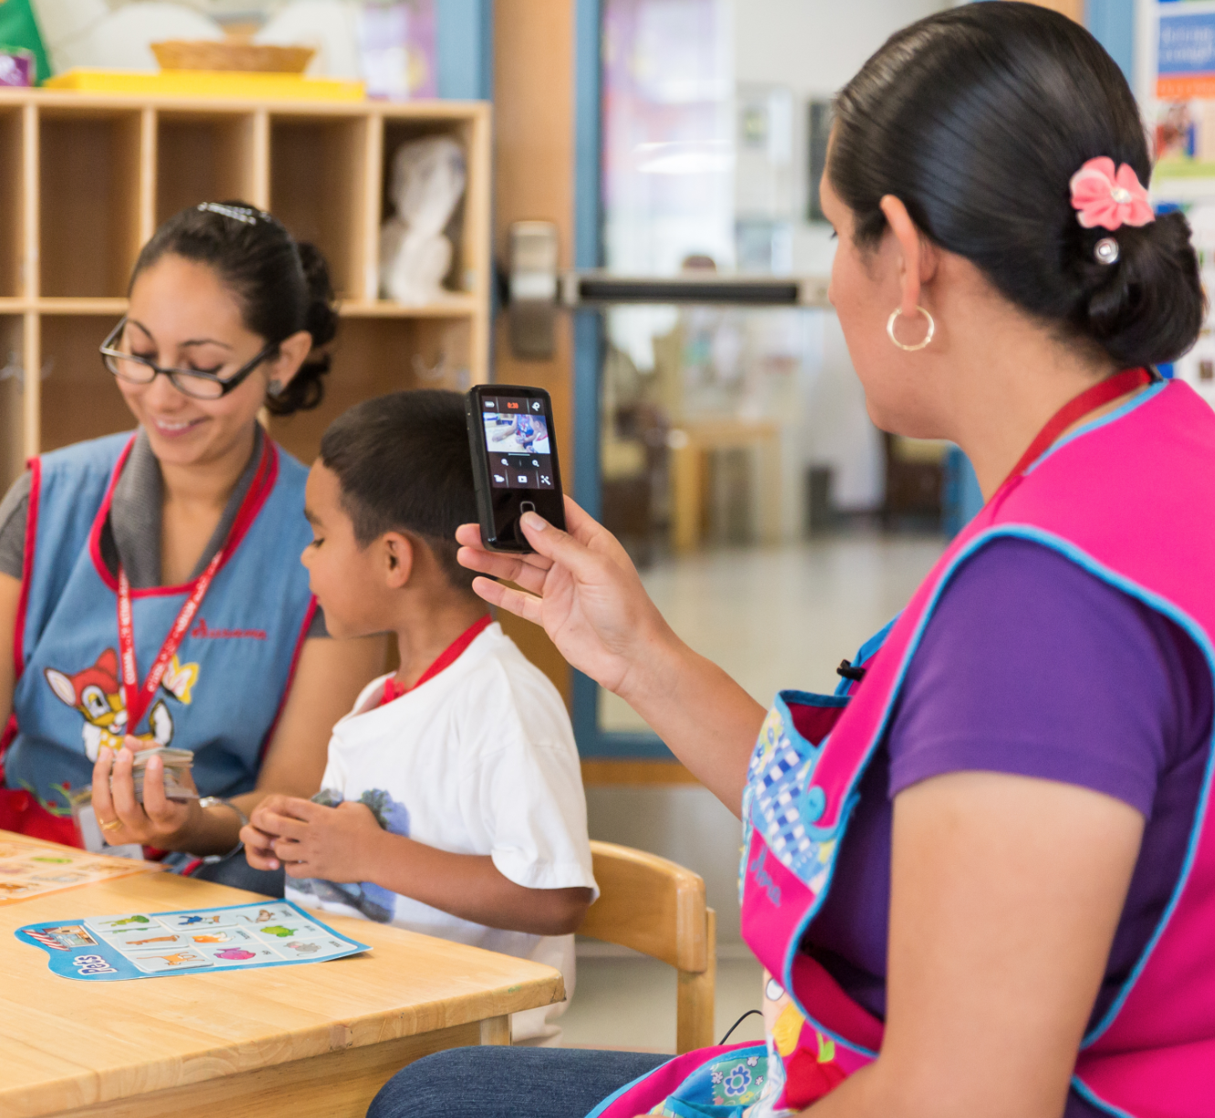
DOCUMENTING PROGRESS OVER TIME
Use videos to monitor children’s progress over time:
Single domain
Multiple domains
Plan to collect enough information:
Take multiple videos of a same skill over time

Slide 10
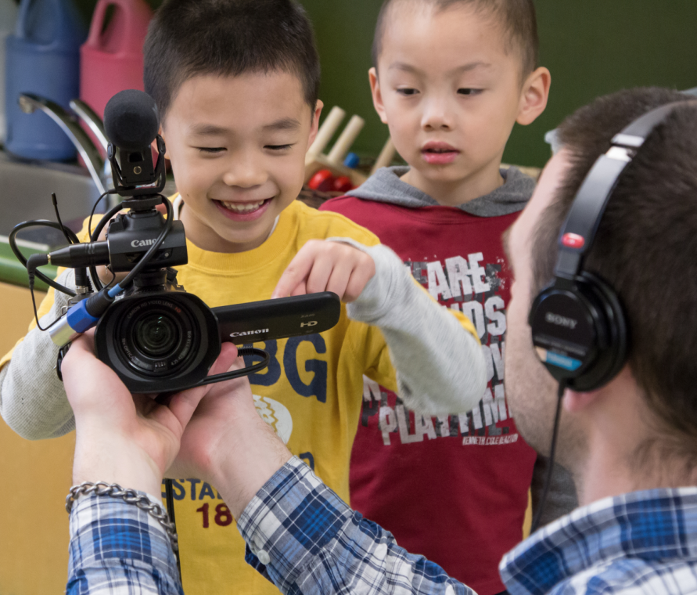
HOW TO CAPTURE VIDEO
Refer to the camera’s instruction manual.
Let the children see and touch the camera.
Get close enough to capture both the visuals and audio.
Use a tripod or brace your arm to keep the camera steady.
Keep the camera close by and charged.

Slide 11
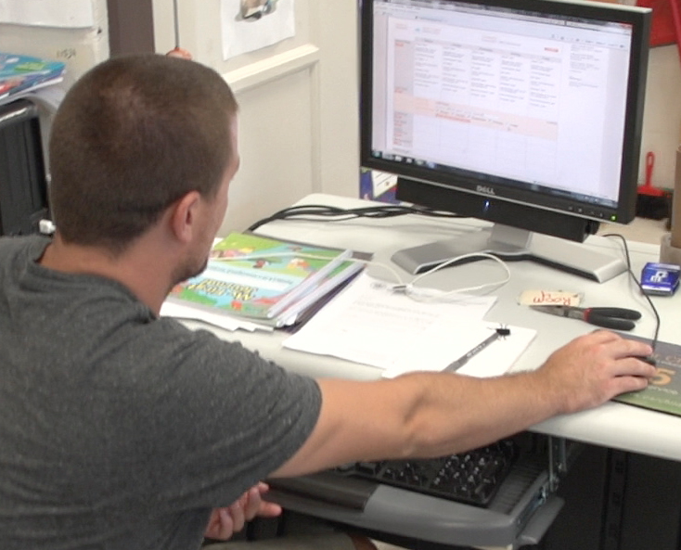
ORGANIZING VIDEO FILES
Choose a simple way to organize video files on the computer.
Copy files from the camera to the computer promptly.
Name the files in a consistent and logical way.
Organize them into folders by:
Child’s name, or
Domain area

Slide 12
INTERPRETING VIDEOS
Schedule time to review, discuss, and interpret the videos regularly.
Interpret children’s behaviors and assess learning.
Interpret children’s progress in curriculum goals:
Review multiple videos of a same skill over time.

Slide 13
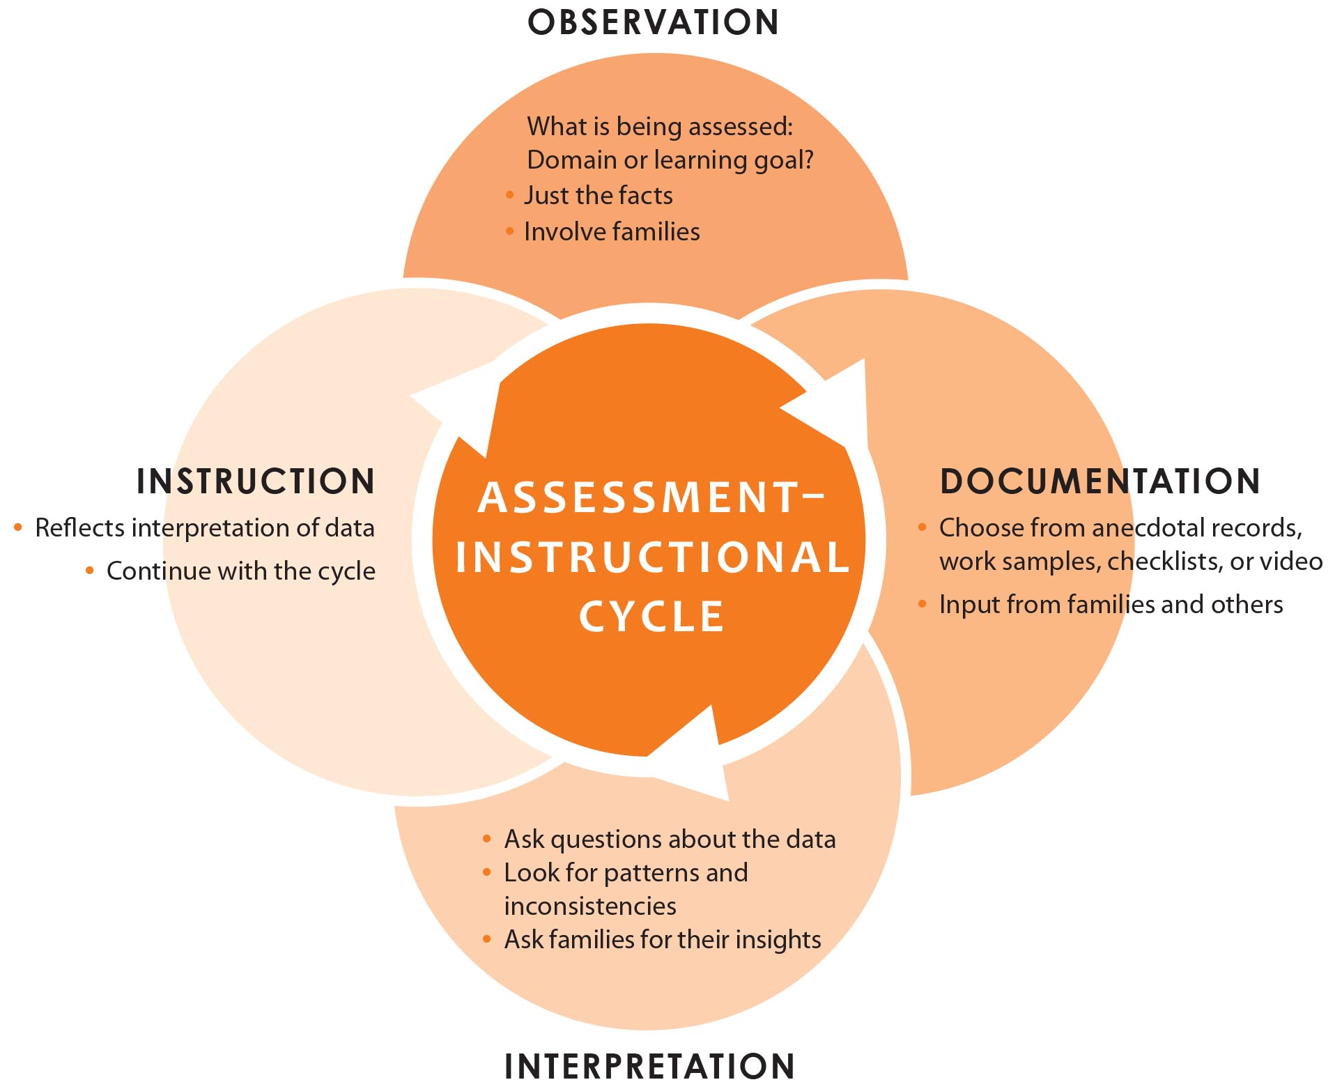
USING VIDEO IN the Assessment-Instructional Cycle

Slide 14
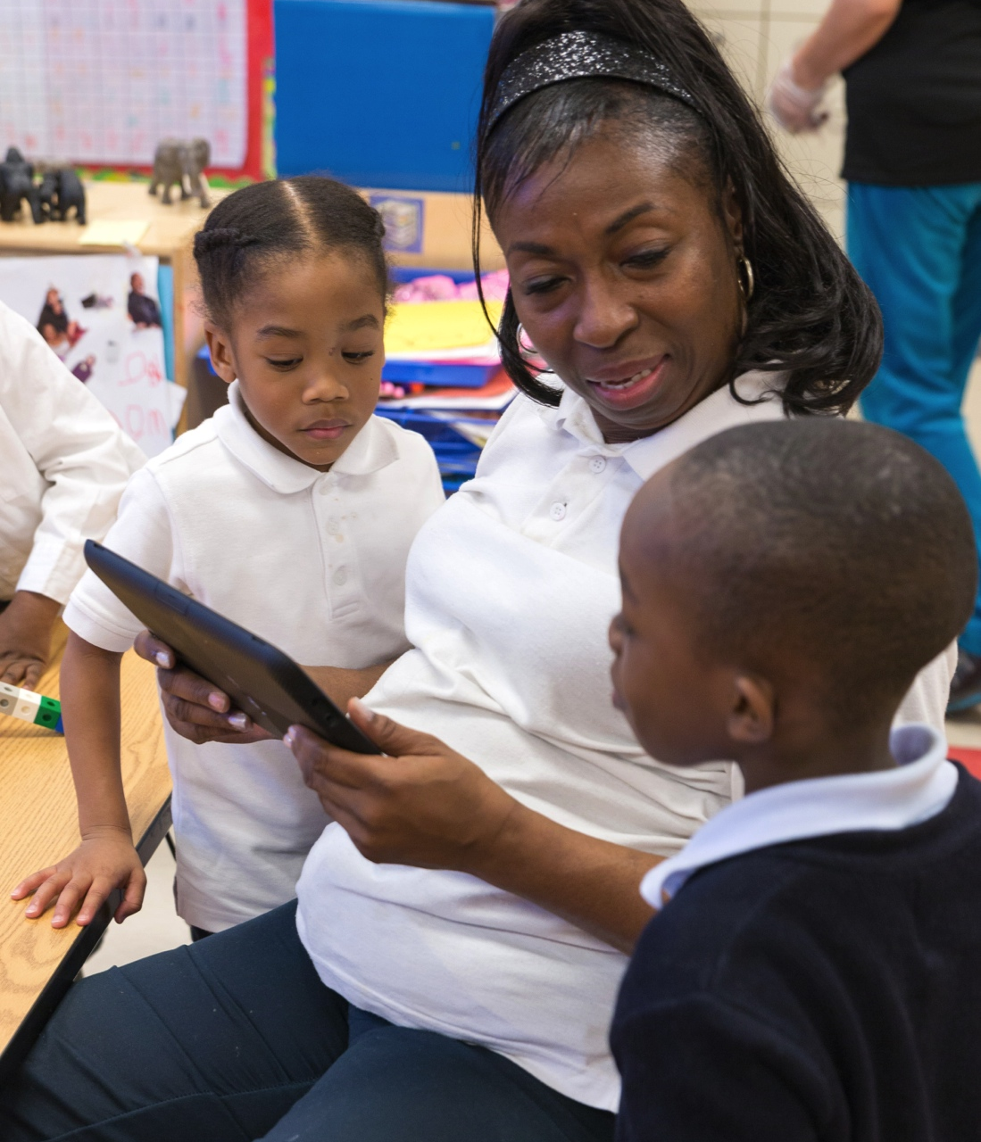
VIDEO AS AN ASSESSMENT TOOL
Show behavior and progress over time
Share video with families:
Parent conferences
IEP meetings
Home visits
Share video with the child
Share video with specialists
Enhance team collaboration and training
Get ideas for next steps
Get direction for modifications

Slide 15
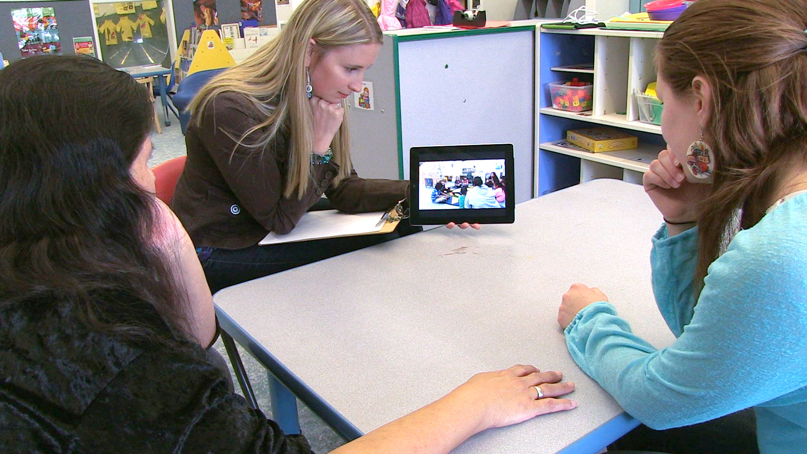
SUMMARY: COLLECTING AND USING VIDEO
Plan ahead
Record
Organize
Interpret
Share

Slide 16
SPRING 2014

