Slide 1
Curriculum modifications: environmental support

Slide 2
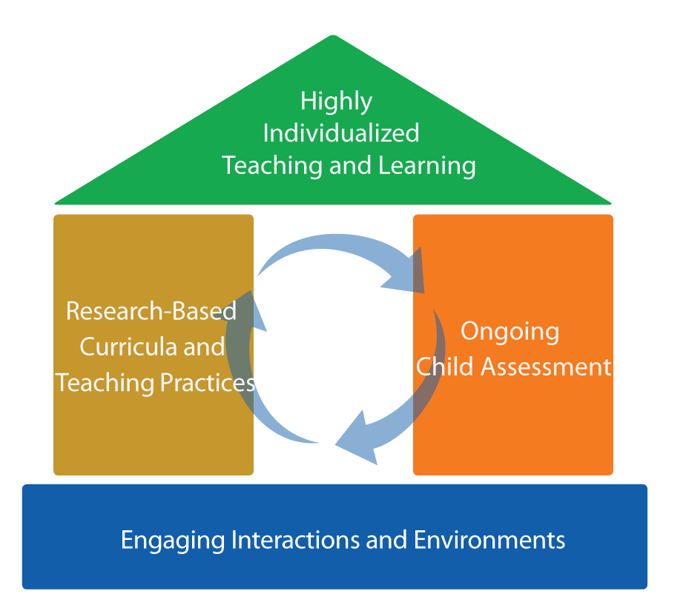
Focus on the roof
FRAMEWORK FOR EFFECTIVE PRACTICE
SUPPORTING SCHOOL READINESS FOR ALL CHILDREN

Slide 3


Curriculum Modification
Intensive,
Individualized
Teaching
Embedded Teaching
Curriculum Modification

Slide 4
objectives
Define environmental supports.
Provide strategies and examples.
Discuss application based on
individual children’s needs.

Slide 5
What is curriculum modification?

Slide 6
Types of Curriculum Modifications
Environmental Support
Special Equipment
Materials Adaptation
Adult Support
Simplify the Activity
Peer Support
Child Preferences
Invisible Support

Slide 7
Environmental support
“
Altering the physical, social, and temporal environment to promote participation, engagement, and learning.
“
— Sandall & Schwartz, 2008

Slide 8
Why
Use ENVIRONMENTAL SUPPORTs?
Increased learning!
Access
Participation

Slide 9
Let the environment do the “talking”
Benefits:
Increases children’s independence
Doesn’t single out a particular child
Empowers children
Allows teachers to be more efficient

Slide 10
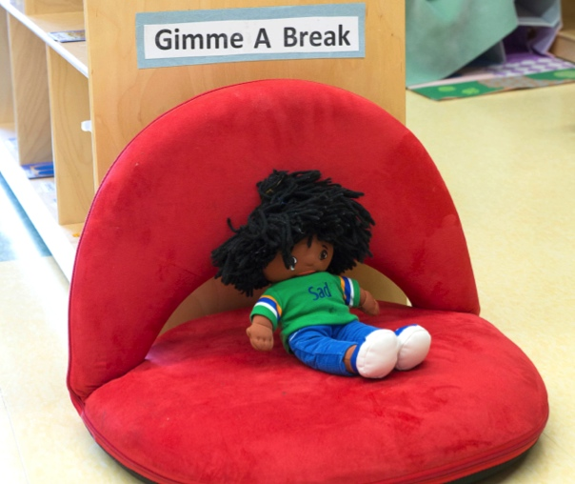
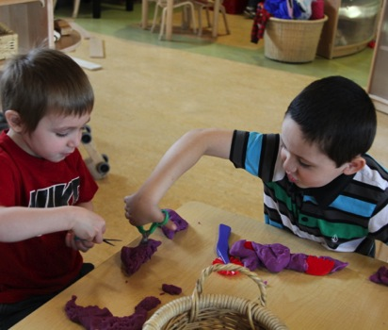
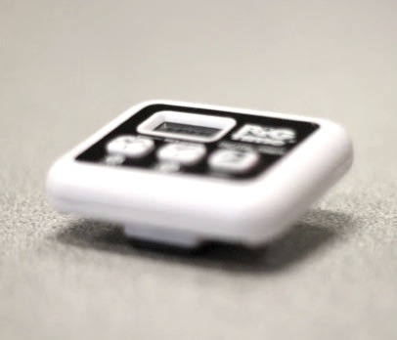
Three strategies for environmental support
1
2
3
Physical
adjustments
Social
adjustments
Temporal adjustments

Slide 11
1. Physical adjustments
Change the space.
Manage materials and supplies.
Define boundaries.
Add visual
cues.

Slide 12
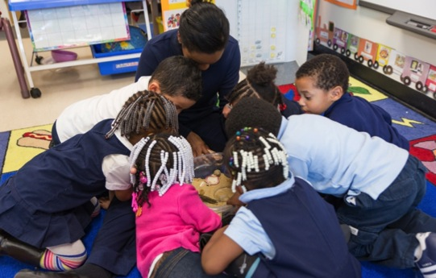
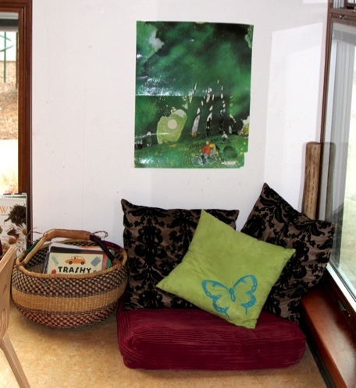
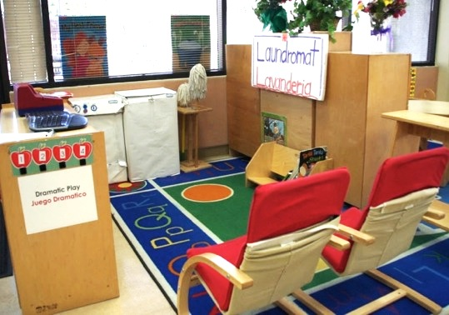
Physical adjustments
Changing the space

Slide 13
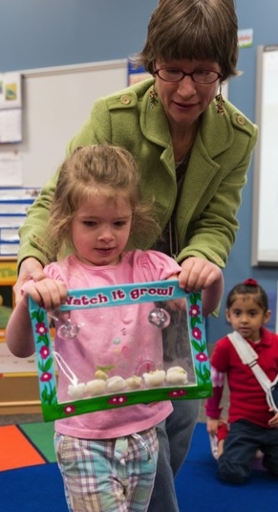
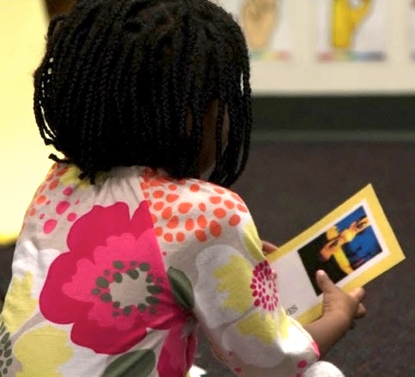
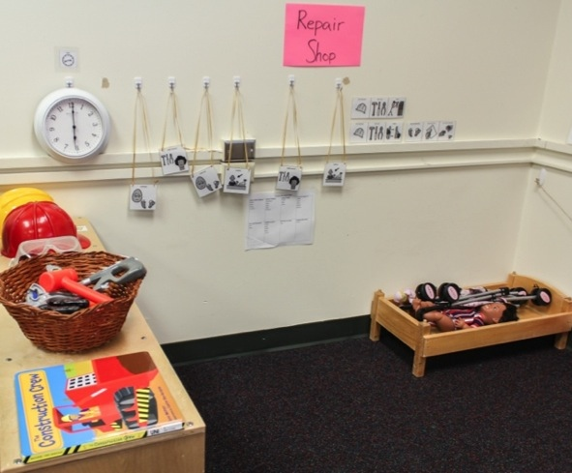
Physical adjustments managing materials

Slide 14
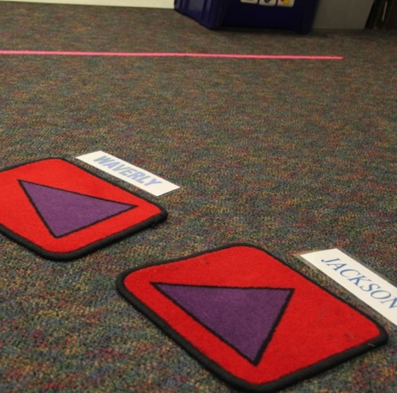
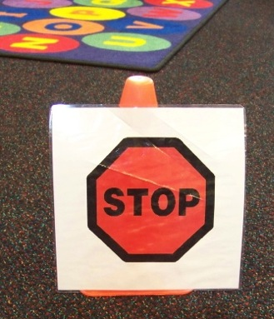
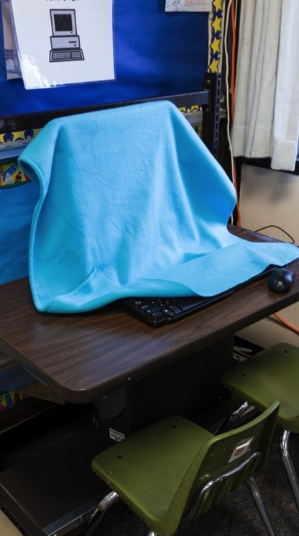
Physical adjustments defining boundaries

Slide 15
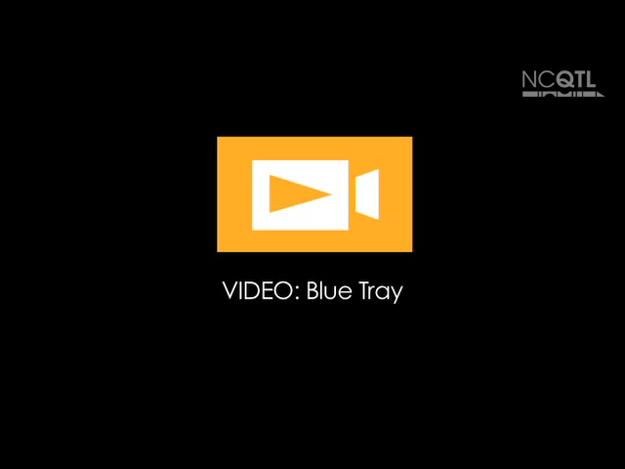
Insert video “Blue tray”
(on N drive: Product Dev/15 min in-service/Curriculum Modification-Environmental Support/Video)

Slide 16

Physical adjustments adding visuals
Visuals can be used to:
Establish rules and routines.
Support play.
Help children understand
and regulate their emotions.
Enhance communication.

Slide 17
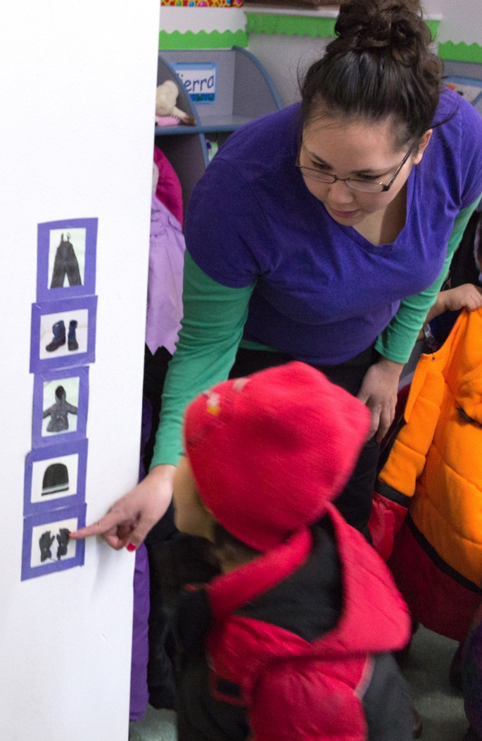
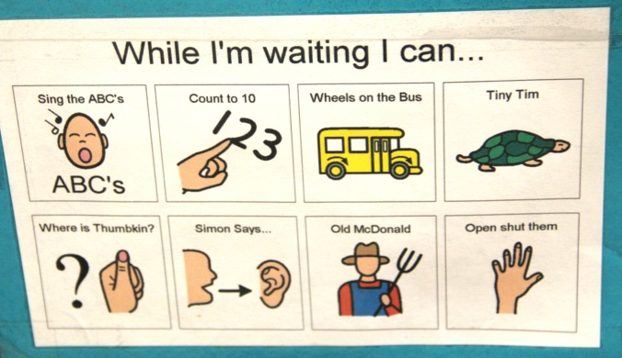
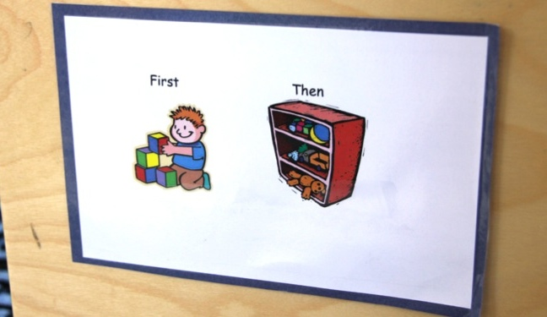
Physical adjustments
visuals: for Rules AND Routines

Slide 18
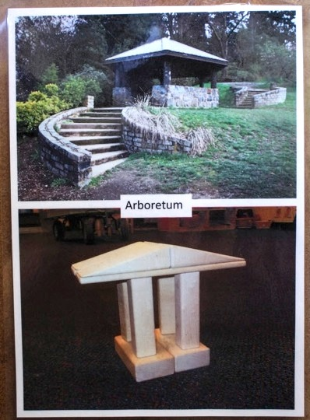
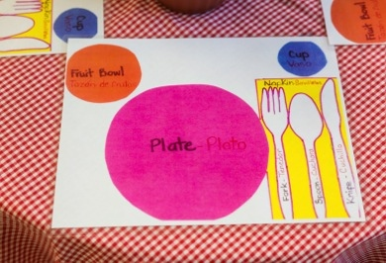
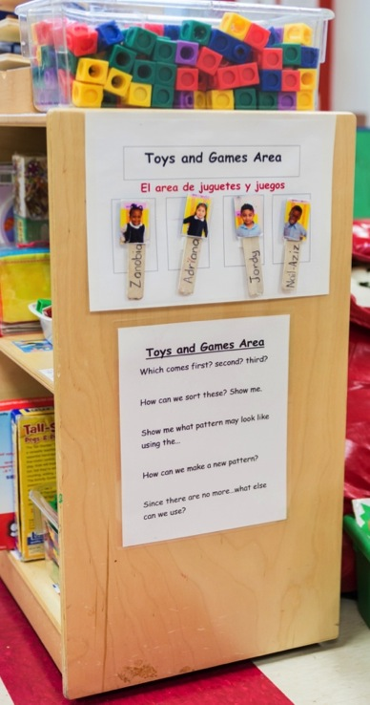
Physical adjustments visualS: to support play

Slide 19
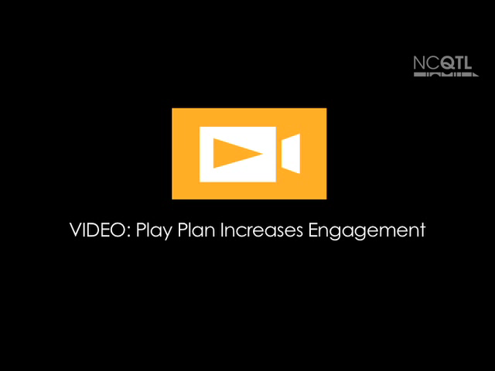
Insert video 2
“Play Plan Increases Engagement”
(on N drive: Product Dev/15 min in-service/Curriculum Modification-Environmental Support/Video)

Slide 20
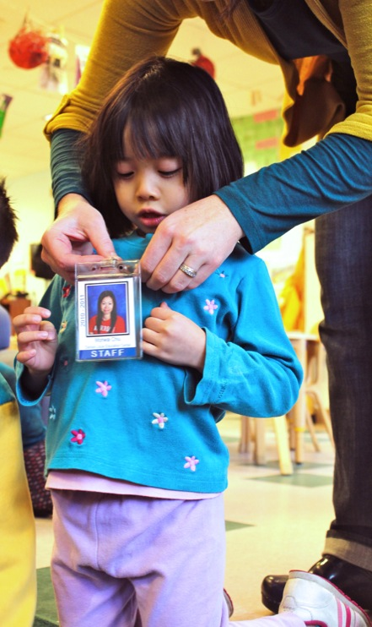
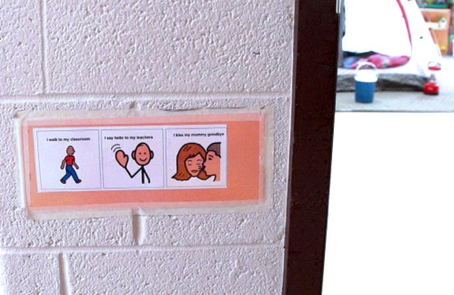
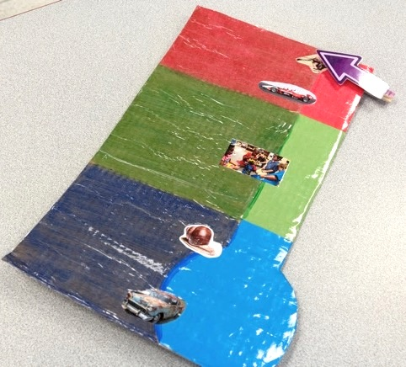
Physical adjustments visualS: for social emotional support

Slide 21
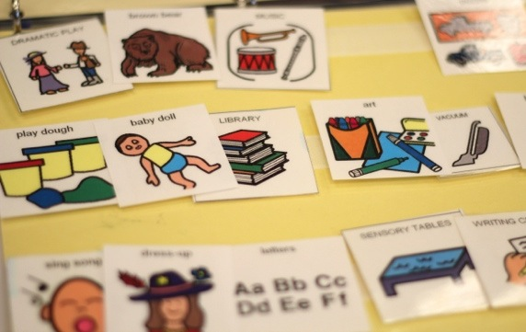
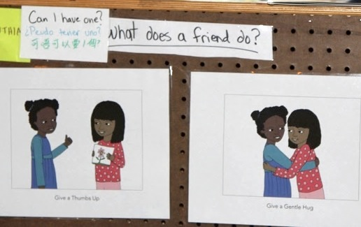
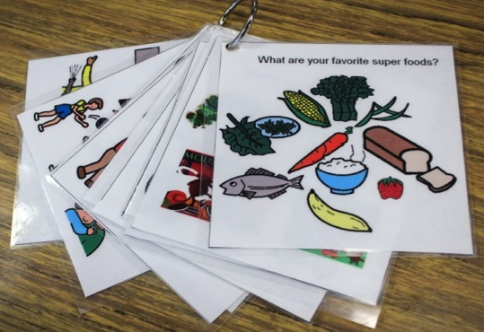
Physical adjustments visuals: for communication

Slide 22

Insert video 3
“Using Visual Supports”
(on N drive: Product Dev/15 min in-service/Curriculum Modification-Environmental Support/Video)

Slide 23
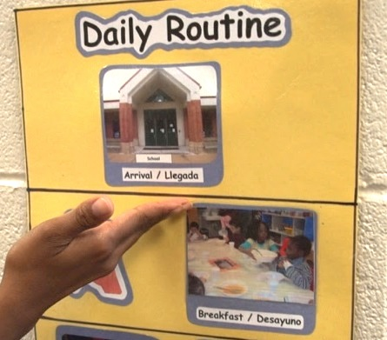
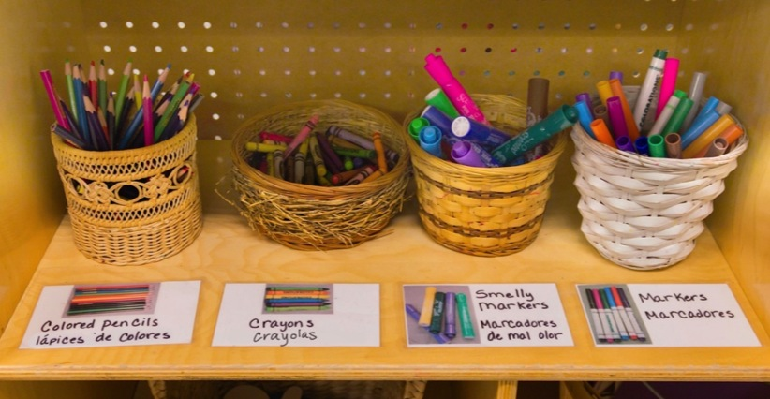
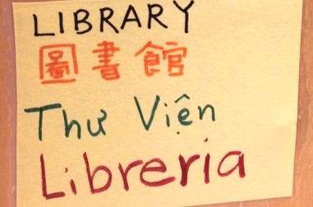
Physical adjustments visuals: for dual language learners

Slide 24

Insert Video 4
“Small Group Visuals”
(on N drive: Product Dev/15 min in-service/Curriculum Modification-Environmental Support/Video)

Slide 25
2. SOCIAL adjustments
To promote participation:
Strategically select
peer pairs, groupings,
and seating arrangements.
Design activities
that promote social interactions.
Select materials that motivate shared play.

Slide 26
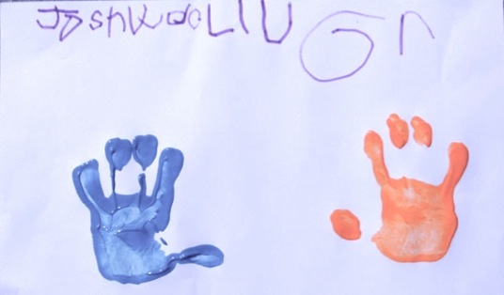
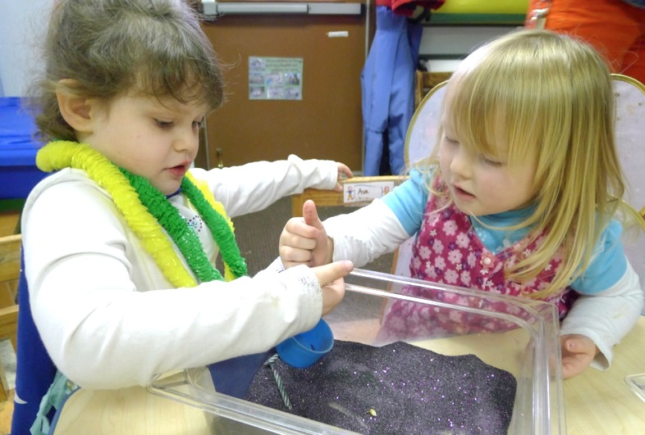
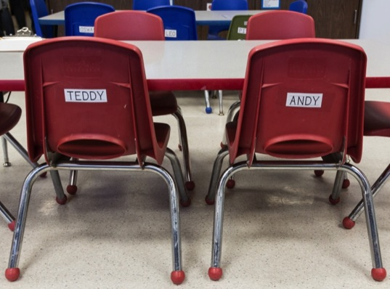
Social adjustments groupings, materials, activities

Slide 27
3. TEMPORAL adjustments
Adjust
the
schedule.
Adjust the time spent on various tasks.

Slide 28
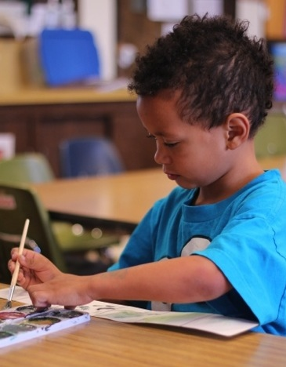
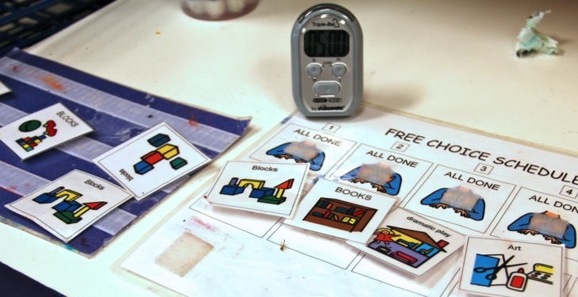
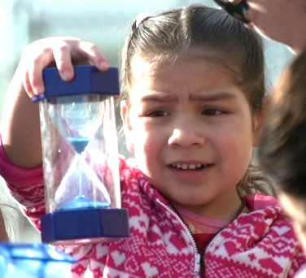
Temporal adjustments
Schedules and time

Slide 29

Insert video 5
“Adjusting Time at Circle”
(on N drive: Product Dev/15 min in-service/Curriculum Modification-Environmental Support/Video)

Slide 30
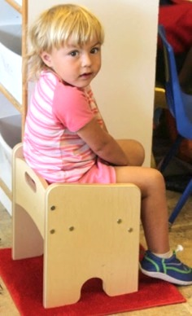
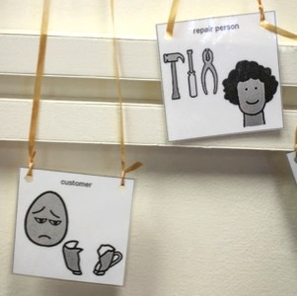
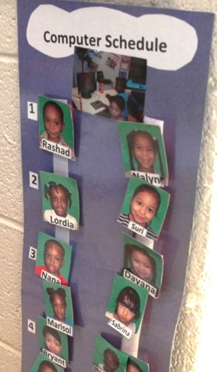
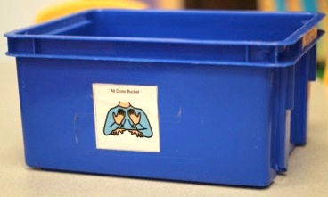
Modification Match: Part 1
A
C
D
B

Slide 31
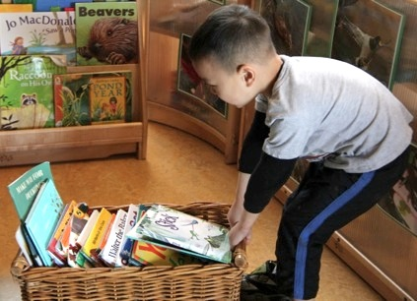
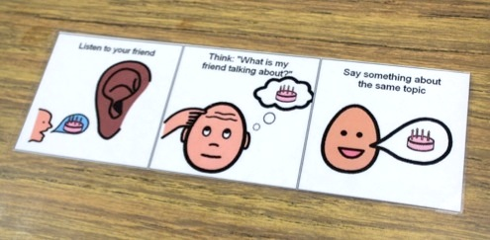
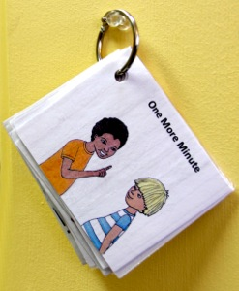
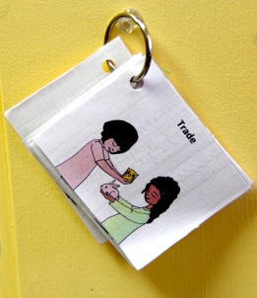
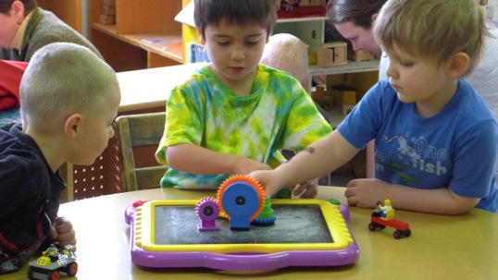
Modification match: part 2
A
C
B
D

Slide 32
review
Curriculum Modifications promote participation.
Environmental Support: A change to the…
  physical environment.
  social environment.
  temporal environment.
Let the ENVIRONMENT do the talking.

