Slide 1

Engaging Interactions:
Making learning meaningful
FALL 2012

Slide 2
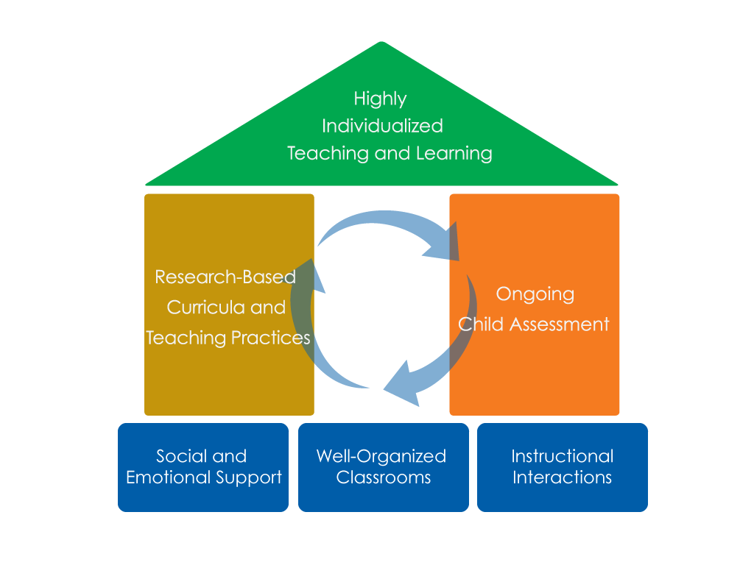
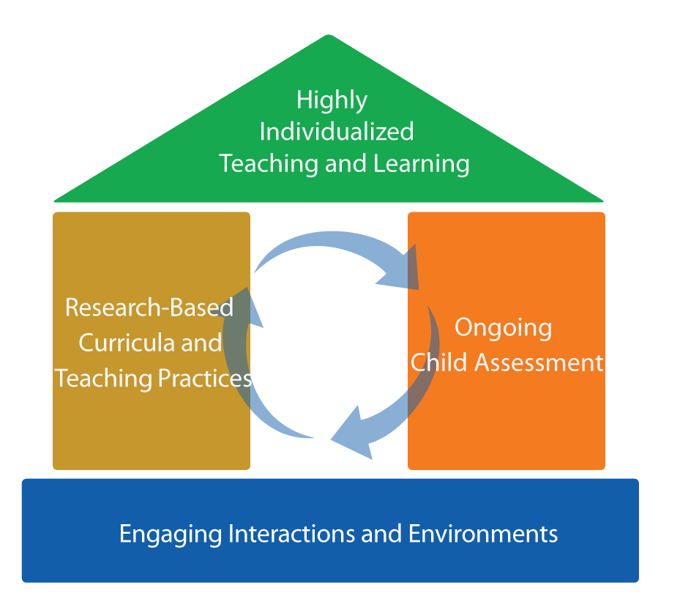
FRAMEWORK FOR EFFECTIVE PRACTICE
SUPPORTING SCHOOL READINESS FOR ALL CHILDREN
FOCUS ON
FOUNDATION

Slide 3
Objectives
  Provide a definition of making learning meaningful for children.
  Give examples and strategies of how teachers can make learning meaningful in the classroom.
  Connect to the Head Start Child Development
  and Early Learning Framework.
  Provide suggestions for teachers on how to make learning meaningful for children.

Slide 4
What does making learning meaningful look like?
Links new learning to children’s previous experiences.
Relates concepts to children’s lives.
Provides children with hands-on learning opportunities.

Slide 5
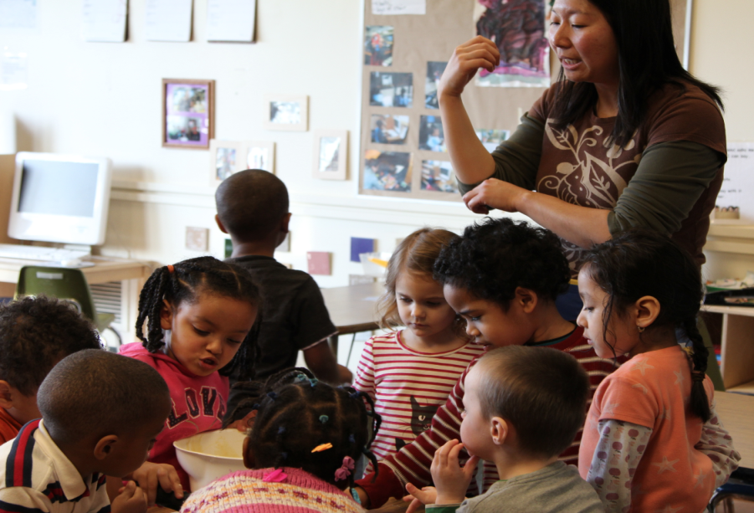
link new learning to children’s previous experience
Link children’s new knowledge to what they have learned.
“Remember last week when we took a trip to the farm? We were able to see how lots of different vegetables grow. Some grow under the ground and some grow above ground. Today we are going to use some of those same vegetables to make a yummy vegetable soup for our families.”

Slide 6
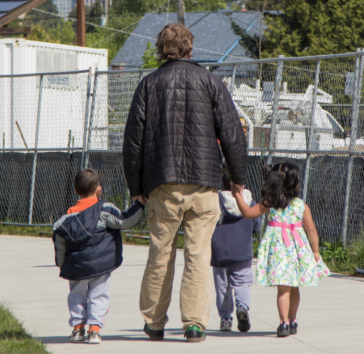
Relate concepts to children’s lives
Teach concepts that are a part of children's everyday experiences.
During a unit on recycling children bring in used food boxes from home. Children flatten them down and collect them in a classroom bin.
When the classroom bin becomes full, they take a walking field trip to the school's large recycling container.

Slide 7
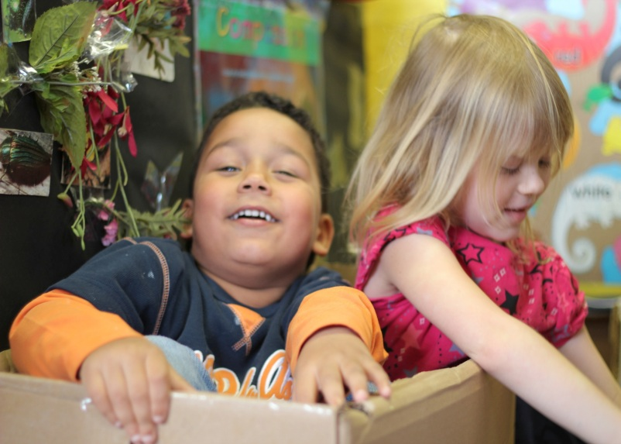
Provide children with hands-on learning
Bring concepts to life by putting learning into action.
Together the teacher and children transform the dramatic play area into an outdoor fishing scene. The teacher provides boxes for children to create boats, blue paper to cover the floor, child-made fish to “catch,” and sticks and string they can use to make fishing poles.

Slide 8
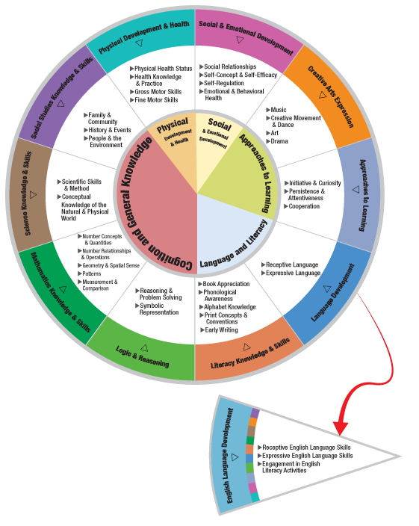
HEAD START CHILD DEVELOPMENT AND EARLY LEARNING FRAMEWORK
Making Learning Meaningful for children is important across many domains of the Framework.
Some examples are:
  Social Studies Knowledge & Skills
  Science Knowledge & Skills
  Social & Emotional Development
  Literacy Knowledge & Skills
  Logic & Reasoning
  Creative Arts Expression

Slide 9
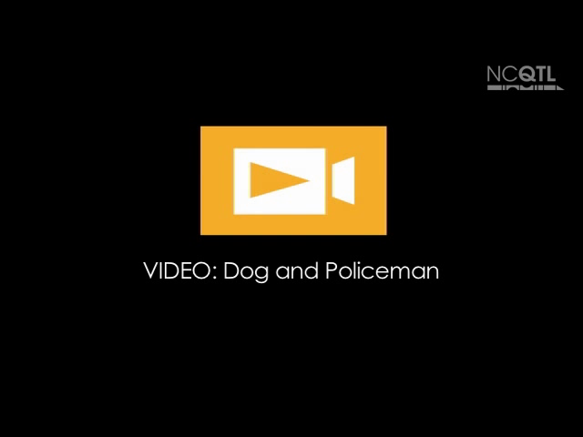

Slide 10
In this clip, the teacher relates a concept to children’s lives and links new learning to children’s previous experience
While talking about a picture of a dog, the teacher relates the concept to children’s lives by asking them if they have dogs.
Supports children’s
Social Studies Knowledge & Skills
The teacher links new learning of the concept of protecting a house to children’s previous experience when they talk about the role of her dog and the toy policeman.

Slide 11

Source: The Center for Advanced Study of Teaching and Learning (CASTL)

Slide 12
In this clip, the teacher provides children with hands-on learning
While talking about the concept of voting, the teacher provides children with hands-on learning when they are given the opportunity to vote which song group they want to be in.
Supports children’s
Mathematics Knowledge
& Skills

Slide 13
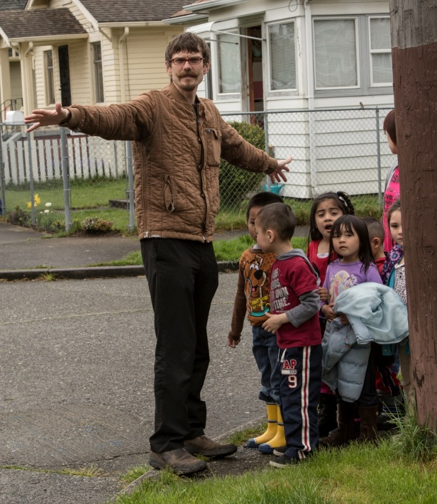
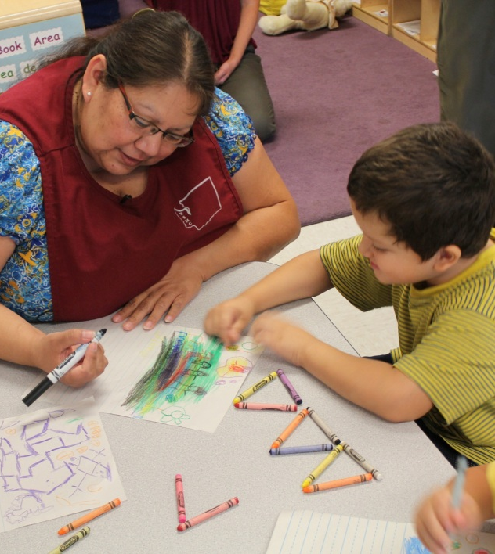
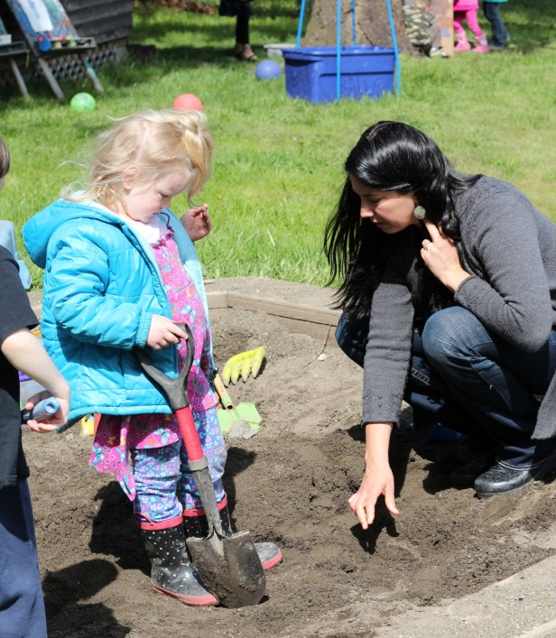
When Can I make learning meaningful for children?
Children’s understanding can be promoted throughout the school day in many classroom activities.

Slide 14
Improving practice
  Video record and review your own teaching.
  Practice with a peer.
  Watch a “master teacher” in action.

Slide 15
Summary
Teachers can make learning meaningful for children by:
  Linking new learning to children’s previous experience
  Relating concepts to children’s lives
  Providing children with hands-on learning

Slide 16
FALL 2012

