Slide 1
Engaging interactions: using the Scientific method
FALL 2012

Slide 2
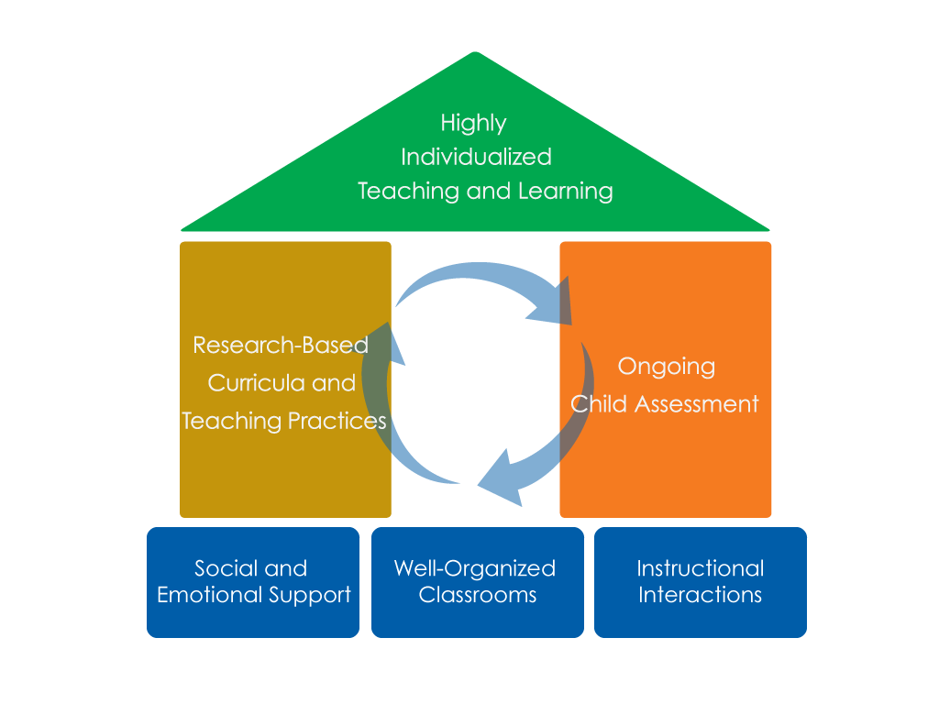
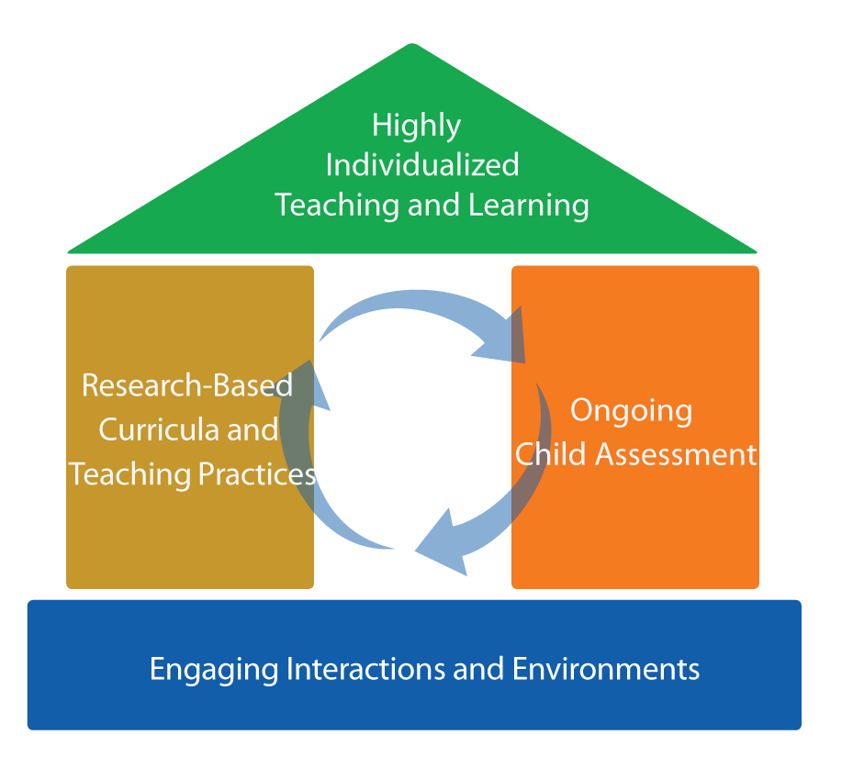
FRAMEWORK FOR EFFECTIVE PRACTICE
SUPPORTING SCHOOL READINESS FOR ALL CHILDREN
FOCUS ON
FOUNDATION

Slide 3
Objectives
  Provide a definition for scientific method.
  Give examples and strategies for using the scientific method in early childhood classrooms.
  Connect to the Head Start Child Development
  and Early Learning Framework.
  Provide suggestions for improving teachers’ abilities to incorporate the scientific method.

Slide 4



Scientific method
The scientific method is a series of steps that help children understand their world.
Teachers use the scientific method when they:
  Help children question.
  Ask children to observe the world around them.
  Encourage children to predict during activities.
  Create opportunities for children to experiment.
  Allow children to discuss the results of their experiment.
Question
Predict
Discuss
Observe
Experiment

Slide 5
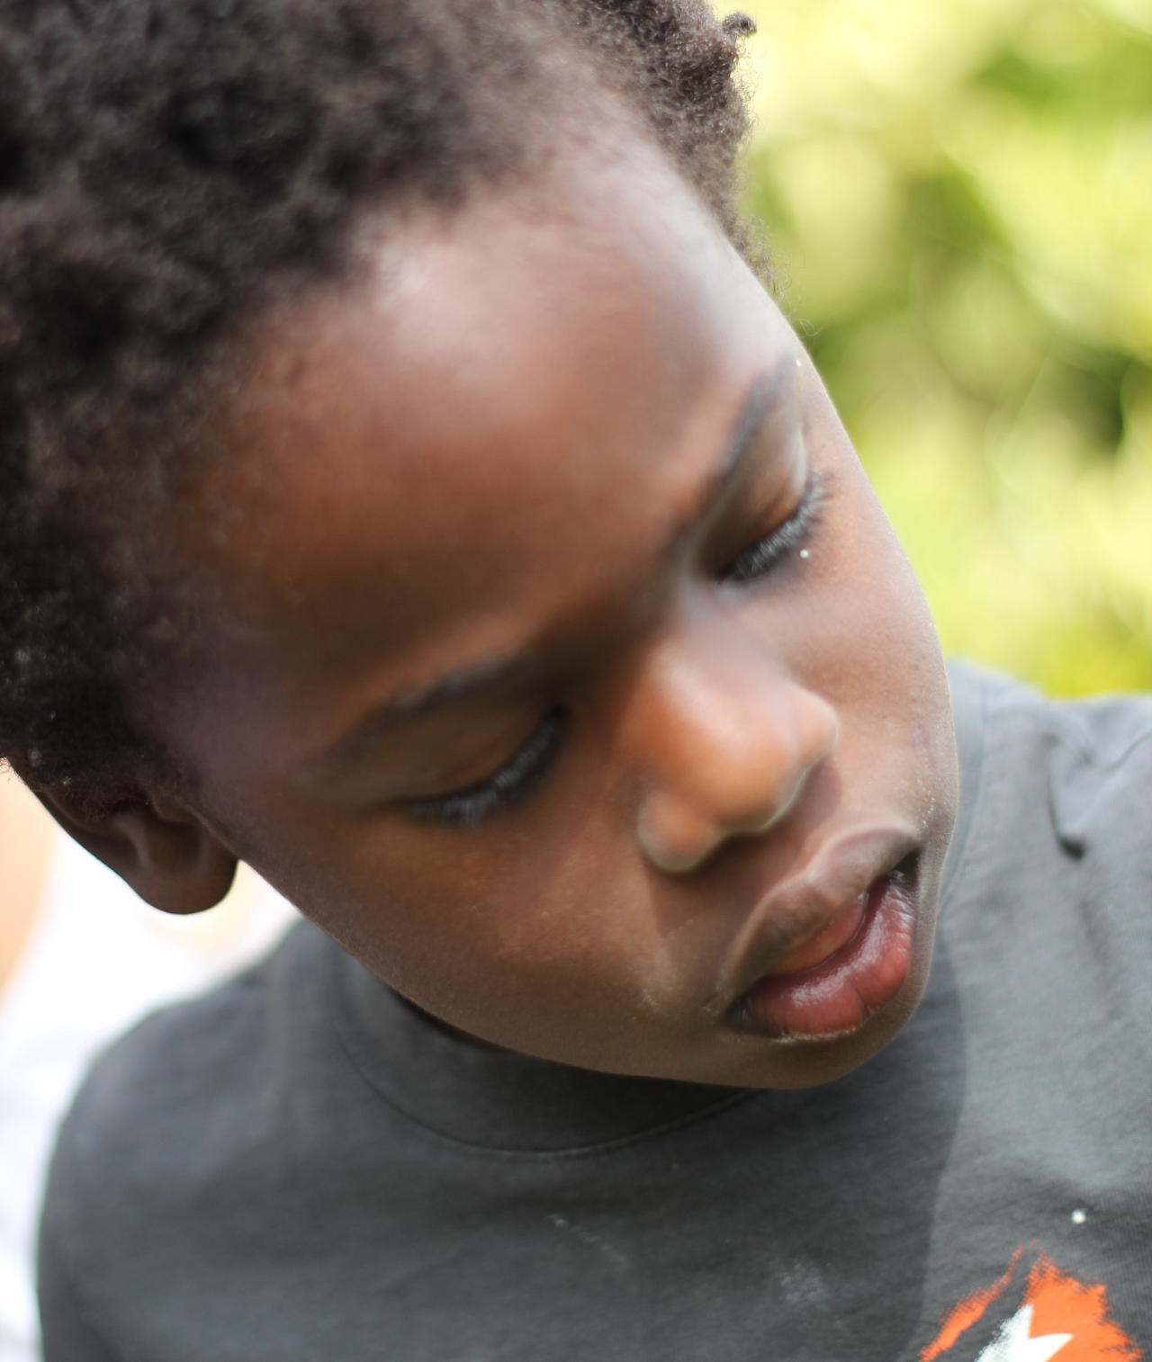
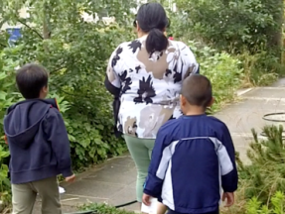
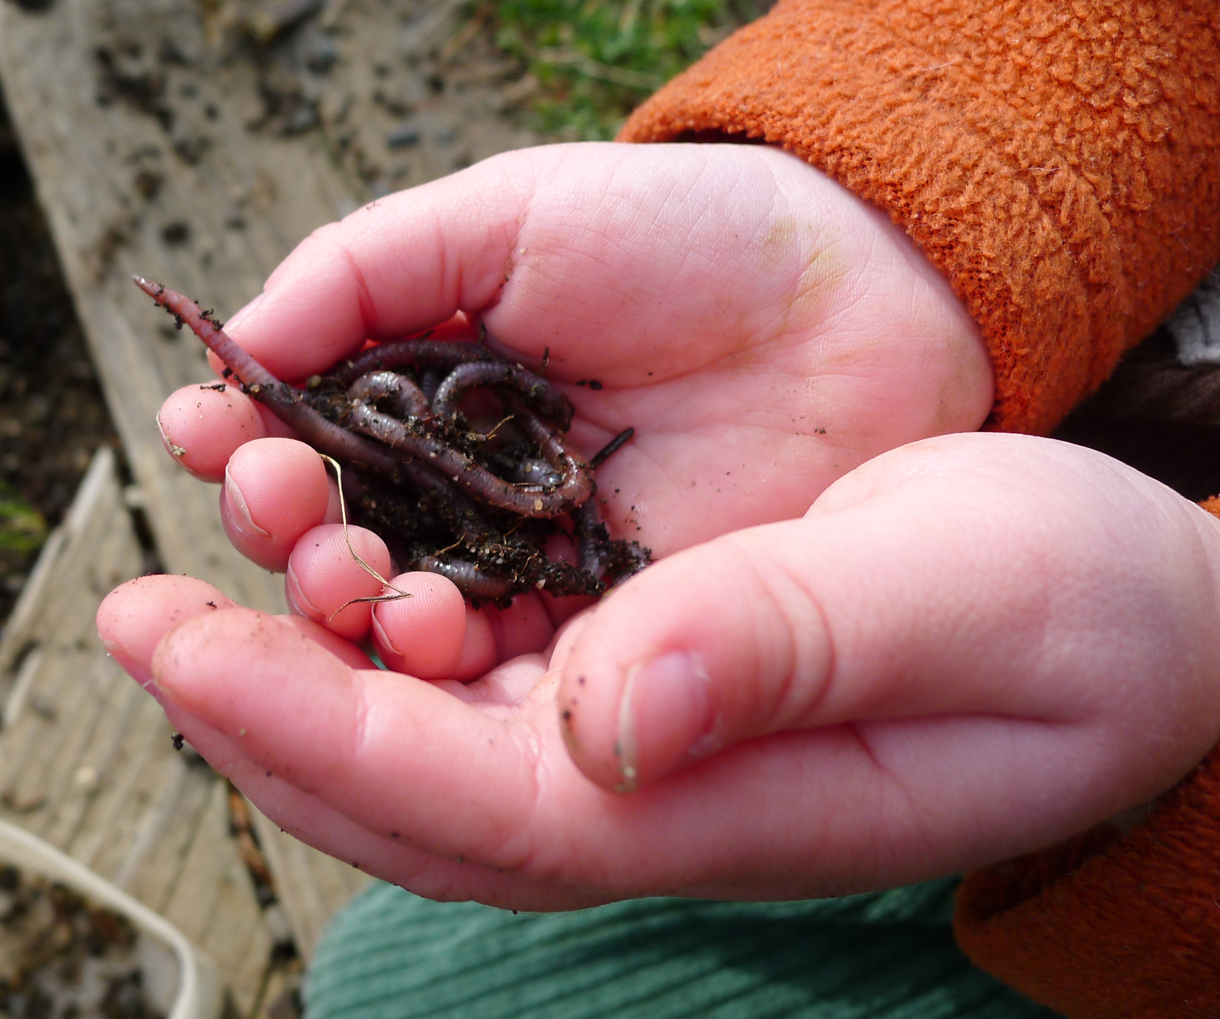
Question
Help children form their own questions related to their world.
A child is playing outside and exclaims:
“Oh no! The plant! What happened?”

Slide 6
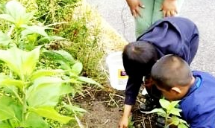
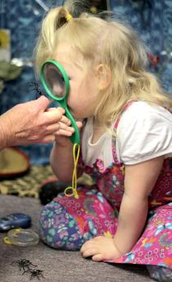
observe
Ask children to use their senses and closely observe the world around them.
“Let’s look at some of the plants that are growing around our school. What do you notice about places where they are growing? How does the soil feel around them?”
(Encourage children to think about water.)

Slide 7
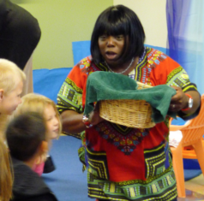
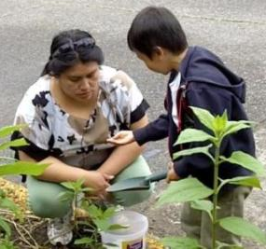
Predict
Encourage children to predict, or guess, the answer to the initial question.
“What do you think plants
need to grow?
What do you think would happen if we gave water to some plants but not others?”

Slide 8
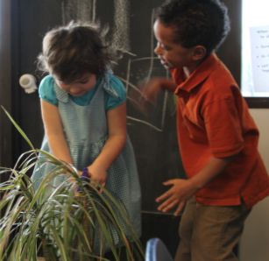
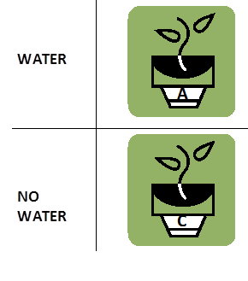

Experiment
Provide opportunities for children to experiment and test their predictions.

Slide 9
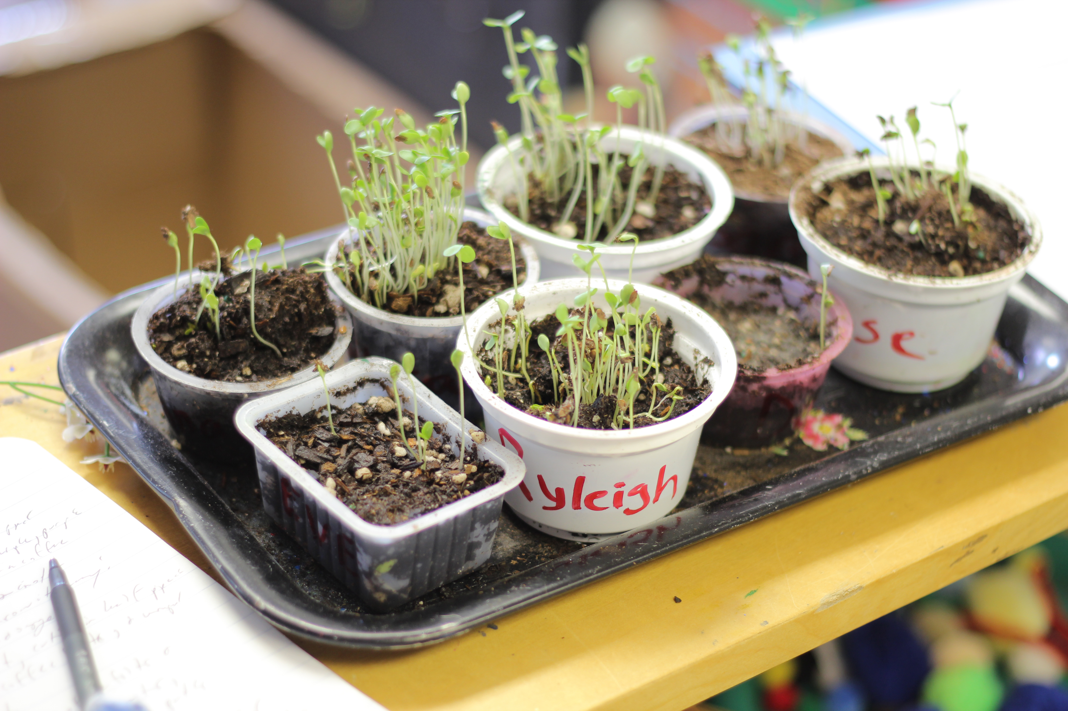
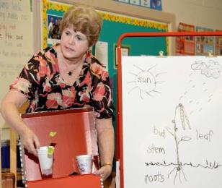
Discuss
Allow children to discuss the results of their experiment.
“Let’s look at our two plants. Remember we treated each plant differently? The first plant got water and the second plant did not get water. What happened to the plants in our experiment? Which plant grew the most?… What do plants need to grow?”

Slide 10
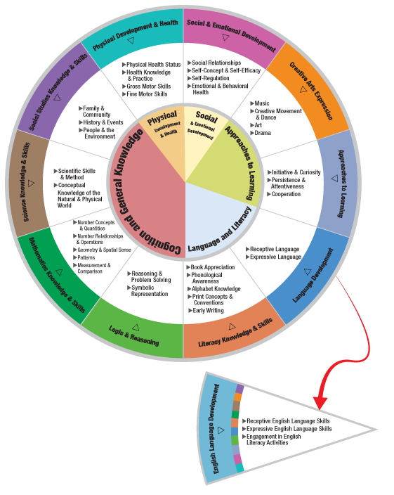
THE HEAD START CHILD DEVELOPMENT AND EARLY LEARNING FRAMEWORK
The scientific method
can be incorporated within many areas of the
framework.
Some examples are:
  Science Knowledge & Skills
  Logic & Reasoning Skills
  Language Development & Skills
  Approaches to Learning

Slide 11
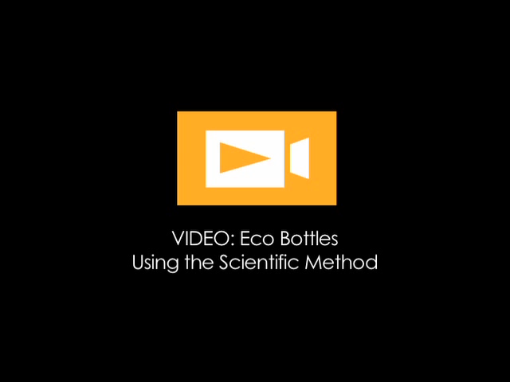
Source: The Center for Advanced Study of Teaching and Learning (CASTL)

Slide 12
IN THIS CLIP, THE TEACHER USES
THE SCIENTIFIC METHOD
Question
Children question if eco-bottles with worms are different from ones without.
Observe
The children observe worms with magnifying glasses.
Predict
The children predict what the worms will do in the bottle.
Experiment
The children experiment by placing worms in only one of the eco bottles.
Discuss
Later in the week, the children discuss the differences between bottles.

Slide 13
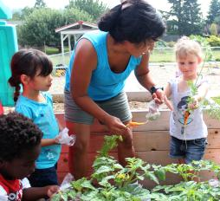
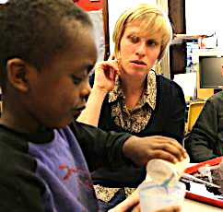
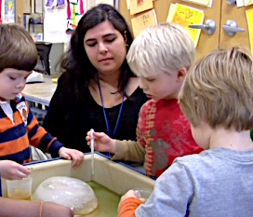
When Can I use the scientific method?
Teachers can use the scientific method throughout the school day in many classroom activities.

Slide 14
Improving practice
  Video record and review your own teaching.
  Practice with a peer.
  Watch a “master teacher” in action.

Slide 15
Summary
  Help children form questions about their world.
  Ask children to observe the world around them.
  Encourage children to predict during activities.
  Create experiments for children to further explore
  and test predictions.
  Allow children to discuss the result of their experiments.
Question
Predict
Discuss
Observe
Experiment

Slide 16
FALL 2012

