Slide 1
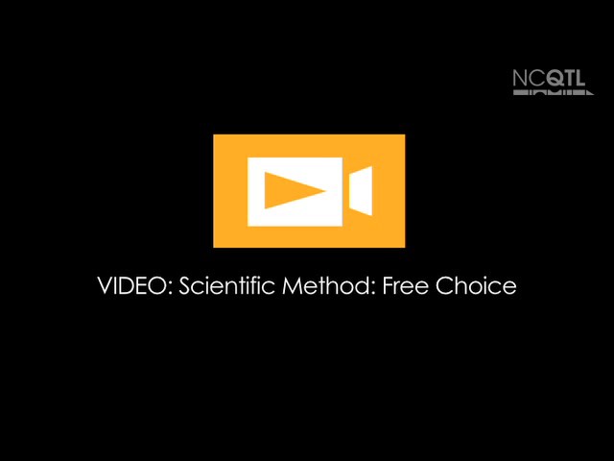
Notes:
Name of video: Scientific Method: Free Choice
Key ideas: Observing; experimenting; asking questions
Summary: A teacher and two girls mix gak with their hands and share observations about the characteristics of the mixture. At 00:04 one girl asks an open-ended question starting with, “What if we . . .”. Then the girls comment about what happens. The teacher repeats what the children say and adds to their comments.
Length of video: 32 seconds
Suite name: Using the Scientific Method

Slide 2
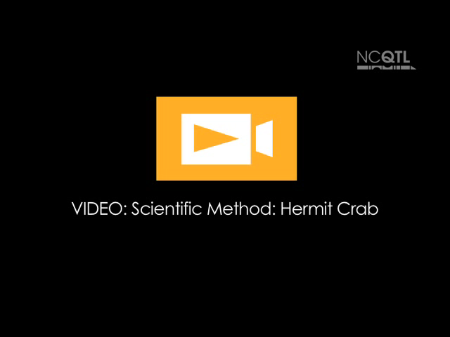
Notes:
Name of video: Scientific Method: Hermit Crab
Key ideas: Observing; recording observations
Summary: A teacher and three girls are observing and drawing hermit crabs. The teacher asks questions about the hermit crabs’ activities and she and the children alternately describe what the crabs are doing.
Length of video: 1 minute 28 seconds
Suite name: Using the Scientific Method

Slide 3

Notes:
Name of video: Scientific Method: Outdoors
Key ideas: Predicting; experimenting; observing
Summary: A teacher and a small group of children examine a roly-poly or pill bug outside. The teacher tries out one child’s prediction that the bug will roll into a ball when touched.
Length of video: 1 minute 15 seconds
Suite name: Using the Scientific Method

