Slide 1
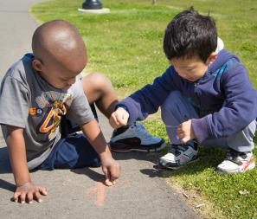
Engaging interactions: Fostering children’s thinking skills
Supporting Quality Teaching and Learning in AI/AN Head Start Classrooms
FALL 2013

Slide 2
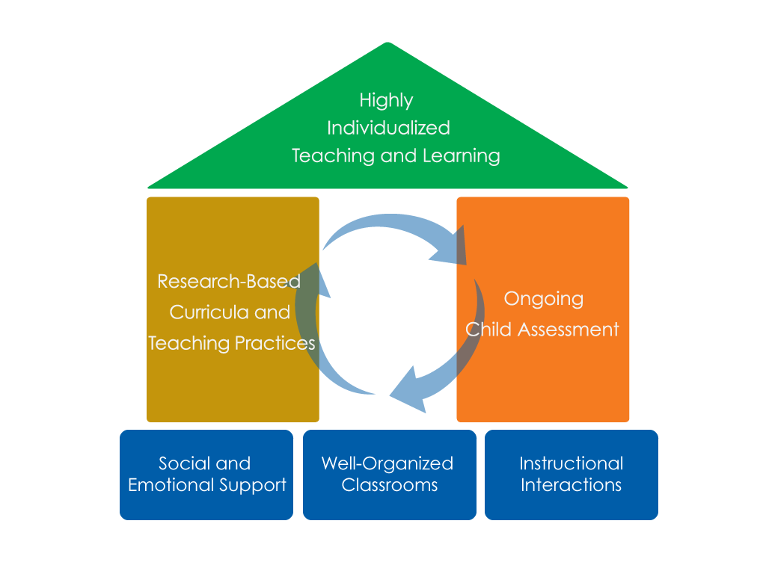
FRAMEWORK FOR EFFECTIVE PRACTICE SUPPORTING SCHOOL READINESS FOR ALL CHILDREN
FOCUS ON
FOUNDATION

Slide 3
Objectives
Provide a definition of fostering children’s thinking skills.
Give examples and strategies for how teachers can foster children’s thinking skills in the classroom.
Connect fostering children’s thinking skills to the Head Start Child Development and Early Learning Framework.
Provide suggestions for teachers on how to improve their ability to foster children’s thinking skills.

Slide 4
Fostering Children’s Thinking Skills
What does it look like?
Classroom interactions that focus on “big ideas” and deepen children’s knowledge of the world around them.
Children’s thinking skills can be fostered during interactions that involve:
Using the scientific method
Problem-solving
Applying knowledge
What does it NOT look like?
Drilling children on facts or skills.

Slide 5
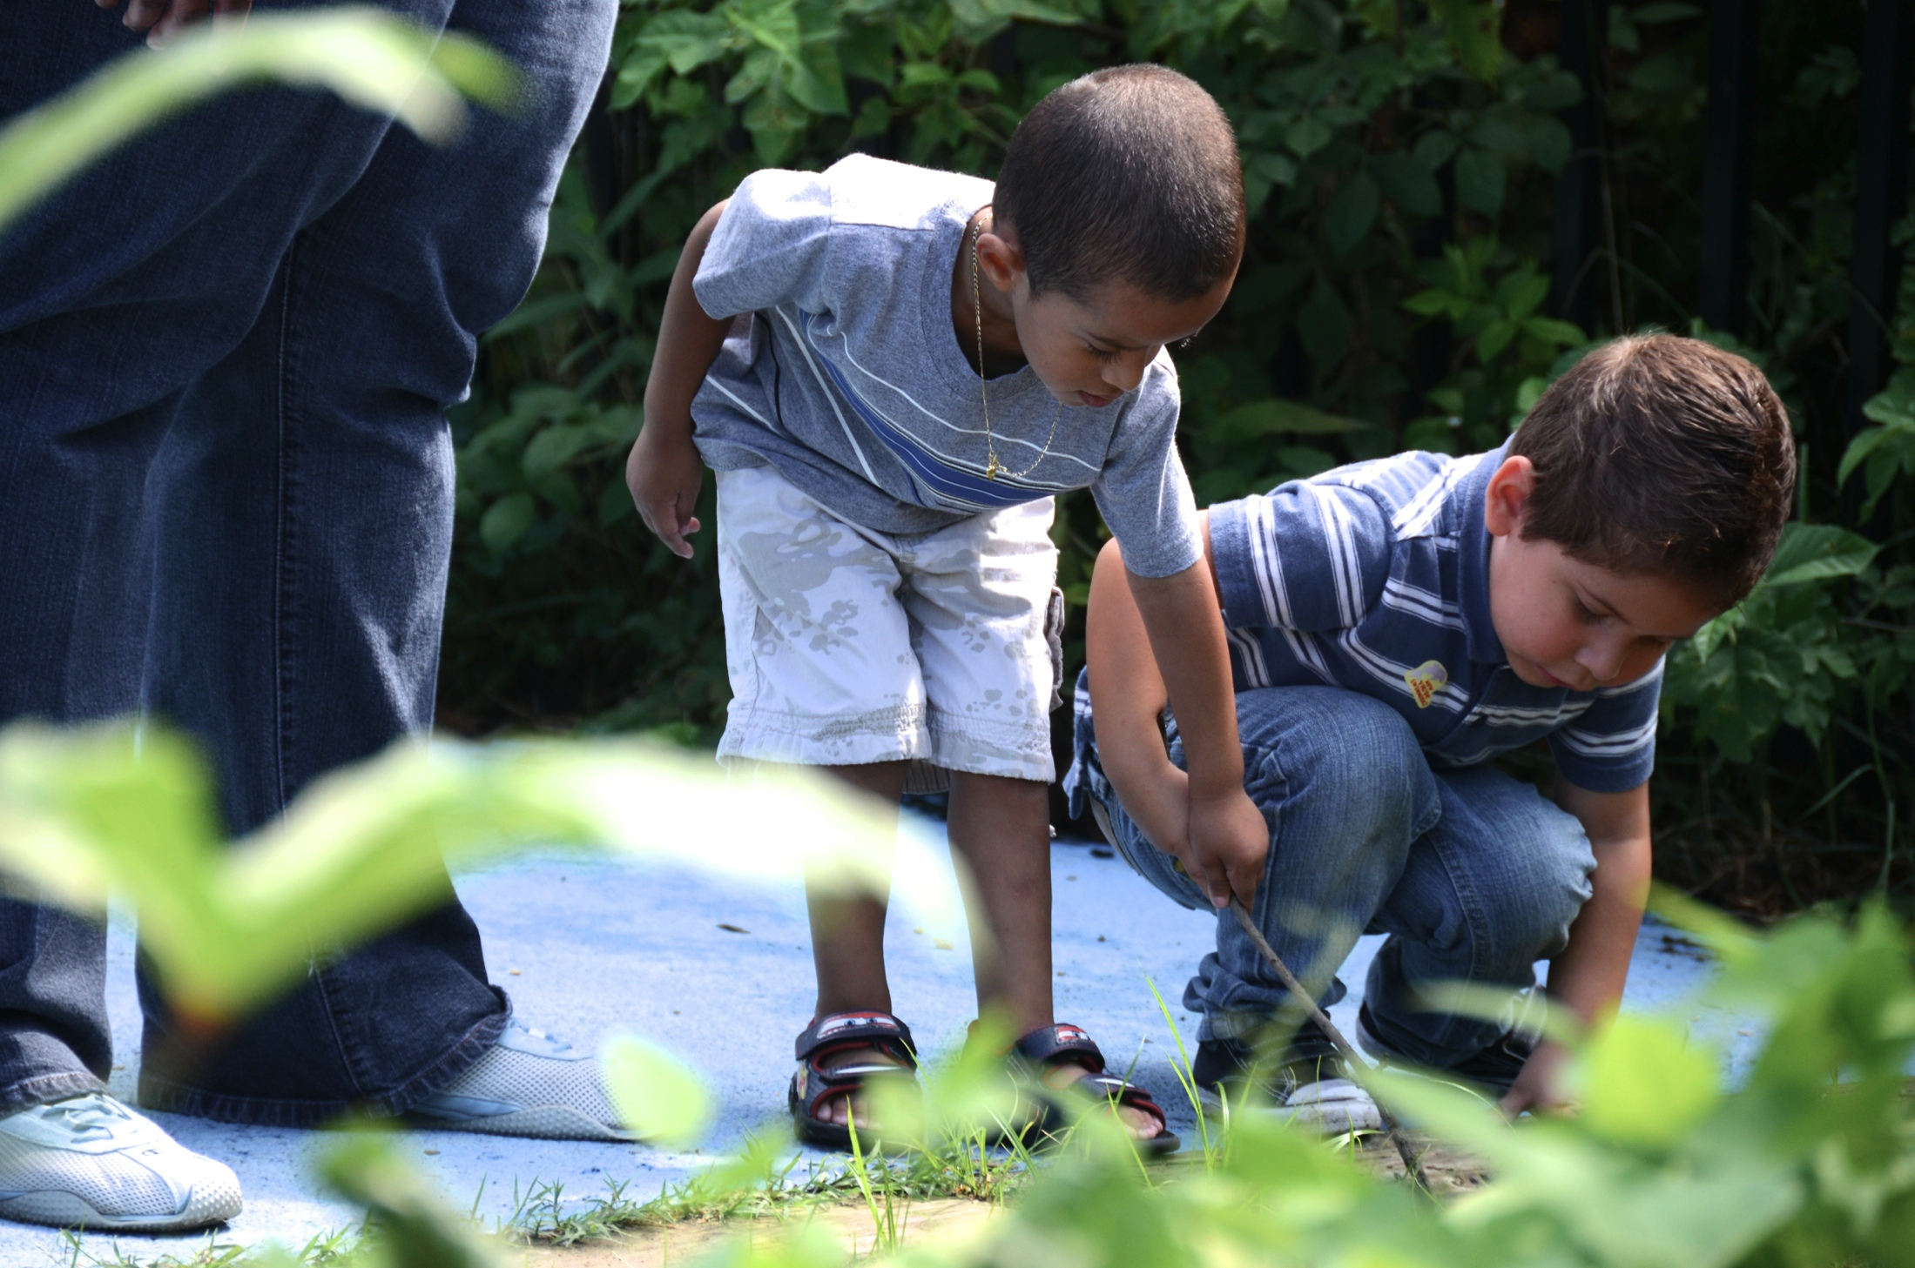
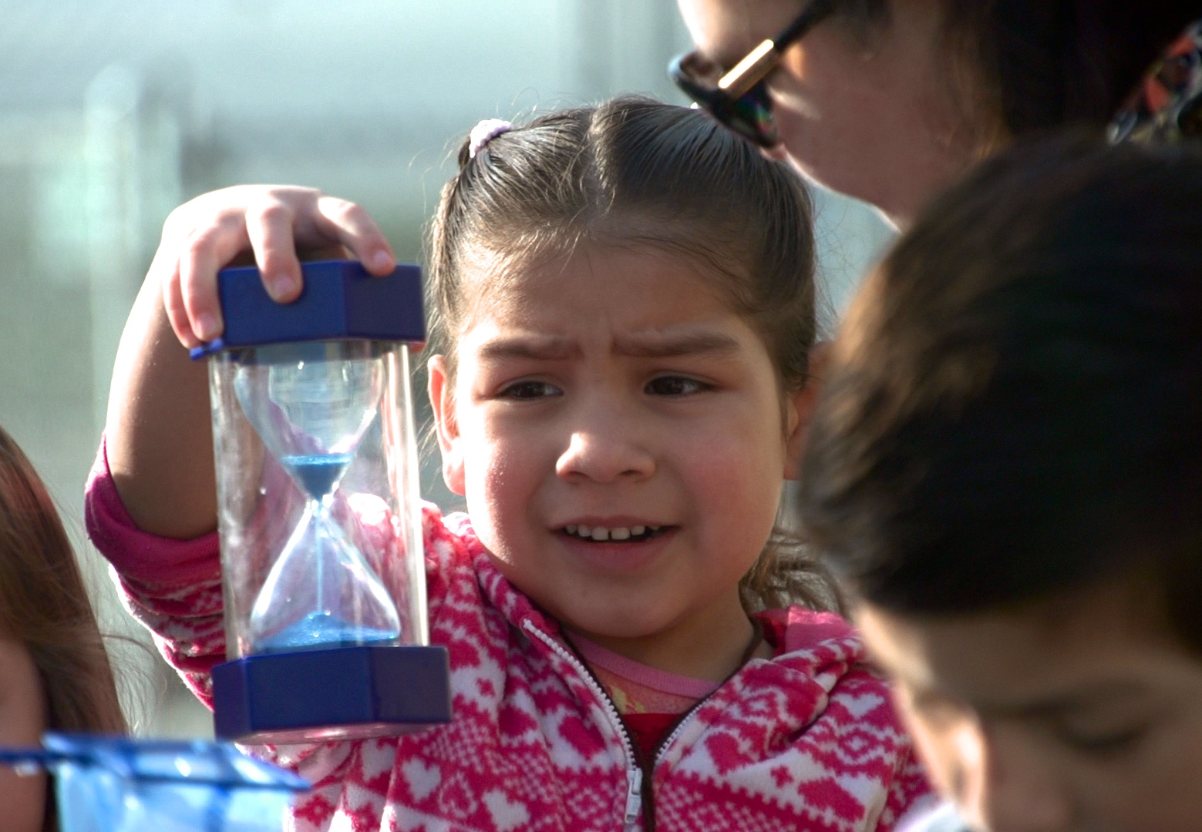
Fostering children’s thinking skills BY USING THE Scientific METHOD
Provide tasks where children can observe, predict, and experiment.

Slide 6
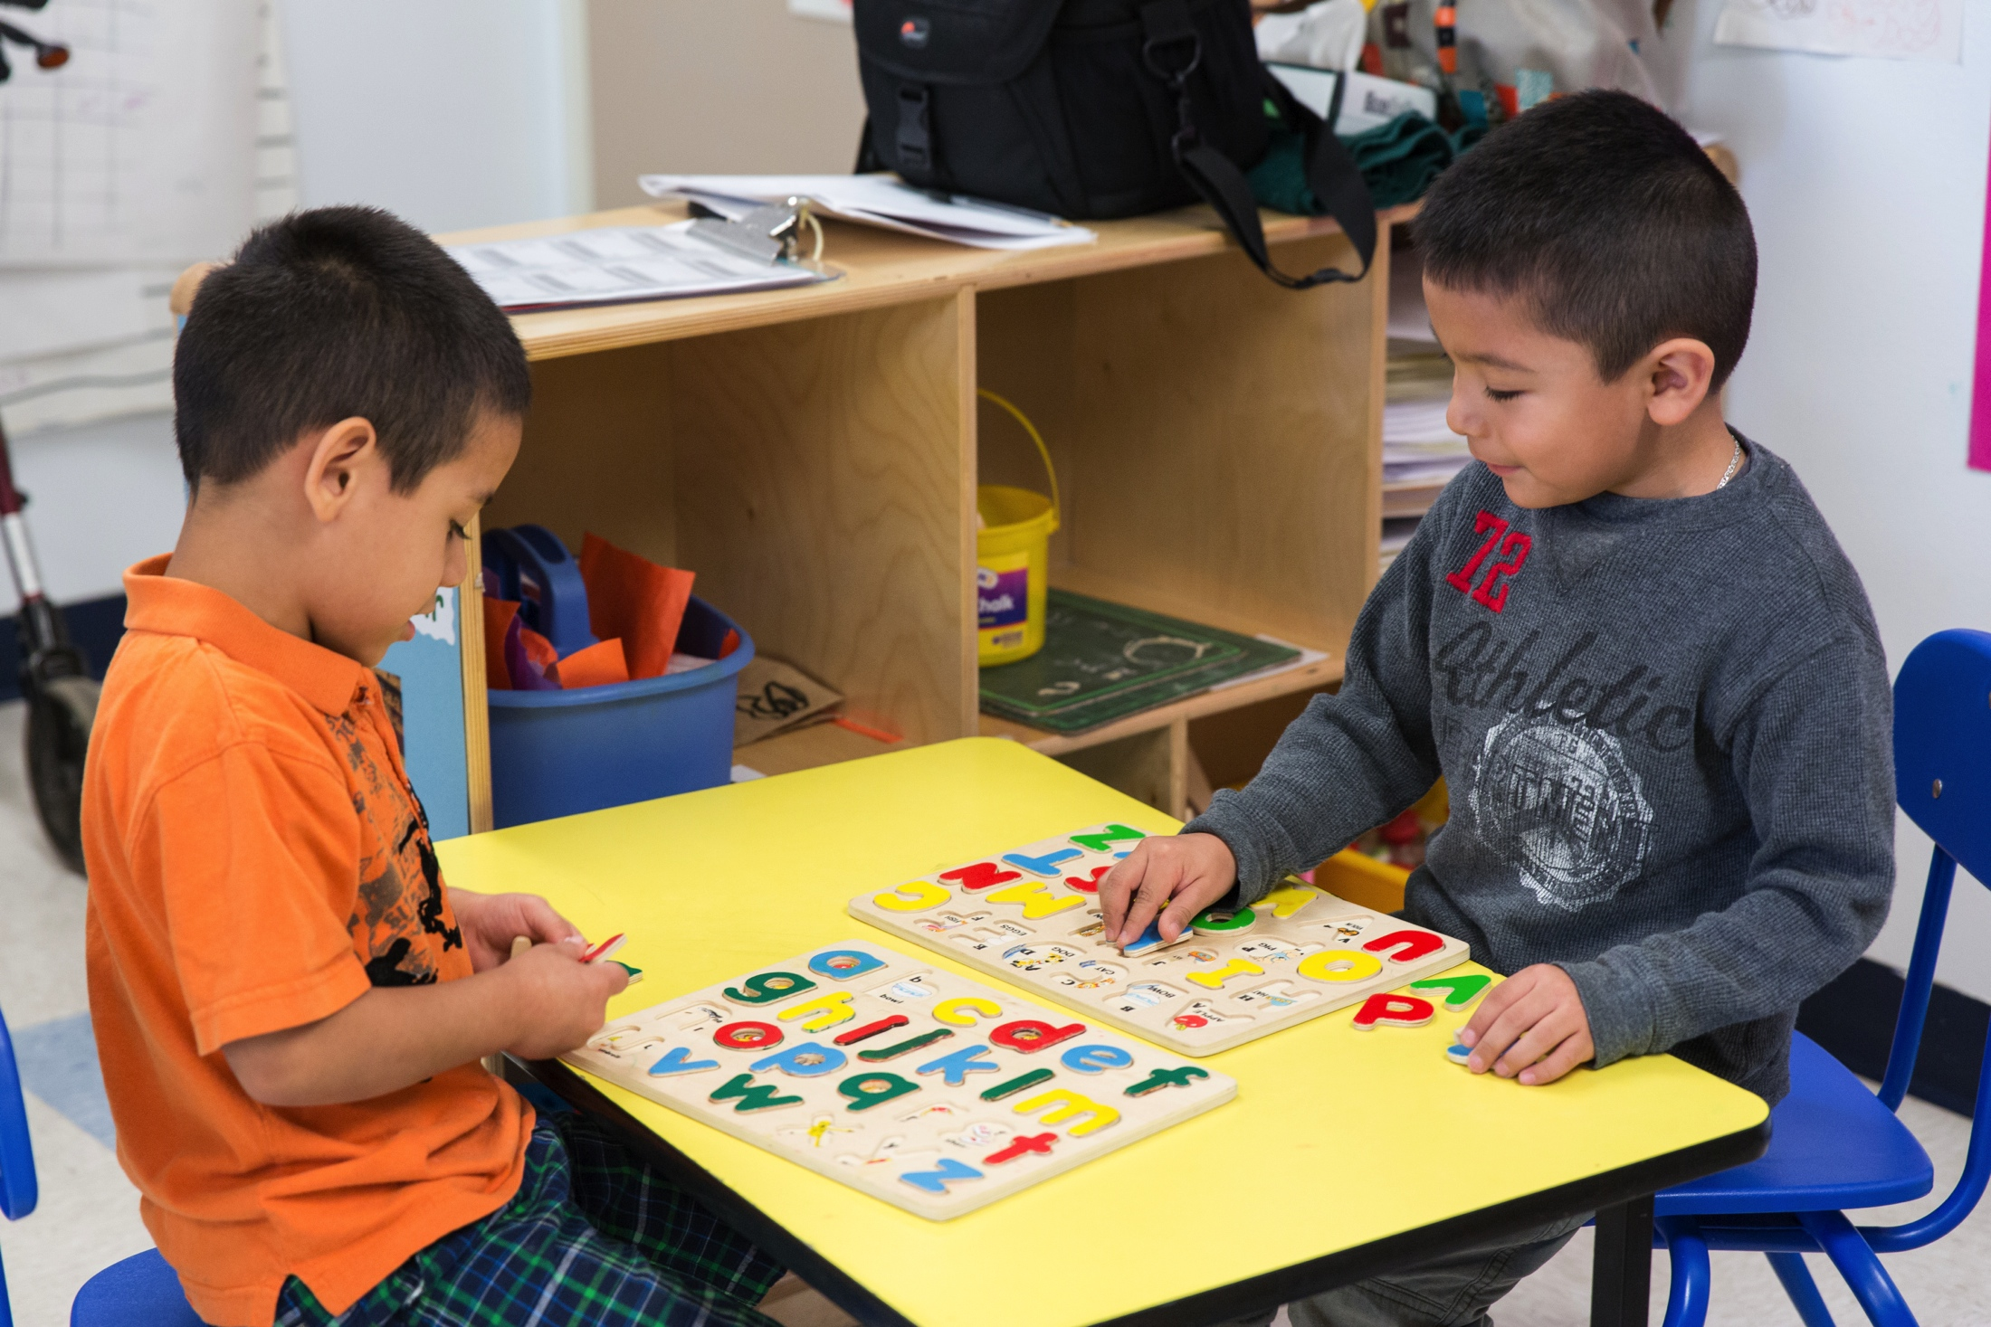
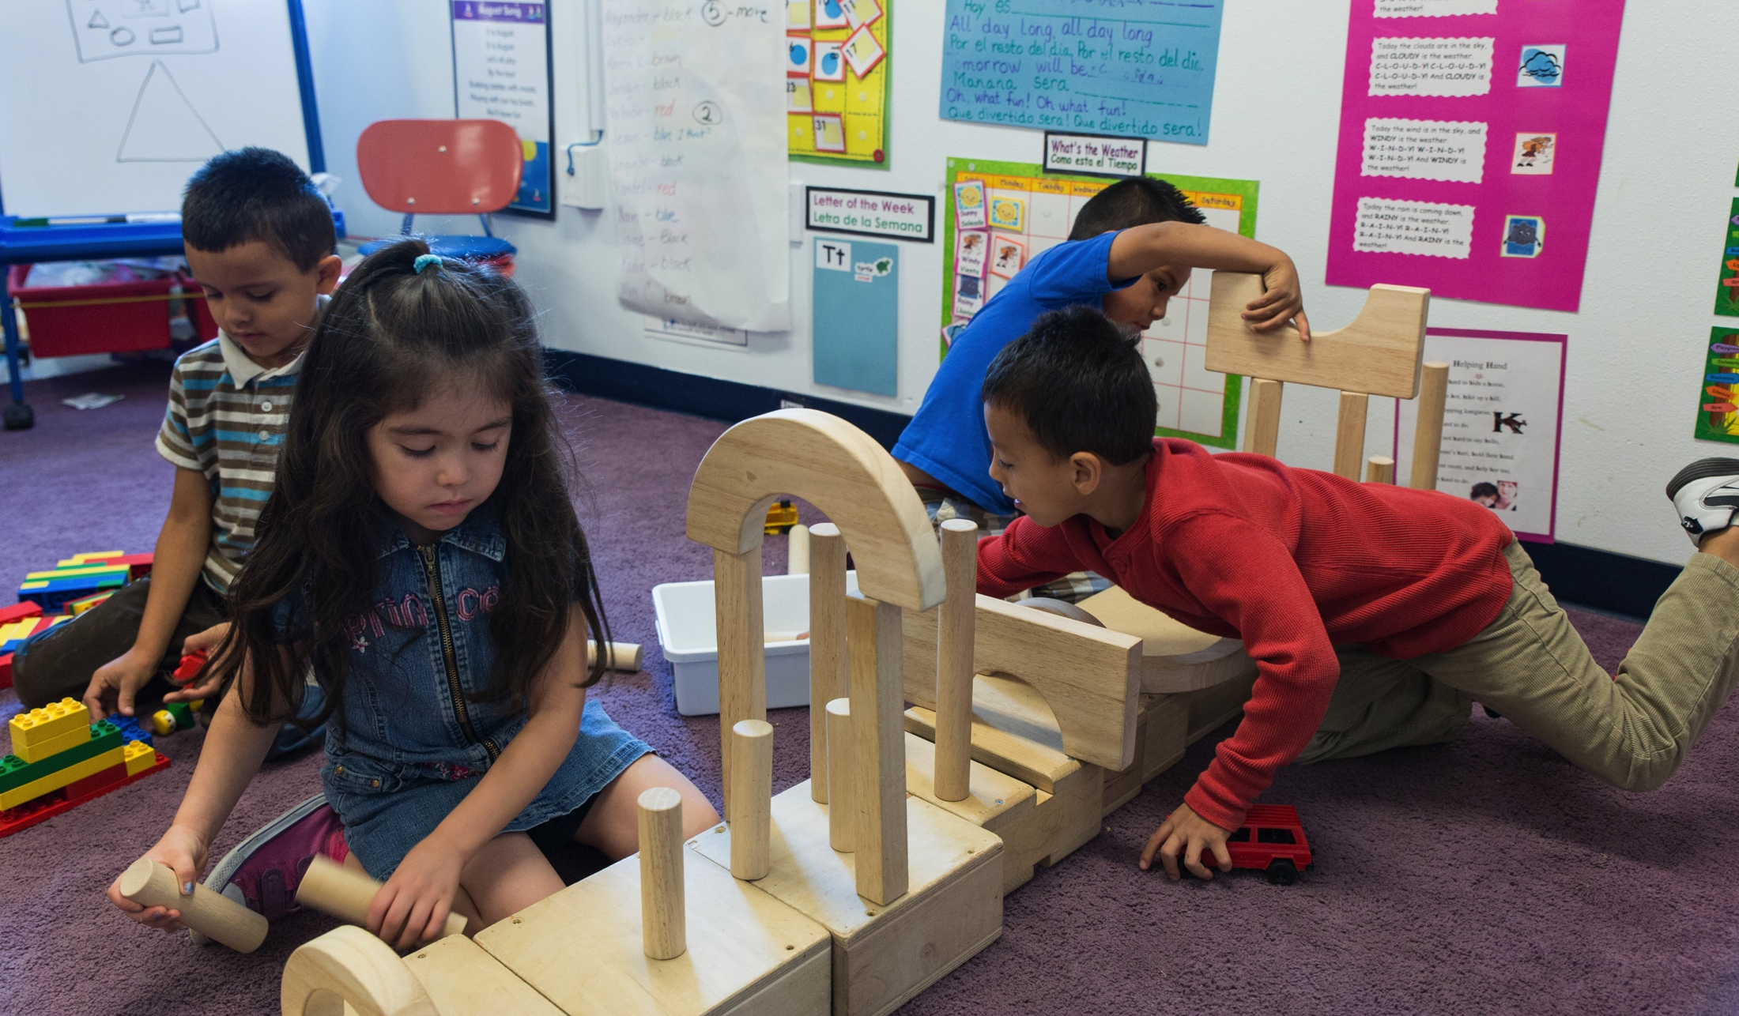
Fostering children’s thinking skills BY problem solving
Create opportunities for children to brainstorm, plan, and solve problems.

Slide 7
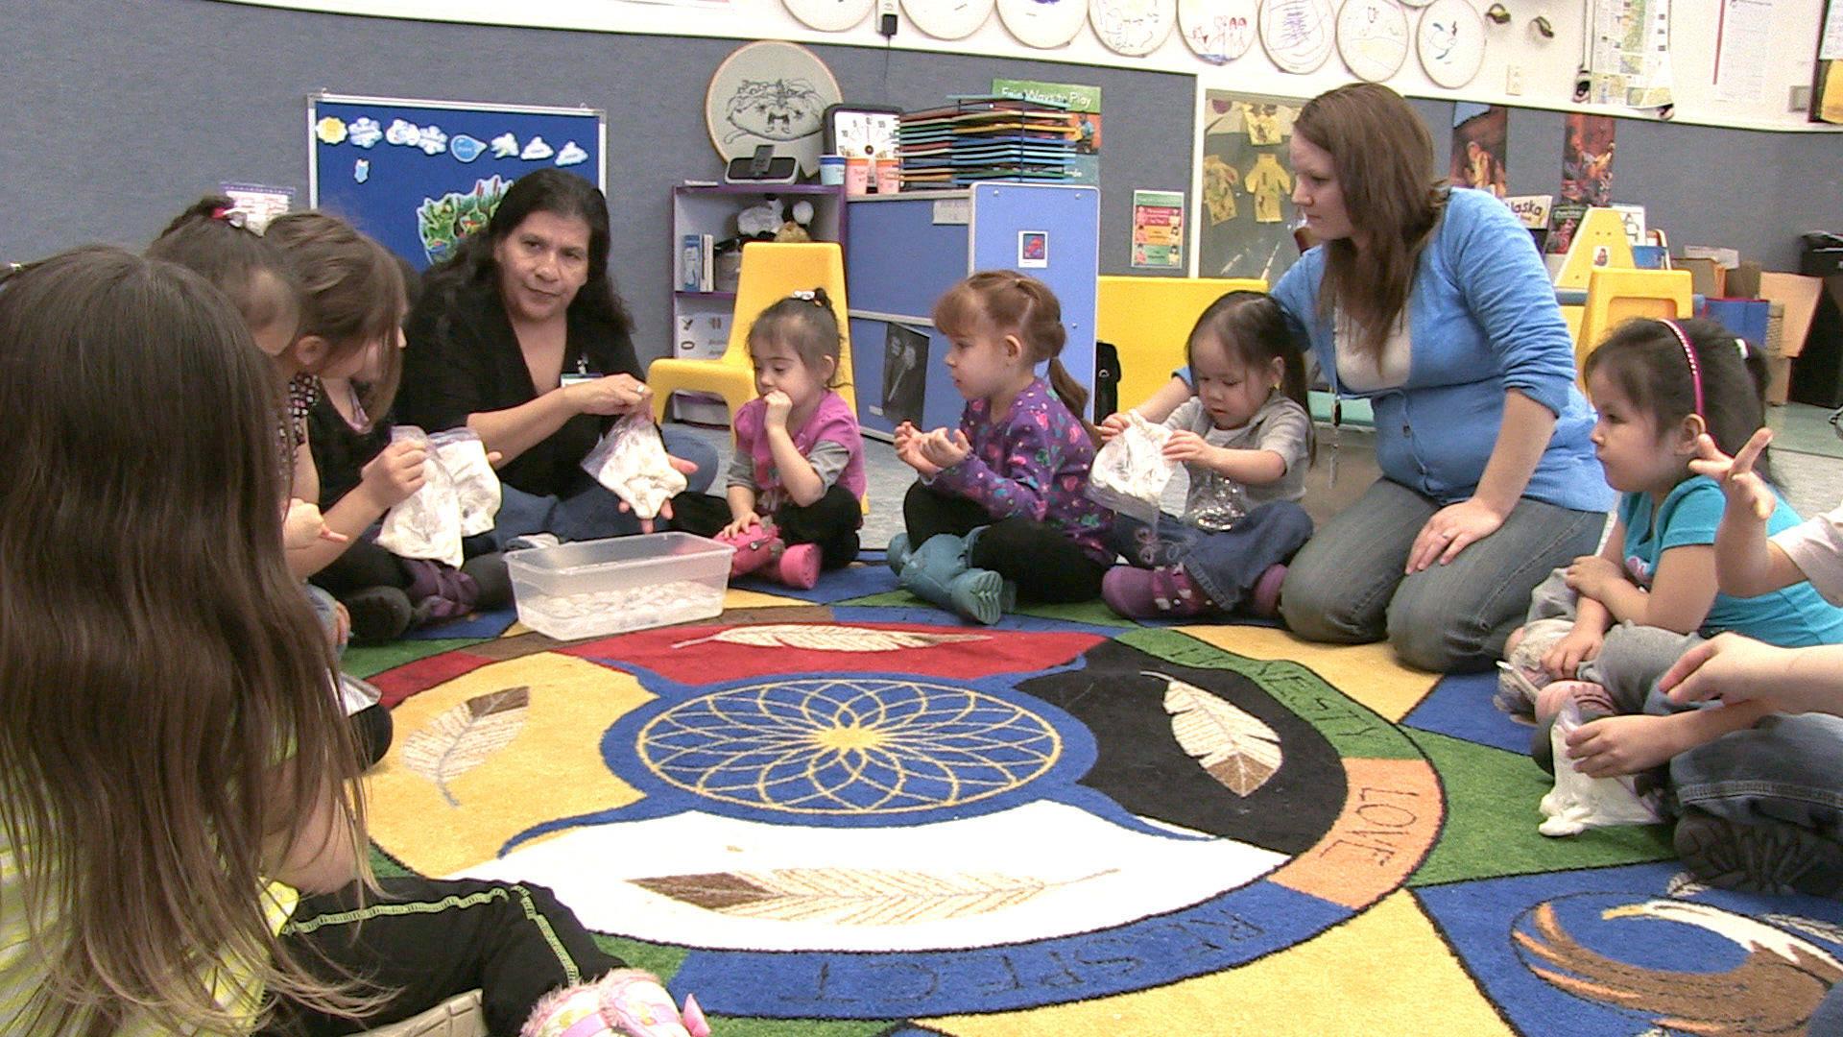
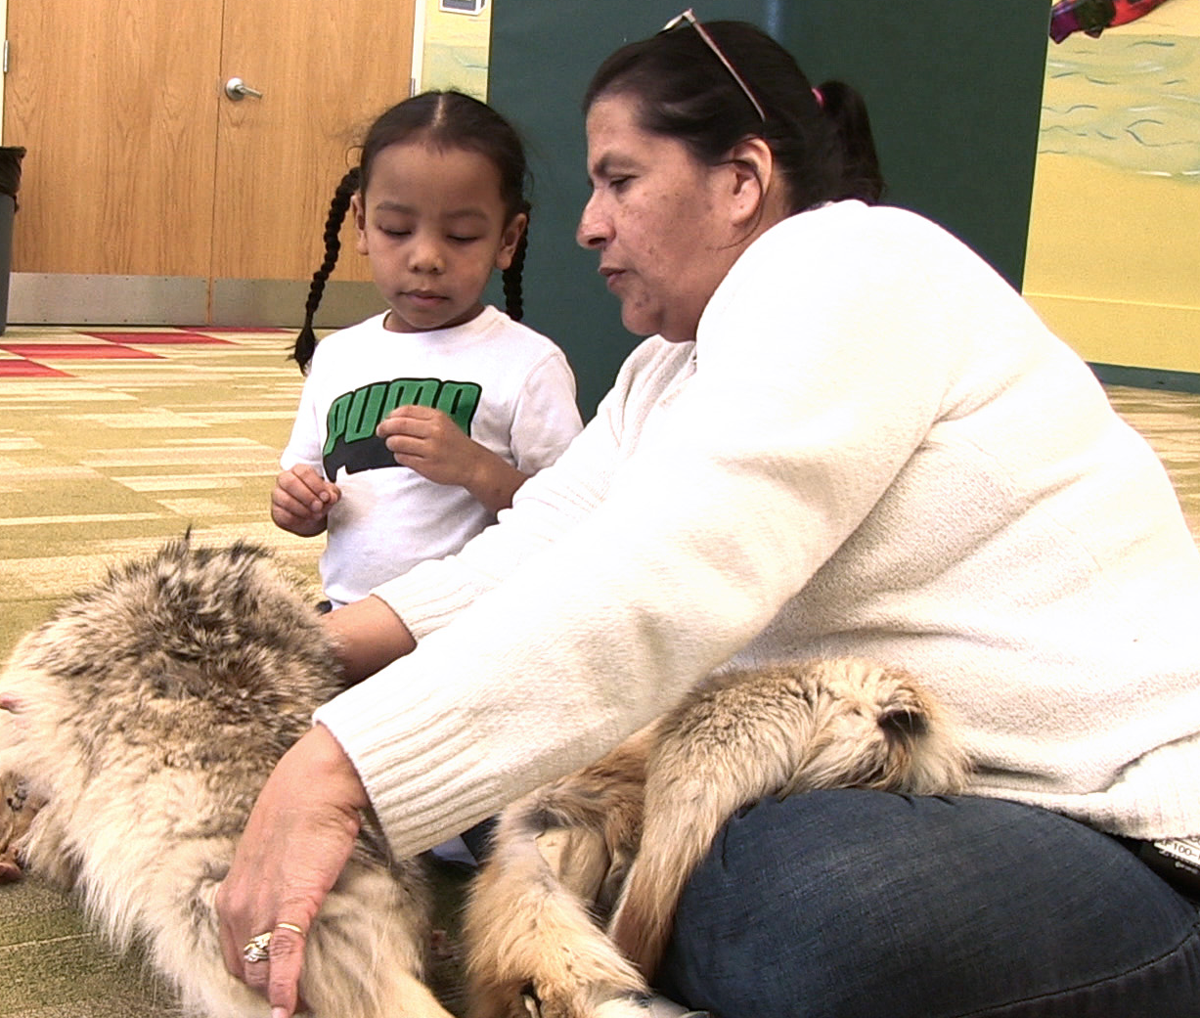
Fostering children’s thinking skills BY APPLYING KNOWLEDGE
Build on children’s natural curiosity by drawing upon their everyday experiences and connecting previous knowledge.

Slide 8
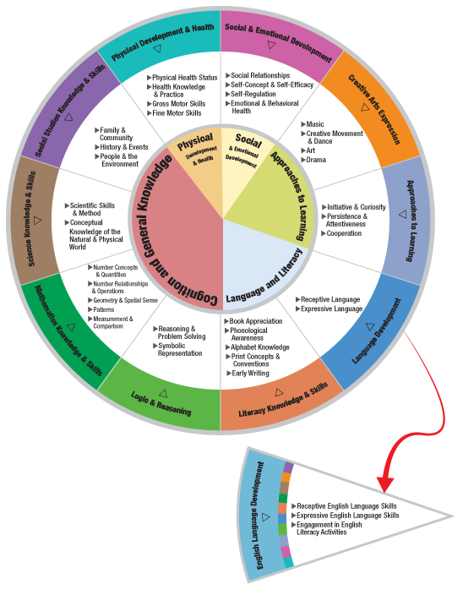
THE HEAD START CHILD DEVELOPMENT AND EARLY LEARNING FRAMEWORK
The scientific method can be incorporated within many areas of the framework.
Some examples are:
Logic & Reasoning
Literacy Knowledge & Skills
Mathematical Knowledge & Skills
Social & Emotional Development
Science Knowledge & Skills

Slide 9
Video: Nature Walk

Slide 10
In this clip, the teacher asks children to…
Predict Which hand will feel cold, and which one will stay warm
Supports children’s Logic & Reasoning Skills
Connect ideas about blubber with how Polar Bears are able to stay warm in ice water

Slide 11
Video: BOOK READING

Slide 12
In this clip, the teacher asks children to…
Brainstorm about: What foxes use their fur and tail for during the winter.
Supports children’s Literacy Knowledge & Skills
Draw upon their experiences: When they wear scarfs to stay warm in the winter.

Slide 13
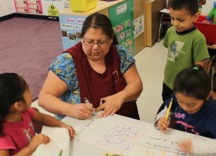
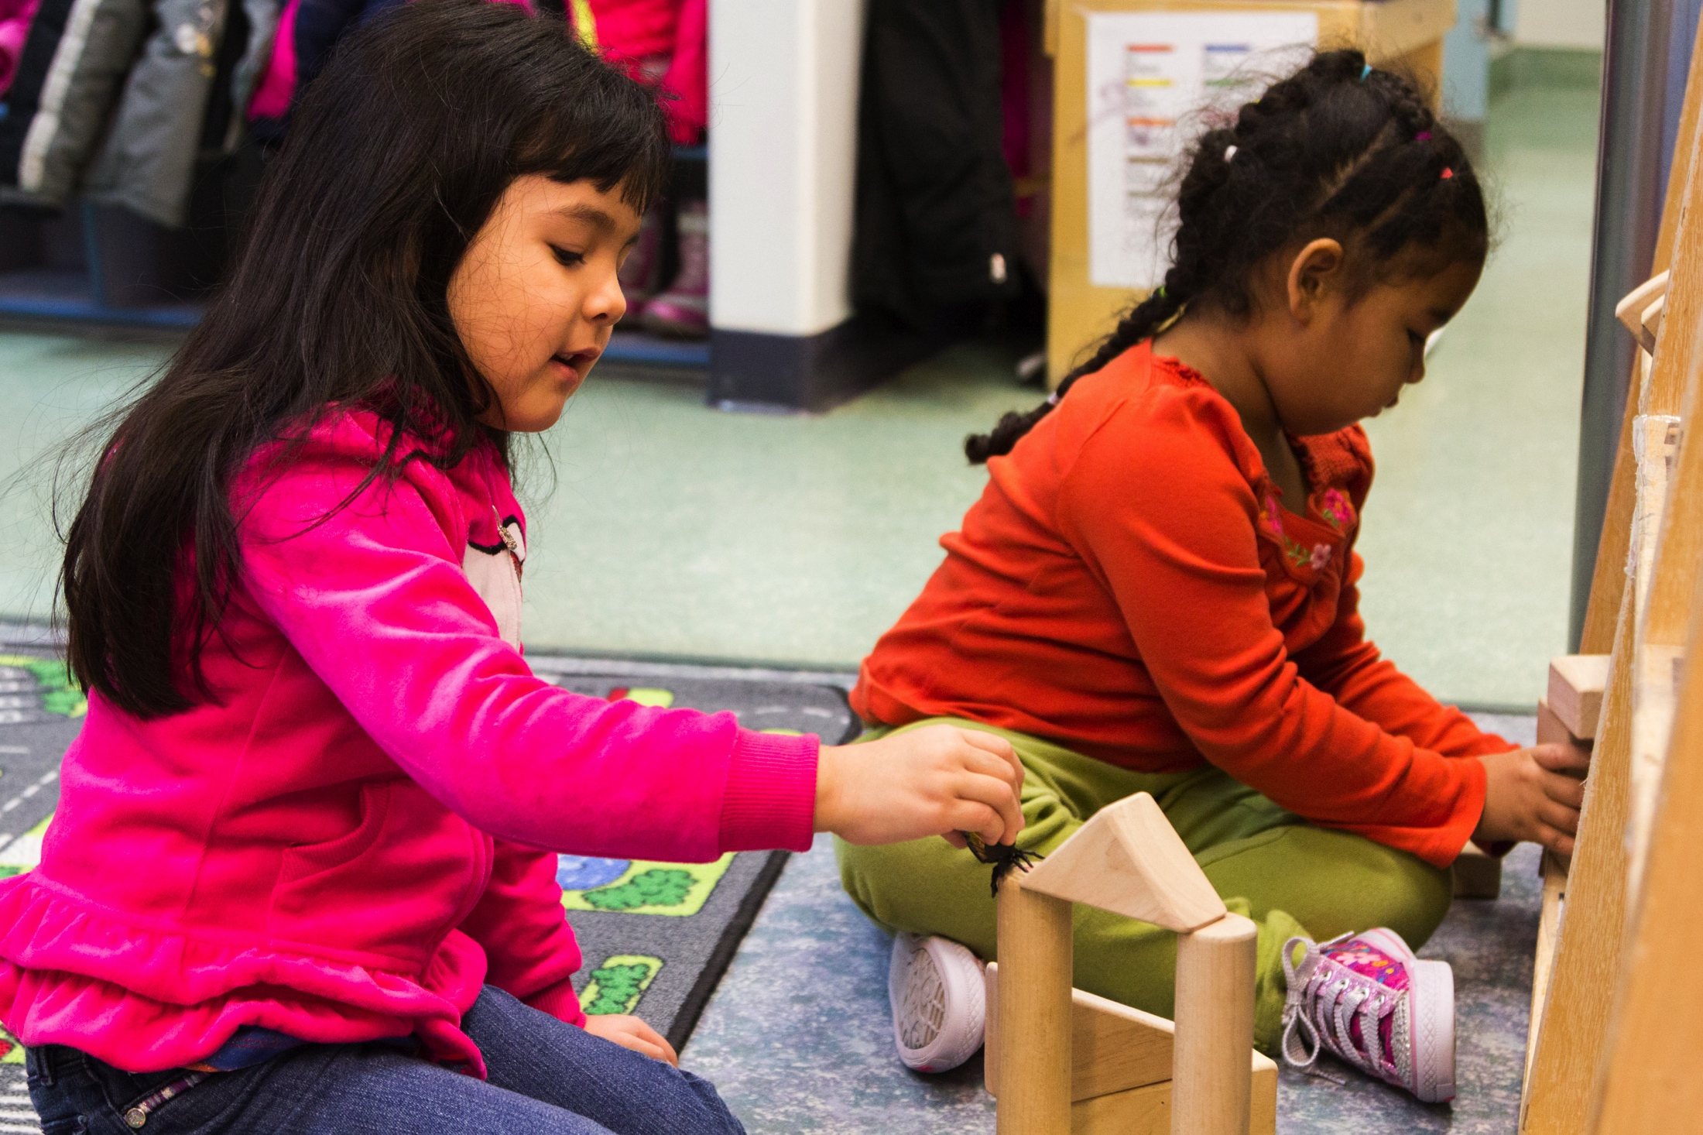
When Can I FOSTER CHILDREN’S THINKING SKILLS?
Teachers can foster children’s thinking and understanding throughout the school day in many classroom activities.

Slide 14
Improving practice
Video record and review your own teaching.
Practice with a peer.
Watch a “master teacher” in action.

Slide 15
Summary
Teachers can foster children’s thinking skills by:
Using the scientific method: Provide tasks where children can observe, predict, and experiment.
Problem-solving: Create opportunities for children to brainstorm, plan, and solve problems.
Applying knowledge: Build on children’s natural curiosity by drawing upon their everyday experiences and connecting previous knowledge.

Slide 16
FALL 2013

