Slide 1
LANGUAGE MODELING AND CONVERSATIONS:
ENGAGING CHILDREN
IN CONVERSATIONS
FALL 2014

Slide 2
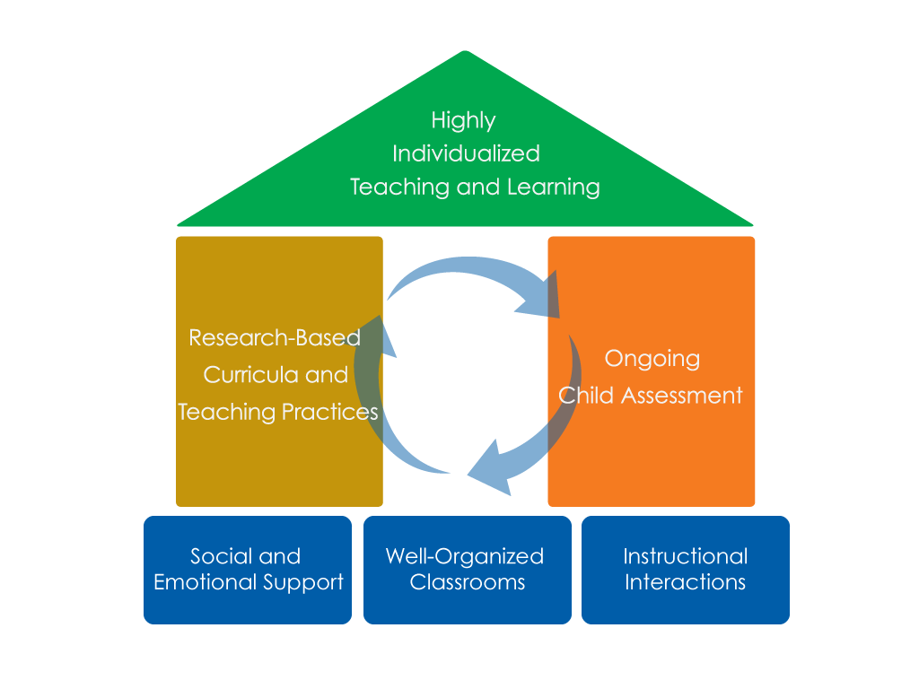
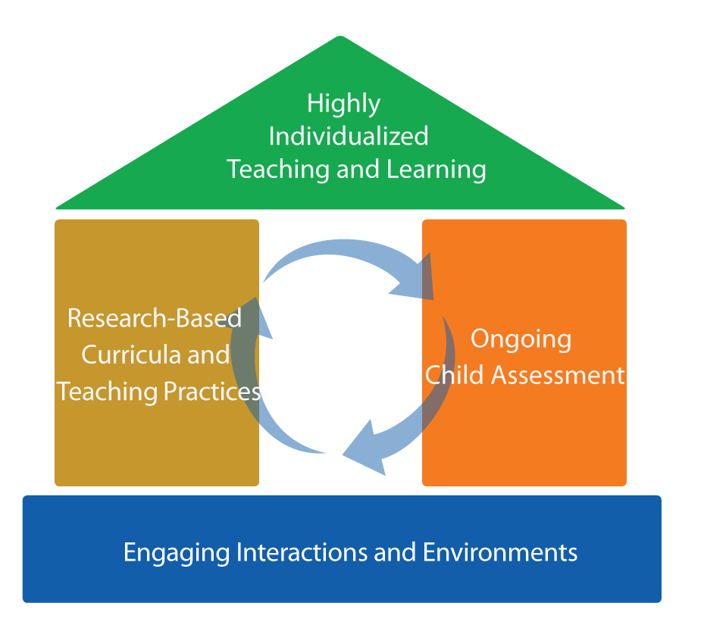
FRAMEWORK FOR EFFECTIVE PRACTICE
SUPPORTING SCHOOL READINESS FOR ALL CHILDREN
FOCUS ON
FOUNDATION

Slide 3
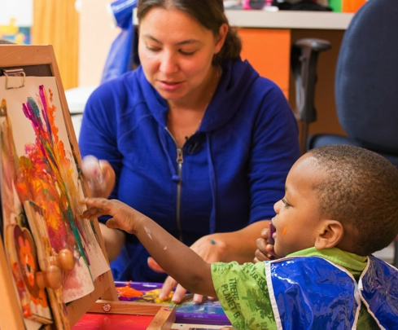
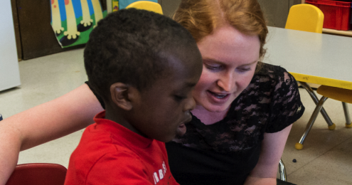
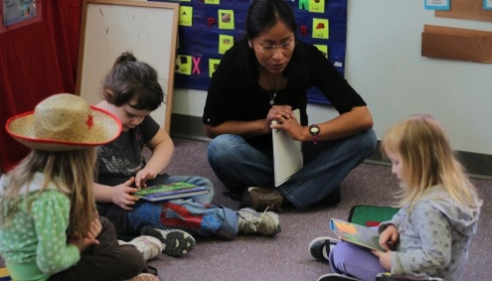
OBJECTIVES
  To learn key elements and benefits of meaningful conversations with infants, toddlers, and preschool children
  To understand basic strategies
  To identify opportunities for conversations

Slide 4
BENEFITS FOR INFANTS, TODDLERS, AND PRESCHOOLERS
Helps children communicate their intentions, feelings, and emotions
Encourages children's learning of new concepts and skills
Introduces children to new vocabulary,
and helps them communicate more clearly and accurately

Slide 5
…AND BENEFITS FOR TEACHERS
Conversations build positive relationships between children and teachers.
Conversations support curriculum
and assessment, and help teachers:
  Assess what children already know.
  Determine what children are ready to learn next.
  Monitor children’s progress as they learn new skills.

Slide 6
KEY CONVERSATION ELEMENTS
In meaningful conversations with infants, toddlers, and preschool children, teachers:
Move to the child’s level.
Watch and listen actively.
Match the child’s mood and feelings.
Wait for a response and encourage
back-and-forth exchanges.

Slide 7
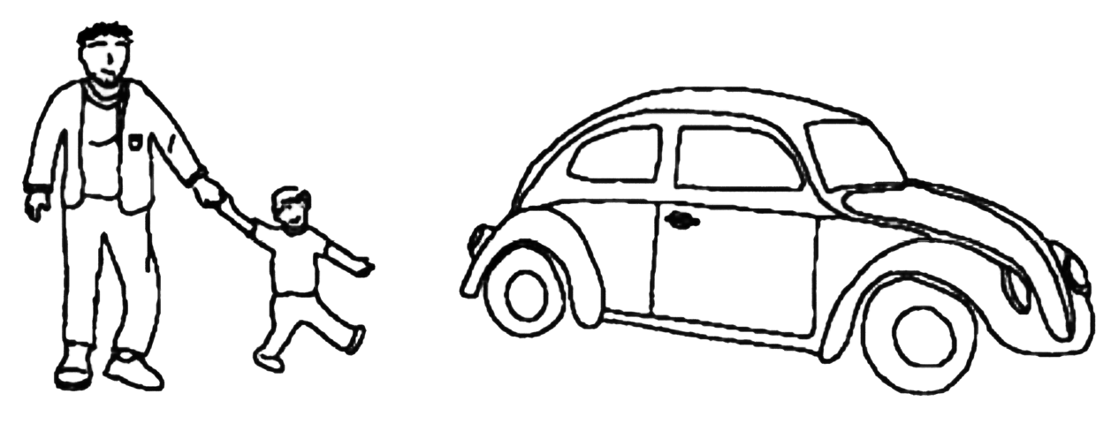
PROMOTING CONVERSATIONS
C. A. R.
Comment
Ask
Respond
Follow the child’s lead and then:
Comment and wait, or
Ask a question and wait, or
Respond by adding a little more and wait.
Adapted with permission.
Cole, K., Maddox., M., Notari-Syverson, A., & Lim, Y.S. (2006). Language is the key: Video programs for building language and literacy in early childhood. Seattle, WA: Washington Learning Systems.
StoryQUEST: Celebrating beginning language and literacy, first year annual report. (April, 2004). Unpublished report, California Institute on Human Services, Sonoma State University, Rohnert Park, CA.

Slide 8
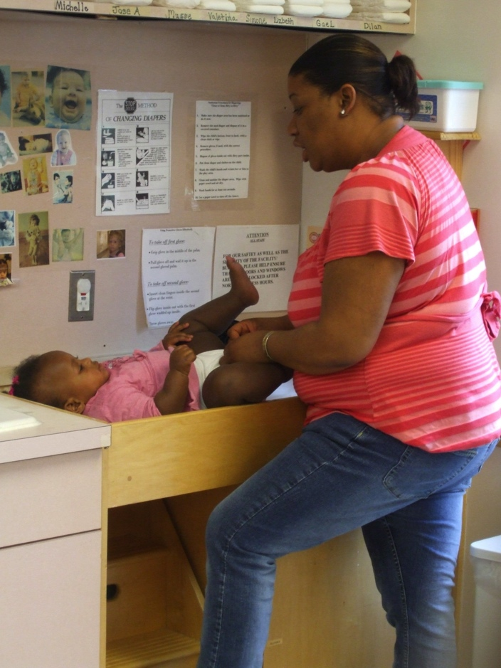
CONVERSATION TIME
INFANTS AND TODDLERS
Opportunities during daily
routines:
Arrival and departure
Diapering and toileting
Dressing and undressing
Mealtimes
Play experiences
Transitions
Photo courtesy of EHS NRC

Slide 9
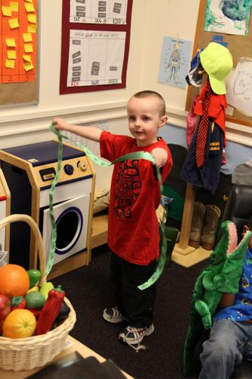
CONVERSATION TIME
PRESCHOOLERS
Opportunities during routines
and play:
Arrival and departure
Times of extended play
Meal and snack times
Small group activities
Transitions

Slide 10


Slide 11
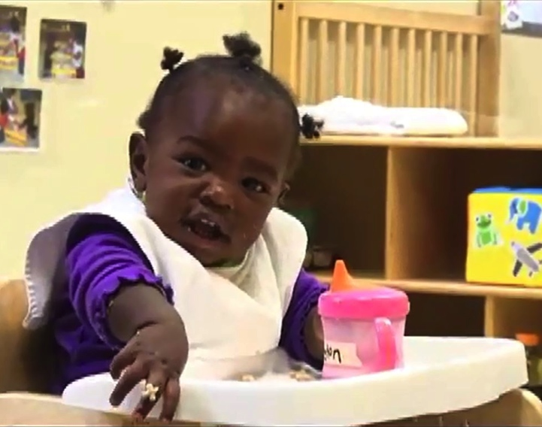
VIDEO REVIEW
CONVERSATIONS: UH OH
INFANTS AND TODDLERS
Listening to the child
Matching tone and emotion
Expressing and expanding on what the child is trying to say
Following the child’s lead
Giving time to respond
Encouraging several
back-and-forth exchanges

Slide 12
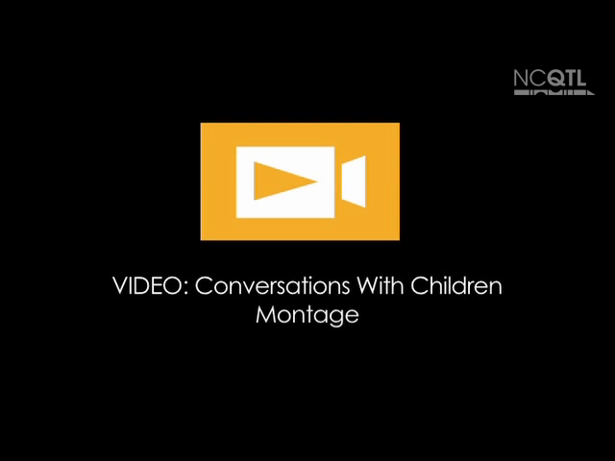

Slide 13
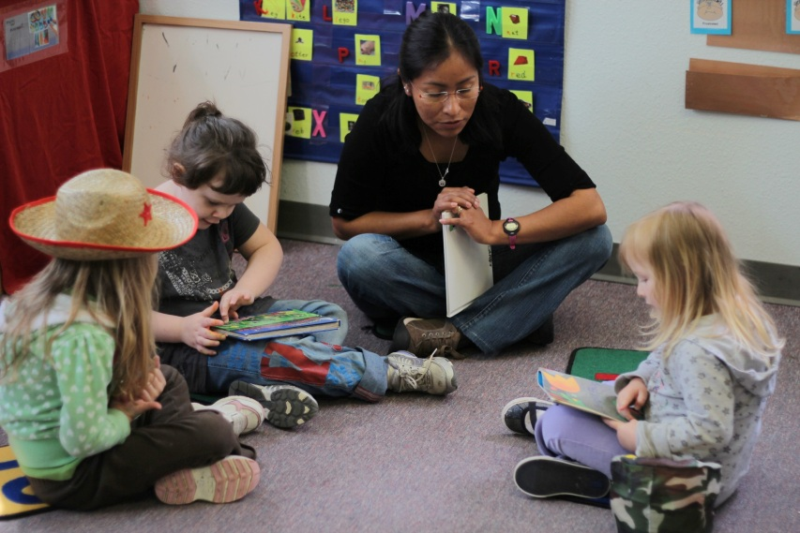
VIDEO REVIEW: CONVERSATIONS
WITH CHILDREN MONTAGE
Active listening
Physically on the
child’s level
Matching tone and
feelings
C.A.R. (Comment, Ask, Respond)
Multiple back-and-forth exchanges

Slide 14
REMEMBER!
Meaningful conversations happen in language-rich environments.
Encourage adults to model quality conversations.
Involve all adults in planning for quality conversations with children.
Integrate conversations throughout the entire day!

Slide 15
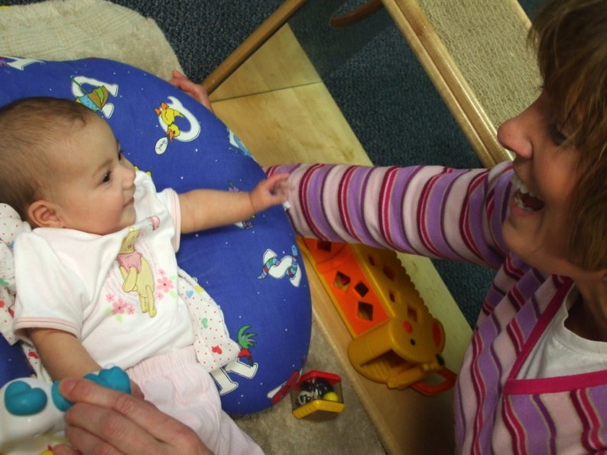
NOW IT’S YOUR TURN!
SET THE STAGE
WITH INFANTS AND TODDLERS
Make sure child is
ready to interact.
Draw the child’s
attention.
Move to the child’s
level.
Watch and listen to what the child says.
Photo courtesy of EHS NRC

Slide 16

NOW IT’S YOUR TURN!
SET THE STAGE
WITH PRESCHOOLERS
Move to the child’s
level.
Listen to what the
child says.
Match the tone of the conversation to the child’s affect.
Take turns talking.

Slide 17
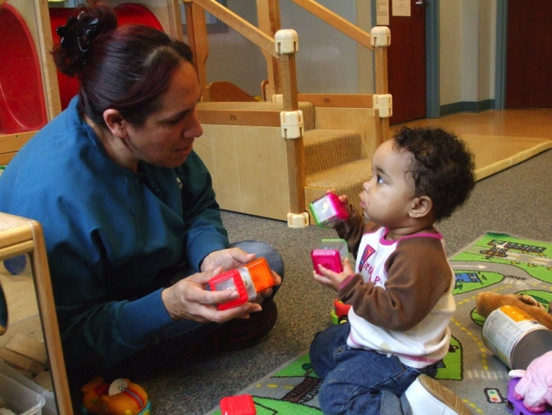
START THE CONVERSATION
WITH INFANTS AND TODDLERS
C.A.R. is also for infants
and toddlers!
Comment or ask a
question.
Pause, give the child time to respond.
Follow the child’s lead.
Watch for cues that child is tiring.
Photo courtesy of EHS NRC

Slide 18
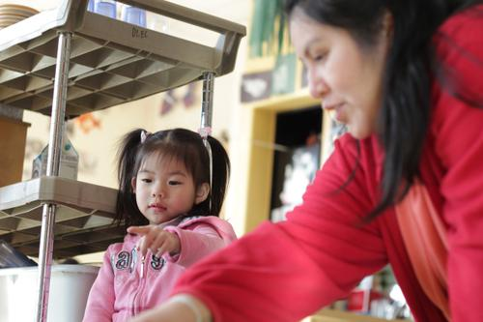
START THE CONVERSATION
WITH PRESCHOOLERS
Comment on what the child
is doing or what the child is
interested in.
Ask a question that relates
to the child’s experiences
or interests. Give the child
enough time to respond.
Respond by adding a little more to what the child says.

Slide 19
SUMMARY
Infants, toddlers, and preschool children all need adults to:
Engage them with verbal and nonverbal language.
Listen actively and wait for them to respond.
Model meaningful, increasingly complex language.

Slide 20
This document was prepared for the U.S. Department of Health and Human Services, Administration for Children and
Families, Office of Head Start, by the National Center on Quality Teaching and Learning under Grant #90HC0002 in
collaboration with the Early Head Start National Resource Center under Grant #HHSP23320100009YC.
FALL 2014

