Slide 1
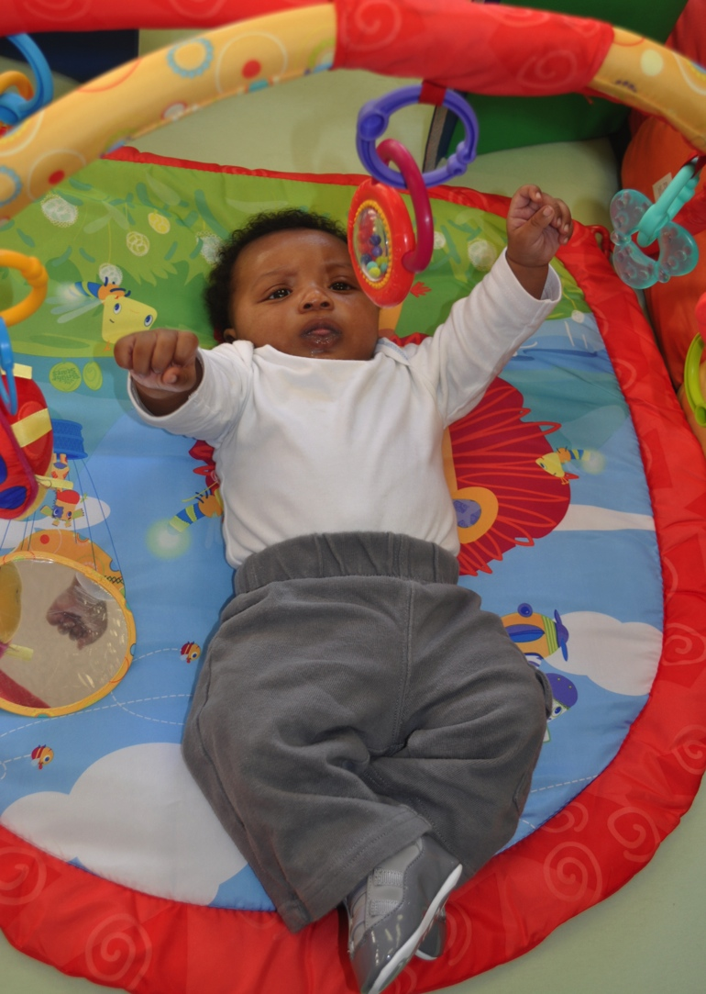
Filling In CHILDREN’S PHRASES (YOUNG INFANT)
Photo courtesy of EHS NRC

Slide 2
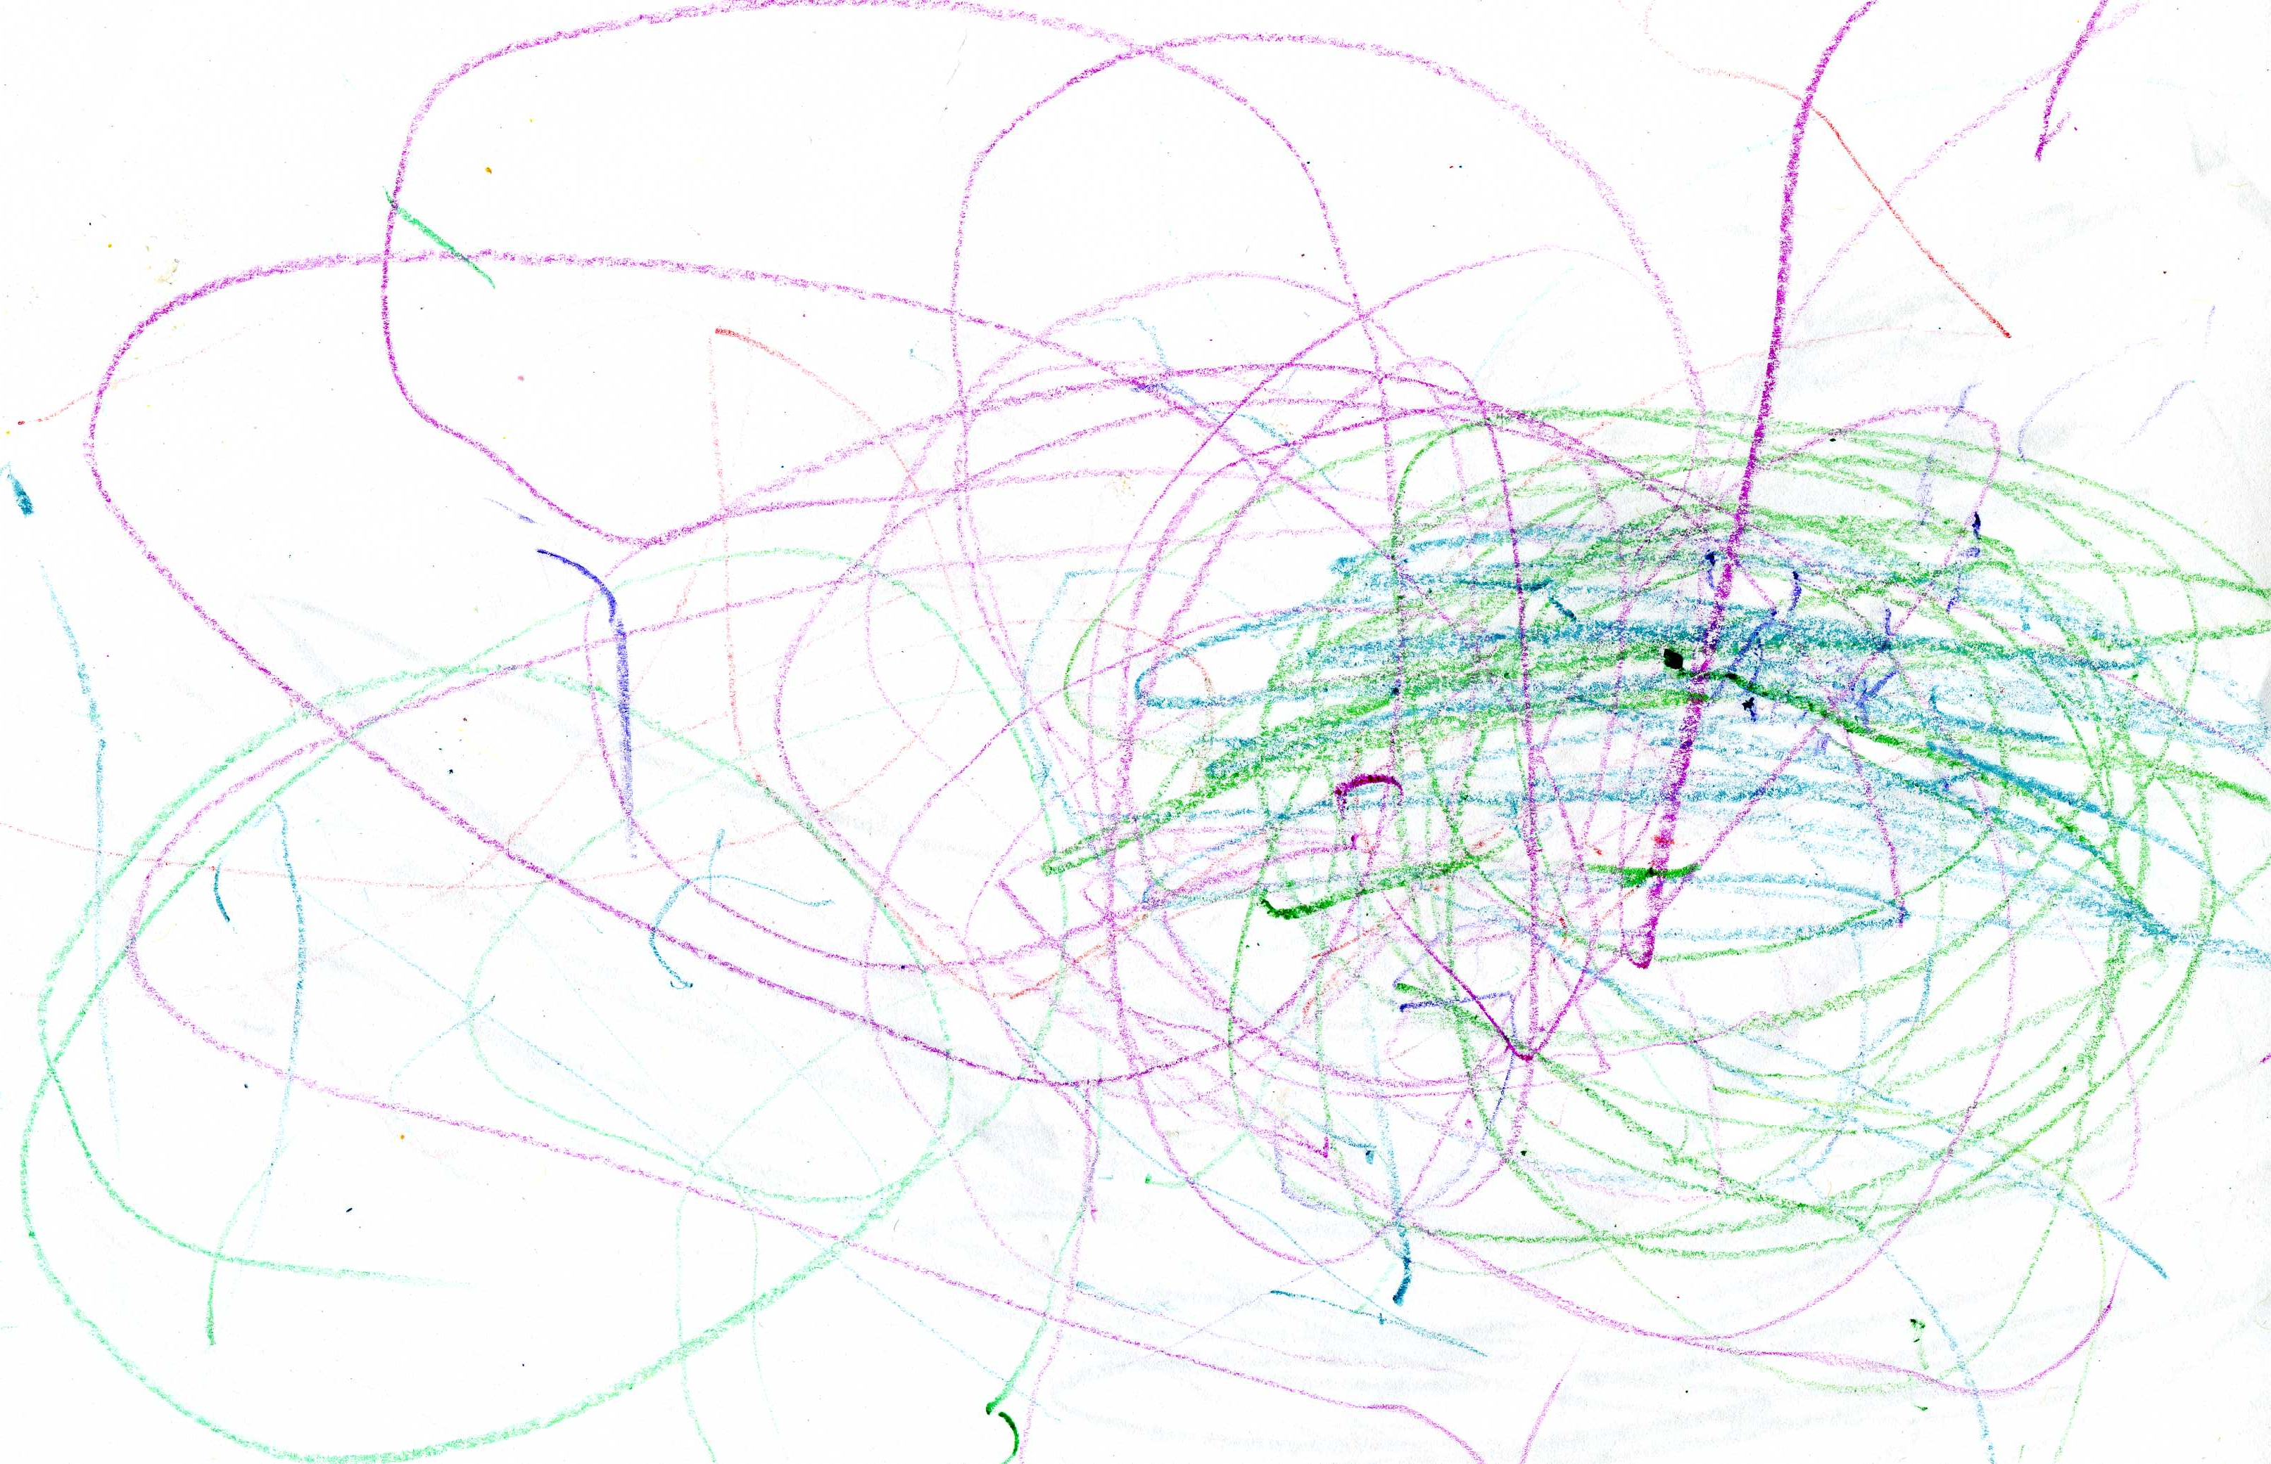
Filling In CHILDREN’S PHRASES (TODDLER)

Slide 3
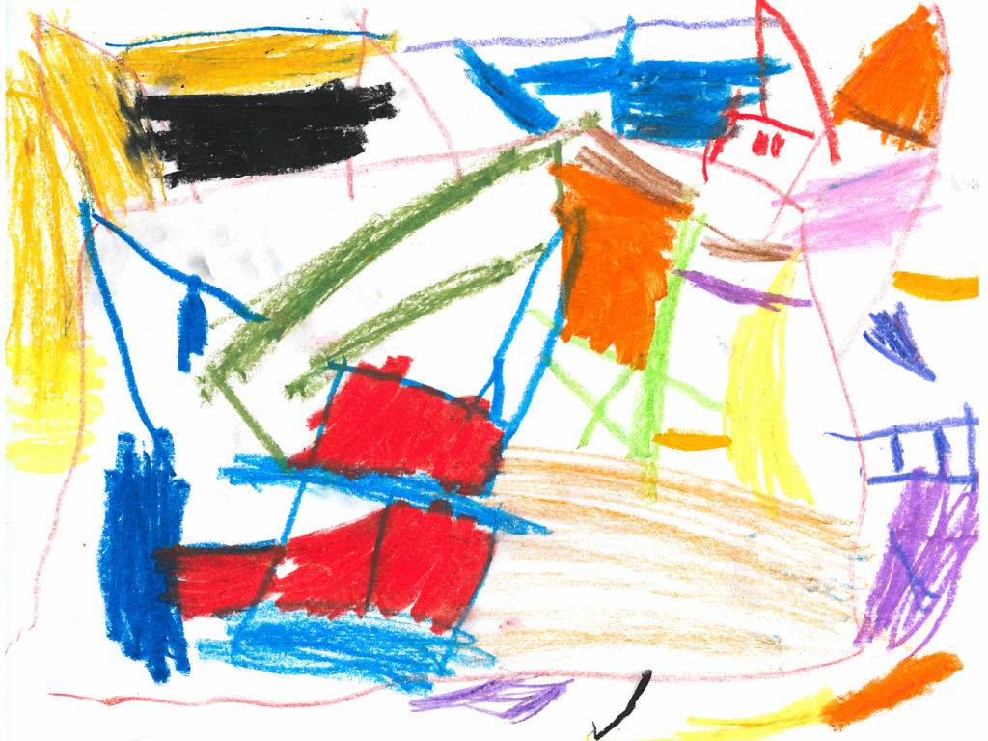
Filling In CHILDREN’S PHRASES (PRESCHOOLer)

Slide 4
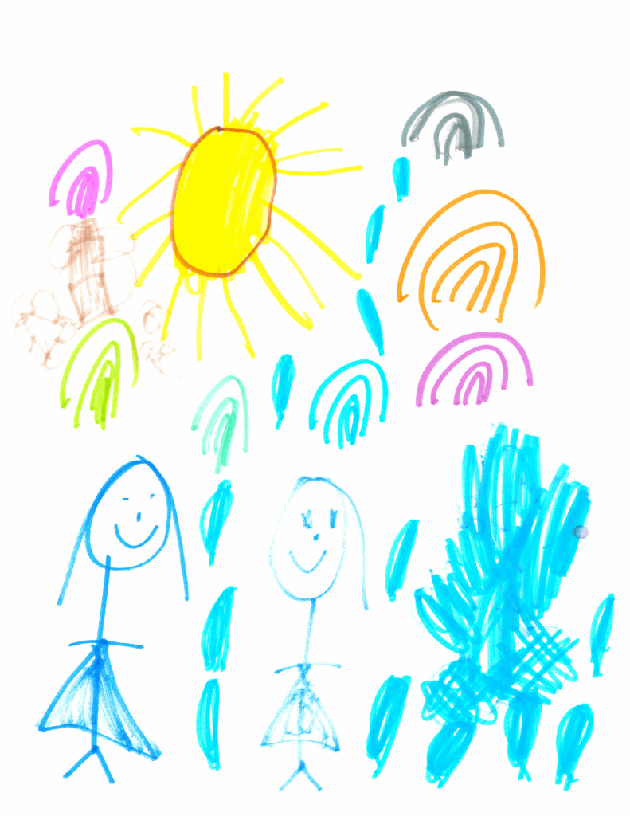
Filling In CHILDREN’S PHRASES (PRESCHOOLer)

