Slide 1
LANGUAGE MODELING AND CONVERSATIONS:
ENGAGING CHILDREN
IN CONVERSATIONS
FALL 2012

Slide 2
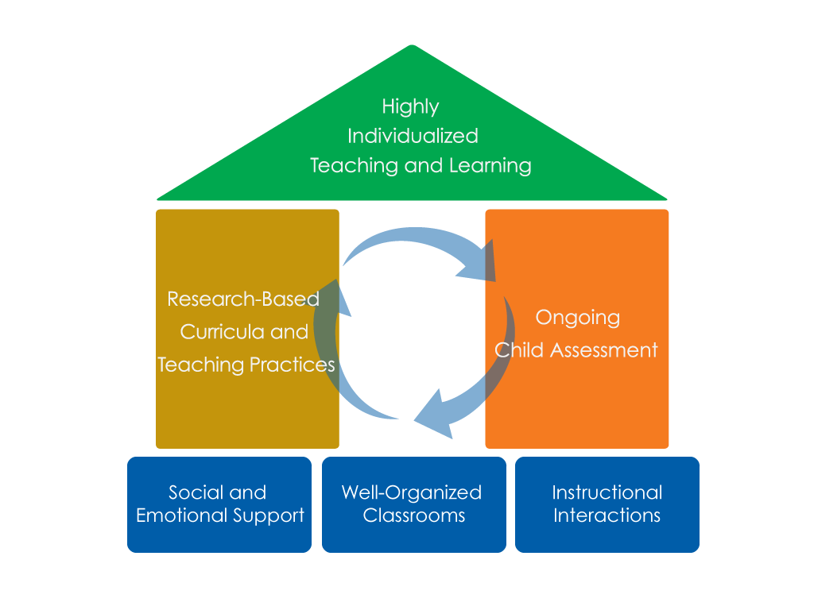
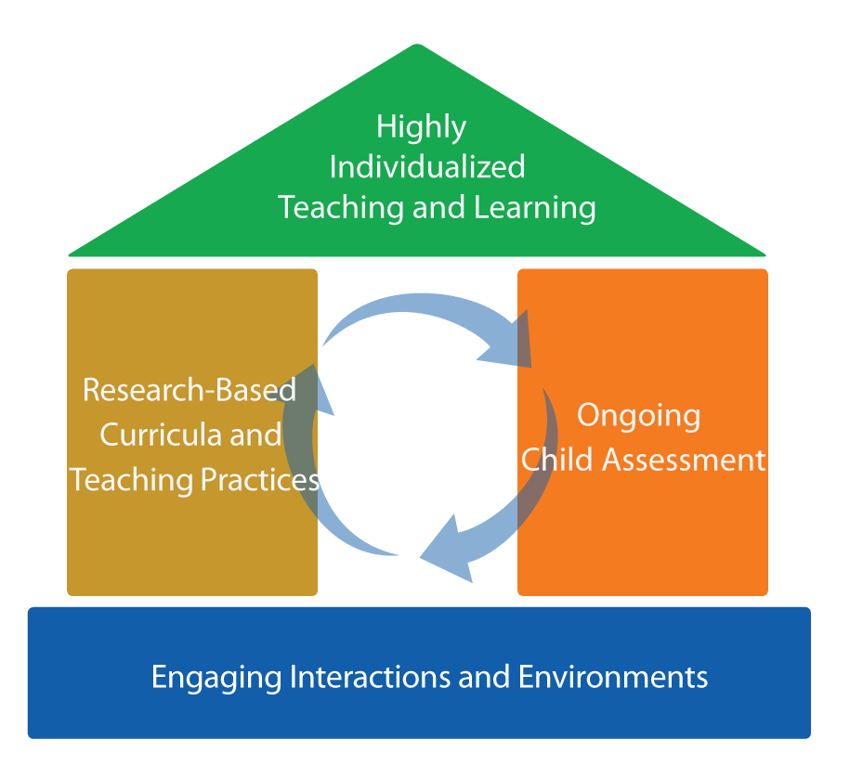
FRAMEWORK FOR EFFECTIVE PRACTICE
SUPPORTING SCHOOL READINESS FOR ALL CHILDREN
FOCUS ON
FOUNDATION

Slide 3
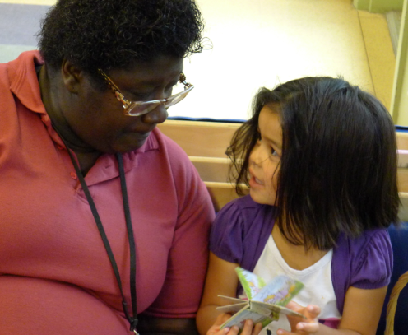
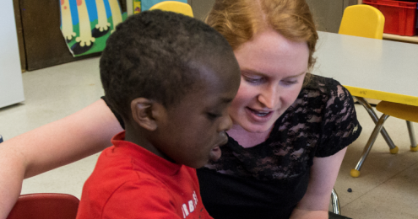
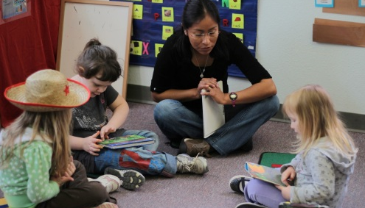
OBJECTIVES
  To learn the key elements and benefits of meaningful conversations with children
  To understand basic strategies
  To identify opportunities for conversations

Slide 4
BENEFITS FOR CHILDREN
Conversations help young children develop and learn new skills:
Build and extend children’s vocabulary
Assist children in learning how to communicate more clearly and accurately
Provide opportunities to learn new concepts
and skills
Foster children’s ability to communicate their feelings and ideas verbally

Slide 5
…AND BENEFITS FOR TEACHERS
Conversations build positive relationships between children and teachers.
Conversations support curriculum
and assessment. They:
  Assess what children already know
  Determine what children are ready to learn next
  Monitor how well children are learning new skills.

Slide 6
KEY CONVERSATION ELEMENTS
In meaningful conversations with young children, teachers:
Listen actively to what a child says.
Get on the child’s physical level.
Match the tone and feelings of the conversation
to a child’s emotions.
Promote multiple, reciprocal, back-and-forth
verbal exchanges.

Slide 7
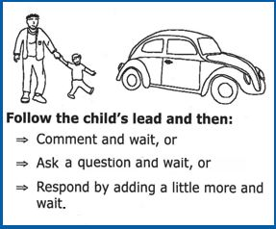
PROMOTING CONVERSATIONS
C. A. R.:
Comment
Ask
Respond
Adapted with permission.
Cole, K., Maddox., M., Notari-Syverson, A., & Lim, Y.S. (2006). Language is the key: Video programs for building language and literacy in early childhood. Seattle, WA: Washington Learning Systems.
StoryQUEST: Celebrating beginning language and literacy, first year annual report. (April, 2004). Unpublished report, California Institute on Human Services, Sonoma State University, Rohnert Park, CA.

Slide 8
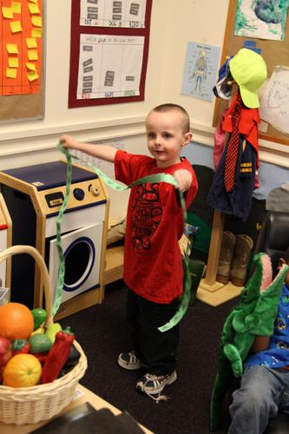
CONVERSATION TIME
Routine times that easily elicit conversations:
Arrival and departure
Times of extended play
Meal and snack times
Small group activities
Transitions

Slide 9
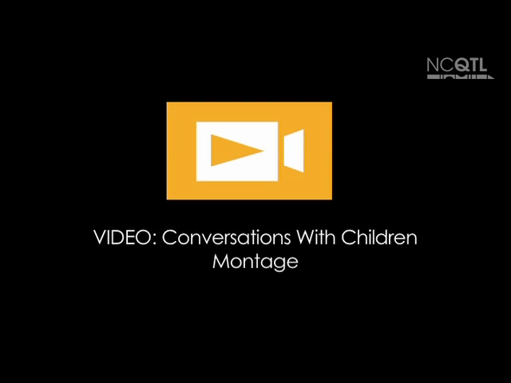

Slide 10

VIDEO REVIEW
Actively listening
Physically, on the
child’s level
Matching tone and
feelings
C A R: Comment, Ask, Respond
Multiple back-and-forth exchanges

Slide 11
REMEMBER!
Meaningful conversations happen in language-rich classroom environments.
Encourage meaningful talk among children
and adults.
Involve all classroom members in promoting conversations with children.
Make sure adults are providing models of quality conversations.
Throughout the entire day!

Slide 12
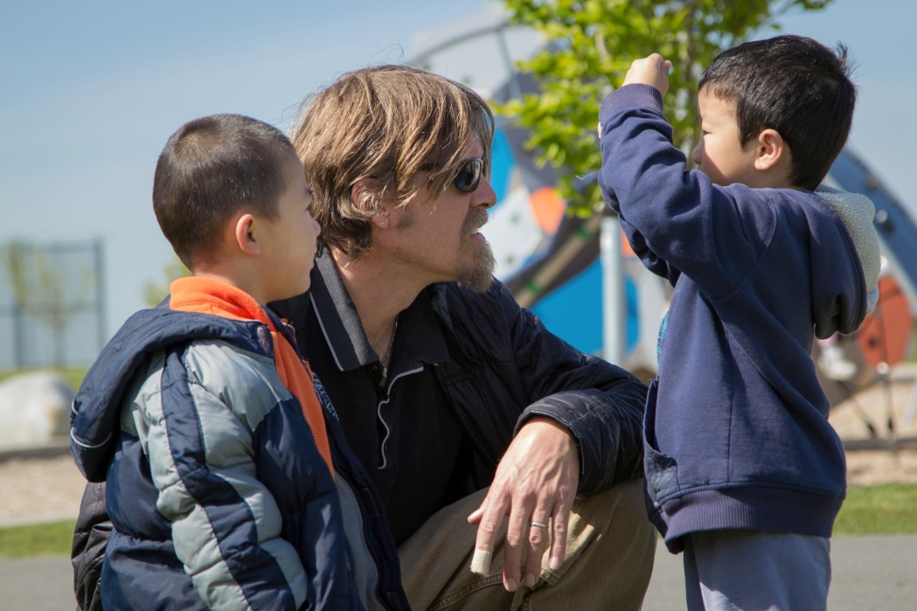
NOW IT’S YOUR TURN!
Set the stage:
Get down on the
child’s level.
Listen to what the
child says.
Match the tone of the
conversation to the child’s affect.
Take turns talking.

Slide 13
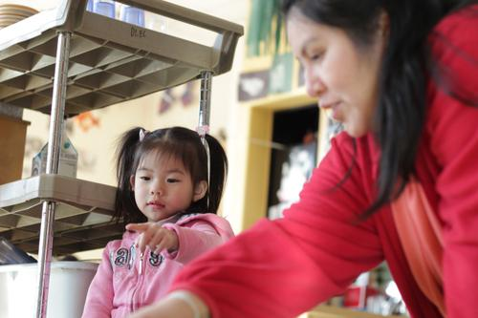
NOW IT’S YOUR TURN
Start the conversation:
Comment on what the child
is doing or what the child is
interested in.
Ask a question that relates
to the child’s experiences
or interests.
Respond by adding a little
more to what the child says.
Give the child enough time to respond.

Slide 14
FALL 2012

