Slide 1
Managing the classroom: Schedules and Routines
Supporting Quality Teaching and Learning in AI/AN Head Start Classrooms
FALL 2013

Slide 2
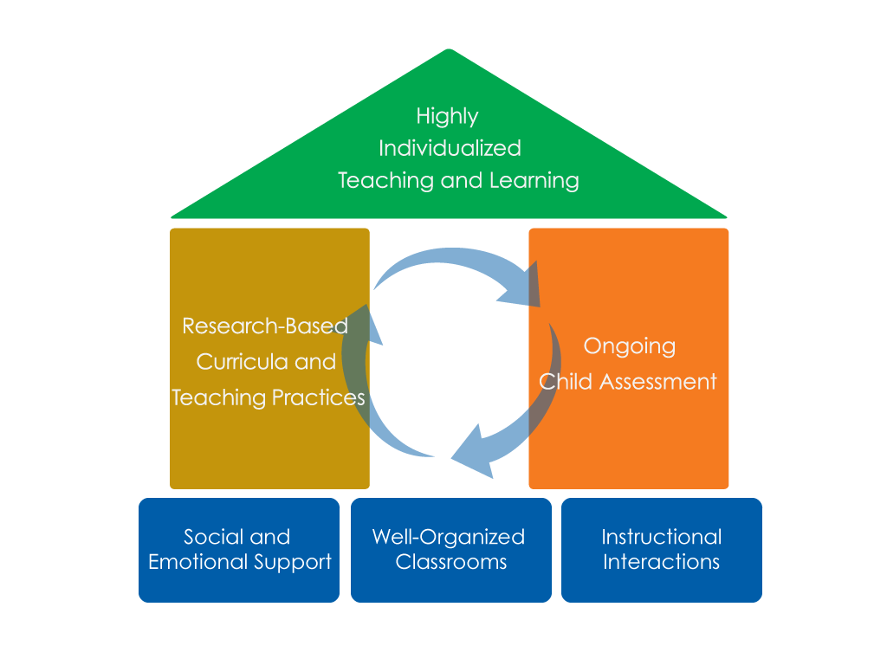
FRAMEWORK FOR EFFECTIVE PRACTICE SUPPORTING SCHOOL READINESS FOR ALL CHILDREN
FOCUS ON
FOUNDATION

Slide 3
Objectives
Define
Daily schedules and routines
Describe
Components of daily schedules and routines
Provide
Guidelines for teaching schedules & routines

Slide 4
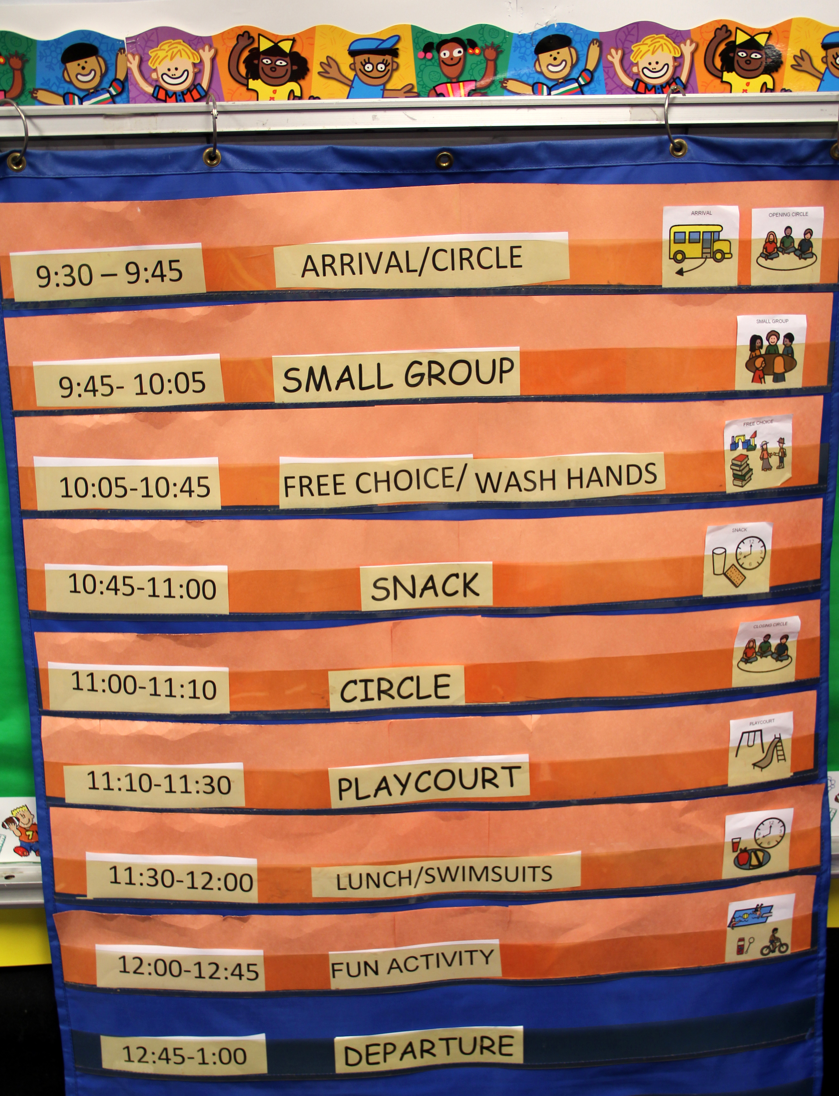
The BIG Picture
Help children know what to expect.
Enhance feelings of security.
Influence cognitive and social development.
Increase rates of engagement.

Slide 5
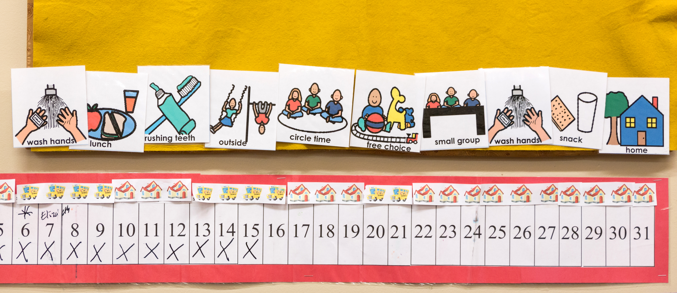
Schedules…
Organize the day
Arrange meaningful experiences for children
Correspond to concrete units of time

Slide 6
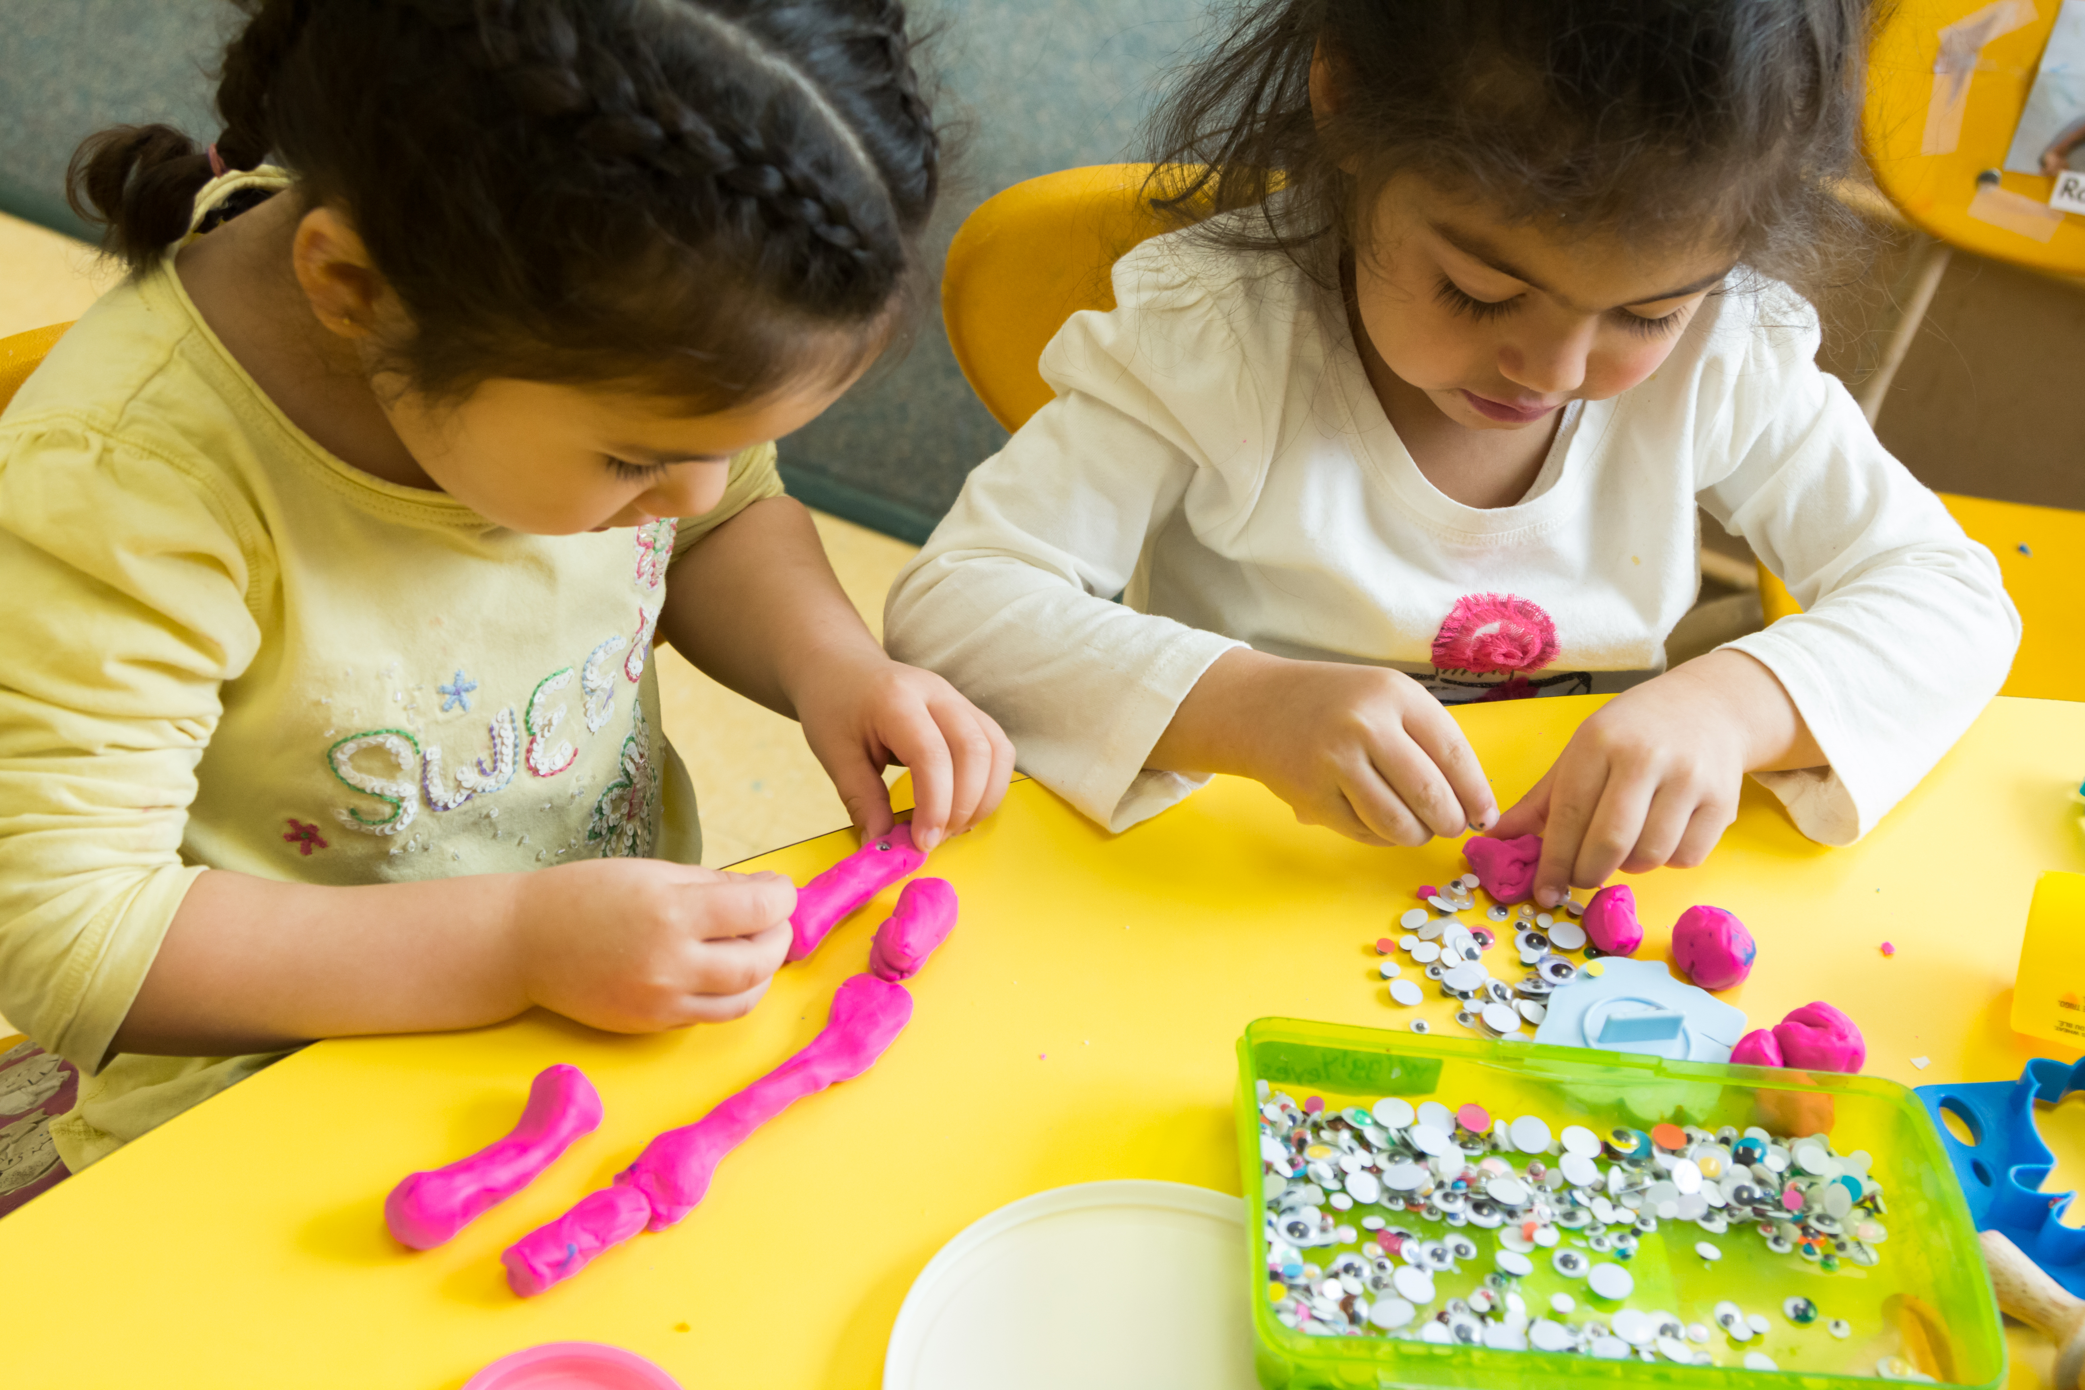
Influences on Child Engagement
Attention span
Alertness level
Adult availability
Sufficient time

Slide 7
Components OF A SCHEDULE
Blocks
of time
Sequence
of time
Group time
Activity/center time
Meals
Outdoor time
Story time
Classroom activities
Classroom routines

Slide 8
Balance
Requirements
Active/quiet activities
Small/large groups
Teacher-directed/ Child-initiated

Slide 9
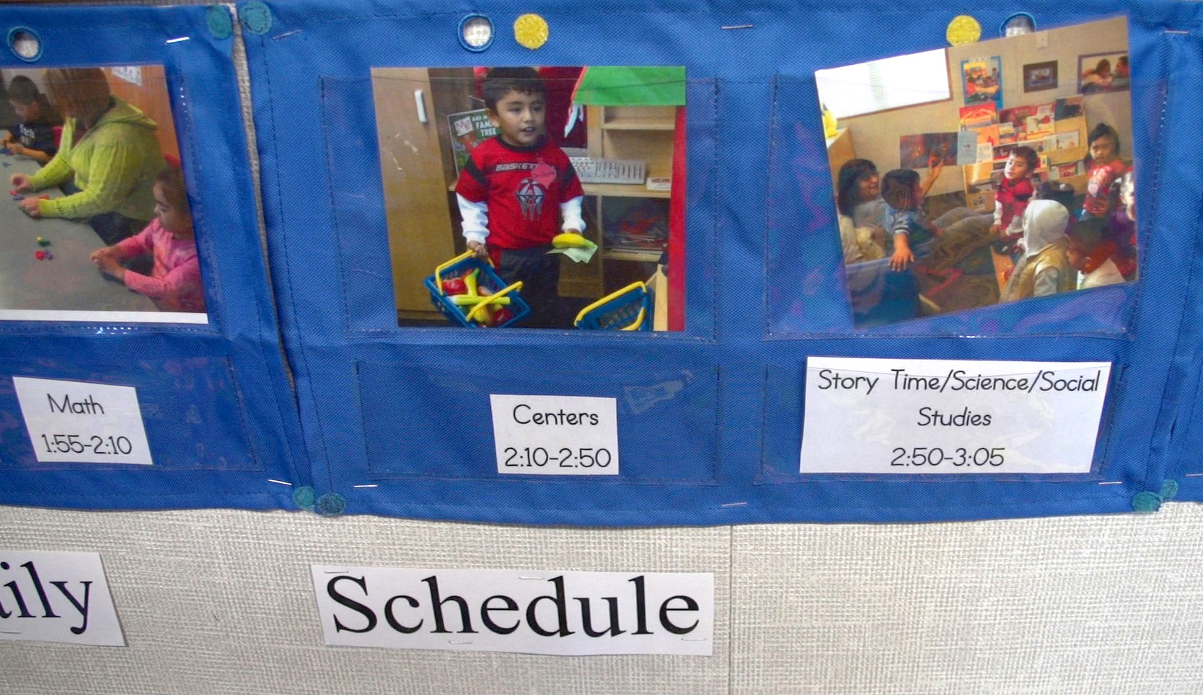
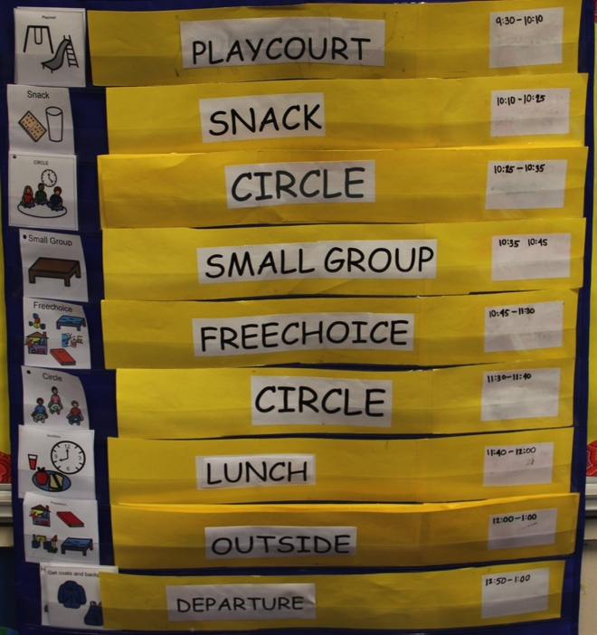
Examples of schedules

Slide 10
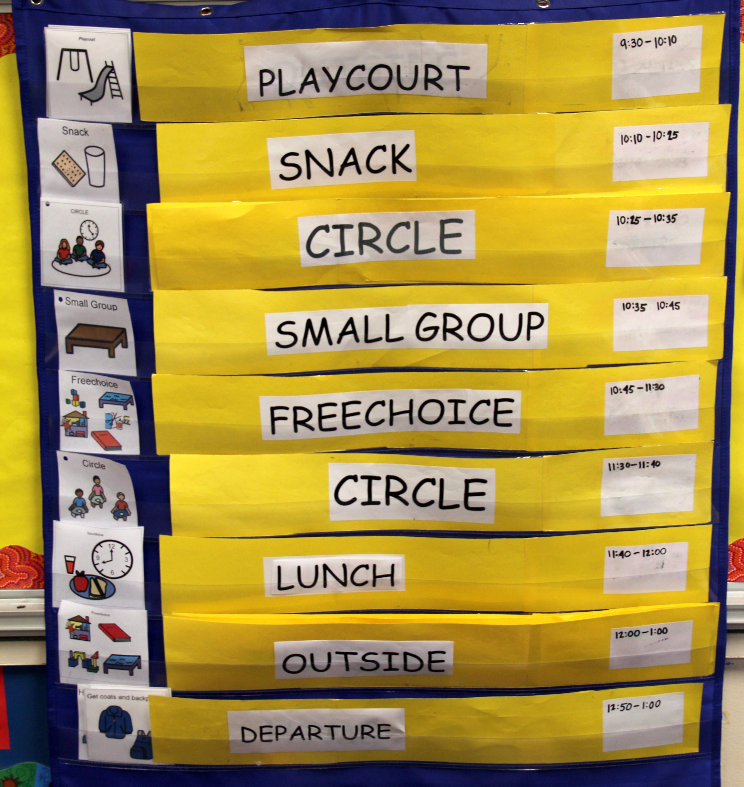
Teaching the schedule
Post the schedule.
Follow the schedule consistently.
Teach the schedule so ALL children understand.
Individualize instruction.
Encourage children’s efforts.

Slide 11
Changes to the Schedule
Prepare children ahead of time
Announce at large group
Provide visual supports
Gently remind children often

Slide 12
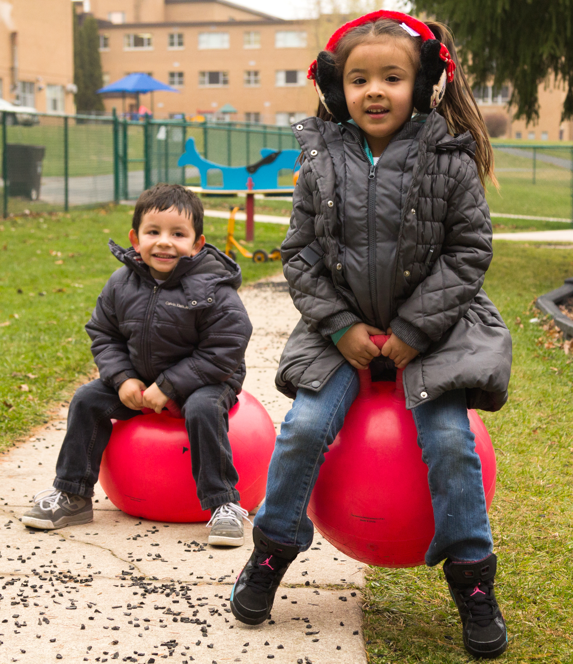
Routines
Series of behaviors
Include:
Clean–up
Meal times
Arrival/departure
Occur regularly

Slide 13
Teaching Routines
Provide model
Provide visual supports
Provide positive feedback

Slide 14
Review
Classroom schedules and routines:
Foster engagement
Meet the needs of children
Promote a safe and fun environment
Schedules:
Blocks of time
Balanced
Sequenced
Posted and taught
Routines:
A series of behaviors that occur regularly
May be posted and taught

Slide 15
FALL 2013

