Slide 1
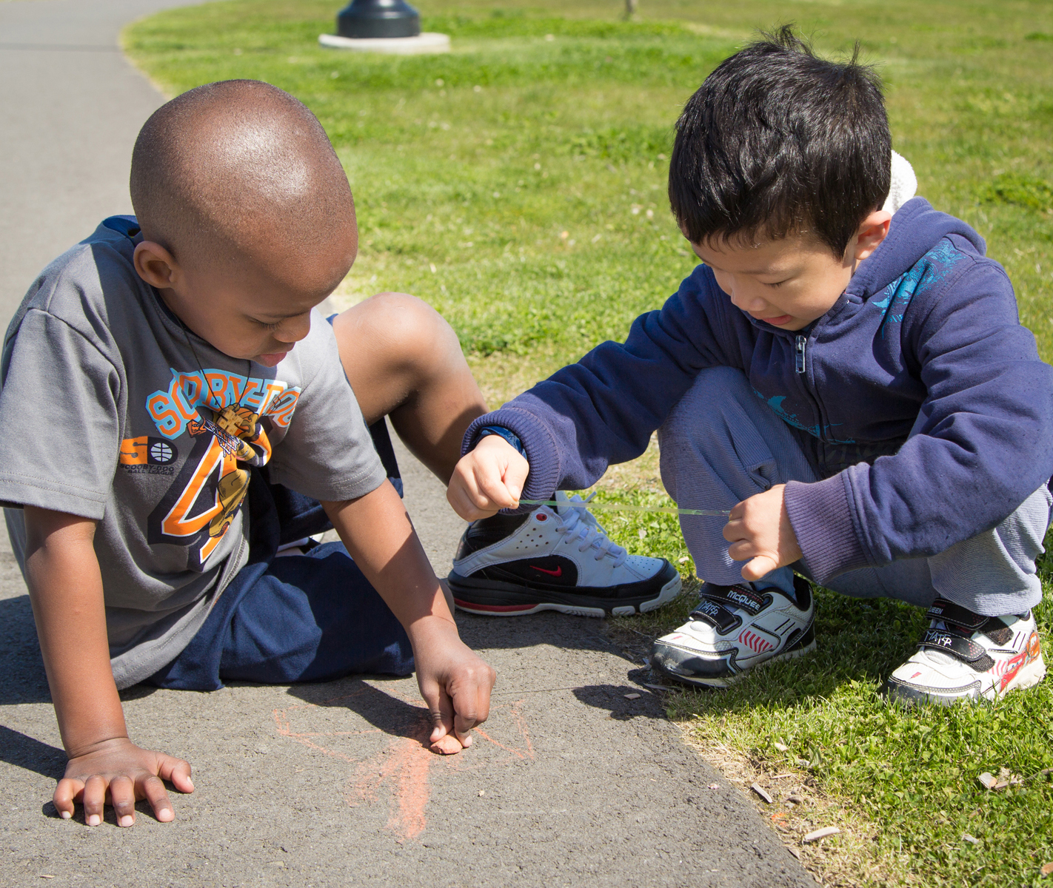


Managing the classroom:
CLASSROOM transitions
FALL 2012

Slide 2
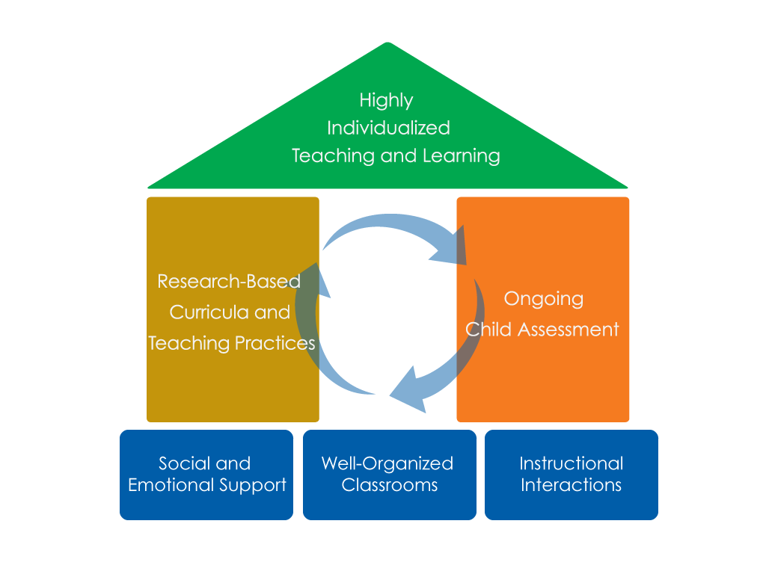
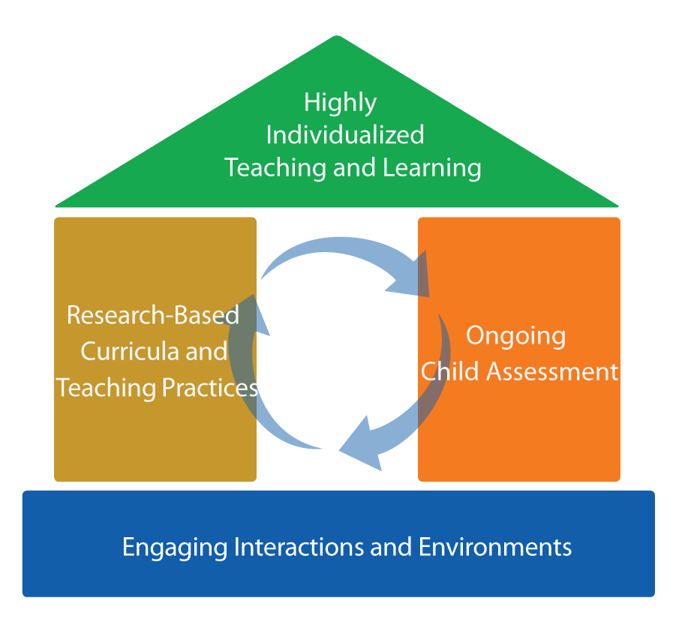
FRAMEWORK FOR EFFECTIVE PRACTICE
SUPPORTING SCHOOL READINESS FOR ALL CHILDREN
FOCUS ON
FOUNDATION

Slide 3
Objectives
To discuss the importance of smooth transitions
To outline effective strategies for smooth transitions

Slide 4
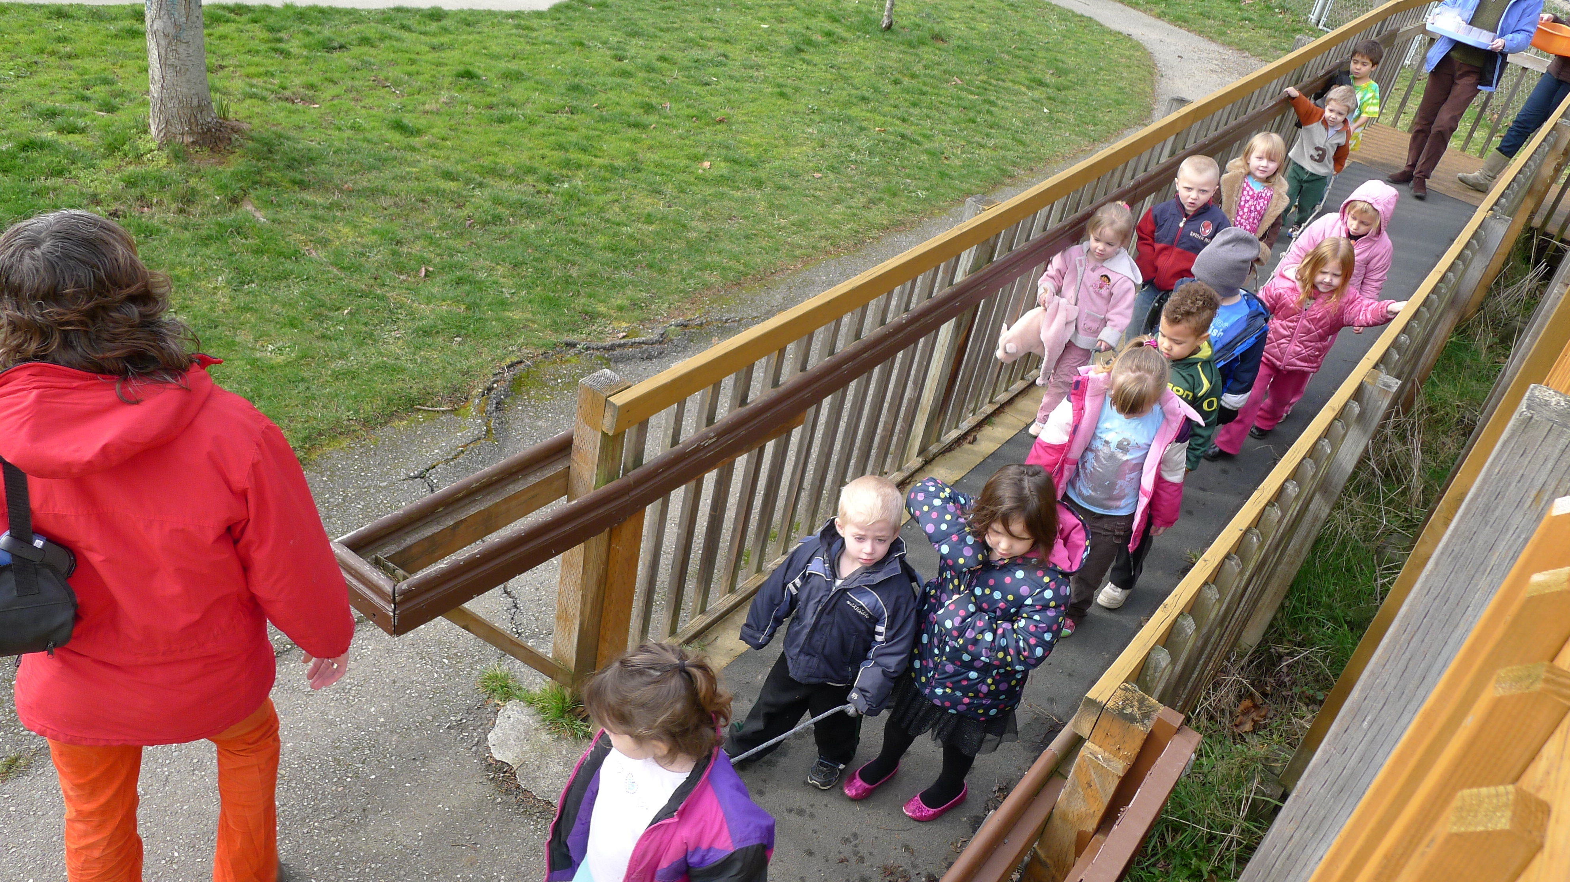
TRANSITIONS BETWEEN ACTIVITIES
Transition refers to a change between:
Activities
Multiple settings
Programs.

Slide 5
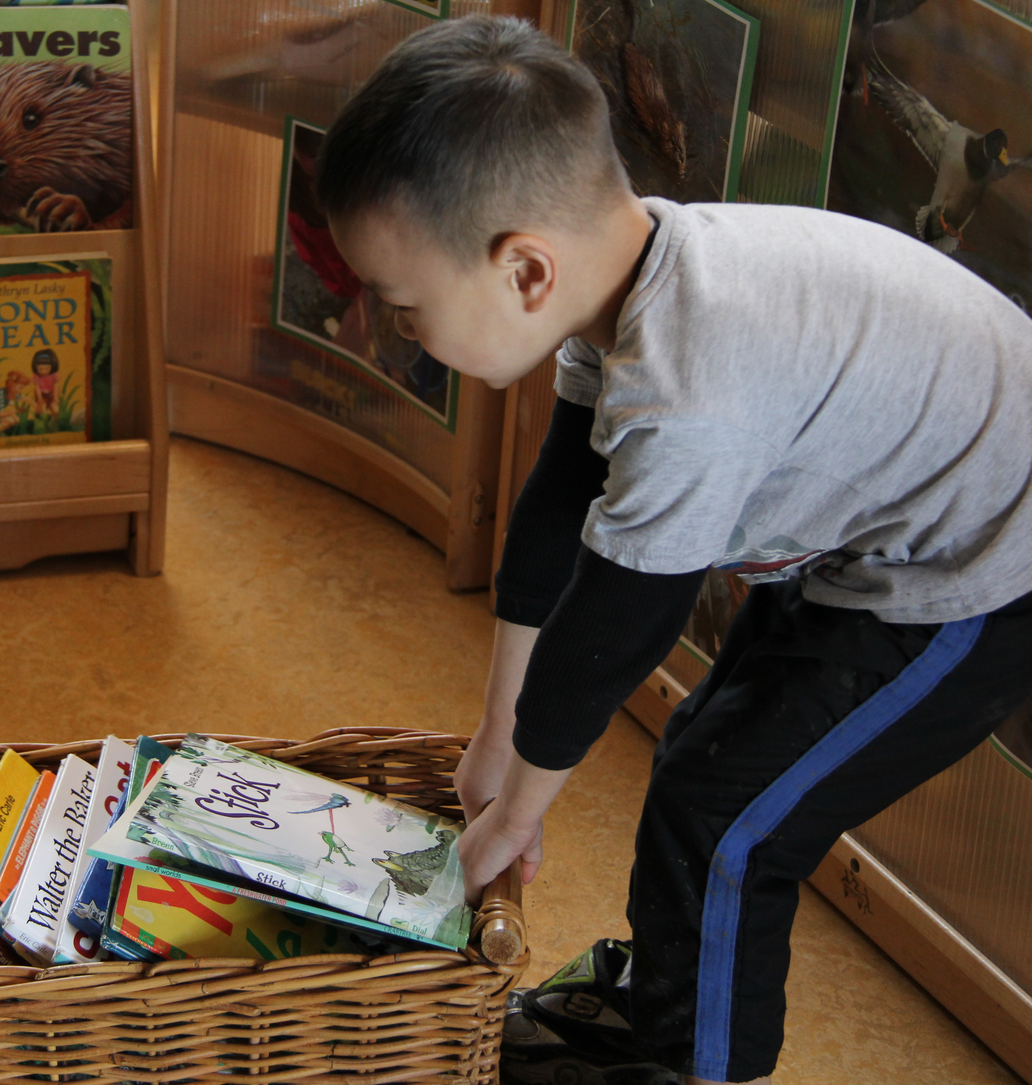
Why is it important?
Transitions are time
consuming.
Idle waiting =
challenging behavior.
They can be stressful
and frustrating.
The ability to transition
is a critical skill.

Slide 6
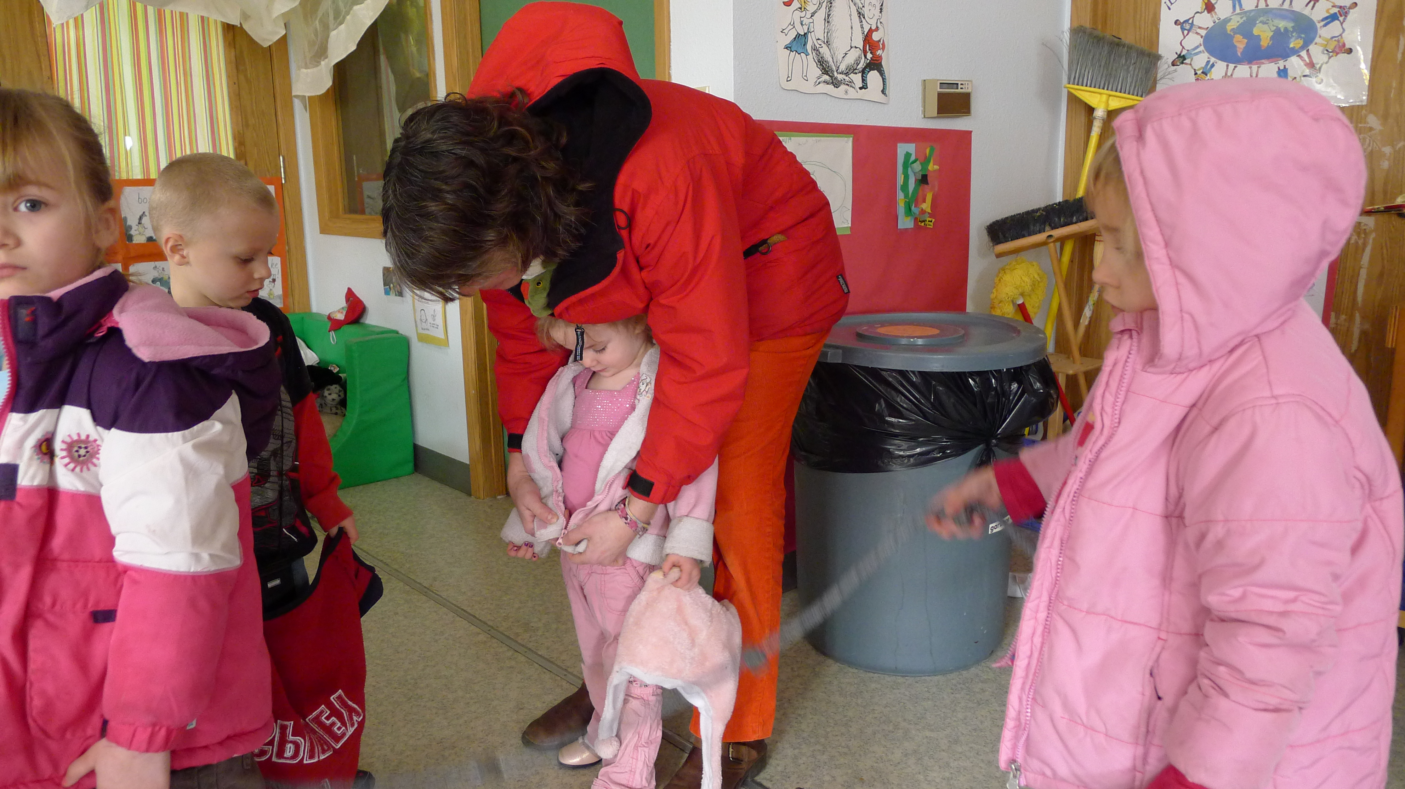
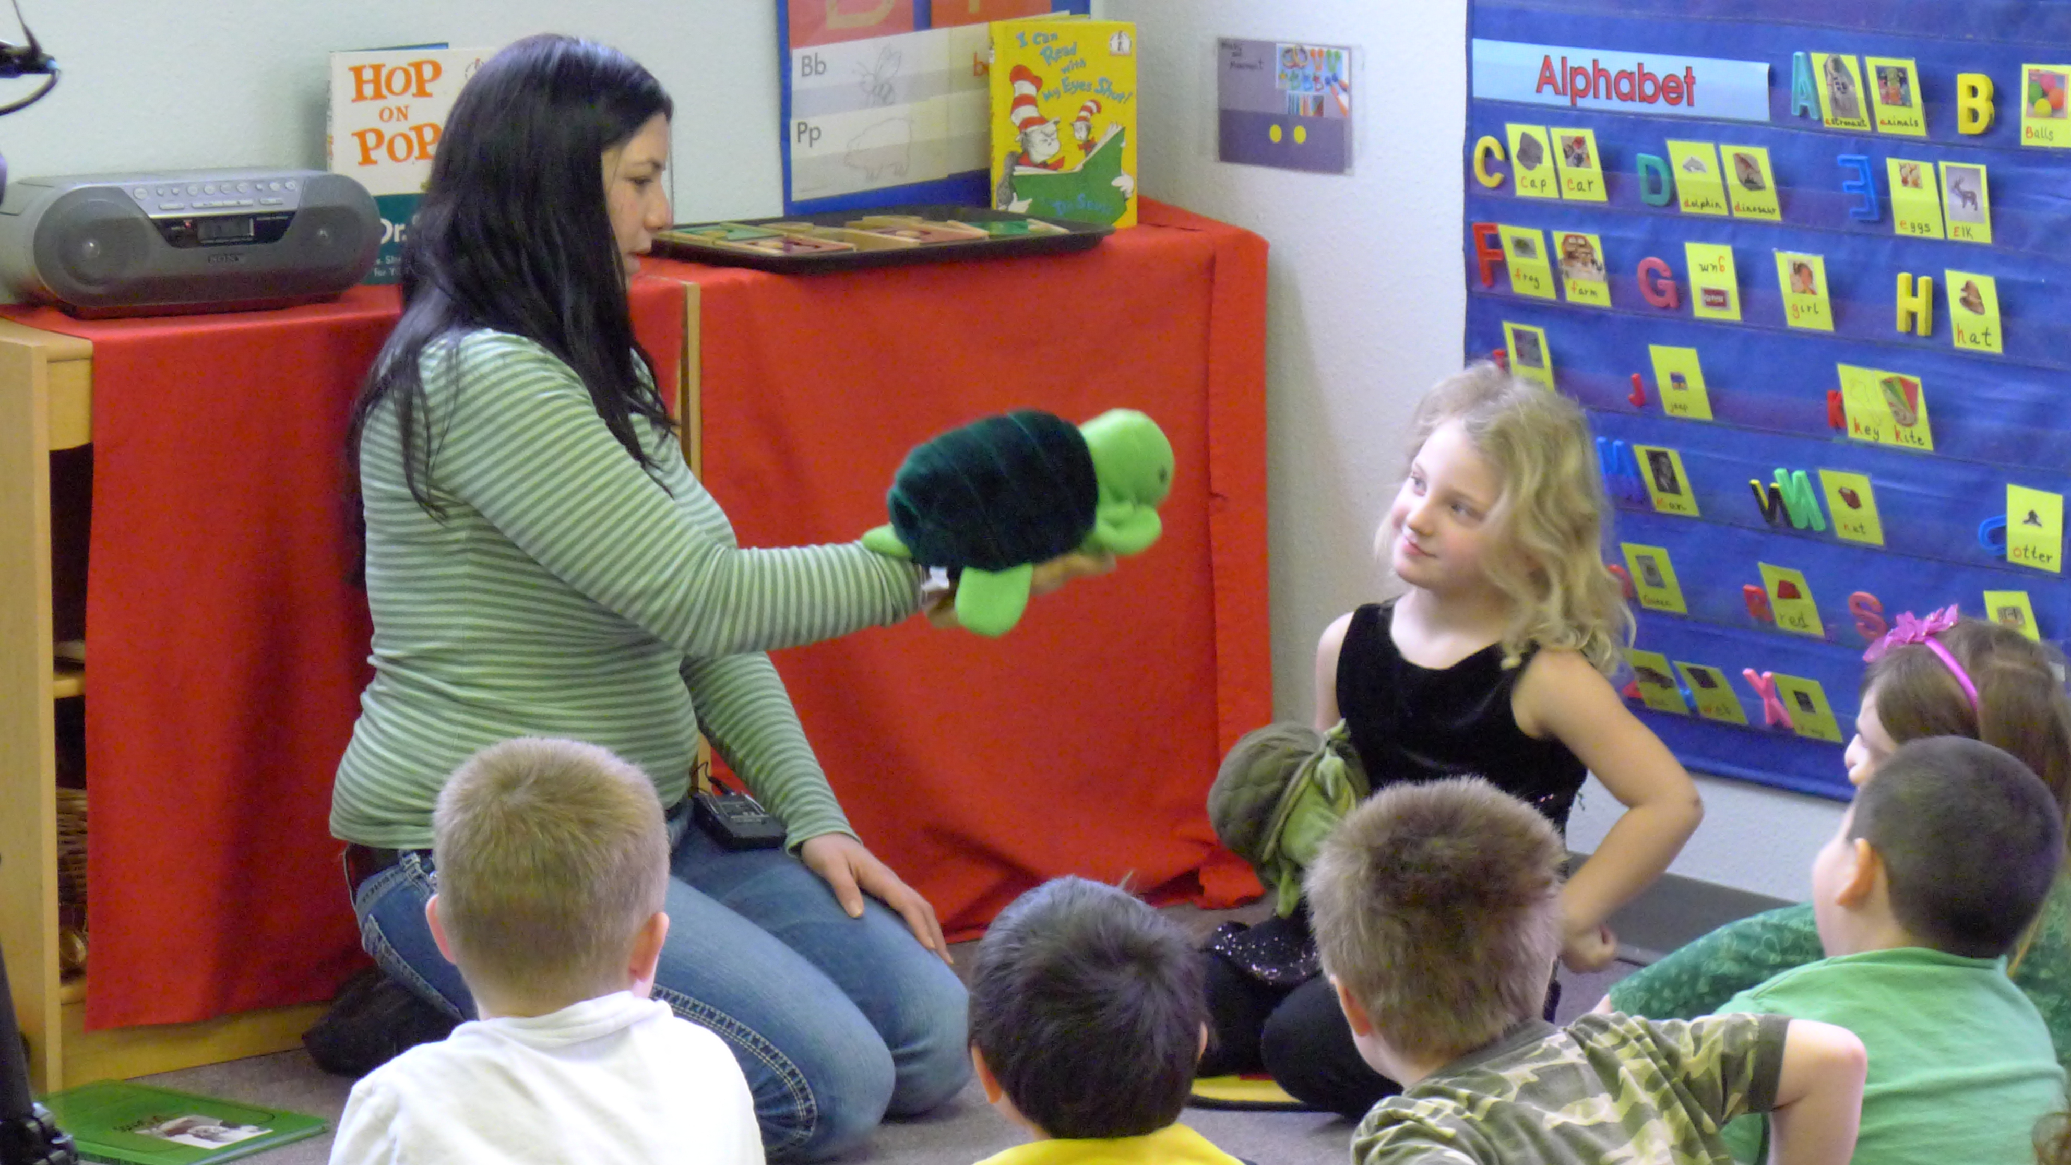
Strategies to support Transitions: Before the transition
Minimize the number of transitions.
Plan for what adults will
do during transition times.
Teach children the
expectations.
Provide verbal and
nonverbal cues.

Slide 7
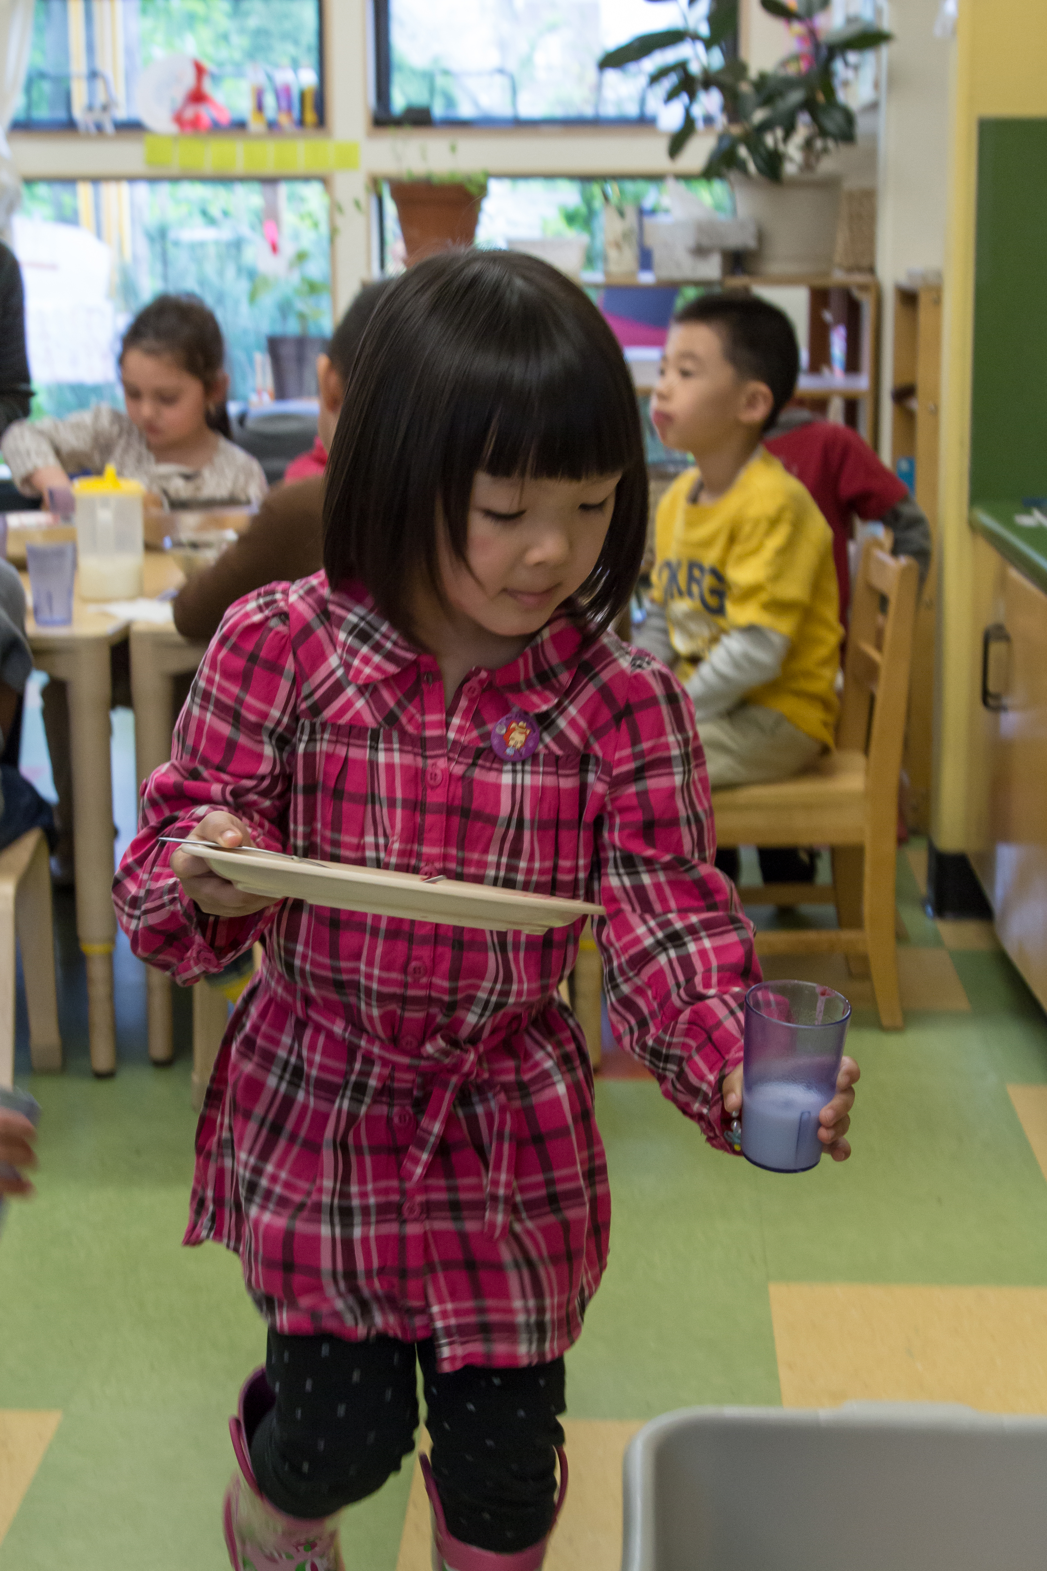
Strategies to support Transitions: During the transition
Engage children.
Allow time to finish projects.
Plan for “quick” finishers.
Individualize support.

Slide 8
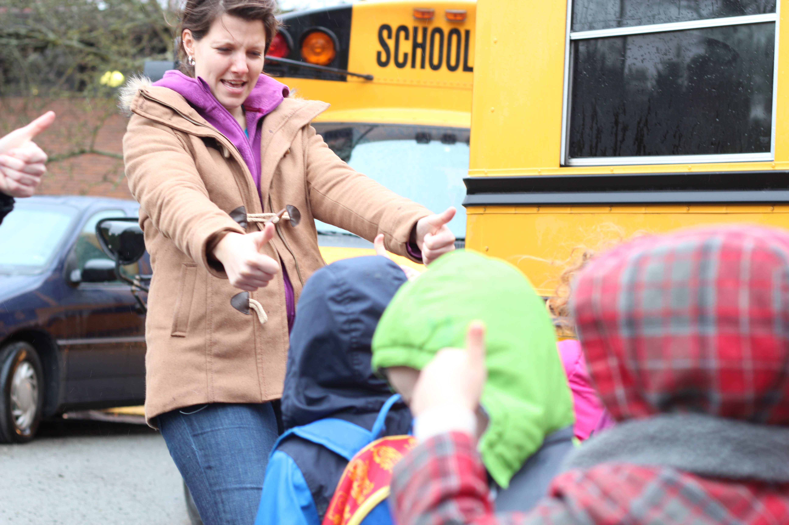
Strategies to support transitions: After the transition
Provide positive attention and feedback to
children.

Slide 9
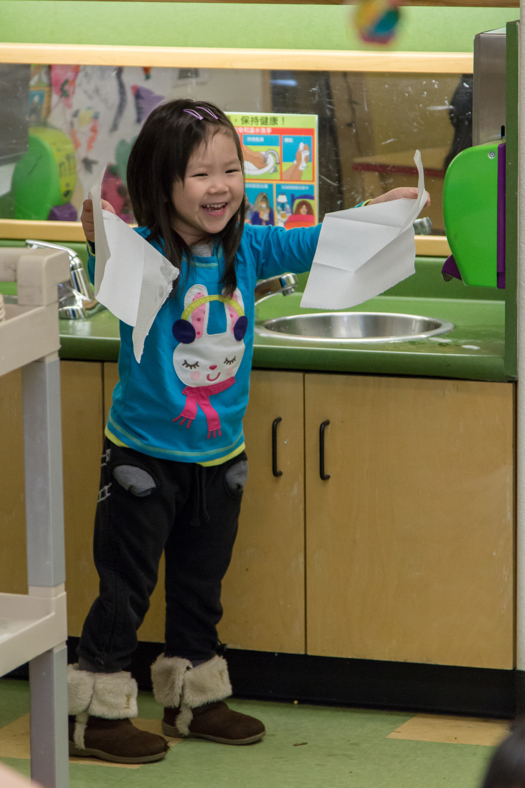
Promote independence during transitions
Allow children to
transition independently.
Teach children to
help one another.
Help children
self-monitor during transitions.

Slide 10

Designing early childhood classroom
The rooms in this video are used everyday with children.
As you watch the video, reflect on both the strengths and limitations you see.

Slide 11

Designing early childhood classroom
The rooms in this video are used everyday with children.
As you watch the video, reflect on both the strengths and limitations you see.

Slide 12
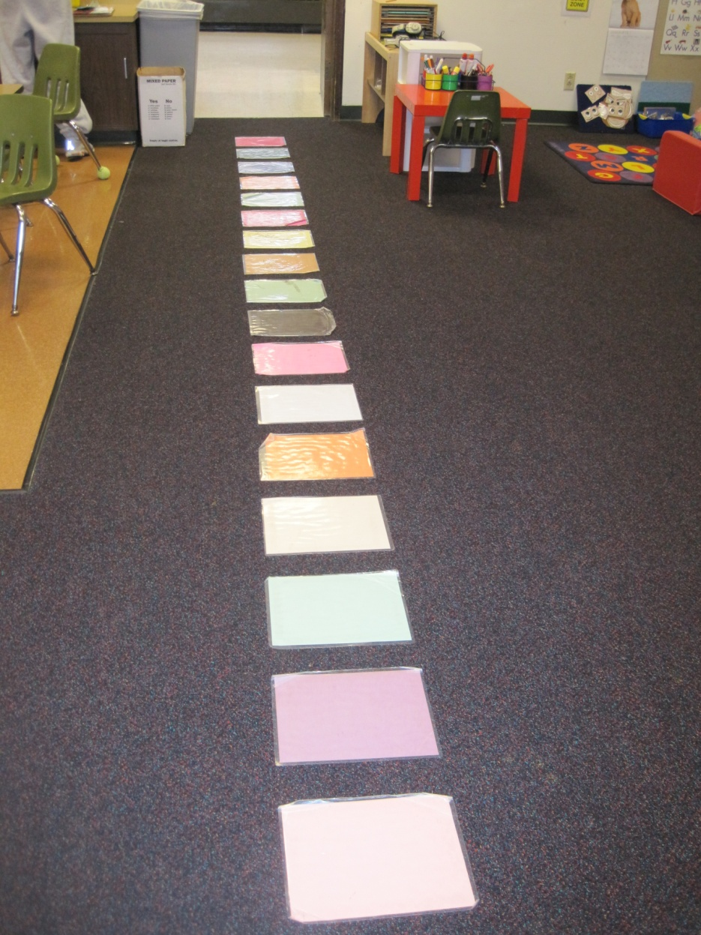
SMOOTH TRANSITIONS:
ENVIRONMENTAL SUPPORT

Slide 13
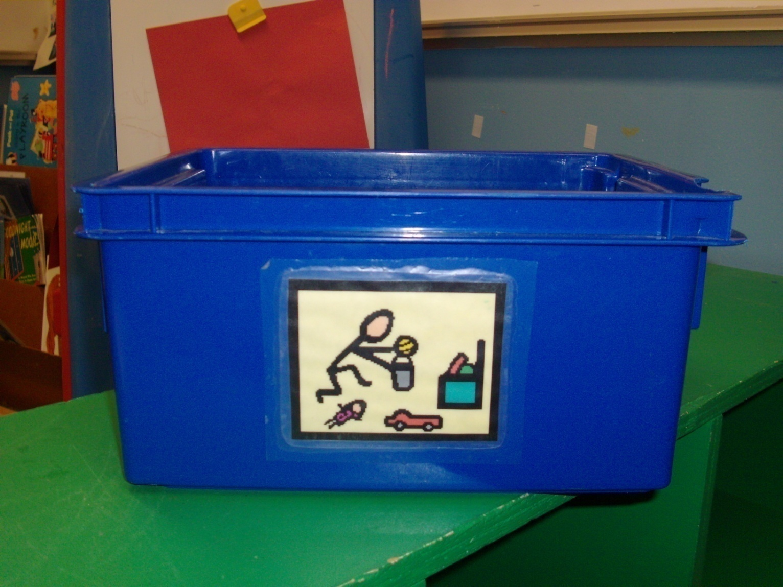
SMOOTH TRANSITIONS:
MATERIALS ADAPTATIONS

Slide 14
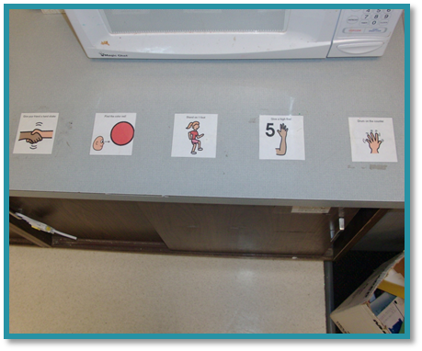
SMOOTH TRANSITIONS:
ENVIRONMENTAL SUPPORT

Slide 15
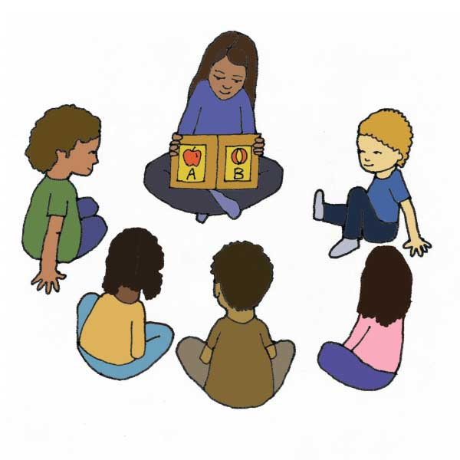

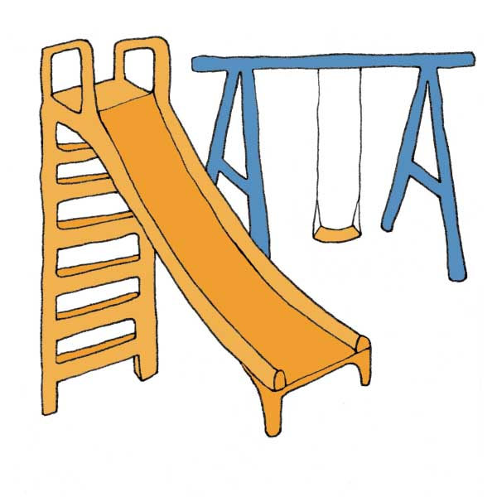
SMOOTH TRANSITIONS: VISUAL SUPPORTS
Transition Cue Cards
See the http://www.HeadStartInclusion.org website for more transition cue cards.

Slide 16
REVIEW
Smooth transitions can reduce stress and frustration for children and teachers.
Transitions should be planned to include what occurs before, during and after transitions.
Teachers should promote independence
in transitions between activities.
Transition procedures should be individualized
as needed.

Slide 17
FALL 2012

