Slide 1

Notes:
Name of video: Teacher Talk: A Necessity
Key idea: Communicating regularly verbally and non-verbally
Summary: A teacher describes two ways she and a co-teacher communicate throughout the day: verbally and non-verbally.
Length of video: 46 seconds
Suite name: Teacher-to-Teacher Talk

Slide 2
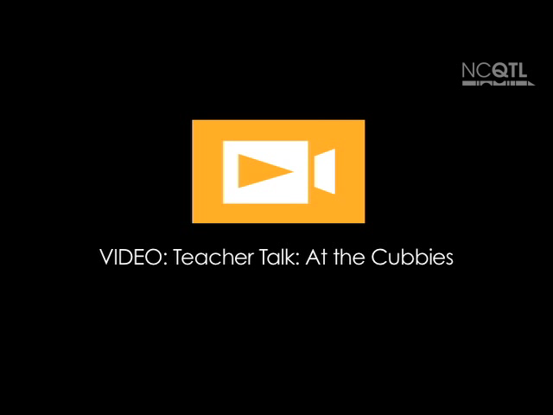
Notes:
Name of video: Teacher Talk: At the Cubbies
Key ideas: Talking about coordinating classroom activities; using respectful language
Summary: During transition, a lead teacher asks a teacher to give a message to another teacher who is at different location.
Length of video: 16 seconds
Suite name: Teacher-to-Teacher Talk

Slide 3

Notes:
Name of video: Teacher Talk: Modeling for Children
Key idea: Modeling positive rapport and working as a team
Summary: A teacher explains why teacher-to-teacher talk is important and how the teachers model positive relationships for children.
Length of video: 30 seconds
Suite name: Teacher-to-Teacher Talk

