Slide 1
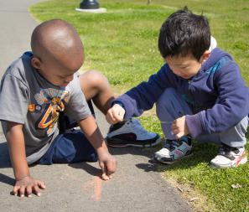
STAFFING: TEACHER-TO-TEACHER TALK
FALL 2012

Slide 2
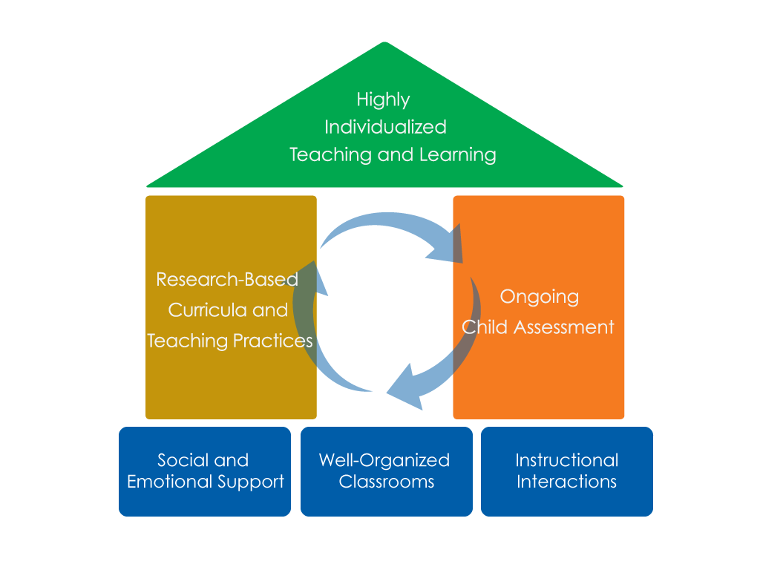
FRAMEWORK FOR EFFECTIVE PRACTICE SUPPORTING SCHOOL READINESS FOR ALL CHILDREN
FOCUS ON
FOUNDATION

Slide 3
OBJECTIVES
To discuss the purposes of communication among the teaching team
To understand how teachers talk with each other to support teaching and learning

Slide 4
Teacher-to-Teacher Talk VIDEO!!
What does teacher-to-teacher talk look like?

Slide 5
DEFINITION: TEACHER-TO-TEACHER TALK
Teacher-to-teacher talk is
the daily, purposeful communication between adults in a learning environment that occurs to ensure teaching and learning are provided in an effective and efficient manner.

Slide 6
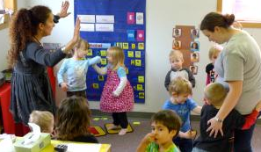
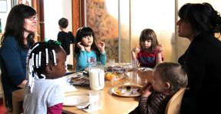
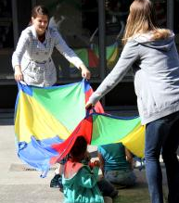
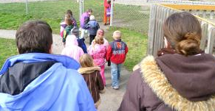
TEACHER-TO-TEACHER TALK DURING THE DAY
Inside the classroom
Meal times
Outdoor times
Transitions
Throughout the day!

Slide 7
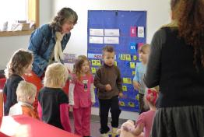
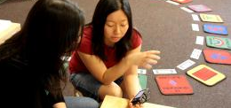
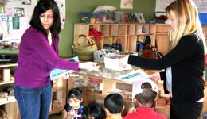
WHY DO TEACHERS TALK TO EACH OTHER?
To ensure consistency with classroom routines and expectations
To share information
To develop/maintain a sense of teamwork

Slide 8
Supporting each other VIDEO!!

Slide 9
WHAT DO TEACHERS TALK ABOUT?
Children’s interests
Teaching
practice
Facilitating children’s positive behavior
Children’s learning objectives
Adaptations to improve instruction

Slide 10
WHAT ELSE DO TEACHERS TALK ABOUT?
Coordinating classroom activities
Transitions
Materials
Work loads
Paperwork and documentation
Child observations
Required forms such as attendance
Lesson planning

Slide 11
SHARING TEACHING PRACTICE

Slide 12
HOW DO TEACHERS TALK TO EACH OTHER?
Use language that implies teamwork.
Express warmth, caring and respect in your interactions.
Bring awareness of non-verbal cues.
It’s
how you say it!

Slide 13
Complimenting another teacher VIDEO!!

Slide 14
Friendly direction VIDEO!!

Slide 15
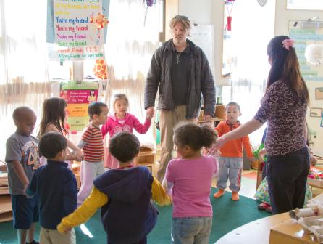
REVIEW: TEACHER-TO-TEACHER TALK
Teachers purposely use Teacher-to-Teacher Talk to:
Ensure consistency.
Share information.
Maintain a sense of teamwork.
What you say and how you say it are both important!

Slide 16
FALL 2012

