Slide 1
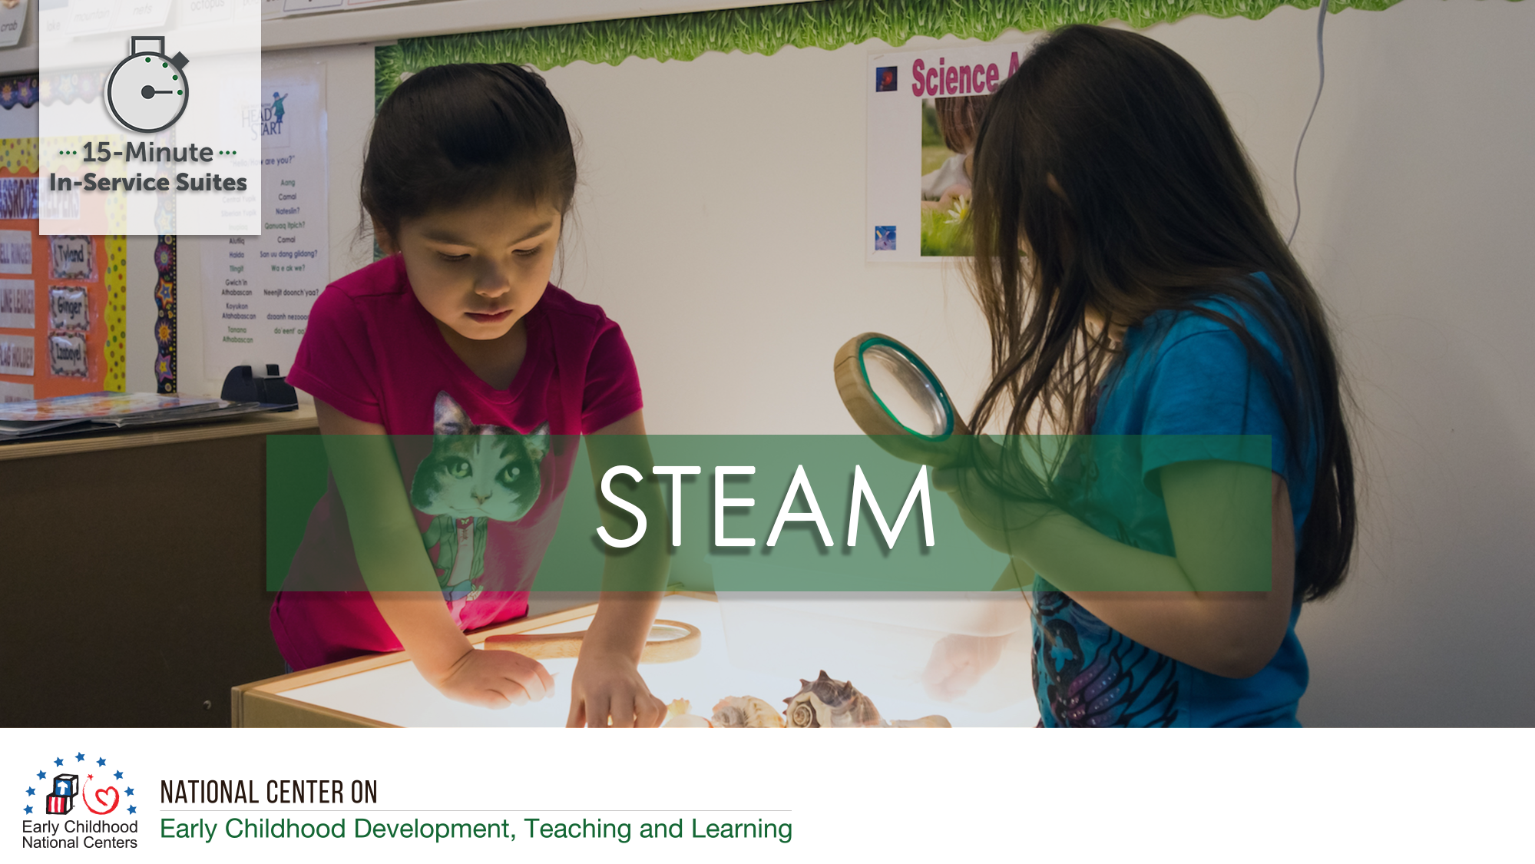

Slide 2
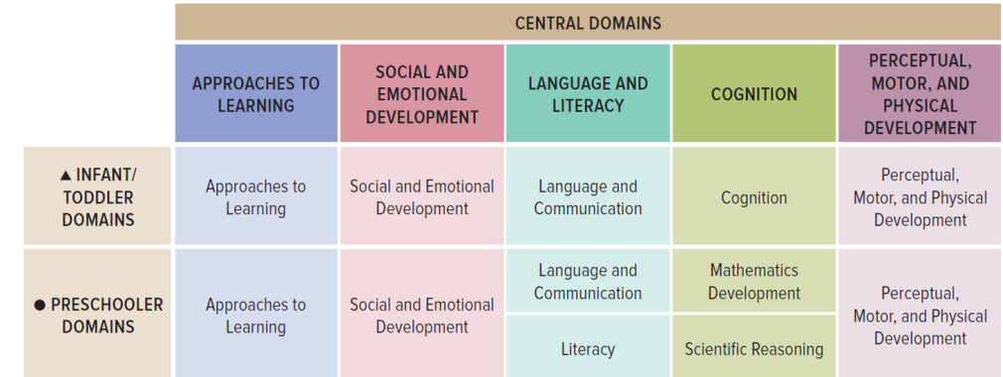
STEAM Stretches Across the ELOF Domains

Slide 3
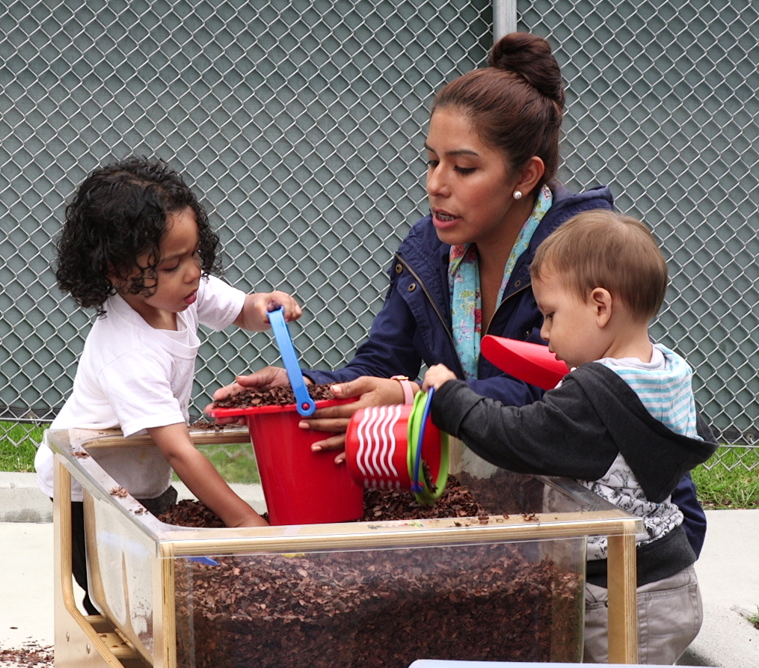
STEAM Stretches Across the ELOF Domains
Cognition (Infant/Toddler)
  Exploration and Discovery
  Memory
  Reasoning and Problem-Solving
Cognition(Preschooler)
    Mathematics Development
    Scientific Reasoning
Approaches to Learning
Social and Emotional Development
Language and Communication
Perceptual Motor and Physical Development
Notes:
OPTIONAL

Slide 4


Slide 5
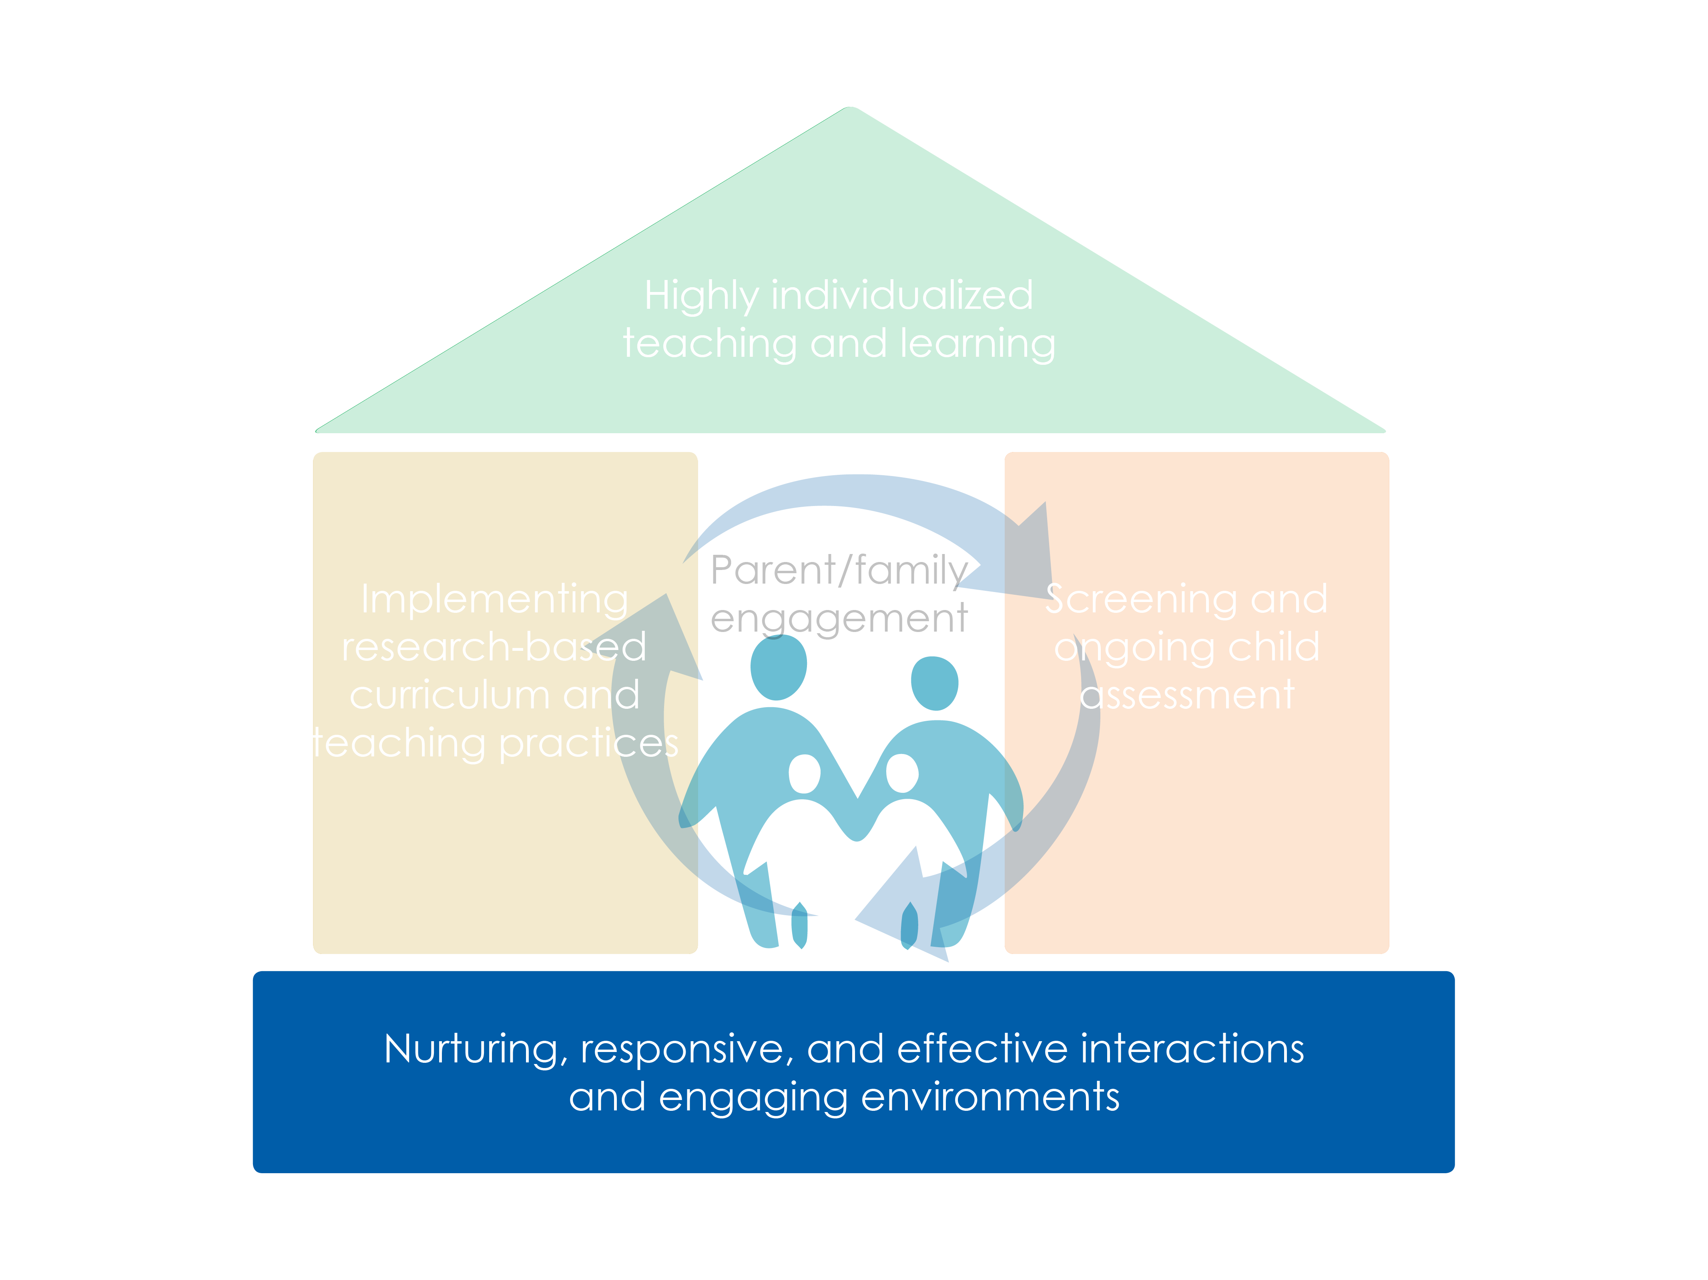

Slide 6
Objectives
Identify ways infants, toddlers, and preschoolers naturally engage in inquiry, reasoning, and problem solving through every day routines and learning opportunities
Describe how the STEAM components share a common approach and focus
Provide strategies to support children’s inquiry and STEAM skills in the early education setting and at home

Slide 7




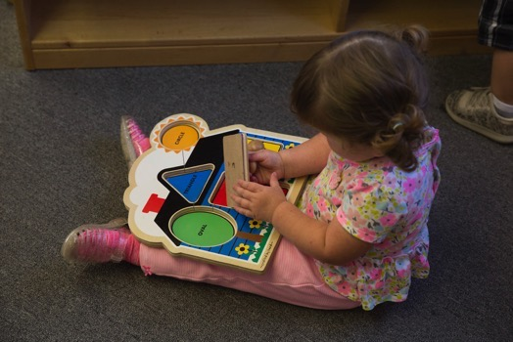
What is STEAM?
Science
Technology
Engineering
Art
Math

Slide 8

STEAM is for Everyone
STEAM is about how people explore the world, not which facts they know.

Slide 9
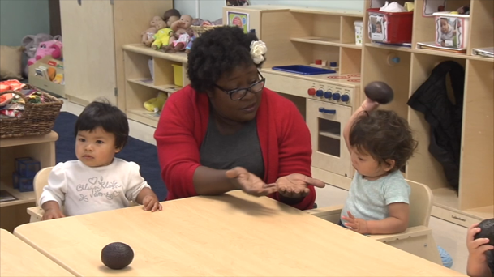

STEAM is All Around

Slide 10

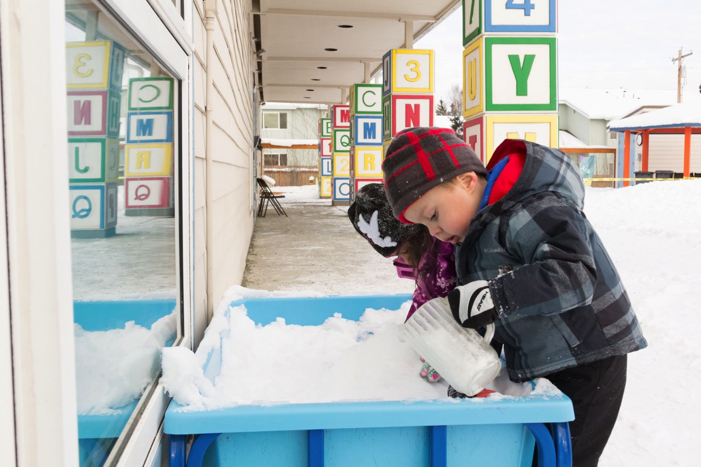
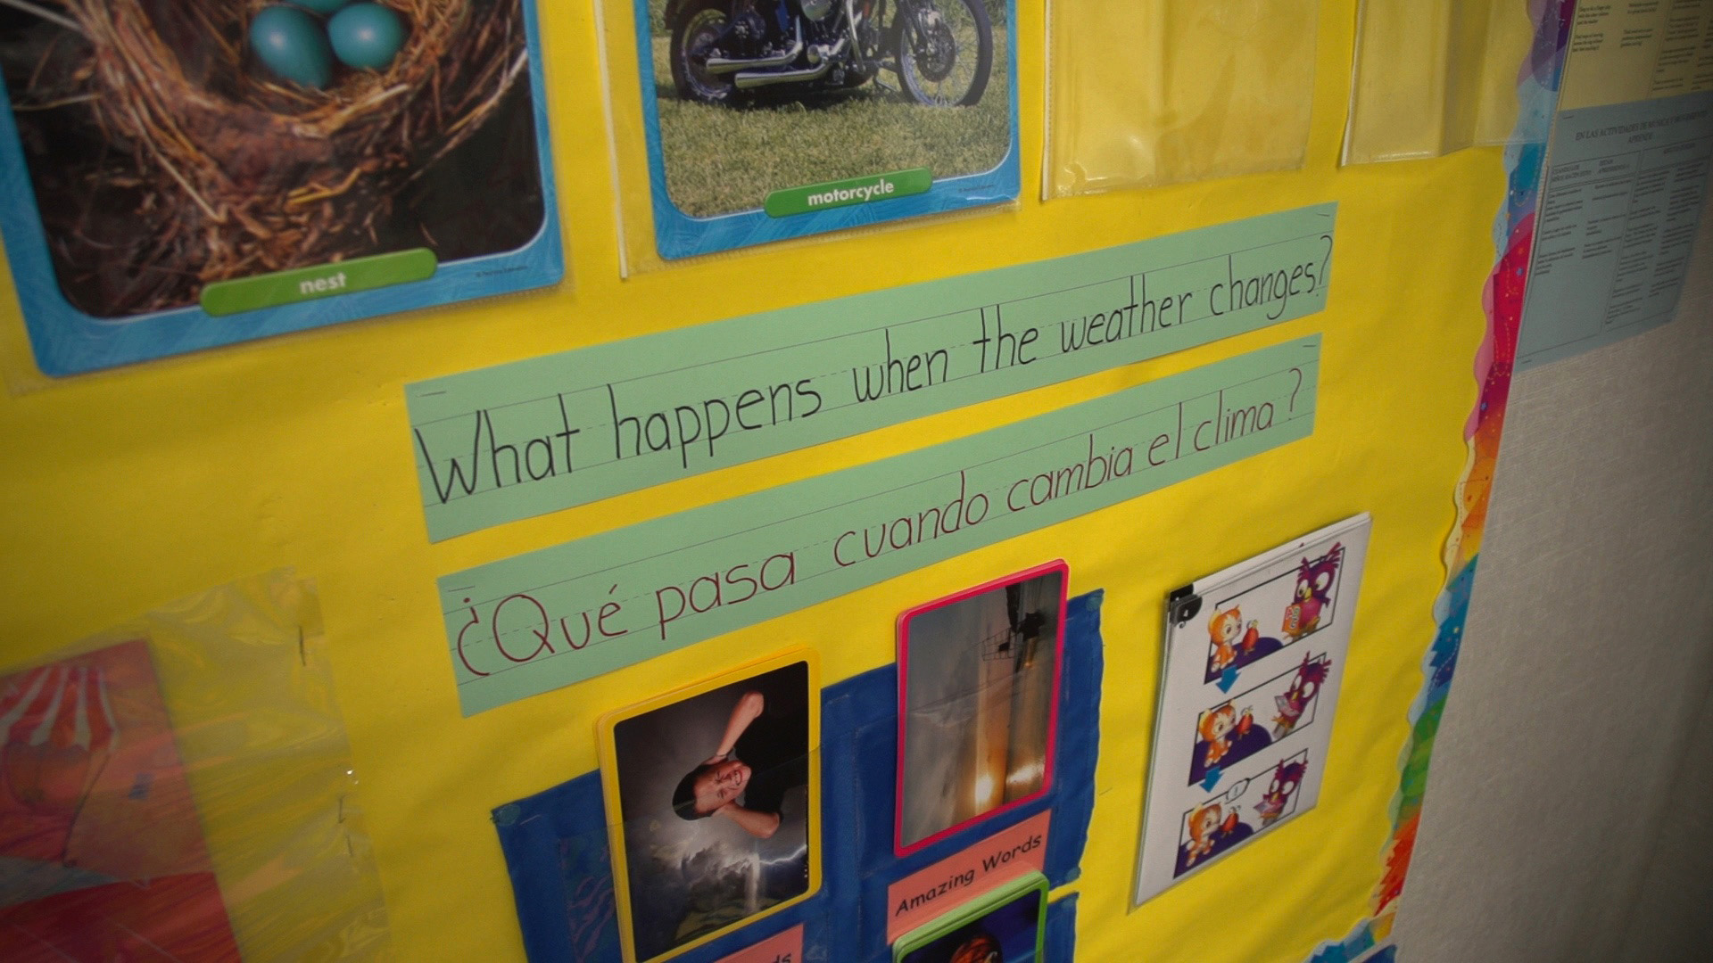
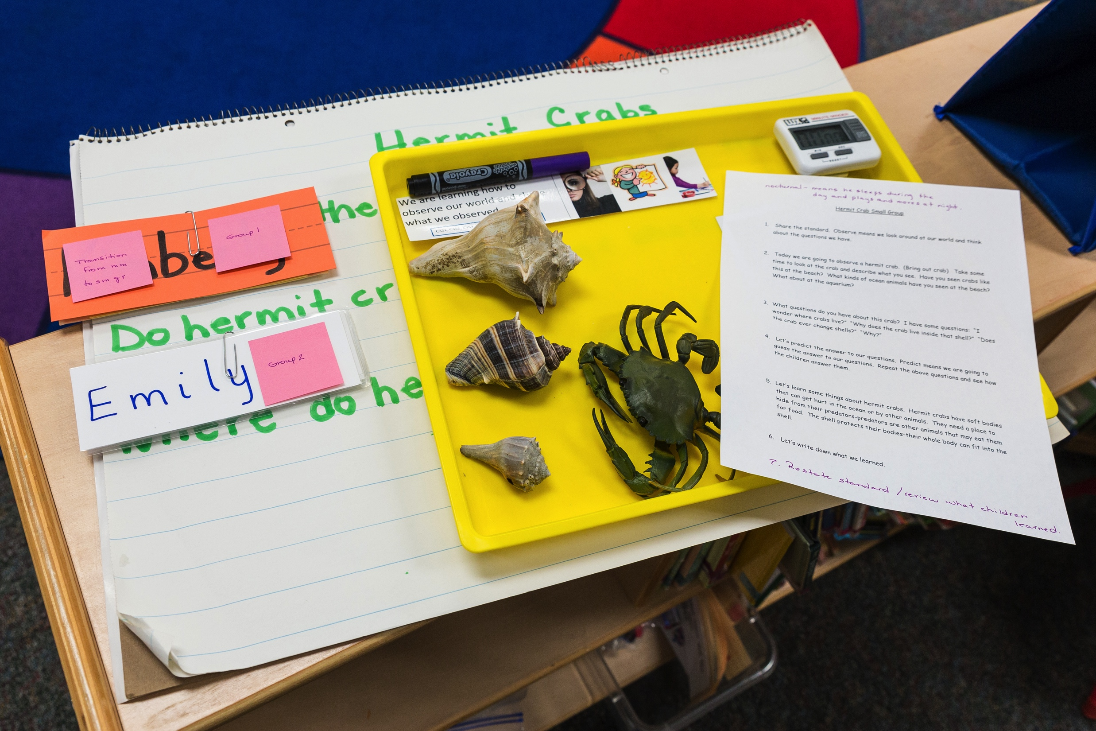
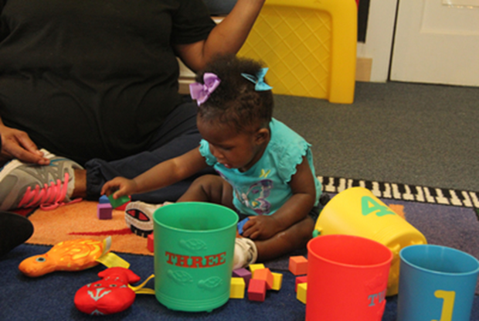
A Common Approach and Focus
STEAM Mindset
STEAM Knowledge
Language of STEAM
STEAM-related Skills

Slide 11

STEAM Mindset

Slide 12
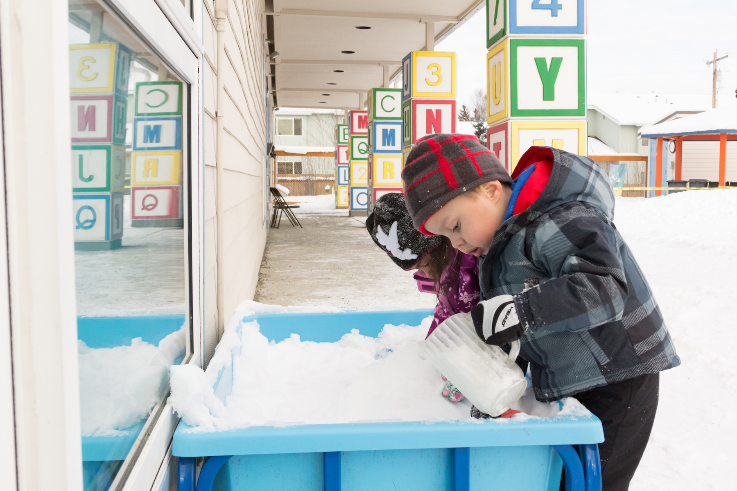
STEAM Knowledge

Slide 13
Language of STEAM

Slide 14

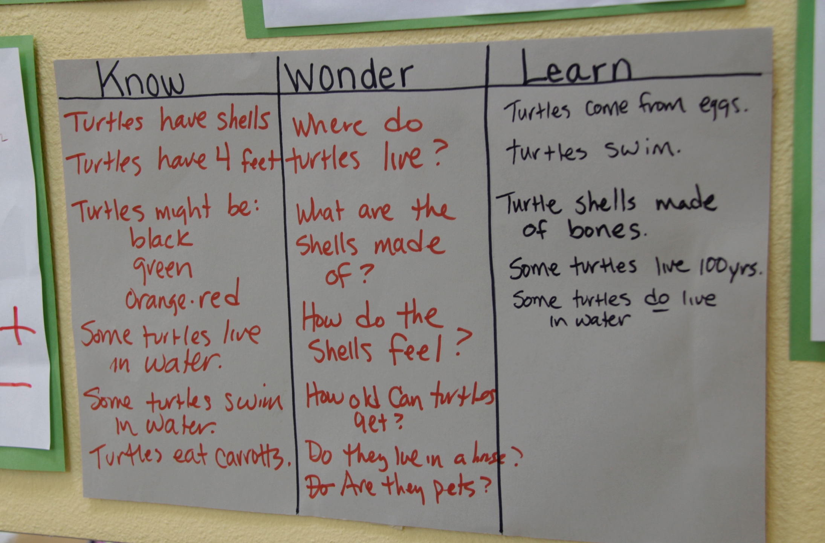
Speak The Language Of STEAM
Observe, observation
Question
Predict, prediction
Similar, different
Compare, contrast
Measure
Count
Investigate
Explore
Experiment
Test
Discover
Record
Explain
Hypothesize, hypothesis, guess
Notes:
OPTIONAL

Slide 15

STEAM-related Skills

Slide 16



How We Can Support STEAM Learning
Engaging
Environments
Nurturing, Responsive, & Effective Interactions
Learning Experiences / Activities

Slide 17
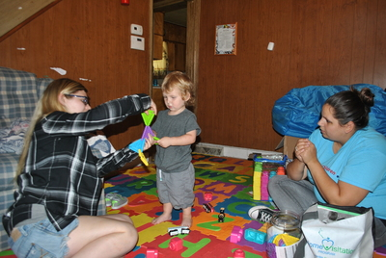
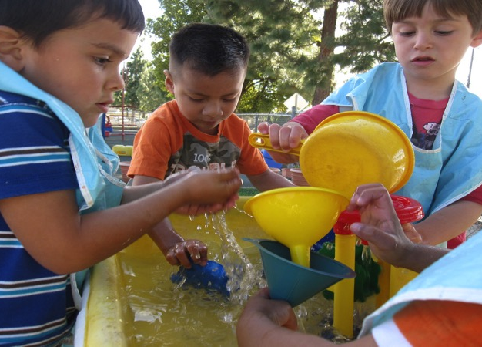


Engaging Environments
Provide open-ended materials
Engage the senses
Consider children’s developmental levels
Use a variety of materials
Pay attention to children’s interests
Arrange materials so they are accessible

Slide 18
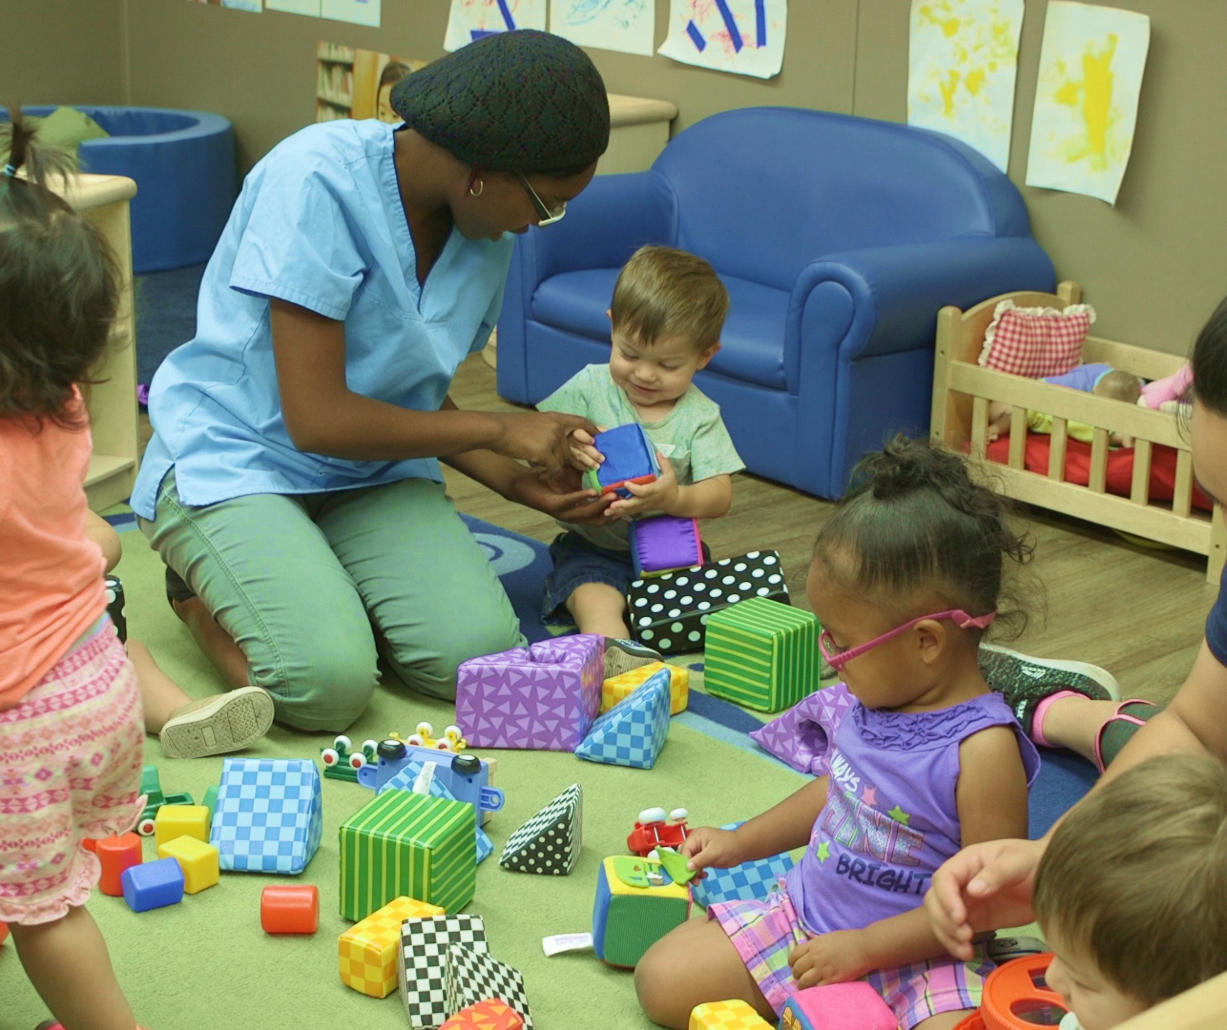

Nurturing, Responsive, & Effective Interactions

Slide 19
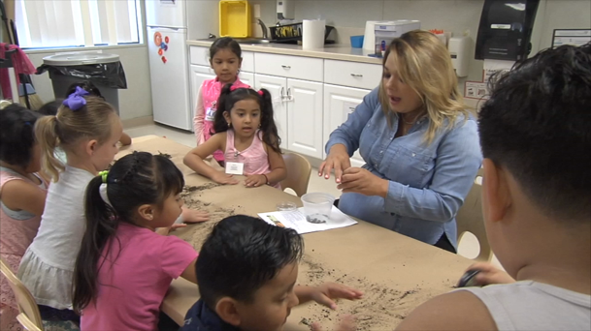
Learning Experiences/Activities

Slide 20

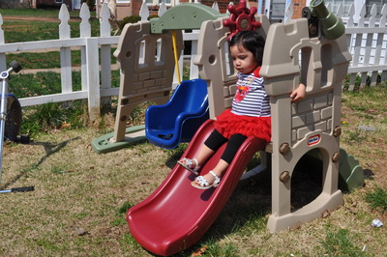

Learning Activity: STEAM in Everyday
Experiences & Activities

Slide 21


Review

