Slide 1
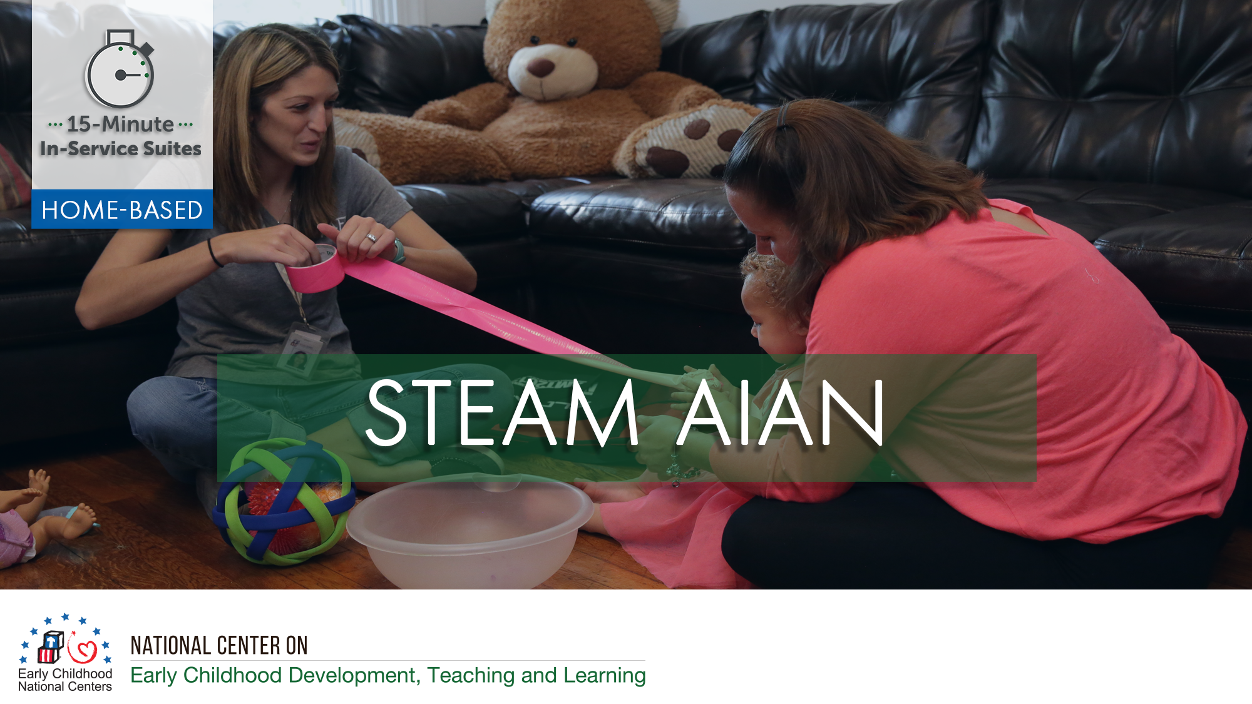
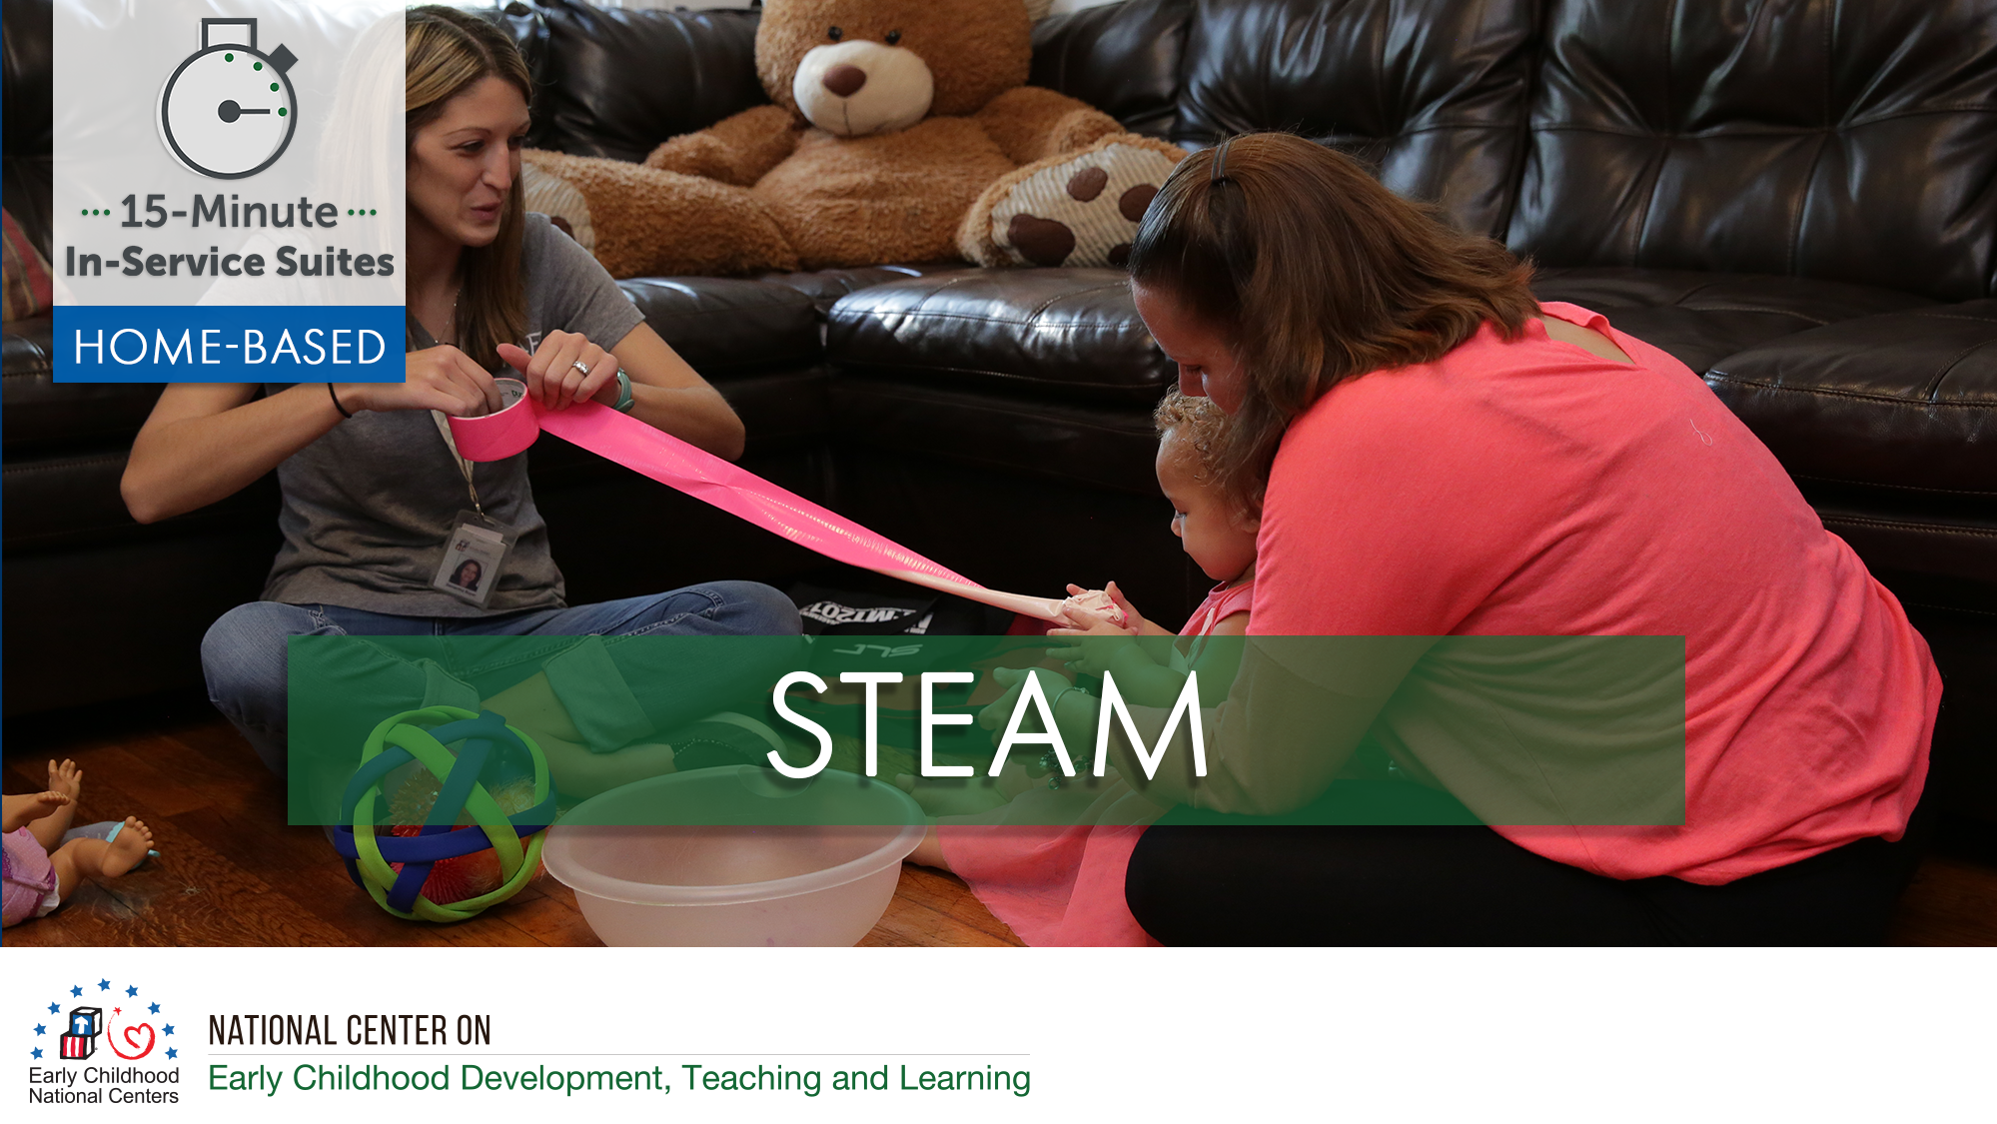

Notes:
Optional HV Slide 1
Opening Slide

Slide 2
HSPPS Support STEAM
Subpart C – Education and Child Development Program Services
1302.30 Purpose
A program must deliver developmentally, culturally, and linguistically appropriate learning experiences in language, literacy, mathematics, social and emotional functioning, approaches to learning, science, physical skills, and creative arts.
Notes:
Optional Slide 2

Slide 3
HSPPS Support Language and Culture
Subpart C – Education and Child Development Program Services
1302.36 Tribal language preservation and revitalization
A program that serves American Indian and Alaska Native children may integrate efforts to preserve, revitalize, restore, or maintain the tribal language for these children into program services. Such language preservation and revitalization efforts may include full immersion in the tribal language for the majority of the hours of planned class operations.
Notes:
Optional Slide 2

Slide 4
HSPPS Support Language and Culture
ACF-IM-HS-15-02 Native Language Preservation, Revitalization, Restoration, and Maintenance in Head Start and Early Head Start Programs
“OHS strongly supports the full integration of AIAN languages and culture in their Head Start and Early Head Start programs, including the use of language immersion, dual language, and other proven approaches…”
Notes:
Optional Slide 4

Slide 5
HSPPS Support STEAM
Subpart C - Education and Child Development Program Services
    1302.35 Education in Home-Based Programs
    A home-based program must provide home visits and group socialization activities that promote secure parent-child relationships and help parents provide high-quality early learning experiences in language, literacy, mathematics, social and emotional functioning, approaches to learning, science, physical skills, and creative arts. A program must implement a research-based curriculum…
Notes:
Optional HV Slide 5

Slide 6
Center-Based and Family Child Care Practices
Effective Teaching Practices
Child Development
Notes:
Optional HV Slide 6

Slide 7
Home Visiting Practices
Effective Home Visiting and Socialization Practices
Positive Parenting Practices
Child Development
Notes:
Optional HV Slide 7

Slide 8
What’s Different for a Home Visitor?
Effective Home Visiting Practices
Positive Parenting Practices
Child Development
Notes:
Optional HV Slide 8

Slide 9
Theory of Change for Home-Based
THEORY OF CHANGE FOR INFANT-TODDLER PROGRAMS
HOME-BASED AND CLASSROOM
Source: Roggman et al, 2016
Notes:
Optional HV Slide 9

Slide 10
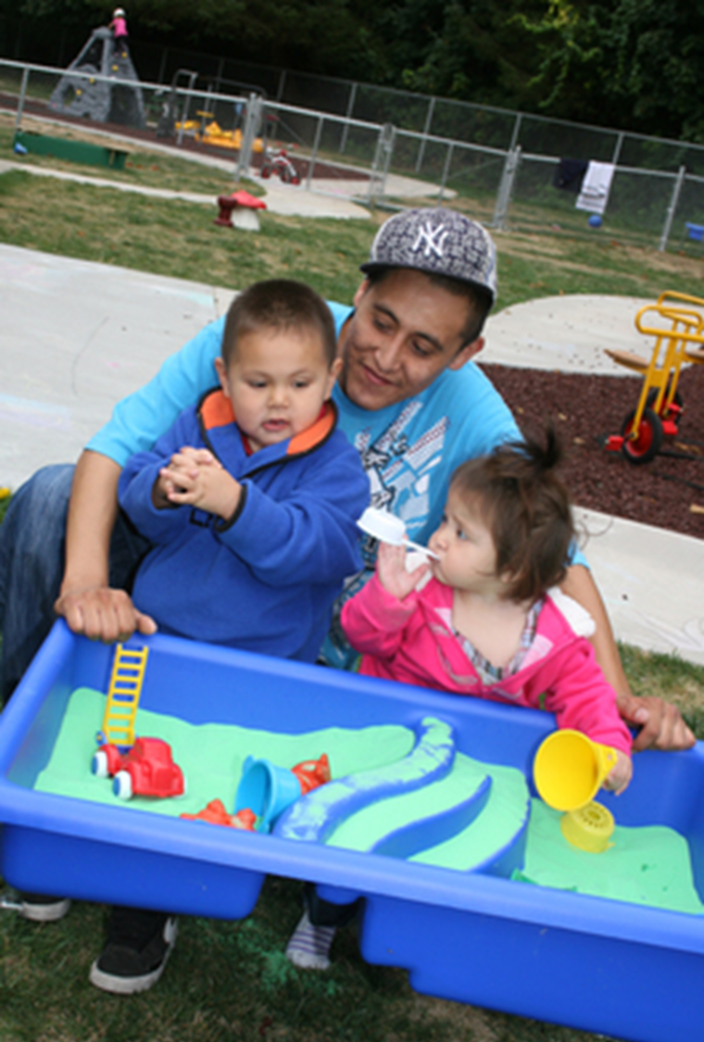
Support Parents in Learning About STEAM
Help parents understand that STEAM is about how children and adults explore the world, not which facts you know.
Notes:
Optional HV Slide 10

Slide 11
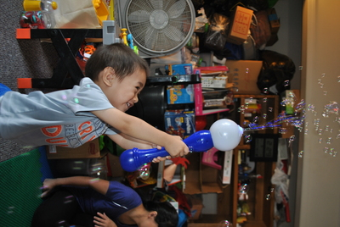
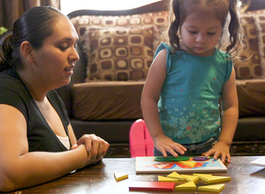
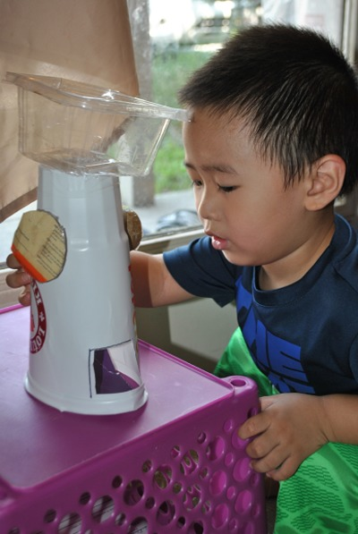
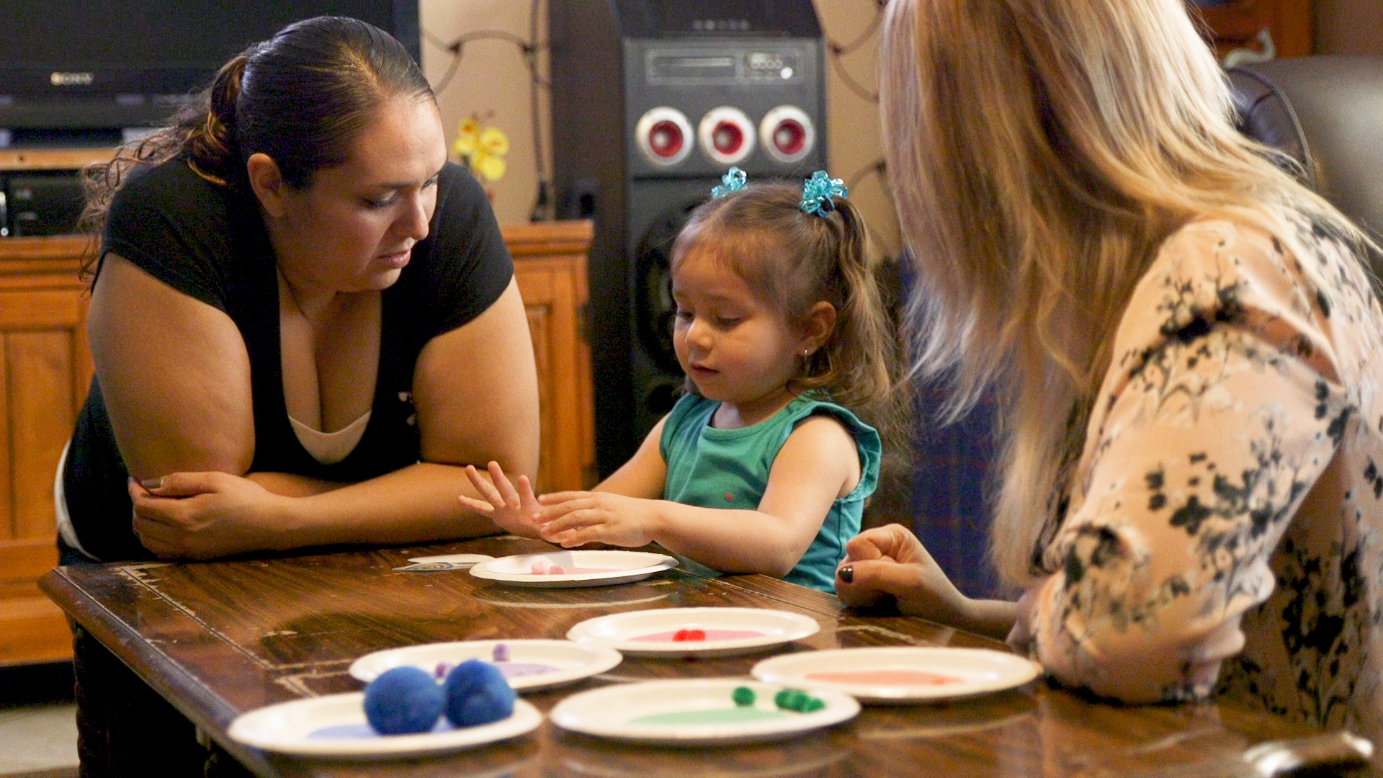
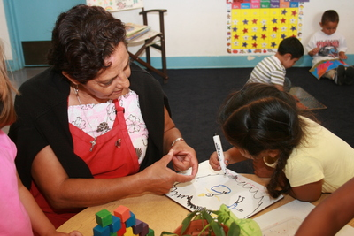
Learning Activity: STEAM is All Around
Notes:
Optional HV Slide 11

Slide 12
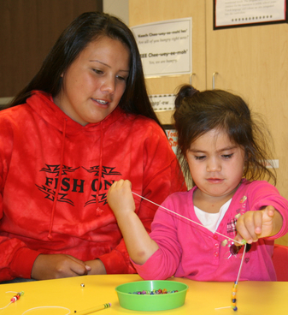
Home Visitors Can Support Families in
Building STEAM
Notes:
Optional HV Slide 12

Slide 13
Show Parents How to
Speak the Language of STEAM
Encourage parents to introduce STEAM vocabulary as children are exploring inside and outside the home.
Share the benefits of using STEAM language with children.
Notes:
Optional HV Slide 13

Slide 14
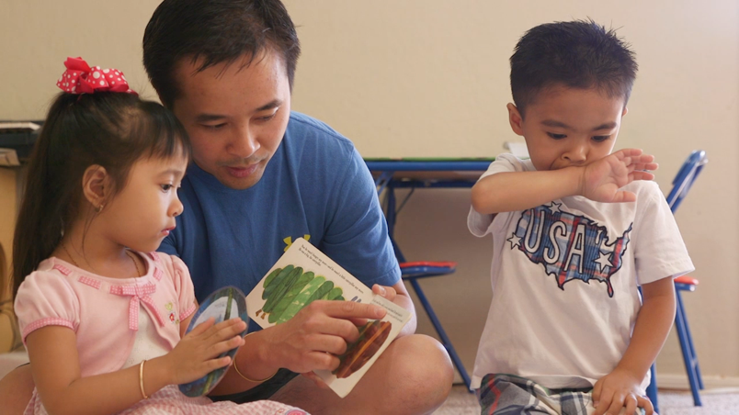

Learning Activity/Experiences
Notes:
Optional HV
Slide 14

