Slide 1


Head Start A to Z, 2.0
Community and Self-Assessment
Part 2: Self-Assessment: Building on
Strengths and Improving Systems
Notes:
Slide 1
Facilitator Notes:
Welcome participants to the session and introduce yourself. If you have co-facilitators, invite them to introduce themselves as well. Begin the session with an introductory activity to create a positive group climate and begin the engagement process. Then explain the following.
Say to Participants: “The National Center on Program Management and Fiscal Operations has updated Head Start A to Z to align with the revised Head Start Program Performance Standards that became effective November 2016. Head Start A to Z was originally designed to support new leaders in their Head Start roles. The term ‘leaders’ ensures that anyone at the management level, or in some cases the governing body, Tribal Council, or Policy Council level, can attend the sessions or use the materials for independent learning.”
“The updated Head Start A to Z, 2.0, learning modules provide baseline-level information primarily through a leadership and management systems lens. The presentations are modeled on ‘learning organization’ concepts. In each of the modules, we recognize key characteristics of learning organizations, including a supportive learning environment, openness to new ideas, and time dedicated for reflection.”
“Each attendee has an important role to play in the success of this session. Those with experience remind us where we’ve come from and what we must do to maintain our identity and uniqueness. New members bring a fresh perspective and remind us what we must do to prepare for the future. All roles are essential for Head Start to be a learning organization that continues to grow and flourish.”
“Head Start A to Z, 2.0, is most successful when it helps us share the best of what we have to offer with a strength-based focus. As you engage in this session, we hope that you will support one another in the learning process by generously sharing your knowledge, experience, and perspective.”

Slide 2
Learning Objectives
In this module, participants will:
Understand the requirements for
self-assessment
Explore the recommended process
for conducting a self-assessment
Recognize the importance of these
activities for planning, evaluation, and continuous improvement
Identify strategies and resources to
support these activities
Notes:
Slide 2
Facilitator Notes:
Distribute the Reflective Practice Tool handout. Review the following learning objectives with the group, reading from the slide or this list.
Tell participants that, in this session, they will:
Understand the requirements for self-assessment
Explore the recommended process for conducting a self-assessment
Recognize the importance of these activities for planning, evaluation, and continuous improvement
Identify strategies and resources to support these activities
Guide participants to the Reflective Practice Tool handout.
Say to Participants: “At the end of our session, you will be asked to use this Reflective Practice Tool to write down some key thoughts about what you’ve learned. We encourage you to jot down some preliminary thoughts as we move through this presentation.”

Slide 3
Six Guiding Principles for A to Z Trainings
Successful programs are learning organizations.
Sound decision-making is driven by quality data.
Relationship-building is at
the heart of transformational leadership.
The effective delivery of services grows out
of strong systems.
School readiness for all is our driving goal.
Culturally and linguistically diverse organizations rely on intentional, specific, and coordinated approaches.
Notes:
Slide 3
Facilitator Notes:
Distribute the Head Start A to Z Guiding Principles handout. Note that for this session, we will focus on Guiding Principle 3: Sound decision-making is driven by quality data.
Say to Participants: “Head Start A to Z, 2.0, is based on six guiding principles. These guiding principles are foundational to the design of the modules and have been aligned with the HSPPS.”
“Head Start directors and managers come from all walks of life with a wealth of employment experiences. However, we all share a commitment to a comprehensive, high-quality early childhood experience. We recognize that, to promote school readiness and be responsive to the needs of our communities, we must engage in ongoing professional development. Head Start A to Z, 2.0, was created to support professional growth and development for the Head Start leaders.”
Guide the participants to the Head Start A to Z Guiding Principles handout. Review the six principles below. You may paraphrase or slightly summarize.
1. Successful programs are learning organizations. Head Start is a dynamic organization with high expectations, values, and traditions. Programs are constantly responding to changing community needs and evolving best practices. To cultivate a learning organization that thrives in this environment, program leaders must support all staff in becoming life-long learners who embrace challenges as opportunities for collective problem-solving and innovation.
2. The effective delivery of services grows out of strong systems. Program leaders must regularly refine their program’s management and fiscal systems. To target community needs and deliver comprehensive services, leaders need to understand systems thinking and view their program through a systems lens. They also need to recognize the relationship between systems, services, and child and family outcomes.
3. Sound decision-making is informed by quality data. Used in planning, evaluating, and communicating information, quality data is integral to cultivating a culture of continuous quality improvement. To this end, it is critical for leaders to establish efficient processes for collecting, aggregating, analyzing, and synthesizing data. This involves training teachers, home visitors, family advocates, health services workers, and other staff how to integrate data management into their day-to-day work.
4. Relationship-building is at the heart of transformational leadership . Robust Head Start communities build on authentic relationships between all of their stakeholders, from children, families, staff, and managers to governing bodies, Tribal Councils, and Policy Councils. To cultivate these communities, leaders need to communicate effectively, empower others, foster team-building, and nurture collaboration.
5. School readiness for all is our driving goal. Head Start leaders play an integral role in conceiving and promoting an inclusive vision of school readiness. To support children with diverse abilities and backgrounds to develop the skills, knowledge, and attitudes needed to be successful in school, effective leaders must stay informed on developments in early childhood education. They also must actively collaborate with parents, staff, governing bodies, local education agencies, and community partners in embedding these best practices into services and programming.
6. Culturally and linguistically diverse organizations rely on intentional, specific, and coordinated approaches. To ensure the full and effective participation of dual language learners and their families, Head Start leaders must coordinate program-wide plans that involve all service areas and multiple staff. This includes staying connected to the communities served, implementing targeted strategies, and articulating how programs and services address specific linguistic and cultural needs.
Say to Participants: “In addition to anchoring the content in Head Start A to Z, 2.0, you will revisit these guiding principles in all of the trainings offered by PMFO.”

Slide 4

Overview
Notes:
Slide 4
Facilitator Notes:
Begin this section on self-assessment.
Say to Participants: “Think of a time when you or something you own underwent an inspection—a physical exam or a car or house inspection. Why did you do it? What did you learn from it? How did it impact your future actions?”
“We monitor our health through regular physical exams. These exams can tell us if we are on track with our goal of maintaining good health. They may lead us to set new goals or adopt new strategies to improve our heath. We inspect our cars to make sure that they are functioning properly so we can get where we want to go safely.”
“It’s the same with the assessments we conduct in Head Start. Community assessment provides an in-depth picture of our community, its people, their strengths and needs, and available resources. It tells us who we should serve and what those services should look like. The annual self-assessment provides an in-depth picture of the services we are providing.”
“Part 1 of this module is about community assessment. Part 2, which is our focus today, is about the annual self-assessment, and only touches on the community assessment briefly. These two assessments are very much linked in the way they inform and adjust our program design over time. While required by OHS, both assessments are designed by programs themselves, and so will vary a bit depending on program needs.”
“Does anyone have additional thoughts or questions about what we’re going to cover in Part 1?”
Take two minutes to discuss any comments or questions.

Slide 5
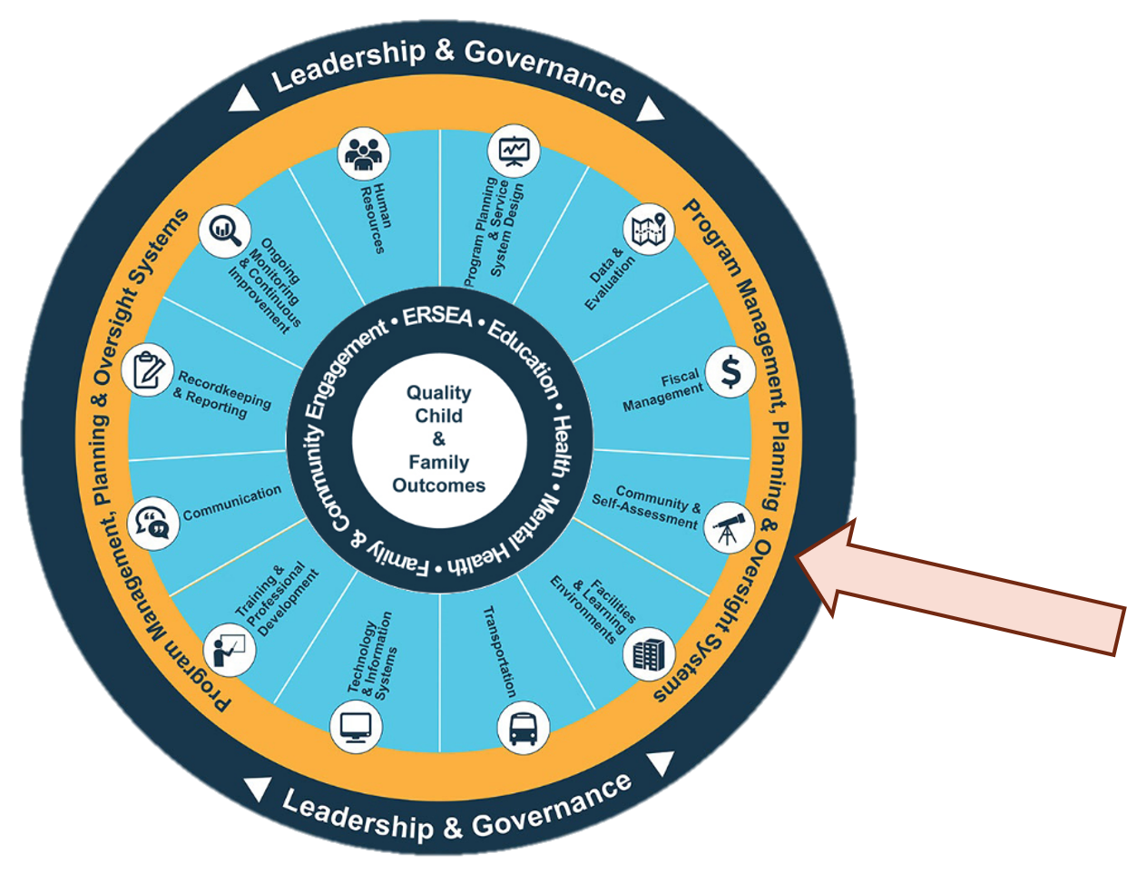
Head Start Management Systems Wheel
Notes:
Slide 5
Facilitator Notes:
Deliver the following material as a mini-lecture.
Say to Participants: “The Head Start Management Systems Wheel can help us understand how self-assessment fits into the overall picture.”
In your own words, explain the graphic on the slide by pointing to its various elements and describing each, basing
your descriptions on the bullet points below.
The dark blue outer circle includes the functions of leadership and governance . They are the bedrocks of effective management, encompassing and informing the 12 management systems.
The yellow circle outlines the scope of these systems.
The segmented aqua blue ring outlines each of the 12 management systems. These systems work together to inform and influence the program’s service delivery. These services include education, health, mental health, community partnerships, family engagement, and eligibility, recruitment, selection, enrollment, and attendance (ERSEA).
Say to Participants: “You see that one of the aqua blue wedges is labeled ‘community and self-assessment.’ That’s the management system we’re looking at in this module. In Head Start, all of these systems work together to inform and influence the program's service delivery, which you see in the dark blue inner circle. When innovative leadership, strong management systems, and well-designed services are working together, we produce quality child and family outcomes.”

Slide 6
Community & Self-Assessment
Community & Self-Assessment
Initiates the program planning process
Provides the right services to the right population
Supports continuous quality improvement
45 CFR §1302.11(b)
45 CFR §1302.102(b)(2)(i-iii)
Notes:
Slide 6
Facilitator Notes:
Direct participants’ attention to the slide.
Say to Participants: “Now that we’ve looked at the wheel itself, let’s take a moment to identify the management system that we will be exploring in this session: community assessment and self-assessment.”
“To fully explore this system within our organizations, we need to understand how our data collection and analysis activities inform the way our programs deliver services.
1. The community assessment focuses on external factors for new and existing programs, ensuring they are providing the right services to the right population.
2. The self-assessment focuses on internal factors, including ongoing monitoring data, to support the continuous quality improvement process.”

Slide 7
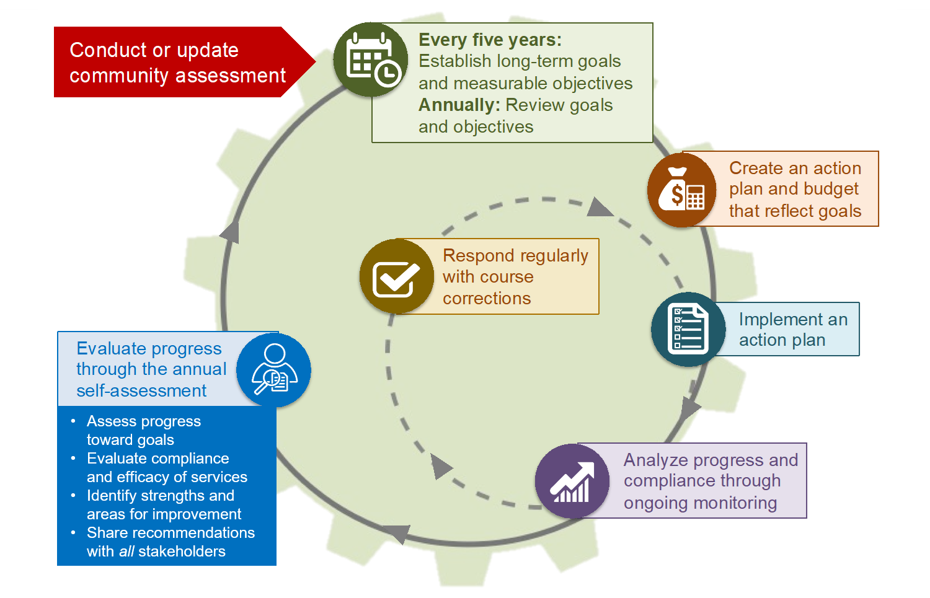
Program Planning Cycle
Notes:
Slide 7
Facilitator Notes:
Distribute the Head Start Program Planning Cycle handout.
Say to Participants: “Before we go any further, we also need to look at how community assessment and self-assessment fit into the Head Start program planning cycle.”
“Programs use the community assessment process to collect and analyze data about the needs and resources of eligible families, the program, and the community to inform goal-setting. For their baseline grant applications, programs identify the strategic long-term goals they will accomplish during the five-year project period. They also identify objectives linked to these expected outcomes. Community assessment—shown at the very top of the program planning cycle—is what feeds all this planning and goal-setting.”
“During their annual planning process, programs review their long-term goals and revise them as necessary. They continue to break down their goals into short-term objectives linked to expected outcomes.”
“Moving clockwise around the circle, you see that programs then develop an annual action plan. The action plan outlines what a program will do to accomplish its goals and objectives. This plan is supported by a budget. As the program implements its plan, it collects data through technology and information system and manages it through its recordkeeping and reporting system. The program continually evaluates progress toward its goals and objectives by reviewing the data it gathers. Based on ongoing monitoring results, programs will continue to implement their action plan as written or make course corrections that require changes in program activities or levels of effort.”
“Finally, the program comes full circle to the annual self-assessment. In this step, the self-assessment team uses its ongoing monitoring, community assessment, and other relevant data to assess the program’s progress in achieving its goals, objectives, and expected outcomes, and to evaluate program compliance with federal requirements.”
“We can see that planning is a circular process that continues to build and evolve over each program year. You can think of it as a slow-moving wheel with forward momentum.”
Encourage participants to take a closer look at the Head Start Planning Cycle Narrative handout for a more detailed explanation of how the community and self-assessment processes provide critical data to programs.
Say to Participants: “Now let’s take a deeper look at the annual self-assessment process.”

Slide 8

45 CFR §1302 Subpart J—Program Management and Quality Improvement
A program must provide management and a process of ongoing monitoring and continuous improvement for achieving program goals that ensures child safety and the delivery of effective, high-quality program services.
Notes:
Slide 8
Facilitator Notes:
Direct participants’ attention to the slide.
Say to Participants: “We want to spend a few minutes looking at the process the Office of Head Start (OHS) recommends for self-assessment. According to the HSPPS, programs must:
Use program data to measure progress toward goals
Assess compliance with the Head Start Program Performance Standards
Determine the effectiveness of professional development and family engagement systems in promoting school readiness”
“Programs are not required to conduct their self-assessments in any particular way. Instead, programs make their own decision about how to complete them. They seek the approval of their Policy Council and governing body or Tribal Council for the plan they develop.”

Slide 9
Achieving program goals, 45 CFR §1302.102
Establishing program goals
Monitoring program
performance
Using data for continuous
quality improvement
Reporting
Notes:
Slide 9
Facilitator Notes:
Distribute the Using Data for Continuous Quality Improvement handout, which includes HSPPS 45 CFR §1302.102. Review the slide with the participants.
Say to Participants: “Achieving program goals, 45 CFR §1302.102, outlines what ongoing monitoring and continuous improvement require and describes how self-assessment fits into this process. It can be found in HSPPS Subpart J—Program Management and Quality Improvement.”
“Take a look at the Using Data for Continuous Quality Improvement handout. You’ll see that the standard addresses how programs must:
Work with their Policy Council and governing body or Tribal Council to establish long-term strategic goals and measurable objectives
Establish ongoing oversight to ensure compliance with regulations and timely correction of quality or compliance issues
Collaborate and share findings from the self-assessment with the governing body or Tribal Council, Policy Council, staff, and parents
Use data to identify program strengths and needs
Make adjustments to the program as necessary”
“The types of data programs are required to use for self-assessment include :
Individual child assessment data
Aggregated child-level data
Classroom-level data on teacher practice
Program-level data on staffing and professional development
Family needs assessments
Comprehensive services”
“The improvement plans programs develop as a result of the self-assessment should aim to strengthen or adjust professional development, the content and scope of services, school readiness strategies, or other goals.”
“Subpart J also outlines reporting requirements, including semi-annual status reports to the governing body and Policy Council, incident reports, and an annual report.”

Slide 10

Self-Assessment
  Success in meeting program goals
  Compliance with Head Start Program Performance Standards (HSPPS)
  Effectiveness of the professional development and family engagement systems in promoting school readiness
  Self-assessment uses program data to measure:
Notes:
Slide 10
Facilitator Notes:
Continue your mini-lecture on HSPPS requirements.
Say to Participants: “In Head Start, the self-assessment process is one that creates continuous quality improvement. It is not simply about compliance. In the new way of thinking about self-assessment, programs are encouraged to dig deeper into data with the goal of strengthening program services. They are also encouraged to delve into an area of need or see whether a particularly strong program area could be replicated in other areas.”

Slide 11

The Role of Data
Notes:
Slide 11
Facilitator Notes:
For this slide, participants will engage in a short exercise involving the Using Data for Continuous Quality Improvement handout they already have. Keep the handout answer key for yourself to review with the group at the end of the activity.
Say to Participants: “Let’s explore the use of data in program monitoring, self-assessment, and continuous quality improvement. Using the questions at the end of the handout as a guide, identify all the ways data can be used to monitor program performance. Also, identify the types of data that are used. You can work with a partner or as part of a table team. We’ll have 10 minutes for this exercise.”
When everyone is finished, ask volunteers to share some of their responses. Listen for answers like those from the answer key and add these points to the discussion if no one brings them up.

Slide 12
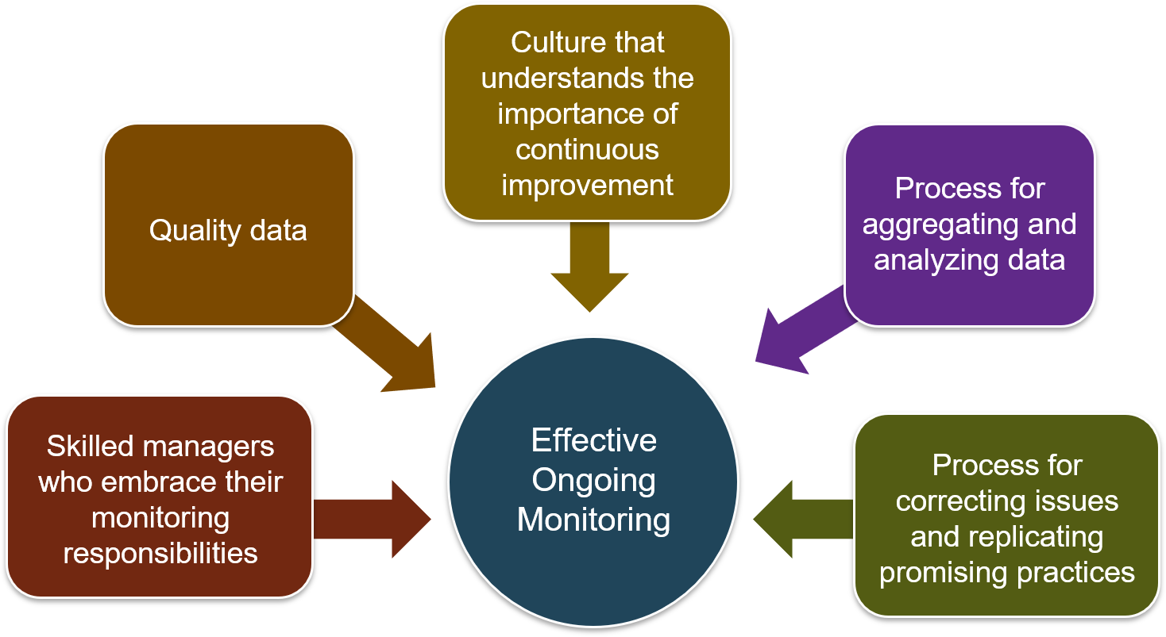
What Makes the Ongoing Monitoring System Work?
Notes:
Slide 12
Facilitator Notes:
Review the slide with participants.
Say to Participants: “An effective monitoring system is a necessary part of continuous quality improvement. A monitoring system is made up of five elements:
Skilled managers who understand their role in monitoring
Processes in place for ensuring data quality
A culture that embraces the importance of continuous quality improvement
A process for putting together and analyzing all your data
A process for correcting issues and learning from success”
“In order to run a high-quality monitoring system, programs should have a written monitoring plan that outlines procedures, responsibilities, timelines, and tools. Monitoring activities should be scheduled and conducted frequently, and the data collected should be shared so it can drive improvement.”
“Directors should be continually informing the Policy Council, governing body or Tribal Council, program staff, and other stakeholders about what they are learning from monitoring. Your data should help you track progress toward program goals and ensure regulatory compliance.”

Slide 13
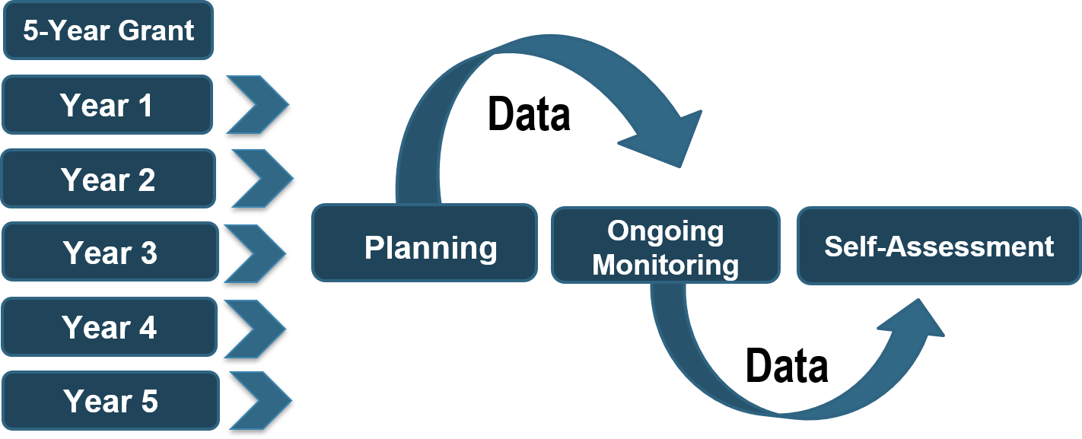
Linking Planning, Ongoing Monitoring, Self-Assessment, and Data within the Five-Year Grant Period
Notes:
Slide 13
Facilitator Notes:
Review the slide with participants.
Say to Participants: “Planning, ongoing monitoring, and self-assessment are all linked, as we can see. It is important to remember that these activities are connected throughout the five-year project period.”

Slide 14

Truth or Myth?
Notes:
Slide 14
Facilitator Notes:
Distribute the Self-Assessment: Truth or Myth? handout.
Say to Participants: “Read each statement and indicate in the ‘Before’ column whether you think it is true or a myth. The answers will be revealed throughout the session. When you hear an answer, go back and mark it in the ‘After’ column. We'll revisit this handout at the end of the session and go over the correct answers.”
Tell participants they will have seven minutes to fill out the “before” column.

Slide 15

Self-Assessment
A process used to measure a Head Start or Early Head Start program's effectiveness in meeting program goals and objectives. Self-assessment helps identify program strengths and opportunities for improvement, particularly relating to the school readiness of children.
The results of the self-assessment
are compiled into a report and
used to support program planning,
continuous quality improvement, and
goal achievement.
Notes:
Slide 15
Facilitator Notes:
Review the slide with participants.
Say to Participants: “Self-assessment is a process used to measure a program's effectiveness in meeting program goals and objectives. It also helps to identify program strengths and opportunities for improvement.”
“The results of self-assessment are compiled into a report and used for program planning and adjustment. Self-assessment must be conducted annually using program data, including aggregated child assessment, professional development, and parent and family engagement data.”
“In doing their self-assessment, programs must communicate and collaborate with their governing body or Tribal Council, Policy Council, program staff, and parents of enrolled children.”

Slide 16
Key Elements of a Self-Assessment
Who's involved?
A mix of stakeholders, including governing body/Tribal Council and Policy Council
Those with an outside perspective
Strategy
Emphasis on analysis
Ask broader questions that focus on outcomes
How do we do it?
Use data from ongoing monitoring process
Assess systems for supporting school readiness
Lead with strengths
Look at outcomes over five years
Why do we do it?
For continuous improvement
To focus on what is achieved each year in the
five-year cycle
Notes:
Slide 16
Facilitator Notes:
Review the slide with participants.
Say to Participants: “Self-assessment is a big-picture activity that looks at systems. You recruit a team with a mix of stakeholders, including individuals with outside perspectives. Think of self-assessment as an opportunity to see strengths and challenges and share new ideas. The process will also help your partners understand your program better and result in stronger relationships with them.

Slide 17

Benefits of Self-Assessment
Help see the big picture
Bring fresh perspective
Understand the possibilities and challenges the program faces
Cultivate new ideas
Build stronger community partnerships
Maximize use of existing resources
Notes:
Slide 17
Facilitator Notes:
This slide is animated. Ask participants the question below, and after they’ve responded, select the slide to reveal each of the six bullet points.
Say to Participants: “Before we delve further into the self-assessment process, I’d like to ask what you think the benefits of self-assessment are. We all undergo this process each year, and not just to meet the HSPPS. So, how do you think this process has benefited your program in the past or will benefit it in the future?”
Have participants call out answers and note them on flipchart paper. When the group has finished offering ideas, select the slide to reveal each bullet point. Read each one as described below.
Say to Participants: “Self-assessment is about:
Big-picture systems thinking, not getting down in the weeds
Inviting fresh perspectives into your program
Bringing both the strengths and challenges of your program into focus
Formulating ideas and innovation to help make your program even stronger
Making good and effective use of community resources and your own human and financial resources”

Slide 18
Knowledge Check #1
Self-assessment measures school readiness efforts, compliance with the
HSPPS, and progress on goals.
Self-assessment focuses only on health and safety and school readiness, as these are addressed during ongoing monitoring.
Notes:
Slide 18
Facilitator Notes:
The next five slides are intended to get participants engaged in the presentation. Move through these knowledge checks quickly.
Each table will need paper and pen for this activity. Read the two choices on the slide and ask participants to write down which statement they think is more accurate, A or B.
Say to Participants: “If you selected response A, you’re correct. The HSPPS require programs to use program data—including aggregated child assessment data, professional development data, and family engagement data—to evaluate progress toward meeting goals throughout the program year. Self-assessment is also used to determine whether your professional development and family engagement systems are promoting school readiness.”
“If you selected response B, not quite. The self-assessment does include looking at health, safety, and school readiness data, but the HSPPS also require programs to review program data and data related to professional development and family engagement.”

Slide 19
Knowledge Check #2
Recommendations from your self-assessment should address the question, “What's wrong
with our program?” The recommendations often result in extensive changes to the structure of
the Head Start program.
Recommendations from your self-assessment should address the question, “How can we
get even better at what we do?” The recommendations often result in changes
that relate to progress on existing goals and objectives and improved program quality.
Notes:
Slide 19
Facilitator Notes:
Read the two choices on the slide and ask participants to write down which statement they think is more accurate, A or B. Remind participants to work with their tablemates and record their responses on paper.
Say to Participants: “If you selected response A, not quite. Self-assessment isn’t about dramatically shifting gears. It’s about making steady progress toward your long-term program goals and objectives. Your resulting recommendations should fine-tune and focus your planning process. Self-assessment is also a way to ensure compliance with the HSPPS throughout the project period.”
“If you selected response B, you’re correct. You can feel confident that you’re on the right path when your process results in recommendations that refine and focus your planning process, rather than cause you to re-think it. Self-assessment is about making steady progress toward your long-term program goals and SMART objectives. Remember that SMART refers to objectives that are ‘specific, measurable, attainable, realistic, and timely.’”

Slide 20
Knowledge Check #3
Self-assessment team members
will be asked to use inquiry skills,
group processing skills, data analysis techniques, and, at times, facilitation skills.
Team members will be required to
use data collection skills.
Notes:
Slide 20
Facilitator Notes:
Read the two choices on the slide and ask participants write down which statement they think is more accurate, A or B. Remind participants to work with their tablemates and record their responses on paper.
Say to Participants: “If you selected response A, you’re right. Teams with data analysis knowledge and inquiry skills are able to form a true picture of the whole program instead of focusing on isolated examples of positive and negative practices. For self-assessment, success hinges on the team’s ability to have a robust dialogue about data that has already been collected.”
“If you selected response B, not quite. Team members will rely on inquiry skills and knowledge of data analysis techniques, but not skills around data collection.”

Slide 21
Knowledge Check #4
The self-assessment team analyzes ongoing monitoring results and reviews multi-year data.
The self-assessment team collects
new data through observation, record review, and interviews.
Notes:
Slide 21
Facilitator Notes:
Read the two choices on the slide and ask participants to write down which statement they think is more accurate, A or B. Remind participants to work with their tablemates and record their responses.
Say to Participants: “If you selected response A, you’re correct. Use your time more wisely by focusing on existing data. Request additional existing data only as needed.”
“If you selected response B, no, not quite. The self-assessment team will focus on using existing program data. Occasionally, the team may need to request additional existing data, but collecting new data should not be necessary. Self-assessment is conducted every year of the five-year project period, and you’ll be using that year’s data from ongoing monitoring. Use data from previous years to compare and contrast. Using the previous year’s data will allow you to track progress on reaching benchmarks established for the five-year period. At the conclusion of the project period, you’ll have ample data to determine if you have met your goals.”

Slide 22
Knowledge Check #5
Just like ongoing monitoring,
self-assessment is ongoing. It
is not a one-time annual event.
Self-assessment occurs once
annually. It has a clear beginning
and ends with a report that is used
to guide program planning.
Notes:
Slide 22
Facilitator Notes:
Read the two choices on the slide and ask participants write down which statement they think is more accurate, A or B. Remind participants to work with their tablemates and record their responses.
Say to Participants: “If you selected response A, no. Self-assessment does have a beginning and an end, unlike the ongoing monitoring process, which is continuous. The annual self-assessment process begins with preparing results from ongoing monitoring, moves through five phases that we’ll be discussing shortly, and ends with a final report.”
“If you selected response B, you’re right. Self-assessment occurs annually. It differs from ongoing monitoring, which, as we’ve said, is continuous.”

Slide 23
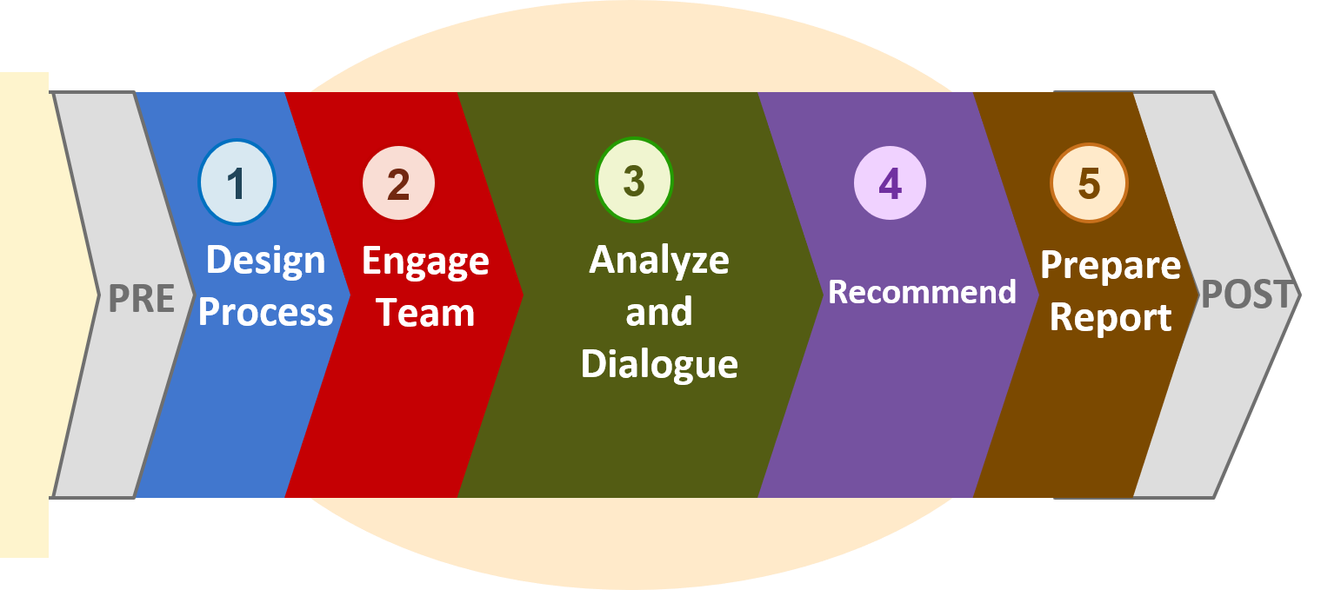
Phases of Self-Assessment
Notes:
Slide 23
Facilitator Notes:
Begin this section on the phases of self-assessment.
Say to Participants: “This session introduces a five-phase process to help guide you through your annual self-assessment. We will go into each step in more detail as we move along.”
“Notice that before the five phases, there is a ‘pre’ phase that links ongoing monitoring to the self-assessment. Afterwards, there is a ‘post’ phase that indicates whether your self-assessment report is helping to guide program planning.”
“The intent of each phase is as follows:
Phase 1 is the design process. In this phase you establish a clear sense of what you want to accomplish and by when. You consult with the governing body or Tribal Council and the Policy Council about the plan and get their approval before proceeding. To create your self-assessment team, select and invite your community partners; parents; members of the governing body or Tribal Council; members of the Policy Council; and stakeholders from the community who bring outside perspectives.
Phase 2 is where you engage the team. In this phase, team leaders prepare and deliver data summaries that provide a complete overview of the program, including progress toward goals, objectives, and expected outcomes. They also outline the self-assessment process and form subgroups, as needed.
Phase 3 is about analysis and dialogue. Subgroups review the program’s progress on goals and objectives and explore systemic issues. They also review and analyze current and previous data to uncover trends and patterns over time. Subgroups engage in dialogue about what is going well and why, and what could be improved.
Phase 4 is when the team makes recommendations. The entire self-assessment team reconvenes in this phase to consolidate discoveries across subgroups. With the whole picture in mind, the team prepares recommendations to inform program planning.
Phase 5 is when program leaders prepare the self-assessment report. The completed report is shared with the Policy Council and governing body or Tribal Council for approval, and then is submitted to the Regional Office. The report is used for annual program planning.”

Slide 24
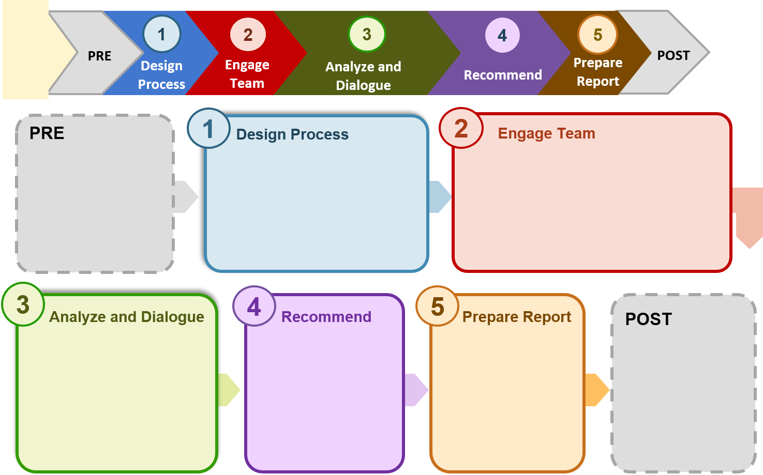
Phases of Self-Assessment
Notes:
Slide 24
Facilitator Notes:
Distribute the blank Phases of Self-Assessment handout.
Say to Participants: “As we discussed in the last slide, there are five phases of the self-assessment process. The boxes on your handout are color-coordinated to their phase, with the blue box going with Phase 1, Design Process, and so forth. Each box will show who does what in that phase.”
“At your tables, take seven minutes to fill out the boxes based on your current knowledge of the process. Think of your own program, and write down roles, responsibilities, and activities you think would happen in each phase. As with the Truth or Myth? activity, you’ll hear the correct answers throughout the session. When you hear about a role or activity related to one of these phases, add it to your handout. We’ll revisit this at the end of the session and everyone will receive another handout that’s completely filled in.”

Slide 25
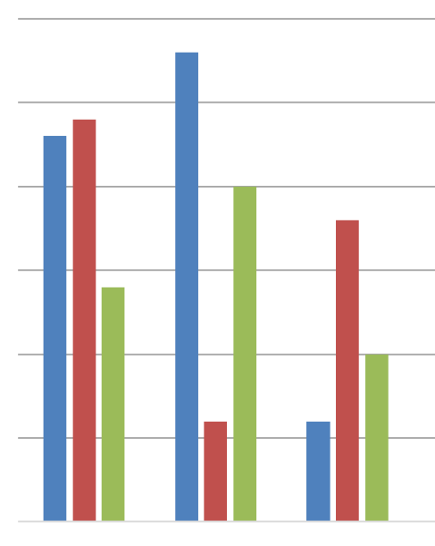
Pre Self-Assessment
PRE
Director and
Management Team
  Ask important questions about the data they have collected thus far
  Prioritize areas for investigation
  Create summaries of the data
  related to areas of focus
Notes:
Slide 25
Facilitator Notes:
Call participants’ attention to the slide.
Say to Participants: “Prior to starting your annual self-assessment, the director and management team should review and summarize program data to help set a direction for process. Asking important questions is critical in this pre-assessment stage. For instance, you may want to focus on the effectiveness of your professional development system and your family engagement activities in promoting school readiness. Or you may want to reflect on the effectiveness of your coordinated approaches to service delivery regarding particular populations of children, such as children who are dual language learners. Or, you might also ask, “Are our services culturally and linguistically responsive?”
When your direction and focus have been established, pull together all the pertinent data and organize it in easy-to-digest ways. This is important. Your data needs to be presented in an appealing and understandable format so your team isn’t intimidated by it. You want them to be able to dive right in and begin analyzing.”

Slide 26
Deeper Analysis and Reflection
PRE
What have we done really well?
How can we better serve children and
families?
How can we be more responsive
to community needs?
How can we improve working conditions and staff performance?
What innovations should we consider?
Notes:
Slide 26
Facilitator Notes:
Call participants’ attention to the slide.
Say to Participants: “Ongoing monitoring answers the question, ‘Are we doing things right?’ Self-assessment answers the questions, ‘Are we doing the right things?’ and ‘Did we do what we said we were going to do?’”
“The self-assessment process is an opportunity to look at:
What things your program has done well
How you can serve children and families better
How you can be more responsive to the community’s needs
How you can improve working conditions and staff performance”
“It’s also an opportunity to look at program strengths and consider adjustments and innovations. The emphasis is on performance as opposed to compliance.”

Slide 27


What Should Be Evaluated?
Data to take into self-assessment:
Data: Time between issue reported and issue repaired
Data: Attendance rates for classrooms and chronic absenteeism data
Data: Emergency preparedness procedures
and safety findings
Questions for the self-assessment team:
“Moving forward, how can our maintenance systems be more responsive?”
“How can we improve attendance?”
“How can we be
best prepared for emergencies?”
Systemic ongoing monitoring issues:
“Seventy-five percent of the classrooms
need to be painted.”
“Average daily attendance is consistently below 85%.”
“Off-site evacuation location
is no longer available.”
Not systemic:
“Leaky faucet in
the green room.”
“Attendance in one classroom is below 85%.”
“No bandages in
Center 3's first aid kits.”
Notes:
Slide 27
Facilitator Notes:
This slide is animated. First deliver the mini-lecture below, then follow the instructions for selecting the grid tiles to reveal one block at a time.
Say to Participants: “When programs have a lot of topics they’d like to consider during self-assessment, creating a grid like this one can be helpful. Remember, it’s all about getting away from small details and into big-picture thinking.”
Proceed from the lower left corner of the grid up the left column, selecting one block at a time. Walk through the first column with participants, then, in the remaining two columns, only reveal each block after participants have guessed what question they might form for the self-assessment team.

Slide 28

Prioritizing the Topics
Does it relate to a bigger theme?
Is it systemic?
Is it an urgent issue that wasn't resolved through ongoing monitoring?
Does it relate to our program goals?
Would it benefit from a fresh perspective?
Does it affect our ability to do everything we
can to ensure the best outcomes for our families
and children?
Does it represent a strength that could be applied
in other areas?
Does it concern health, safety, or school readiness?
Notes:
Slide 28
Facilitator Notes:
Direct participants’ attention to the slide.
Say to Participants: “The following questions will help leaders decide whether any particular issue warrants the intense focus of the self-assessment process. They should ask if the topic:
Relates to a bigger theme
Is systemic (i.e., affects the program as a whole)
Is urgent and wasn’t resolved through ongoing monitoring
Relates to the program’s goals
Would benefit from a fresh perspective
Affects the program’s ability to produce the best outcomes for families and children
Represents a strength that could be applied in other areas
Involves health, safety, or school readiness”

Slide 29
Determining Topics
Classroom Assessment Scoring System (CLASS®) scores are lower than they have been in the last two years.
A classroom did not get their developmental
screenings done within the required 45 days.
A parent-child literacy series at one site had
consistently high attendance and positive evaluations.
A classroom checklist indicated a shortage of
outlet covers in one of the classrooms.
Teacher turnover has made it difficult to
adequately staff classrooms.
A recent licensing visit identified several facility issues.
Notes:
Slide 29
Facilitator Notes:
Participants may work individually or with their tablemates to answer the questions you’ll be reading from the slide.
Say to Participants: “I’m going to read each statement on the slide. Ask yourself if the issue should be the topic of a self-assessment. After you’ve responded, we’ll review the correct answer.
“Classroom Assessment Scoring System (CLASS®) scores are lower than they have been in the last two years. How many of you think this issue should be considered in the self-assessment?”
Wait for a show of hands.
Say to Participants: “The answer is yes, this data could be a topic for the self-assessment. It may be necessary to look at additional data to help determine what factors may be contributing to the declining scores. Could they be related to budget cuts, staffing, facilities issues, or community health or mental health issues?”
“A classroom did not get their developmental screenings done within the required 45 days. Does this belong in the self-assessment?”
Wait for a show of hands.
Say to Participants: “No, this topic shouldn’t be explored in a self-assessment. Only one room was affected, not the entire program.”
“A parent-child literacy series at one site had consistent high attendance and positive evaluations. How about this? Does it belong in the self-assessment?”
Wait for a show of hands.
Say to Participants: “Yes. This is an example of success, and it should go into the self-assessment. The strategies used here could be used in another program area or for other activities.”
“A classroom checklist indicated a shortage of outlet covers in one of the classrooms. Does this get considered in the self-assessment?”
Wait for a show of hands.
Say to Participants: “The answer is no, this shouldn’t be a topic for the self-assessment. This problem appeared in only one classroom. Even though the problem must be corrected immediately, it isn’t classified as systemic unless it becomes a repeat offense.”
“Teacher turnover has made it difficult to adequately staff classrooms. How many of you think this goes in the self-assessment?”
Wait for a show of hands.
Say to Participants: “The answer is yes, this should be a topic of your self-assessment. This is a larger issue that can have consequences across several systems.”
“A recent licensing visit identified several facility issues. Does this go into the self-assessment?”
Wait for a show of hands.
Say to Participants: “This should probably be a topic for your self-assessment. These issues may have been identified by the staff before the licensing visit. If so, there was no follow-up on environmental health and safety issues, which itself suggests the issue needs attention.”
Remind participants that the HSPPS require programs to use data to evaluate progress toward meeting program goals, and to assess the effectiveness of professional development and family engagement systems in promoting school readiness.

Slide 30
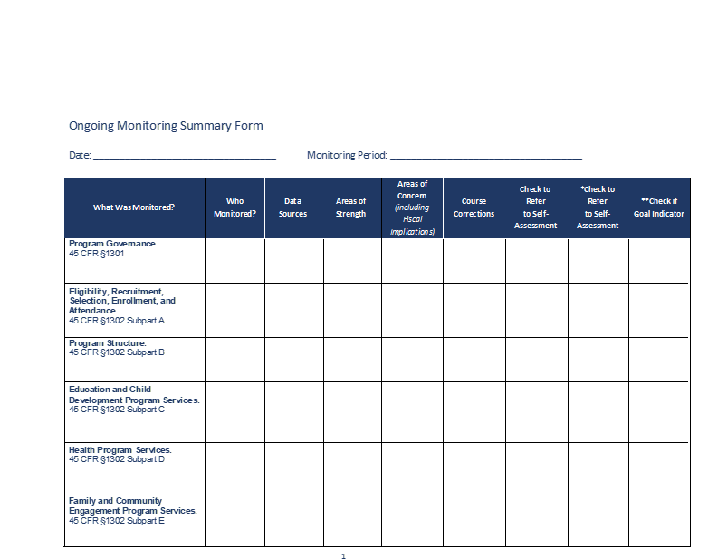
Summary of Ongoing Monitoring Results
Notes:
Slide 30
Facilitator Notes:
Distribute the Ongoing Monitoring Summary Form handout.
Say to Participants: “Take a look at the Ongoing Monitoring Summary Form on your table. There’s no requirement that you use this, but it’s a helpful tool. It can make it easier to summarize data and decide what your priorities should be in the self-assessment. It’s also an easy way to share data with your self-assessment team. One way to use the form is to complete it every quarter, and then roll the four quarterly forms into an annual summary. This summary will help you identify areas of strength and concern. These are the issues that may need further evaluation by the self-assessment team.”

Slide 31
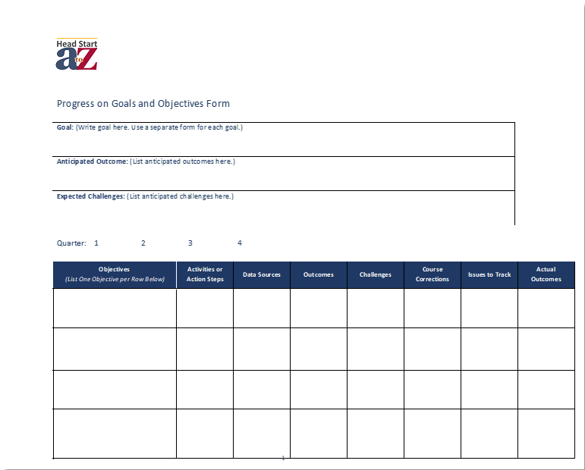
Recording Progress on Goals and Objectives
Notes:
Slide 31
Facilitator Notes:
Distribute the Progress on Goals and Objectives 1 and 2 handouts.
Say to Participants: “During the annual self-assessment, you also need to evaluate progress toward the goals and objectives you have been tracking during the program year. Here are two more tools that you can take back to your program. They capture similar information but in slightly different ways; you can use either one, depending on your needs and preferences. Note that the forms are aligned with grant application narrative requirements, so you can capture the information you will need for that process at the same time. If you prefer, you can download these tools and fill them out electronically, since they come in a fillable PDF version.”

Slide 32


Phase 1: Design
Director and
Management Team
  Develop plan for
  self-assessment
  Identify and invite internal
  and external team members
  Consult with Policy Council and governing body/Tribal Council and seek approval of self-assessment plan
Notes:
Slide 32
Facilitator Notes:
Begin Phase 1 of the self-assessment process by directing participants’ attention to the slide.
Say to Participants: “Now we’re going to look at each of the five phases in depth. In Phase 1 of self-assessment, the leadership team develops the plan for what the self-assessment will look like and determines who they want to invite to participate. In addition to the director and managers, the team should include Policy Council and governing body or Tribal Council representatives, community partners, and parents of enrolled children. You will need to seek approval of the plan from the Policy Council and governing body or Tribal Council.”
“Who would you want to have on your self-assessment team? Think about the topics you might have identified for your self-assessment and who you might invite based on those topics.”
Invite participants to share their thoughts.

Slide 33
Develop a Plan
  Create a timeline
  Know what data you are
  bringing forward
  Ensure data is summarized accurately and completely
  Identify topics for focus
  Determine need for subgroups
  Create and practice your
  “elevator speech”
Notes:
Slide 33
Facilitator Notes:
Continue discussing Phase 1 of the self-assessment process.
Say to Participants: “Programs should put their self-assessment plans in writing. That’s going to help you share the plan and stay on task.”
“In developing a self-assessment plan, you’ll need to:
Create a timeline for how you will move through the phases of self-assessment. Though there may not be a distinct beginning and end to each phase, it is important to establish realistic timelines to help the process move efficiently.
Highlight what data you will want to bring to the forefront based on the priorities you established earlier in the ‘pre’ phase.
Summarize data in accurate, complete, and easy-to-digest ways to help the team finalize the areas of focus
Determine if subgroups will be needed on the self-assessment team. As you start inviting community members and staff to be a part of the team, include those with special expertise to help with your areas of focus.
Create an elevator speech. This will be a concise and appealing description of the process, and you’ll need it to recruit team members. We’re going to do an elevator speech exercise in a few minutes.
Everyone who is recruiting team members needs to be clear and consistent in their message. That means everyone should know the elevator speech and be comfortable delivering it on the spot.”

Slide 34
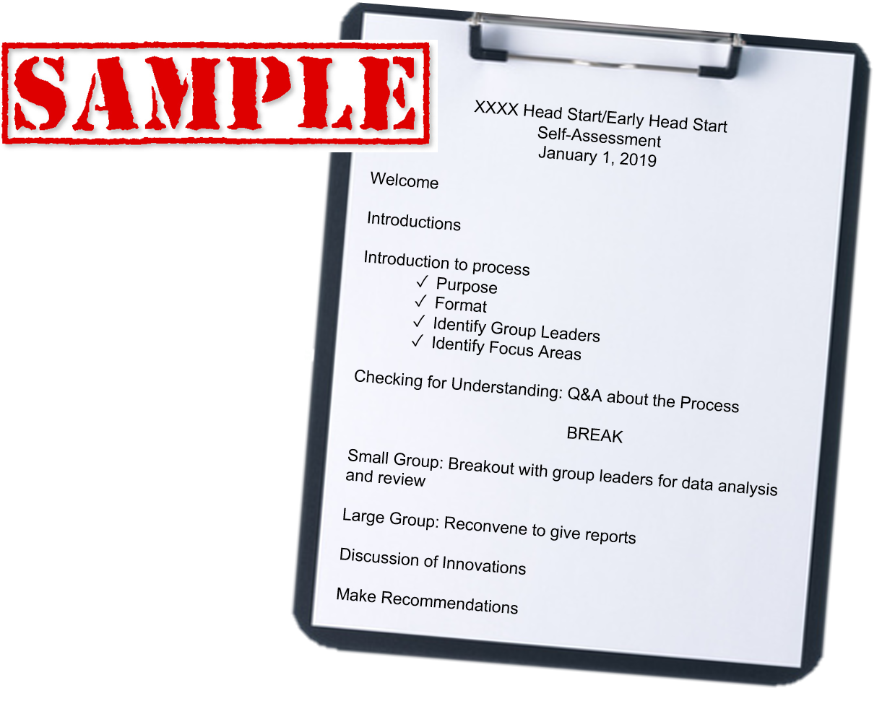
Decide on a Process
Notes:
Slide 34
Facilitators Notes:
Continue with your discussion of Phase 1.
Say to Participants: “In order to create a project timeline, leaders need to structure the process.”
“Depending on their size and structure, programs may want to devote a day or more to conducting their self-assessment. Large programs or those with a large service area may need several meetings with multiple subgroups. Smaller programs may be able to accomplish the entire assessment in a day-long retreat. Email or shared file folders may be helpful in the process, making it possible for participants to receive and review materials ahead of scheduled meetings. Video conferencing can bring in people who may not otherwise be able to attend.”
“One sample timeline for the process might look like this:
The whole team gets together
Leaders explain the process, including the purpose, format, and focus areas
Subgroups form to analyze data
The entire team reconvenes to hear reports from subgroup leaders
The team:
Defines its areas of focus
Discusses innovative ideas and strategies for program enhancements
Makes recommendations”
“Programs needing more time can hold additional subgroup meetings and come together at a later date to synthesize findings.”

Slide 35

Recruit Your Team
Notes:
Slide 35
Facilitator Notes:
Continue discussing Phase 1 of the self-assessment process.
Say to Participants: “So now that we’ve given an overview of how you might want to structure the process, let’s look at recruiting your team. As we’ve said, in the self-assessment process, you delegate a big part of the analysis to an independent team. That’s why it’s crucial to invite team members who represent your community, have an interest in what you do, and have the time to devote to participation. Consider how an individual’s unique experience and expertise can strengthen your assessment team. Having a well-rounded and diverse team is essential, because the team drives the self-assessment process in terms of discussion, analysis, and final recommendations.”

Slide 36
Create an Elevator Speech
  Brief overview of process
  Make it personal
  Why do you need me?
  What are next steps?
  SAMPLE: “Our Head Start program is beginning our annual self-assessment. You've been a Head Start parent for four years and know a lot about how things work. You'd be a valuable addition to our team. It will take a few meetings, fruitful discussions, and everyone's ideas to make our Head Start program the best it can be.”
Notes:
Slide 36
Facilitator Notes:
Distribute the Elevator Speech handout and review the slide.
Say to Participants: “As we’ve said, to recruit your team, you’ll need an elevator speech—a concise and appealing description of the self-assessment process. The intent is to inspire people to be on the team and convey to them that you value their participation and input.”
“Using the handout, take 10 minutes to draft an elevator speech you could use to recruit members to your team.”
When they have finished, ask for one or two participants to share their completed speeches.

Slide 37


Phase 2: Engage the Team
Director and Management Team
Orient self-assessment team members
Share the self-assessment plan
Share ongoing monitoring, last year's self-assessment report, and other data
Self-Assessment Team
Define how to be a good team member
Form subgroups and begin process
Notes:
Slide 37
Facilitator Notes:
Begin Phase 2 by directing participants’ attention to the slide.
Say to Participants: “In Phase 2 of the self-assessment, you are engaging your team. You’ll provide them with some information about Head Start and your particular program, orient them to the self-assessment plan, and share the data that has already been prepared in the ‘pre’ phase. This would include ongoing monitoring data, last year’s self-assessment report, outcomes data, and any other data that you want to present.”
“It is recommended that the self-assessment take place near the end of the program year, when you have complete data sets available to analyze. Ideally, as you go through the five years, you will bring data from previous years into your process in order to track changes and paint a picture of progress over time.”
“As your team begins meeting, you should consistently:
Welcome and encourage input from everyone
Be honest and transparent; the data will reflect both program strengths and challenges, and the team should discuss the full spectrum of issues
Understand you may need to experiment with different groupings of people so everyone participates
Stay focused on the big picture rather than individuals or incidents that distract from systems and services”
“Be aware that some team members, such as parents, may be unfamiliar with working in groups and may not know much about data analysis. Take care to make them feel comfortable and draw out their opinions.”

Slide 38
Being a Good Team Member
Six Useful Tips:
Keep a strengths-based approach
Let go of control
Include all team members
Use multiple strategies to engage team
Keep the dialogue flowing
Focus on the “big picture”
instead of details
Notes:
Slide 38
Facilitator Notes:
Distribute the Engage the Team handout.
Say to Participants: “Consider the six tips on the slide when engaging with your self-assessment team members. Always think about how what you say will be heard and interpreted. Staying positive and inclusive will help move the process forward.”
Direct participants to the handout. Instruct them to work with a partner to identify the sentence in each section that would work best to engage team members. Give them five minutes for this task.
Answers to the questions are: 1. A; 2. B; 3. A; 4. B; 5. A; and 6. A. Ask for volunteers to share their responses and go through the answers as a group.

Slide 39
Orient the Team
Present the self-assessment plan
Identify subgroups and areas of focus
Share ongoing monitoring results related to areas of focus
Present and review last year's
self-assessment report
Ensure roles and responsibilities
are clear
Useful Resource:
Orientation to the Self-Assessment Process in Head Start
Notes:
Slide 39
Facilitator Notes:
Review the slide with participants.
Say to Participants: “In Phase 2 of self-assessment, Head Start directors and managers orient the self-assessment team members to the overall plan, share ongoing monitoring results and other data, and let the team know about areas needing further exploration during the self-assessment process.”
“The larger self-assessment team may be divided into subgroups to look at specific areas of focus. Team or subgroup members might start to explore whether additional data is needed to help them with their investigations. Another part of orientation is helping managers understand their role as self-assessment team members. Although they may represent particular programs within the agency, as members of the self-assessment team, they need to be neutral and prioritize the needs of the overall program.”
“A good orientation also ensures participants are clear about their roles and the tasks ahead of them, and about expectations and timelines.”

Slide 40


Phase 3: Analyze and Dialogue
Self-Assessment Team or Subgroups
  Explore systemic issues
  Review and analyze data and seek additional data as needed
  Engage in dialogue using probing questions
  Examine progress on goals and objectives
  Describe what you’ve discovered
Notes:
Slide 40
Facilitator Notes:
Begin your discussion of Phase 3.
Say to Participants: “Phase 3 of the self-assessment process is devoted to analyzing and discussing data. Since understanding the data and discussing what it means is so vital to the self-assessment process, more time is typically spent during this phase.”
“In Phase 3, teams and subgroups will:
Explore systemic issues
Review and analyze data, and seek additional data as needed
Use probing questions to uncover more information and ideas
Examine progress toward program goals and objectives
Describe what they have discovered through their analysis”

Slide 41
Types of Head Start Data
Program Information Report (PIR)
Eligibility, Recruitment, Selection, Enrollment, and Attendance (ERSEA)
Community assessment
Ongoing monitoring
Child outcomes
Family engagement
Professional development
Health, mental health, and nutrition
Transportation, fiscal, and facilities
Notes:
Slide 41
Facilitator Notes:
Review the slide with participants.
Say to Participants: “Team members will be reviewing data that’s come from many sources. The types of data most relevant to the annual self-assessment process come from:
Program Information Reports (PIR)
Eligibility, Recruitment, Selection, Enrollment, and Attendance (ERSEA)
Community assessment
Ongoing monitoring
Child outcomes
Family engagement
Professional development
Health, mental health, and nutrition
Transportation, fiscal, and facilities”
Ask participants to share examples of data associated with each bullet point.

Slide 42

Analyze the Data
What do we know? What is the
data telling us?
What additional data do we need?
What questions does the data pose?
What patterns and trends do
we notice when we compare
year-to-year data?
What do we learn from looking at multiple sources of data regarding one topic or issue?
Notes:
Slide 42
Facilitator Notes:
Distribute the Data Analysis 101 handout and keep the answer key for yourself.
Say to Participants: “On the slide is a series of questions we should be routinely asking about our programs. We want to know what:
Data is telling us about various aspects of our program
Additional data we might need
Patterns we are noticing from year to year
We can conclude about any particular issue from the data”
“These are important questions. We can answer them using some common data-analysis techniques. Let’s talk about them one by one. Take a look at your handout.
Disaggregating means to break apart data to look at patterns and details. When numbers or trends don’t make sense, disaggregating data can help explain what’s really happening. For example, is the attendance falling below 85 percent at all of your program sites, or is it worse at one particular site? Are CLASS® scores lower in rooms that have had teacher turnover or high staff absenteeism?
Looking at data over time lets you compare data from different time periods so you can see trends. How did our children perform in math and science last year as compared to this year? To know if trends are up or down from previous quarters or years, you need to look at data from those periods.
Examining multiple sources of data helps you investigate relationships between two or more things that you might not have seen before. For example, your preschool enrollment is down in one community compared to a year ago and you have more families taking their children out of the program than in previous years. Your community assessment shows that there are more opportunities for preschoolers in the community. These facts seem connected. You also want to look at your enrollment data to find out if there are other reasons for the drop. In fact, you should review multiple sources of data to explore this issue.”
Instruct participants to work together at their tables to review the scenarios on the handout and select the best response. Tell them they have seven minutes for this activity. When they have finished, go over the answers one by one.

Slide 43

Dialogue with the Team
Establish ground rules
Hear everyone's voice
Stay focused on the big picture
Help the team get “unstuck”
Notes:
Slide 43
Facilitator Notes:
Continue discussing Phase 3.
Say to Participants: “Dialogue is arguably the most important part of a successful self-assessment. The team digs into the data and asks meaningful and relevant questions about what they see. Think of a time you were involved with a group or team in a process that was efficient and effective. What was it about that group or facilitation that really worked? Does anyone want to share their thoughts?”
Lead a brief discussion on this topic.
Say to Participants: “Analyzing data within subgroups is central to self-assessment. So when your subgroups meet to do this work, make sure you:
Establish ground rules. You can ask participants to share ground rules they feel are important and use a flipchart to track responses. Include things like:
Not interrupting
Not judging or making comments personal
Hearing from everyone
Avoiding distractions like phones and other technology
Hear everyone’s voice. Conduct a round-robin process where the facilitator calls on each person for a comment or thought; ask participants to write down their questions or comments if they aren’t comfortable sharing. Keep track of questions that come up that will require more data or a response from someone outside the subgroup.
Stay focused on the big picture. Create a signal or other way for members to let you know when they think the team is going off track. Avoid sidebar conversations and keep a list of ‘topics to discuss later’ for issues that aren’t relevant to the immediate conversation.
Get unstuck. If a discussion is unproductive or veering off topic, table it and try again later. Or ask the team, ‘What is the heart of the issue here?’ Ask team members to try to separate their personal preferences or positions from what is in the best interests of the program overall.”

Slide 44
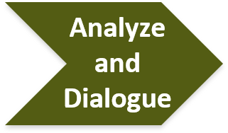
Asking the Right Questions
Analyze data through
Dialogue
What patterns or trends do you see over time?
How has the program made progress on its goals and objectives?
How are we doing on our most important measures?
What is our impact?
How else can we look at this?
Identify challenges
Where did we fall short of our expectations?
Why did we
fail to make progress?
What aspects
of “what is working” can
be used to find
a solution?
Imagine possibilities
What limitations are we placing
on our thinking?
How can we go beyond what
we first thought?
Where can
we innovate?
What will success look like?
Lead with strengths
Where do the data say that your program has been particularly successful?
What is the story behind the success?
Name
discoveries
What did your analysis lead you
to find?
How do your discoveries relate
to the program's goals and objectives?
What connections did you find among discoveries?
Notes:
Slide 44
Facilitator Notes:
Distribute the Asking the Right Questions handout.
Say to Participants: “To conduct an effective analysis, team members have to ask the right questions. Let’s look at some suggestions on the slide.”
Review the slide with participants, highlighting the types of questions that should guide teams through the process of analyzing data, discovering trends, identifying challenges, and drawing conclusions.
Direct participants to the handout. Give each table five minutes to discuss its recommendations for conducting productive group dialogues.
After five minutes, ask participants to reflect on a time when they have used one of the three “learner mindset” questions at the bottom of the handout. Those questions are:
What possibilities does this open up?
What can we do about this?
What can we learn from this?
Ask volunteers to share why they chose the question they did and how that question might be beneficial during this phase.

Slide 45


Phase 4: Recommend
Self-Assessment Team:
  Consolidates discoveries across teams
  Prepares final recommendations
  to inform program planning
  Provides feedback on the process for next year's self-assessment
Notes:
Slide 45
Facilitator Notes:
Begin Phase 4 by reviewing the slide with participants.
Say to Participants: “In Phase 4, the whole self-assessment team reconvenes and the subgroups share their recommendations. Let’s look at this process more closely.”

Slide 46
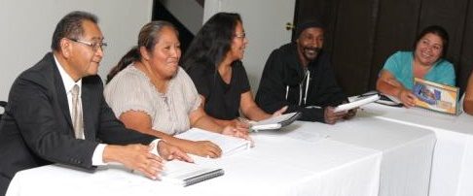
Reminders for Formulating Recommendations
Focus on:
    Suggestions versus solutions
Systems versus the details
Categorize based on:
  Progress on goals and objectives
  Systemic issues
  Innovations and new resources
Notes:
Slide 46
Facilitator Notes:
Review the slide with participants.
Say to Participants: “After each subgroup has ample time to meet, analyze, dialogue, and make discoveries, the larger self-assessment team reconvenes. The team looks at all discoveries across subgroups, identifies themes, and creates final recommendations.”
“As you plan for how the team should work together, think about using some of the group facilitation strategies that have worked for you in the past. You might do small-group work, charting, brainstorming, or a combination of techniques that allow the team to grasp the work of the subgroups, identify important themes, and make recommendations.”
“Before the team starts working on recommendations, remind participants that:
It’s not their job to solve problems. Instead, teams make suggestions for what might work or name innovations they think the program should consider.
They should focus on systemic issues instead of smaller details. For example, they should make recommendations for what might improve overall parent participation instead of recommendations for new parent training topics.
They should create categories for recommendations to help stay organized and focused. Recommendations may be categorized as one or more of the following:
Progress on goals and objectives, which show progress toward an established goal
Systemic issues, which relate to the ‘big picture’ of how your program operates or have program-wide implications
Innovations, which are cutting-edge practices or new avenues that could benefit your program”

Slide 47

Putting It All Together: A Case Study
Notes:
Slide 47
Facilitator Notes:
Distribute the Community Connections Case Study handout. Note that the activity related to this handout will take 25–30 minutes to complete. If you don’t have this much time, you may want to substitute one of the optional activities described on the handout.
Say to Participants: “We’re going to dig into a case study to see how we can apply some of the self-assessment techniques and principles we’re learning about today. I’d like you to take about 25 minutes to work with your tablemates to read the scenario on this handout and answer the questions that follow.”
Instruct participants to work in teams at their tables, read the case study scenario on the handout, and answer the questions that follow. Have groups assign a recorder to write down thoughts and a reporter to share the groups’ ideas with the rest of the participants at the conclusion of the activity. When everyone has completed the exercise, facilitate a discussion about it.

Slide 48

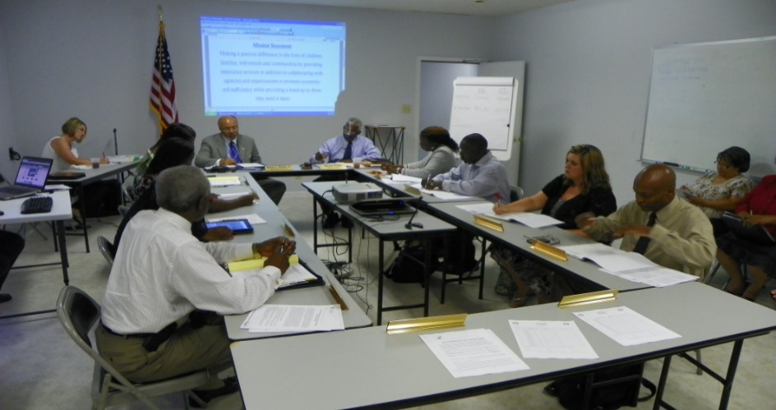
Phase 5: Prepare Report
Leaders:
  Prepare self-assessment report
  Submit report to Policy Council and governing body/Tribal Council for approval
  Submit approved report to Regional Office
Notes:
Slide 48
Facilitator Notes:
Move into Phase 5 by reviewing the slide with participants.
Say to Participants: “The fifth and last phase of the self-assessment process is preparing the report. This task is usually completed by internal program leaders.
But first, acknowledge to the team how far the self-assessment has come and briefly review the four steps leading up to this point.
The team:
Designed the process
Engaged deeply with the issues
Analyzed and discussed data
Made recommendations”

Slide 49
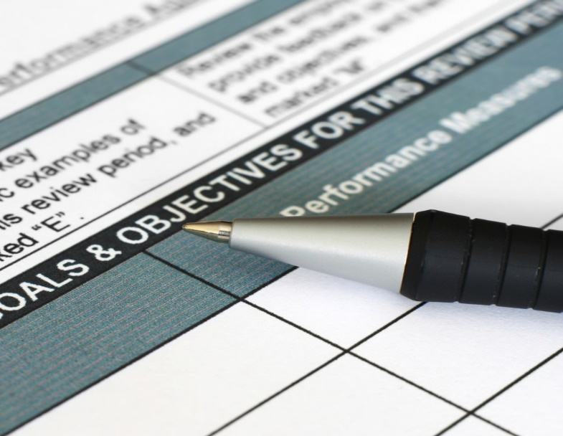
Elements of a Self-Assessment Report
  Introduction
  Methodology
  Key Insights
  Recommendations
Notes:
Slide 49
Facilitator Notes:
Review the slide with participants.
Say to Participants: “Good self-assessment reports have standard components. Your report should have:
An Introduction. Describe who was involved on the team, how many meetings were held and when, and any other pertinent information about the time and resources that went into the process.
A Methodology Section. Describe how the team did its work. Name all the types of data the team reviewed and describe how it was analyzed.
Key Insights. Share how the team arrived at its findings and recommendations. Describe what the data revealed in terms of systemic issues, successful program innovations, and any other discoveries.
Recommendations. List the team’s conclusions and recommendations. Identify steps to be taken post-assessment.”

Slide 50
How Is the Self-Assessment Report Used?
Director creates final report from recommendations
Policy Council and governing body/
Tribal Council approve the report
Director submits report to Regional Office with a Program Improvement Plan
Planning team uses report in future planning and goal-setting
Data shows progress towards
five-year goals and objectives
Notes:
Slide 50
Facilitator Notes:
Call participants’ attention to the slide.
Say to participants: “The collection of self-assessment reports throughout the five-year grant period will tell you if programmatic goals and objectives have been met for the project period. This multi-year view will answer the question, ‘At the end of five years, did our program have an impact on our children, families, and community?’ It also gives the program the data it will need to begin the next five-year grant process.”
Ask if any participants in the room have been through the self-assessment process before. If so, solicit stories of how the self-assessment report helped in their overall program planning.

Slide 51


Post Self-Assessment
Program Leadership
  Review feedback from this
  year's self-assessment team to help plan for next year
  Use self-assessment report recommendations to confirm
  or revise program goals and objectives
  Add to or revise annual action plan as necessary
  Communicate self-assessment insights to staff and other stakeholders
Notes:
Slide 51
Facilitator Notes:
Begin your discussion of the post self-assessment phase.
Say to Participants: “In the post self-assessment phase, program leadership will:
Review feedback at the conclusion of this year’s self-assessment to help plan for the next year
Use self-assessment recommendations to confirm or revise program goals and objectives
Revise action plans if needed to reflect any programmatic changes that came about as a result of the self-assessment
Share the self-assessment report with staff and stakeholders; you may want to develop highlights or summarize the reports for particular audiences”
“Remember that the self-assessment report, and Program Improvement Plan that is developed as a result, are both submitted with your grant application.”

Slide 52
Keep Self-Assessment in Mind
When you are:
Conducting or updating
your community assessment
Writing or reviewing goals
and objectives
Developing an action plan
and budget
Implementing an action plan
Evaluating progress through
ongoing monitoring
Notes:
Slide 52
Facilitator Notes:
Review the slide with participants, elaborating on each bullet point.
Say to Participants: “Keep the following points in mind about the self-assessment process:
At the completion of the self-assessment, program leaders continue along the planning cycle. Changes in community assessment data could result in major program modifications, such as the need for a new site, a change in program options or the ages of children served, or a need to hire staff who speak the language of a new population. These changes in community needs may become the focus of a self-assessment.
Self-assessment provides information on your program’s progress toward its goals and objectives. This information is essential both as you write your initial goals and as you revisit them during each year of the five-year project period. You may find you have accomplished a short-term objective over the course of the year, and the recommendations from the self-assessment team will lead you to set a new objective toward accomplishing that goal. Occasionally, your self-assessment team may recommend developing a broad new goal with SMART objectives.
Progress on goals and objectives that you note during self-assessment will guide your action planning and budgeting for the following year. Be sure to develop an action plan for any new goals or objectives you have developed based on self-assessment recommendations.
Make sure you check on how effectively your program is implementing your action plan by reviewing your ongoing monitoring data. Data that you collect during ongoing monitoring serves as information for next year’s self-assessment. Assess the progress toward your goals and objectives at least quarterly to make sure you are reaching your benchmarks. If you make a course correction as a result of self-assessment—that is, if you change goals, objectives, or action steps—be sure you are capturing the right data to measure progress for that change.”

Slide 53
Truth or Myth?
Notes:
Slide 53
Facilitator Notes:
In this slide, participants revisit the Self-Assessment: Truth or Myth? handout they have already partially filled out. You will need the answer key to complete this exercise.
Say to Participants: “Look again at the Self-Assessment: Truth or Myth? handout from earlier in the session. Recall that you already filled it out, making your best guesses about the right answers. I hope you’ve been adding more information to it as you’ve gone through the session and learned more facts about self-assessment.”
Ask participants to review the “After” column and see if they have corrections to make. Using the answer key, go over the answers with the group. Then ask, “Did anyone have an answer that changed after this session? What were those questions?”

Slide 54

Phases of Self-Assessment
1
2
Design Process
Director and Management Team
Develop plan for self-assessment
Identify and invite internal and external team members
Consult with Policy Council and governing body/Tribal Council and seek approval of self-assessment plan
Engage Team
Director and Management Team
Orient self-assessment team members
Share the self-assessment plan
Share ongoing monitoring, last year's
self-assessment report, and other data
Self-Assessment Team
Form team and subgroups and begin process
Identify additional team members, as needed
PRE
Director and Management Team
Discuss data and areas for focus
Prioritize topics
Summarize and prepare data
3
4
5
Analyze and Dialogue
Self-Assessment Team or Subgroups
Explore systemic issues
Review and analyze data and seek additional data, as needed
Engage in dialogue using probing questions
Examine progress on goals and objectives
Formulate discoveries
Recommend
Self-Assessment Team
Consolidate discoveries across teams
Prepare final recommendations to inform program planning
Provide feedback on
the self-assessment process for next year.
Prepare Report
Director
Prepare self-assessment report
Submit report to Policy Council and governing body/Tribal Council
for approval
Submit approved report to Regional Office
POST
Director and Management Team
Review feedback
to plan for next self-assessment
Confirm and revise goals and action plans
Share with stakeholders
Notes:
Slide 54
Facilitator Notes:
Distribute the Phases of Self-Assessment (filled) handout. Review the graphic on the slide, inviting participants to follow along on their handout.
Say to Participants: “You’ll remember that we also filled out the Phases of Self-Assessment handout earlier.”
Give participants a moment to find the handout. Ask them to compare their earlier answers to those on the new, completed handout.
Say to Participants: “Is it clearer now how each team has certain responsibilities in each phase of the self-assessment process?”
Lead a brief discussion with the group and answer any remaining questions.

Slide 55
Key Messages
Brings both program strengths and challenges into focus
Analyzes already collected internal data
Surfaces ideas and innovations to help make the program even stronger
Focuses on the big picture
Invites fresh perspectives
Notes:
Slide 55
Facilitator Notes:
Distribute the Which One Is It? handout and keep the answer key for yourself.
Say to Participants: “As we reach the end of Part 2 of the Community and Self-Assessment module, let’s look back on all what we’ve covered.”
“We touched on the community assessment and how it links to the annual self-assessment. As we have said, the community assessment looks outward at the community to see what’s needed. Self-assessment looks inward and is about continually improving your program.”
“We started this session on self-assessment by exploring the concept of continuous improvement. We looked at the role of data, and particularly ongoing monitoring data, in project planning and implementation. We also talked about how we comply with regulatory requirements around collecting and using data. Finally, we outlined a five-step process for self-assessment and completed some activities to deepen our understanding of the concepts involved.”
“One activity, the Community Connections case study, provided an opportunity to see how data from both the community assessment and self-assessment can be used to guide and improve a program.”
Ask participants if they have any remaining questions or comments about what they have learned. Lead a brief discussion if so.
Direct participants’ attention to the Which One Is It? handout. Ask them to take three minutes to complete it. Then, ask participants if the exercise was easy for them, given what they have just learned about self-assessment and community assessment.

Slide 56
Closing Reflections
What have
I learned?
*Adapted from: Professional Development Guides for Implementing PFCE
What excites or concerns me about what I learned?
What will I do with what I've learned?
Notes:
Slide 56
Facilitator Notes:
The final exercise is intended to help participants reflect on and reinforce what they’ve learned.
Say to Participants: “Now, let’s take some time to turn inward, to digest and reflect honestly on what we’ve learned and how we will use this information to benefit our Head Start work after we leave.
Using the handout, direct participants to take a few minutes to reflect and write down their thoughts about the following questions on the handout:
What have you learned?
What excites or concerns you about what you have learned?
What will you do with what you’ve learned?
If time permits, allow volunteers to share their responses aloud, and process the activity using the following questions:
What themes are emerging?
What insights do you need to remember?
How can you use these insights?”
Ask Participants: “What themes did you hear? What insights do you need to remember? How can you apply these insights?”

Slide 57
Related ECLKC Resources
About Us
https://eclkc.ohs.acf.hhs.gov/about-us/article/office-head-start-ohs
Head Start Programs
https://eclkc.ohs.acf.hhs.gov/programs/article/head-start-programs
Head Start Act
https://eclkc.ohs.acf.hhs.gov/
policy/head-start-act
Notes:
Slide 57
Facilitator Notes:
Discuss additional resources with participants.
Say to Participants: “If you’d like to build your knowledge about PMFO, I want to call your attention to the resources on the slide.”
“The Early Childhood Learning and Knowledge Center, or ECLKC, also has several excellent resources on community assessment and self-assessment. To find them, go to the ECLKC website and search for those terms.”

Slide 58



Contact PMFO
pmfo@ecetta.info
https://eclkc.ohs.acf.hhs.gov/ncpmfo
Call us: 888-874-5469
Notes:
Slide 58
Facilitator Notes:
Review the contact information on the slide with participants. Invite them to reach out with questions or delve further into topics discussed in this module.

