Slide 1
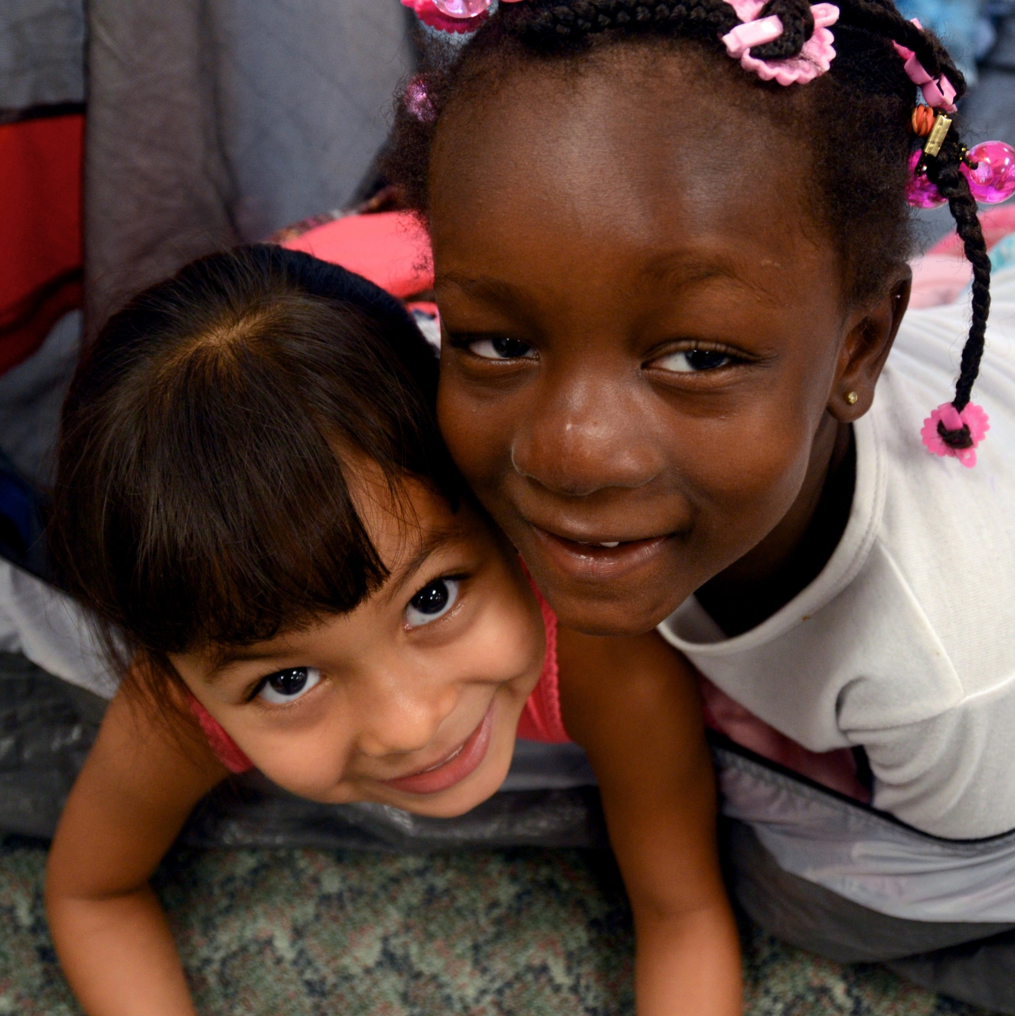
Supporting an Effective
Transition to Kindergarten
Presenter:
Home Visiting
Webinar Series
Notes:
Intro session and speakers

Slide 2
Introductions
Take a few minutes to:
Introduce yourself to others at your table.
Describe the role you play in transition work.
Share one recent transition you have experienced and how you dealt with that period of change.
Notes:
Objective
To have participants become familiar and comfortable with one another
What to do
Introduce yourself and describe the role you play in transition work. Next, give instructions on the slide and allow participants about five to ten minutes to get to know one another.
Examples of recent transitions that participants may have experienced:
Marriage
A new job
Moving
An empty nest

Slide 3
Agenda
1. The state of school readiness.
2. Why we are concerned about early transition experiences.
3. The nature of the kindergarten transition.
4. Conceptualizing effective transition.
5. Transition partnerships.
6. Building successful transition experiences.
Notes:
Note to presenter:
This is a sample agenda. Modify it to fit your presentation. This agenda follows the PPT presentation as it now stands.
Objective
To give participants an outline of how the presentation will be structured
What to say
In this session we will talk about:
The current state of school readiness, particularly in at-risk populations in the United States.
The importance of early childhood transitions and the effects of these experiences on success in school and life.
What we know from research and practice about children’s transition experiences and their adjustment to school.
Three major components for fostering successful adjustment: information, relationships, and alignment.
The goals and importance of each of the four types of transition connections.
6. The best practice, evidence-based framework for creating successful preschool to kindergarten transitions and examples of practices which use that framework.

Slide 4
Goals for the Day
Meet and collaborate with fellow educators and other early childhood stakeholders.
Gain a better understanding of the importance of successful early childhood transitions for children’s success.
Learn about best practices related to the kindergarten transition.
Share experiences to learn from each others’ successes and challenges.
Make plans to move forward in your own transition work.
Walk away with knowledge about kindergarten transition that you can share with colleagues.
.
Notes:
Note to presenter:
These are sample summit goals. Depending on what stage of transition planning the attendees are in, modify the goals to fit your presentation.
Objective
To introduce the summit’s goals
What to do
Review goals on the slide.

Slide 5
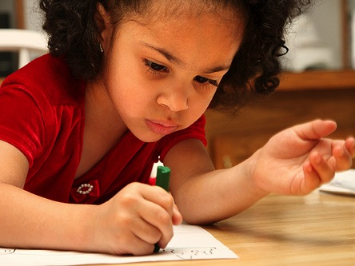
What Does School Readiness Mean?
Notes:
We know that:
• Effective early school experiences can close opportunity gaps.
We also know that
• Stability and consistency between settings is crucial to children’s continued success.

Slide 6
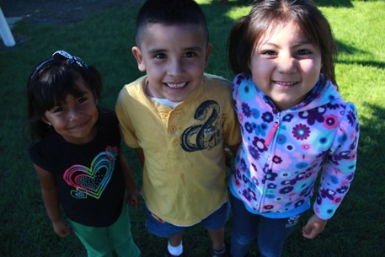
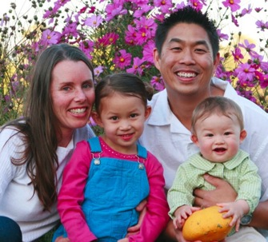

What Does School Readiness Mean?
“
The Head Start approach to school readiness means that children are ready for school, families are ready to support their children’s learning, and schools are ready for children.
“
+
+
Notes:
Objective
To look at Head Start’s definition of school readiness
What to say
This is how Head Start officially defines school readiness. This definition is an excellent way to conceptualize school readiness, but it is somewhat broad.

Slide 7
Common Themes
How a group of parents defined school readiness:
Academic competencies
Social skills
Communication among all stakeholders
Schools that are ready for children and families
Knowledge of kindergarten standards
Notes:
Objective
To review how some teachers and parents define school readiness and to note where collaboration is needed
What to say
These are common goals for children, families, and educators, but there is still another level we can dig down to—part of what we want to do is build on this.
Let’s just think about some of the questions these responses bring up:
What should social skills facilitate (i.e., what should kids be able to do socially)?
How should readiness models incorporate the culture of the community?
How do we facilitate communication between stakeholders?
How do we make schools ready for children and families?
How can we better connect with schools regarding their expectations?
How, specifically, can we connect with other organizations and how can they help?
To support school readiness, we need collaboration among stakeholders. This includes educators, parents, policy makers, and children.
We will revisit this need for collaboration shortly, but first we’ll take a broad look at how “ready” children currently are for the transition to kindergarten.

Slide 8
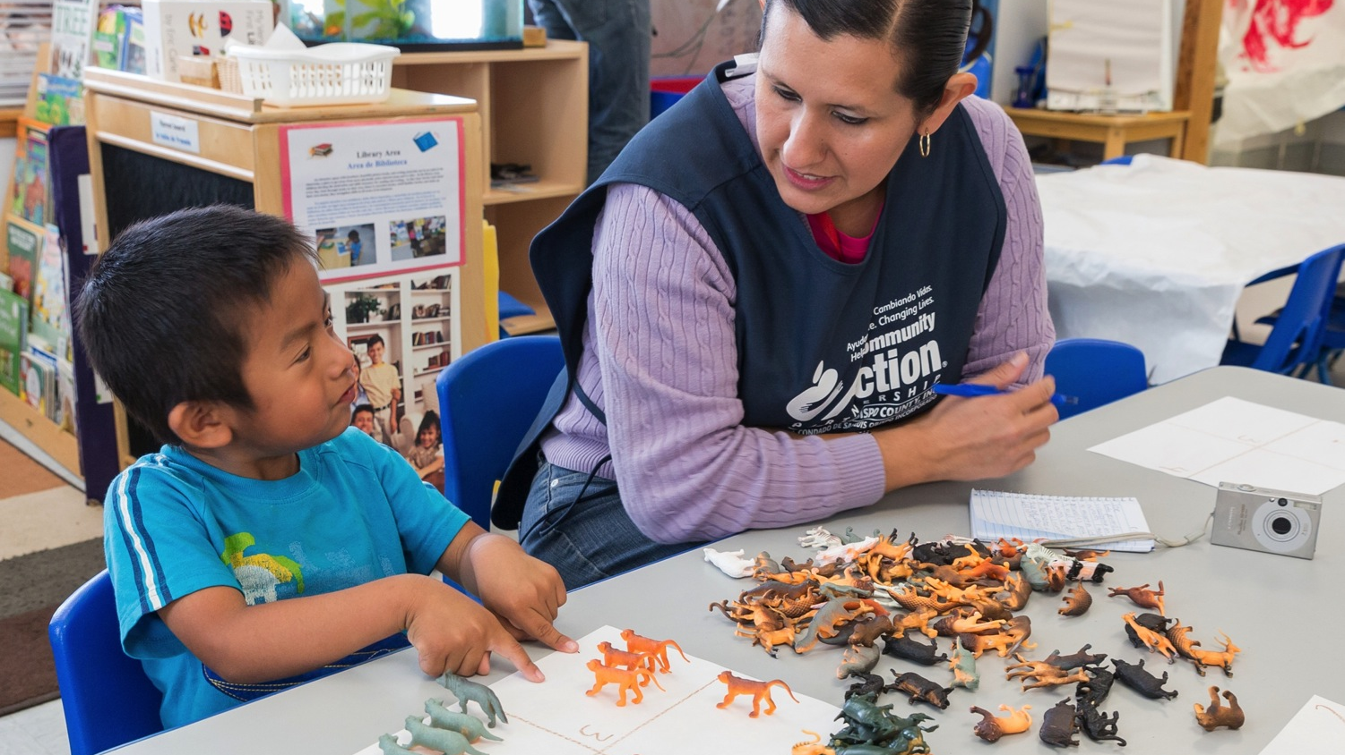
The State of School Readiness
Notes:
Objective
To orient participants to the focus of this section
What to say
Now we will look at the current state of school readiness in the United States, focusing on at-risk populations.

Slide 9
How Are Young Children Doing?
We are seeing increasing poverty.
  Of American children under age six, about 1 in 5 currently lives in poverty, and the total number has steadily increased over the past decade.
  Of those in poverty, most have multiple additional risk factors such as single parent homes, low levels of parental education, or teenage mothers.
(2017)
Notes:
Objective
To present recent demographic trends for young children in the United States
What to say
When we look at how young children in the country are doing, according to data collected in 2017, we see two disturbing trends: increased poverty; and increased disparities (or differences) between how poor and non-poor children are performing and how children of differing racial and ethnic groups are performing.

Slide 10
How Are Young Children Doing?
Low-income children are at risk for entering school significantly behind their more affluent peers:
  On average, children aged 4-5 living in
  low-income households are 12–14 months
  below national language development norms.
Notes:
Objective
To present information on the state of at-risk children’s educational performance and possible implications of that performance later in life
What to say
The disparities in development between children living in low-income and more affluent houesholds are not only apparent when looking at academic skills such as language development and letter knowledge, but also when looking at social and emotional competencies.
Perhaps the most challenging part of this situation is that it perpetuates itself in several ways:
Children living in low-income households, who may enter school behind their similarly-aged peers, are also more likely to attend lower-quality schools, which leads to fewer opportunities to catch up.
Children who begin school behind are unlikely to catch up. There is a sort of snowball effect where children who are behind don’t understand new material and therefore keep falling further behind.
And in turn, these children who are behind and fall further behind are at an increased risk for dropping out of school.

Slide 11
How Are Young Children Doing?
Of children experiencing poverty:
70% do not read on grade level at
3rd grade.
73% do not catch up in later grades.
Notes:
Note to Presenter:
Citations for the data on these slides are below:
70% fail to read on grade level at 3rd grade: National Center for Children in Poverty (2007) http://www.nccp.org/media/releases/release_35.html
73% will not catch up in later grades: The Children's Reading Foundation https://www.readingfoundation.org/school-readiness
What to say
These disparities affect children’s lives through adulthood: graduation rates, risk of incarceration, and likelihood of adult unemployment.
It is VERY important to note that this does NOT mean children living in poverty are destined to follow these trends. This is simply data based on averages, and individuals CAN overcome these odds.

Slide 12
Disparities Begin Early
Hart & Risley, 1995
Notes:
Objective
To demonstrate how early discrepancies are seen between children living in low-income households and their more affluent peers
What to say
The discrepancies between children living in low-income households and their more affluent peers are evident early in life, as seen here in this graph illustrating language development from infancy.
As you can see, children living in low-income households tend to develop significantly less vocabulary than children from more affluent households very early on. The prevailing and evidence-based theory about this trend is that children in poverty are exposed to more limited vocabulary, and have less access to enrichment opportunities.
This is not because their parents don’t care about them but that their exposure to some aspects of what is considered to be standard language may be more limited. Let’s think about what it means to be in poverty. Parents and other caregivers are often stressed, preoccupied by the need to provide for their children’s basic needs, and lack the funds other families may have to buy books or involve their children in enrichment opportunities. Furthermore, many parents who live in poverty have a low level of education and do not often use language vocabularies which are currently standard in academic settings, which means that children have limited exposure to this language.
Here are two more statistics along this line:
Children living in the lowest socio-economic status (SES) group are read to about 25 hours before entering kindergarten, compared with 1,000 hours for the highest SES group of children.
Children in the lowest SES group hear a total of 13 million words prior to kindergarten, compared with 45 million for children in the highest SES group.

Slide 13
Disparities by Kindergarten
Percent of Kindergarteners Passing Proficiency Levels in Fall
Child Trends, 2010
Notes:
Objective
To illustrate how disparities in early childhood tend to follow children into school, therefore putting them behind right from the start
What to say
Here’s another look at some school readiness comparisons between children from low- and high-income households entering kindergarten that illustrates the challenges that children from low-income households may be facing as they enter school.

Slide 14
.
How Successfully Are Children Entering Kindergarten?
Difficult
16%
Successful
52%
Ease of
Transition
Some problems
32%
Rimm-Kaufman, Pianta, & Cox, 2000
Notes:
Objective
To understand how children are transitioning to kindergarten, it is useful to look at some data on the topic.
What to Say
Unfortunately, about half of the children from this study were perceived as experiencing some sort of adjustment problems.
Additionally, higher degrees of difficulty were found in groups of children who are considered to be at-risk, with up to 25% of children rated as having “difficult” transitions.
Children from disadvantaged families and minority children are overrepresented in the groups that had difficulty with adjustment, which highlights the need for additional supports for these children and their families.
It is important to remember that vulnerable children mean vulnerable families.
Transition seems to be a stressful experience for children.
It all comes down to adjustment: WHEN KIDS ARE STRESSED, THAT’S WHEN PROBLEMS SHOW UP.

Slide 15
Teachers say “half my class or more” exhibit
these problems entering kindergarten:
Difficulty following directions
46%
Lack of academic skills
36%
Difficulty working independently
35%
Difficulty working as part of a group
31%
Problems with social skills
21%
Difficulty communicating/
language problems
14%
0
10
20
30
40
50
Rimm-Kaufman, Pianta, & Cox, 2000
Notes:
Objective
To show where problem areas are occurring—not just in academics
(These data are from the same national survey of 3,500 teachers as the previous slide.)
What to say
Here’s what teachers see as problem areas in their classrooms.
Notice that academic skills are on this list, but they are only one issue concerning teachers. The majority of their concerns are more about things that require skills such as self-control, self-regulation, and the use of social skills.

Slide 16
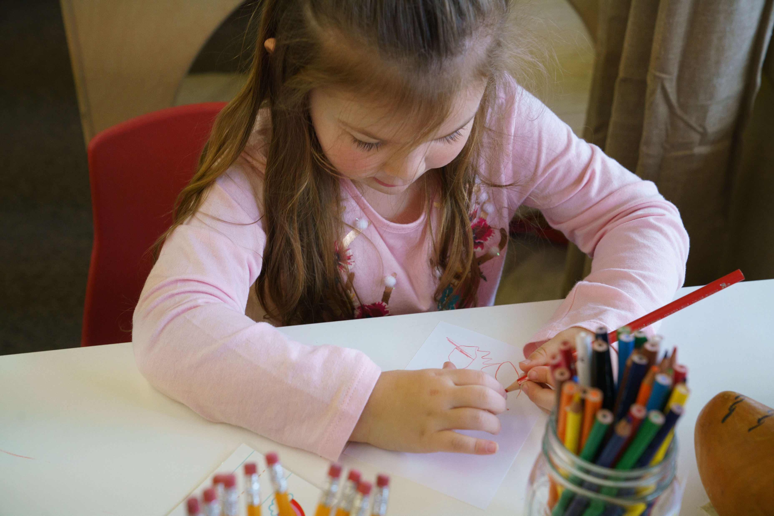
Why We Are
Concerned
About Early
Transition
Experiences
Notes:
Objective
To orient participants to the focus of this section
What to say
Now let’s discuss why we care about early transition experiences.

Slide 17
Early School Experiences Matter
We know that:
Effective early school experiences can close achievement gaps.
Stability and consistency between settings is crucial to children’s success.
Notes:
Objective:
To illustrate that early education experiences are important to children’s school success
What to say:
So now that we know stressful experiences are detrimental to children, how does education fit into it?
The answer is that early school experiences matter for children.
The slides we saw in the first section of this presentation showed some distressing trends, but the good news is that QUALITY EARLY CHILDHOOD EDUCATION CAN HELP TO CLOSE THESE GAPS, improve school readiness, and help children maintain and increase skills.
Stability and consistency between settings is one crucial component for early childhood success. This is one of the areas where transition experiences can really make a difference—by helping to bridge disconnects between pre-k and kindergarten, successful transitions can help to promote consistency between settings. Teachers’ emotional support and consistency predict children’s social and academic skills.
Sources on school readiness: NICHD, multiple years; Gormley, et al., 2008; and Ou and Reynold, 2006
Sources on changes in teachers association with school readiness: Tran and Winsler, 2011
Sources on teachers’ emotional support: Curby, et al., 2012; LoCasale-Crouch, et al., 2012

Slide 18
Early School Experiences Matter
Educator–child relationships predict:
  Academic and behavior outcomes through eighth grade, particularly for children with behavior problems in kindergarten.
  Stability of relationships with educators over time.
Notes:
Objective
To further illustrate how early education experiences, including family involvement, matter for children
What to say
Successful transition practices also promote early child–teacher and family–school connections, which benefit children.
Sources: Hamre and Pianta, 2001 and Jerome, et al., 2009

Slide 19
Early School Experiences Matter
Kindergarten family involvement is associated with:
  More cooperative, self-controlled, and socially engaged children.
  Lower rates of high school dropout, increased on-time high school completion, and higher grade completed.
  Higher achievement in language and math, and higher ratings on peer interactions.
McWayne, et al., 2004; Barnard, 2004; and Rimm-Kaufman, et al., 2003
Notes:
Objective
To show the connections between kindergarten engagement and children’s success in school and life

Slide 20

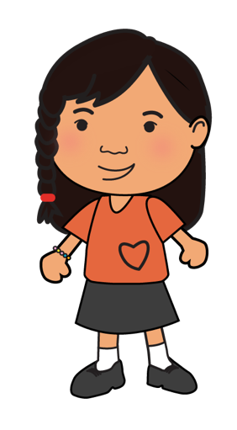
.
Transition Activities and Positive Outcomes
  At the beginning of kindergarten:
  Greater frustration tolerance
  Better social skills
  Fewer conduct problems
  Fewer learning problems
  More positive approaches to learning
More preschool to K transition practices
=
NCECDTL, 1,000 children, 250 schools
Notes:
Objective
To demonstrate that more transition practices result in better outcomes for children
What to say
More transition practices equal better outcomes for children.
Successful transition practices mean a less stressful transition and better adjustment to the new environment, which translates into children being more ready to learn instead of being distracted by adjustment problems.
The slide shows some examples of positive social emotional outcomes and general adjustment.

Slide 21
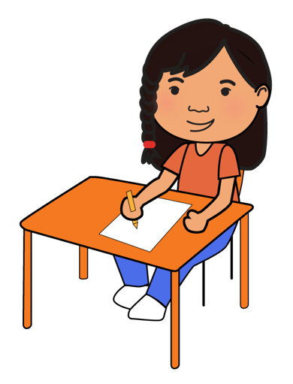
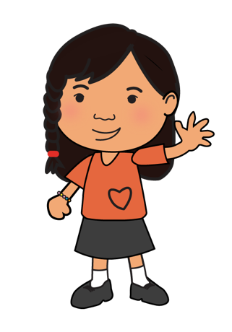
.
Transition Practices and School Success
Early Childhood Longitudinal Study
17,212 children, 992 schools
Fall K Transition
Practices
Spring K Academic Skills
=
  Schulting, Malone, & Dodge, 2005
Notes:
Objective
To convey that more transition practices also improve children’s success academically
What to say
As we see from a different study, transition activities also affect academic skills.
This study found that more transition activities in the fall translated into higher academic performance in the spring.

Slide 22
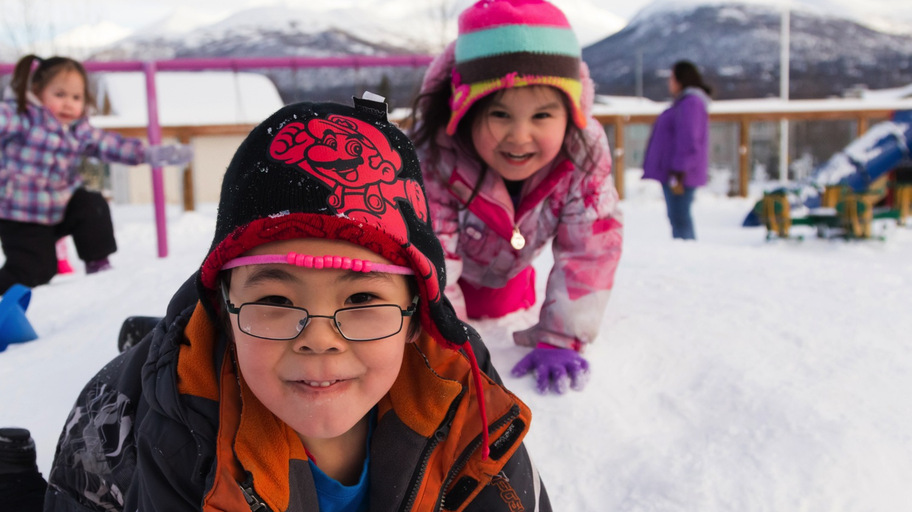
The Nature of
Kindergarten
Transition
Notes:
Objective
To orient participants to the focus of this section
What to say
So what is the nature of the transition to kindergarten? That’s what we will talk about now.

Slide 23

.
Early Learning Settings vs. Kindergarten
Preschool
Kindergarten
37%
33%
23%
20%
10%
6%
6%
4%
Free Choice/Centers
Individual
Small Group
Whole Group
LaParo et al., 2009
Notes:
Why are children having problems adjusting to kindergarten?
The simple answer is that the kindergarten setting is much different than the preschool setting. Children are having trouble adjusting for good reasons.
Children are coming from an environment where they are allowed a lot of developmentally appropriate free choice time and small amounts of time when they are required to work individually, to a setting where they have very little or no free choice time and a relatively large portion of time when they are asked to work individually.
Additionally, children in kindergarten are getting less individualized attention because they are spending more time in large groups.
It is important to note that the high amounts of free choice time in early learning settings are developmentally appropriate for young children.
portant to note that the high amounts of free choice time in early learning settings are developmentally appropriate for young children.

Slide 24
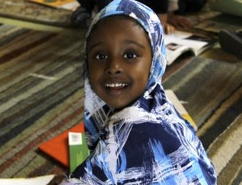
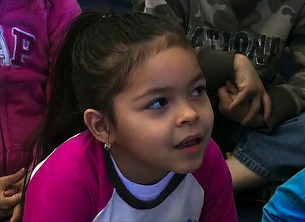
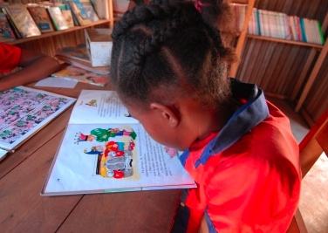
KINDERGARTEN CHANGES
Kindergarten Changes
Changes in academic demands and curricula
Less family connection with school
Complexity of social environment (peers and adults)
Less individual or small group time with educator(s)
Pianta & Kraft-Sayre, 2003
Notes:
Objective
To point out the many changes occurring at this stage in children’s lives, all of which can make adjustment difficult
What to say
The problem is that this developmental period is rife with change in context and experiences, creating disconnects and misalignment.
Kindergarten entry marks the transition from a less-structured preschool environment to a formal school setting with different demands and increased expectations (Rimm-Kaufman and Pianta, 2000).
These include:
Changes in academic demands
Less family engagement with school
More complex social environments
Less one-on-one time with teachers
These changes can lead to misalignment between preschool and kindergarten and put successful adjustment at risk.

Slide 25
Family Transition Experiences
His educator called several days before school started; it was great and really made Nate feel great.
At the beginning I got her excited by talking about starting school six months before it started….It made the transition easy….Before school started I took her to the classroom to get her adjusted to it.
I am pleased...The educator called after the first two days of school to say how well she was doing.
Pianta & Kraft-Sayre, 2003
Notes:
Allow participants to read the testimonials on the slide.
What to say
Here are some examples of good experiences parents and children have had with this transition.

Slide 26
Family Transition Experiences
On a more personal level, my son spends eight hours a day with his educator and his best friend. I want to know those people. I don’t want it to be a once-every-three-months-for-report-card thing. I want to have more interaction.
The educator called the first week of school to say
he is the biggest clown in the class.
Pianta & Kraft-Sayre, 2003
Notes:
Allow participants to read the testimonials on the slide.
What to say
Here are some examples of good experiences parents and children have had with this transition.

Slide 27
Family Transition Experiences
The kindergarten teacher called me the first week of school and said she should have been evaluated for Ritalin because she can’t teach her.
We weren’t sure about sending him, he may be too young. His kindergarten teacher called to say he’s way behind and should go back to preschool.
I’m not happy with it…I sent in notes but got no response from the educator…The kindergarten teacher is new and she’s not very organized. I’m anxious about this year.
Pianta & Kraft-Sayre, 2003
Notes:
Allow participants to read the testimonials on the slide.
What to say
Here are some examples of negative experiences parents and children have had with the kindergarten transition.

Slide 28
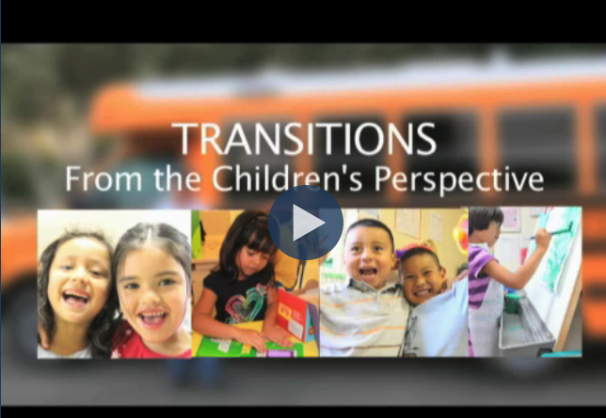
Kindergarten Transition Perspectives
Notes:
Objective
To show different perspectives on the transition to kindergarten
What to say
For many children, it is not easy to articulate their excitement or fears about kindergarten. In this video, we get a glimpse into what the experience can be like for children. These uncertainties are important to keep in mind as you work to create a smooth transition, so that you can address and ease children’s worries or curiosity about kindergarten along the way.

Slide 29
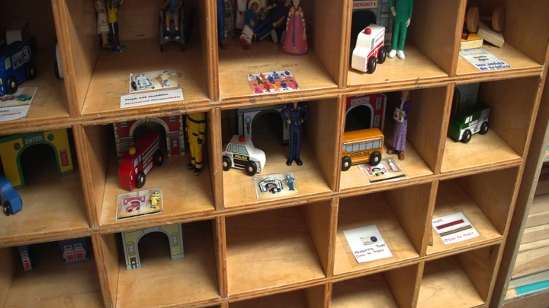
Conceptualizing
Effective
Transition
Notes:
Objective
To orient participants to the focus of this section
What to say
Now we will talk about a model to help us better understand the transition process.
Note that we will focus on the transition to kindergarten here, but the principles for successful adjustment that we’ll examine are the same principles that will promote successful transitions to other settings, such as starting Early Head Start, beginning preschool, etc.

Slide 30
Transitions Across a Lifetime
Becoming a new parent
Going to (or back to) college
Moving to a new town
Starting a new job
Experiencing an empty nest
Retiring from a career
Getting married
Notes:
Objective
To have participants think about transition experiences in their own lives and the resources they used to help them through those transitions
What to say
Transitions are not limited to the school environment. In fact, we experience transitions across the lifespan. The slide shows a few examples.
Think about the transitions you have made that you talked about earlier at your table. Think about what challenges they posed, and what resources helped you navigate those transitions.
So what types of resources did you come up with that helped you through some big life transitions?
What to do
Have several participants share some resources they relied on to get through their own transitions.
What to say
As adults, we actually know a lot about how to facilitate transitions. We do it every day.

Slide 31


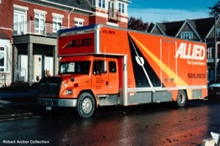



Transitions Across the Lifespan
Transition = Change = Difficulty
What creates successful transition?
Information
Relationships
Alignment
Successful Transition
Children need our help to manage these changes.
Pianta & Kraft-Sayre, 2003
Notes:
Objective
Use discussion points from participants regarding transition resources to emphasize the need for information, relationships, and alignment for the transition to kindergarten.
Convey that information, relationships, and alignment are what contribute to successful school adjustment.
What to say
The goal of a smooth transition is to create conditions for successful adjustment.
The three major contributions to setting up successful adjustment during transitions are:
Access to information (The more you know, the more at ease you feel).
Supportive relationships (People to support and guide you along the way is always important).
Alignment between environments (The more your new environment is like your old one, the easier your transition will be).
Again, as adults, we can make these things happen for ourselves. For kids, we have to make it happen for them.
As adults, we can make these things happen on our own, but children need our help.

Slide 32
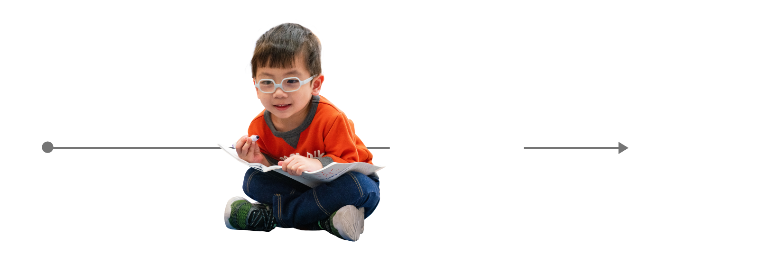
School Readiness and Transition
INADEQUATE VIEW
Cognitive Readiness & Intelligence
Language Abilities
Temperament
Poverty Status
Gender
Preschool
Kindergarten
Notes:
Objective
To convey that only a child-focused view of school readiness is inadequate
What to say
Often school readiness, and its measurement, is thought of as simply a set of skills that kids need, such as knowing the alphabet. However, this perspective ignores the fact that children’s learning is dynamic and heavily influenced by what’s happening and available around them in the classroom or at home.
Relationships and alignment between settings are important. The old way of thinking about transitions is inadequate.

Slide 33
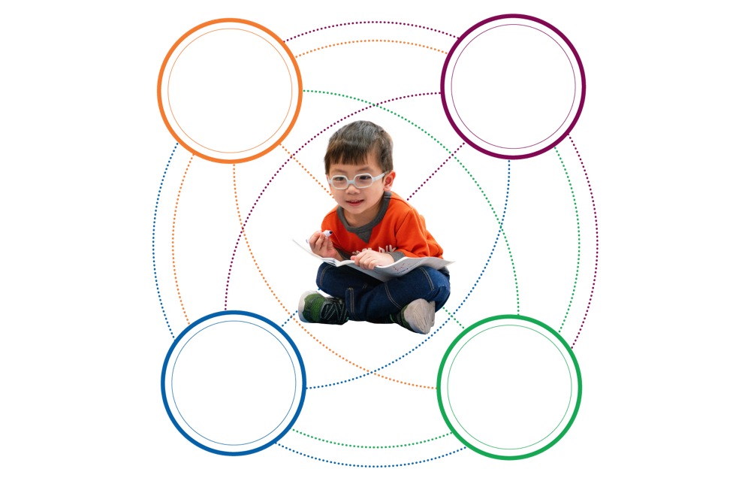
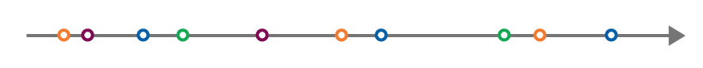
When Connections Are The Focus
Teachers
Peers
Community
Family
Early Experiences
Kindergarten
The changing dynamics of these relationships during transitions influence child outcomes.
Rimm-Kaufman & Pianta, 2000
Notes:
Objective
To convey the complexity of all the factors that contribute to school readiness for children and the resources that are needed. Also, to tie in examples from participants’ exercise about transitions from their own lives.
What to say
Research has found that it is more useful to take an interactive view of transitions.
In other words, there are both relational and informational links between children and the people and community around them, just like the examples from adult life.
There is a great web of potential supports that we as educators can tap into.
This framework, and not the child-focused framework, should then guide best practices for transition planning.

Slide 34
Guiding Principles
For successful transitions, remember that:
It’s a process, not a program.
Supportive and informational relationships are resources for children.
Connections serve as a bridge for children, families, and schools across time and contexts.
Pianta & Kraft-Sayre, 2003
Notes:
Objective
To convey the guiding principles to keep in mind when thinking about transitions
What to say
What makes for good transitions?
There are several guiding principles to keep in mind when thinking about transitions:
It is important to understand that the transition from preschool to kindergarten is a process and not a “one-size fits all” formula. For example, open houses may work for some families but not for others, and information given in English may work for some but not others. Individualization is key.
We need to remember the importance of relationships in children’s lives. They serve as a resource—and different relationships can meet different needs.
Parents can be a source of support as well as information. Also, peers can be a source of support.
There are connections between families, schools, communities, and children that can be used to help with the transition process.

Slide 35
Dual Language Learners (DLLs)
General transition practices are beneficial for all children. Children who are dual language learners can further benefit from additional supports, such as:
  Provide information to families in their home language(s).
  Communicate about the benefits of maintaining
  a child’s home language while learning English.
  Identify continued language learning services for the child in the new learning setting.
Notes:
Note to Presenter:
Refer participants to the handout: Transition to Kindergarten: Tips for Children with IEPs
Objective
To convey the importance of addressing the needs of different populations and what to consider in doing so
What to say
All children and families benefit from the same supports we’ve already discussed: information, relationships, and alignment. All populations can also make use of the connections addressed in the collaborative model of transition that we have reviewed, but there are some special considerations to keep in mind.
Dual language learners are one group who may need extra support during the transition to kindergarten. First of all, families of DLLs have the right to receive information about school, registration, and other matters in their native language. It is important that families know that this is their right so that they know to request it. This may include the provision of documents in more than one language and/or the use of a translator. Also, it is important that educators know the value of having children maintain their native languages while learning English. The advantages of maintaining their first language include:
Maintenance of family communication.
Establishment of a cultural identity therefore, fostering a stronger self identity.
Cognitive benefits.
Future financial benefits.
Children with special needs, such as disabilities will need the same supports as other children, but to an even greater extent. These children are more at risk for adjustment difficulties so a focus on communication between all parties should be a priority.

Slide 36
Children with Disabilities
Children with disabilities can benefit from the supports in place for all children, in addition to individualized supports, such as:
  Increased communication and planning between educators, consulting educators, families, and children.
  Participation by both Head Start and elementary school educators in the IEP transition planning meeting.
  Individualized accommodations prepared prior to the child’s arrival in the new school environment.

Slide 37
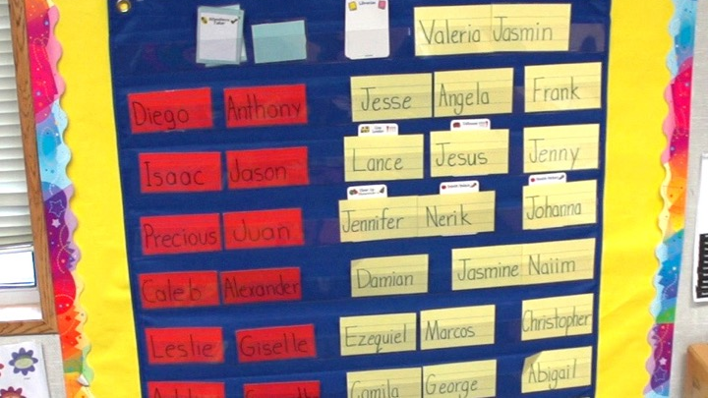
Transition
Connections
Notes:
Objective
Orient participants to what types of connections we will be talking about.
What to say
We will talk about four key sets of connections today, all of which contribute to the transition process. Then, we will discuss examples of how these connections can be used within this transition framework.

Slide 38
Child–School Connections
Goal: To foster children’s familiarity with the kindergarten setting and the people within it.
This serves to:
  Increase comfort.
  Decrease anxiety.
  Build educator–child relationships.
Pianta & Kraft-Sayre, 2003
Notes:
Objective
To convey the goal and importance of child–school connections
What to say
One important connection is that between the child and the school. The goal of this connection is to get the child familiar with the new classroom setting and the people who will be there.
One strategy to build this connection is to expose the child to his or her new setting before the start of school.

Slide 39
How a Child Sees Kindergarten
Emily: It’s a big, big, big school and there's more kids. Because there's hundreds and hundreds and hundreds. And there's kids that don't know each other's names. Everyone knows names here.
JS: Are you ready to go to kindergarten next year?
Marcy: Yeah.
JS: How do you know you're ready?
Marcy: Because I feel so happy.
Squires, 1999
Notes:
Objective
To illustrate that children do not necessarily see transitions as adults do
What to say
Here are a couple of interesting examples of how children view the transition to kindergarten.
They are not necessarily thinking about being able to follow directions, work independently, or excel in academics (the things that adults may see as the most important aspects of adjustment).

Slide 40
FAMILY–SCHOOL CONNECTIONS
Family–School Connections
Goal: To foster family collaboration and engagement with the school and the transition process. This serves to:
  Facilitate sharing of child data and records.
  Familiarize parents with school routines.
  Help parents to support learning at home.
Pianta & Kraft-Sayre, 2003
Notes:
Objective
To convey the goal and importance of family–school connections
What to say
Another connection we will talk about is the family–school connection.
The goal of this connection is to foster collaboration between these two parties in order to share information and become partners in the transition process.

Slide 41
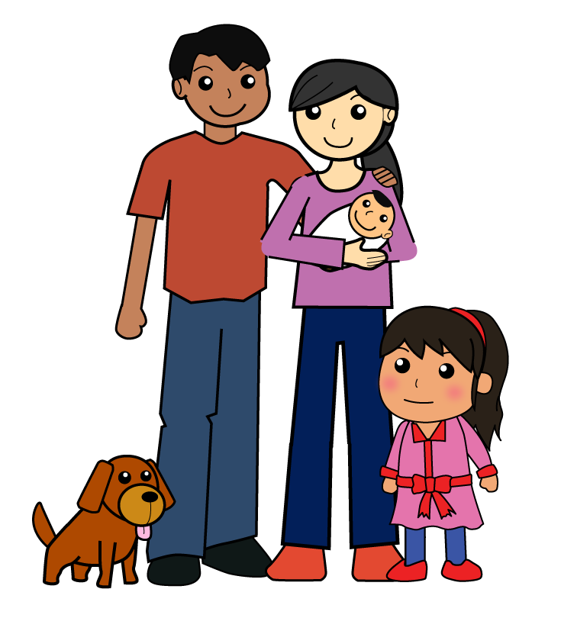
HOW FAMILIES CONTRIBUTE
How Families Contribute
Family well-being is a powerful predictor of school success.
Notes:
Objective
To convey the importance of the family in promoting school success
What to say
An important point to consider when talking about families is not only that family engagement in the transition process matters, but also that the general well-being of families also matters. Children from stable, well-adjusted families are typically better prepared for school entry than those who live in unpredictable or chaotic households.
Programs may be in a position to recommend resources and supports to families and children, which may help to improve family well-being.

Slide 42
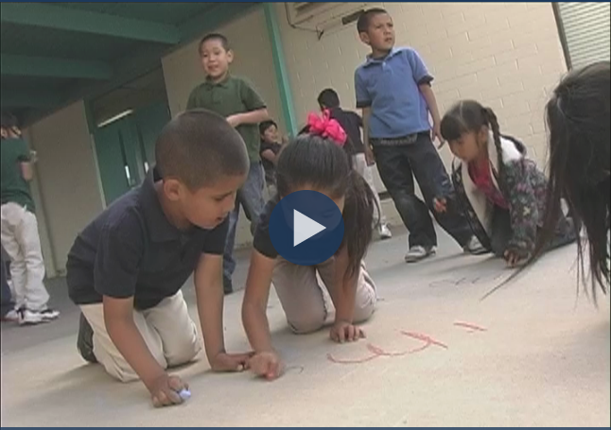
Connecting with Families
Notes:
Note to presenter: In order to show this video, you will need internet access during your presentation. If you do not have internet access, delete this slide.
Objective
To share an example of how one school reached out to families to help create a successful transition
(child–school connection)
What to say
Here’s an example of how one New Mexico Head Start program involved families in the kindergarten transition.
What to do
Show video

Slide 43
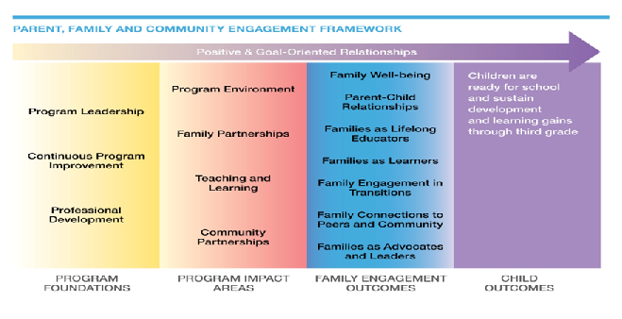

The Head Start Parent, Family, and Community
Engagement Framework
Successful Transitions
Notes:
Note to Presenter:
Refer participants to the Parent, Family, and Community Engagement Framework handout.
Objective
To convey the importance of family engagement in transitions from Head Start’s perspective
What to say
This is the Head Start Parent, Family, and Community Engagement (PFCE) Framework. Head Start recognizes that family engagement in successful transitions is important and that it is a key component for children being ready for school.
Parent and family engagement is about building relationships with families that support family well-being, strong relationships between parents and their children, and ongoing learning and development for both parents and children.
The PFCE Framework is a road map for progress in achieving the kinds of outcomes that lead to positive and enduring change for children and families.
The first section of the PFCE Framework outlines the importance of a systemic, integrated, and comprehensive approach to family engagement. Next, the PFCE Framework discusses parent and family engagement activities in the context of program foundations and program impact areas. Essentially, when parent and family engagement activities are systemic and integrated across program foundations and program impact areas, family engagement outcomes are achieved. The framework describes seven parent and family engagement outcomes. For each of the seven outcomes, it gives a definition and examples of program foundational strategies and program impact area strategies. It also offers examples of family progress for each outcome area.

Slide 44
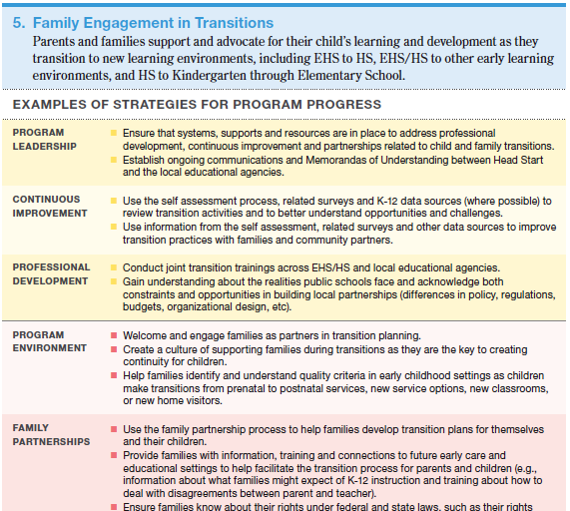
Available on:
Head Start’s Early Childhood Learning & Knowledge Center eclkc.ohs.acf.hhs.gov
Notes:
Objective
To convey the importance of family engagement in transitions from Head Start’s perspective
What to say
Here are some specific practices that Head Start suggests for facilitating successful transitions and engaging families in the process. This document as well as other important information on the PFCE Framework can be found on the Early Childhood Learning and Knowledge Center website at the address shown.

Slide 45
TRANSITION ACTIVITIES FOR FAMILIES
Transition Activities for Families
Percent of families who
found this activity helpful
Transition activity
Had child visit a kindergarten classroom
Met with the early childhood educator
Met with the principal
Took a tour of the school
Talked with Head Start staff about kindergarten
Visited the kindergarten classroom
Talked with families of new classmates
Participated in elementary school activities
Attended a workshop for families
Met with the new kindergarten teacher
Attended a kindergarten orientation event
99
89
95
100
99
97
97
100
98
92
96
Pianta et al., 1999
Notes:
Objective
To show that families found almost any transition strategy useful. They clearly want to be involved.
What to say
Here are some examples of both child and family connections with the school.
The point here is that there are many different ways to foster this connection, but out of all of these, almost all of the families who participated in any sort of connection with the school found it to be useful.

Slide 46
Program-School Connections
Goal: To provide children with stable, high-quality learning experiences and to increase consistency between settings by aligning:
    Routines
    Curricula
    Learning standards
    Assessments
Pianta & Kraft-Sayre, 2003
Notes:
Objective
To convey the goal and importance of program–school connections
What to say
Another connection is the program–school connection.
The goal of this connection is to provide stability in the transition from one learning setting to the other.

Slide 47
Transition Activities for Educators
 | Early Childhood Educators | Kindergarten Teachers
Transition activity | Percent who found the activity helpful | Percent who found the activity helpful
Children visiting their future kindergarten classroom Early childhood educator visiting a kindergarten classroom Holding an elementary school-wide event with new students Having a spring orientation about kindergarten for parents of preschool-age children Having an individual meeting between educators and families Sharing child records | 100 100 83 100 100 100 | 96 100 100 100 100 100
Pianta et al., 1999
Notes:
Objective
To point out that teachers find transition strategies useful as well, so they are likely to be open to the idea of using them
What to say
Here are some examples of program–school connection activities.
Again, as with the family–school connection activities, there is a variety, but almost all of the education staff who participated in any of these activities found them to be useful. This suggests that educators WANT to be involved in transition planning and strategies.

Slide 48
PROFESSIONALS WORKING TOGETHER
Professionals Working Together
Kindergarten and early childhood educators meet four times per year and focus on aligning experiences for children. The outcomes of this cooperation are:
  Increased participation in transition opportunities such as kindergarten camp.
  Increased consistency between settings related to routines and expectations.
  Increased awareness of the community needs for more spaces for children.
Smart Beginnings, 2011
Notes:
Objective
To share an example of one program–school transition effort
What to say
Here is an example of how one community used transition strategies.
Kindergarten and early childhood educators meet just four times a year, but are able to make a sizable impact. Outcomes include:
Children, families, and teachers feel more prepared.
Early childhood educators feel their knowledge of children and families is valued.
Kindergarten teachers feel children are more socially and academically prepared.
An additional preschool classroom may be added to the elementary school.
They also talked about differences between the two experiences that may confuse children, such as what bathroom signs look like, emphasis on handwriting, etc.

Slide 49
Community–School Connections
Goal: To facilitate the transition process with community support, including:
  Distributing information about the kindergarten transition.
  Identifying community resources, and providing them where they are needed.
Pianta & Kraft-Sayre, 2003
Notes:
Objective
To convey the goal and importance of community–school connections
What to say
A final connection to take advantage of is the one between communities and schools.
The goal of this connection is to provide information and resources that help to facilitate the transition.

Slide 50
Community–School Connections
Clarifying community hopes and needs regarding schools and the kindergarten transition.
Achieving inter-agency connections.
Providing additional support to children who are at risk.
Pianta & Kraft-Sayre, 2003
Notes:
Objective
Further convey what community–school connections can do. Convey that kids at risk are the ones not participating in transition activities, so this is where the community piece seems to really matter.
What to say
Community–school connections have a lot to add to the transition process. They can help assess needs and convey expectations.
Getting accurate information into the community about the kindergarten transition is key. For example, many people do not know about or may not understand all of the paperwork involved with kindergarten registration. Those who work with social services should be able to get help from social workers regarding information about what is involved and required of them.
Where the community connection really seems to matter is with kids who are at risk. These are the kids whose families may need extra notification about when to register for kindergarten, what is expected, and what resources are available to them. Community efforts that are geared toward these children are especially helpful.

Slide 51

Community in Action
Children’s Museum of Pittsburgh Website
Notes:
Objective
To share an example of a community–school connection
What to say
Here is one great example of a community–school interaction. A local children’s museum set up an event for entering kindergarteners, in which children could sit on a school bus and meet community employees they may come in contact with, such as crossing guards. Additionally, families could meet with child development experts and health care providers to talk about the transition.

Slide 52
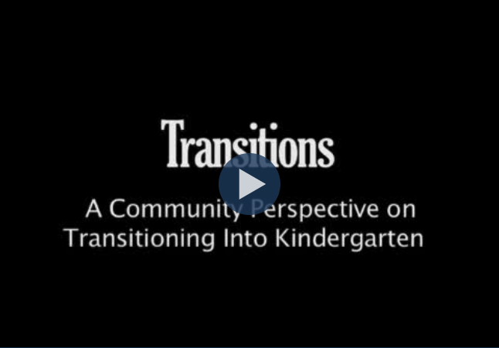
.
Transitions: A Community Perspective on Transitioning Into Kindergarten
Notes:
What to say
This video highlights the key role and potential benefits gained when the community is involved in the transition to kindergarten. Community support and resources can aid children, families, programs, and schools alike as they navigate the transition to kindergarten.

Slide 53
Kindergarten Camps
Child, family, program, school, and community connections support:
  Improved kindergarten social adjustment.
  Improved familiarity with routines.
  Reading and mathematical skills.
Berlin, Dunning, & Dodge, 2011; Borman, Goetz, & Dowling, 2009
Notes:
Objective
To convey that multiple connections can work together for positive outcomes
What to say
An example of all of these connections coming together is in kindergarten camps. When done well, all of the key players (children, families, programs, schools, and communities) are involved.
In a study of one kindergarten camp, researchers saw improved kindergarten adjustment for some children. Another study found that children who attended a kindergarten camp showed higher reading scores than those children who did not.
Both of these studies targeted “at risk” children, who likely benefit the most from such experiences.
But in many places, activities such as these are available only to children who have registered for kindergarten. So, many children who need this preparation the most—those who are at risk—are the last to sign up and therefore may miss out on these opportunities. This is where some of those steps we just talked about to increase community awareness can really help.

Slide 54
Benefits From Connections
Children become more socially ready and
can participate more academically.
Families become more connected to school, which improves long-term child outcomes.
Teachers achieve better relationships with children and families that improve child outcomes.
Pianta & Kraft-Sayre, 2003
Notes:
Note to Presenter:
Refer participants to Transition Activity Ideas by Connection. This handout provides ideas for activities to do based on the various types of connections. Also refer participants to Selected Children’s Books about Kindergarten.
Objective
To show that children who experience more connections during transition do better
What to say
The big messages here are that multiple large-scale, nationally representative studies keep showing consistent patterns: Children who experience an environment with more support and connections between key players within their lives reap the benefits by experiencing a successful transition to school, which in turn sets them up for both social and academic success in kindergarten.
Also, building these connections is a fiscally smart move. The transition activities advocated here cost little to implement and yield big results in terms of child outcomes.
So how do we, in more specific terms, build successful transitions?

Slide 55
Transition Questionnaire Results
Notes:
Note to presenter:
If the Pre-summit Questionnaire was given to participants, insert slides summarizing results here. If the survey was not given, delete this slide and continue on to the next section.
Objective
To review where this particular locality is in planning and implementing successful transition practices
What to do
Review questionnaire results with the group, drawing attention to those connections that seem to be receiving less attention. This will help participants focus their plans for future work.

Slide 56
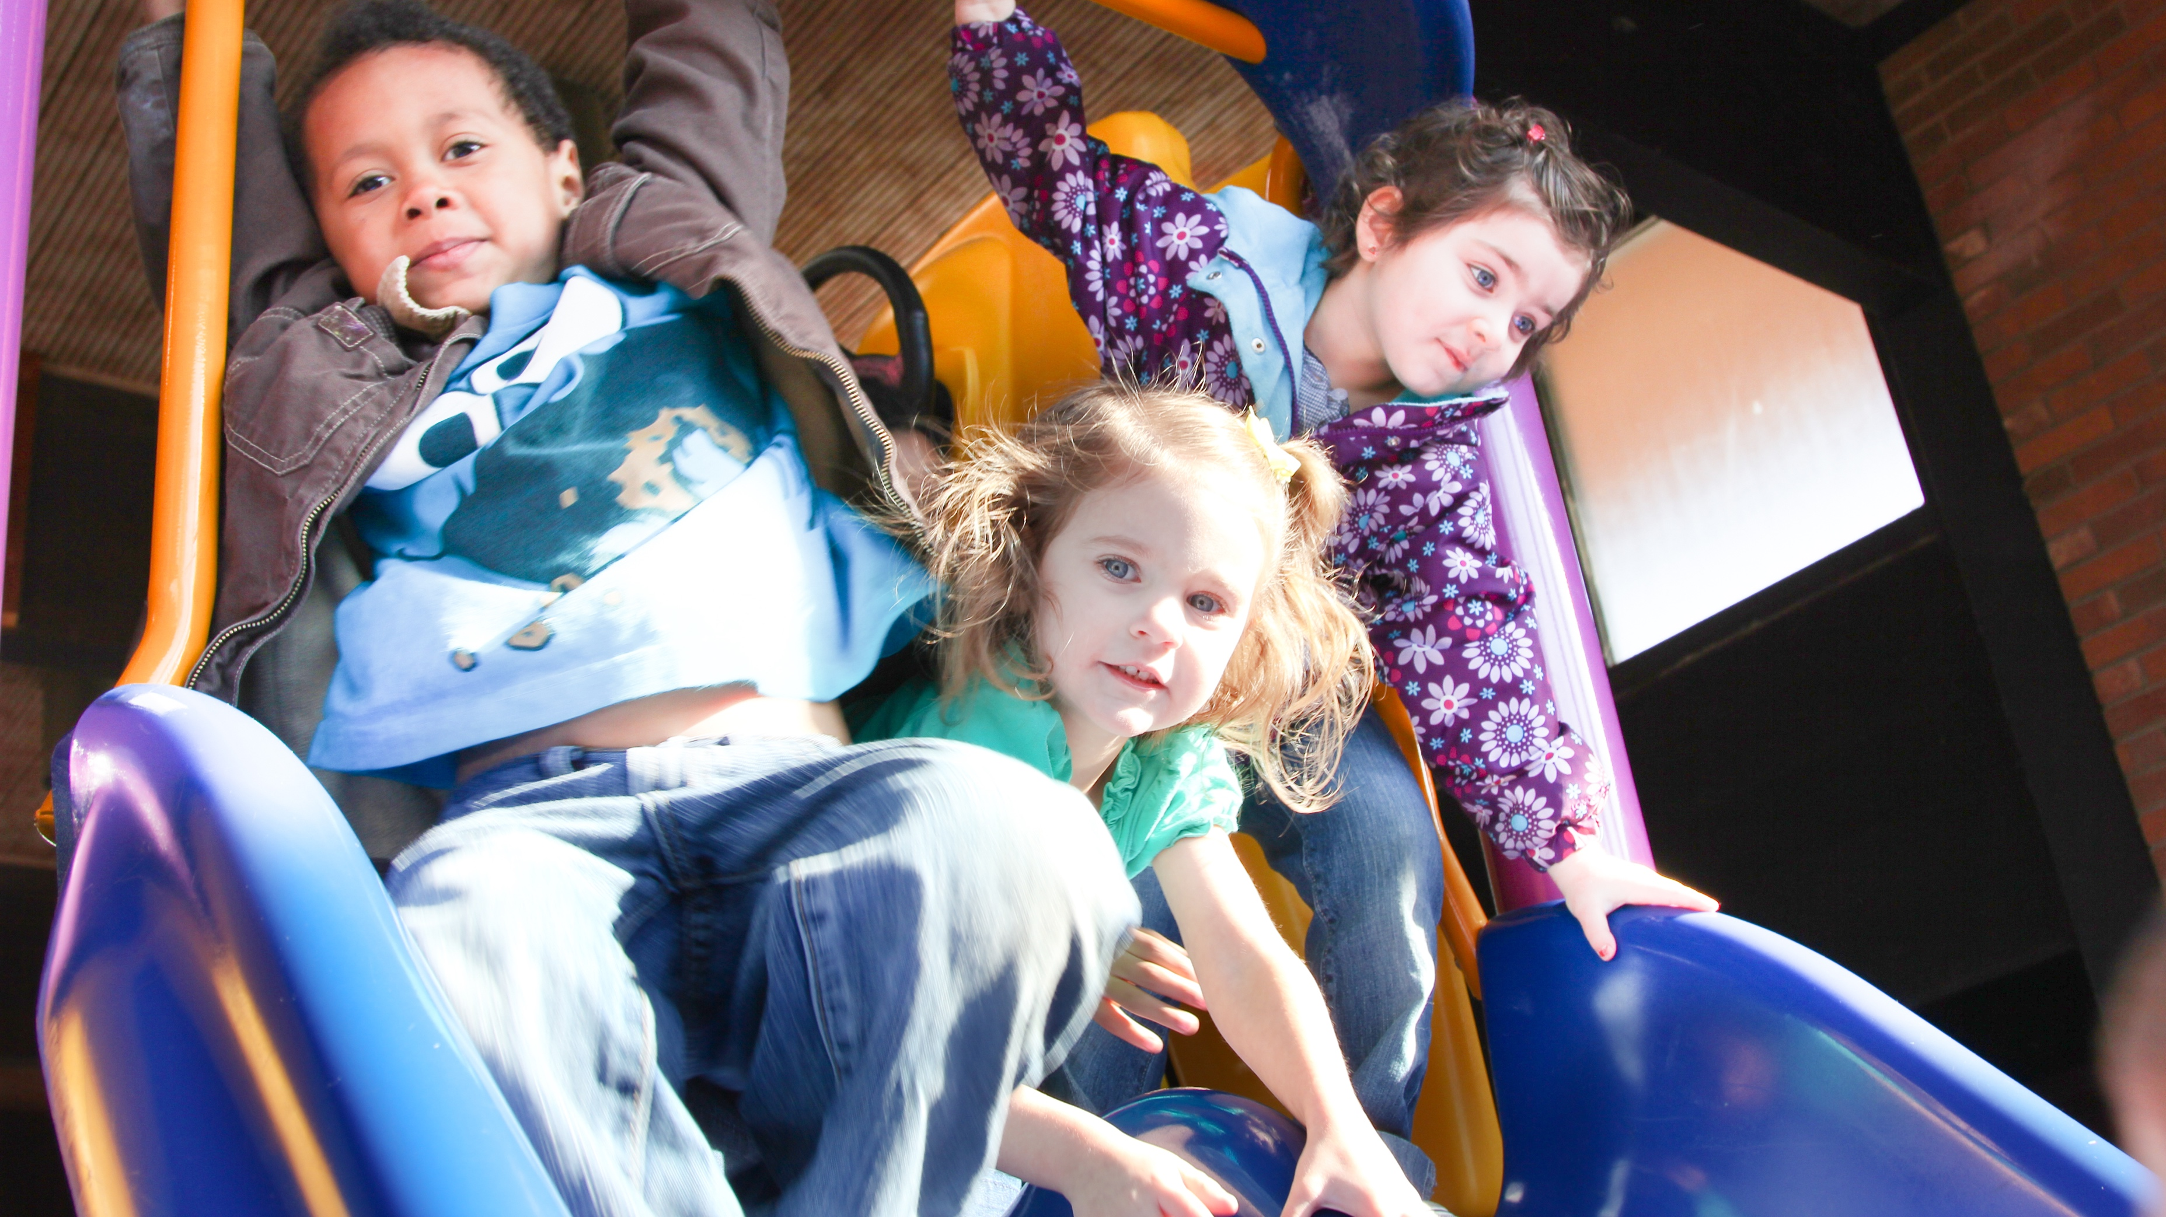
Aligning
Curricula
and
Assessments
Notes:
Objective
To orient participants to the focus of this section
What to say
How do we go about building successful transition experiences? The first step is partnering with others to facilitate collaboration. In this section we will address key steps to partner with schools and families.

Slide 57
Creating Partnerships
Partnerships:
Strengthen educational community.
Support transition.
Narrow the achievement gap.
Foster school-readiness and self-efficacy.
Engage parents.
Notes:
Objective
To convey some reasons why partnerships are important
What to say
These are some of the key reasons why partnering around the transition to kindergarten is important:
Partnerships strengthen educational community: The K-12 school system is embedded within a broader community that sustains (or impedes) the purposes of schooling. This broader education community (parents, other educational leaders, the business community, religious organizations, not-for- profit groups, and citizens in general) requires stewardship and careful cultivating to make it grow and flourish. One way to engage in the stewardship of schools is to form collaborative partnerships between preschools and kindergartens.
Partnerships assist children and their families with the transition to a new setting: Every transition is difficult. There are new routines, a new culture, new rules and procedures, and new people in power. This newness can produce anxiety for both children and their families. One of the facts of the educational system is that each new setting is larger and “busier.”
Partnerships help address the achievement gap: In most cases the achievement gap between middle class children and children from low-income households is evident at the entrance to kindergarten. One of the major purposes of early childhood education programs is to address this achievement gap and prepare children to be successful in kindergarten and beyond. Program–schools partnerships acknowledge this and work to increase the skills and knowledge of children entering kindergarten.
Partnerships can help make every student a confident learner: These partnerships address the idea of developing and maintaining a sense of self-efficacy for each child.
Partnerships involve families in the education of their children: Family engagement is a well-known correlate of student achievement. Families often need assistance in providing educational support for their children, and they need to feel welcomed by the school as important and valued members of the team that is educating their children. Many early childhood programs develop strong bonds with families, and kindergartens can leverage this bond if parents are made to feel welcomed and valued from the very beginning of the kindergarten experience.

Slide 58
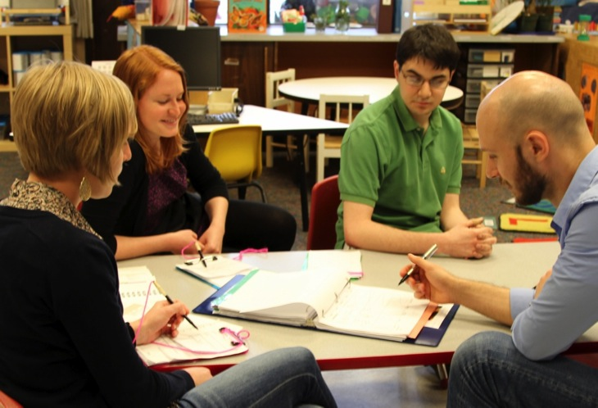
Big Ideas Around Partnering
  Partnerships can
  boost school
  achievement.
  Collaboration is a
  relational endeavor.
  Welcoming and
  supporting parents
  enhances child learning.
Notes:
Objective
To review some key concepts around partnering
What to say
These are some key ideas around partnering.
Partnerships can help kindergartens leverage the learning that takes place in preschools by creating a seamless transition of children and by articulating the curriculum between preschool and kindergarten.
Collaboration is a relational endeavor. Relationships matter. The key to the partnerships is built on individual relationships between the administrators and staff of the preschools and the kindergarten. Using your best relationship skills, especially listening and respect, are key components.
Welcoming parents and their children enhances child learning.

Slide 59
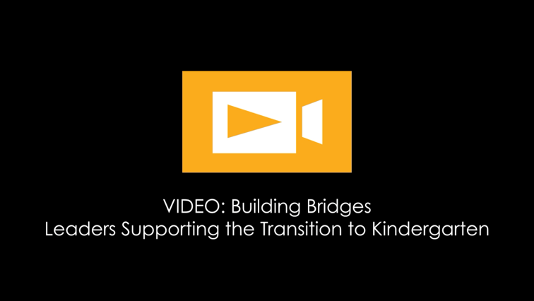
.
Leaders Supporting the Transition to Kindergarten
Notes:
Note to presenter: In order to show this video, you will need internet access during your presentation. If you do not have internet access, delete this slide.
Objective
To share stories and examples of leadership strategies for supporting the transition to kindergarten.
What to say
This video features a series of interviews with Head Start and elementary school leaders who have successfully navigated the transition to kindergarten, and offers a variety of practical leadership strategies while highlighting the key components of successful kindergarten transitions.

Slide 60
Video Discussion
  Overall impressions or concerns
  The importance of the program–school partnership
  Strategies for partnering and possible barriers
Notes:
Objective
To discuss thoughts and ideas related to the video
Have groups discuss and share answers to the questions listed.
What to say
Some key ideas:
Community commitment to education is enhanced by program and school partnerships.
The partnership team consists of the kindergarten teacher, family, and early childhood educator.
Kindergarten teachers and early childhood educators can discuss kindergarten entry expectations.
Early childhood programs can inform kindergarten teachers what children know, their development, and learning.
Partnerships can work on aligning curricula and sharing common expectations.
Early childhood program staff and kindergarten teachers can inform families about what their children need to know to be successful in kindergarten, how families can help their children at home, and what to expect in kindergarten.
One way to start forming family partnerships is to have families and their children meet with kindergarten teachers before schools starts.
The most important feeling for kids entering kindergarten is “I can” (i.e., self-efficacy).

Slide 61
Forming Partnerships
Create list
Meet
Share
Visit
Form plans
Notes:
Objective
To review a process for forming program–school partnerships
What to say
This is a process you can use to help form program–school partnerships.
Create a list of elementary schools that your students feed into (for early childhood audiences) or early childhood programs from which you receive children (for elementary school audiences).
Select one early childhood program or school to start partnering with and then replicate the process with others. Starting small makes this process seem doable.
The program and school leaders should meet to discuss the partnership and make plans.
The leaders need to establish the importance of this partnership and serve as leaders, as well as arbitrators if problems arise. It is very important for the leaders to form a strong, positive relationship and get buy-in from one another.
Identify people in the kindergarten and early childhood settings who will serve as primary liaisons.
Someone needs to be the primary liaison: a person who wakes up every morning thinking about what needs to be done to make this project work.
Begin sharing information and making plans.
This can include cross-site visits of staff or shared professional development.

Slide 62
Forming Partnerships with Families
Devise activities.
Support family members.
Facilitate
the establishment of formal groups.
Notes:
Objective
To review a process for partnering with families
What to say
Welcoming and supporting parents enhances child learning.
Devise activities to welcome parents to preschool or kindergarten, perhaps before schools starts.
Support parents in working with their children at home.
Facilitate the formation of formal parent groups.
Develop effective transitions for children AND their families from early learning settings to primary school.

Slide 63
Partnering: A Joint Effort
Early childhood and elementary school leaders jointly ensure successful transitions.
Teachers need guidance and support from leadership to implement transition practices.
The best transition plans include collaboration between administrators, educators, parents, and community members.
There should not be an adversarial relationship between educators and leadership.
Notes:
Objective
To share the importance of effective partnering
What to say
When talking about effective partnering, it is important to note the points in the slide.
Everyone has the same goal in the end—to help children succeed.

Slide 64
Elements of Effective Partnering
Creating effective partnerships requires focused effort and leadership.
Transition work is most effective when strong relationships and valuable partnerships are established before kindergarten starts.
Successful transition teams have leadership, support, commitment, active engagement, connections with families, and access to community resources.
Notes:
Objective
To share the importance of effective partnering and introduce key elements of successful partnering
What to say
Creating effective partnerships requires:
Commitment to shared goals by all stakeholders.
Active engagement of preschool programs.
Shared understanding of the importance of quality early learning experiences.
Connection with families.
Ready access to community resources and support.

Slide 65
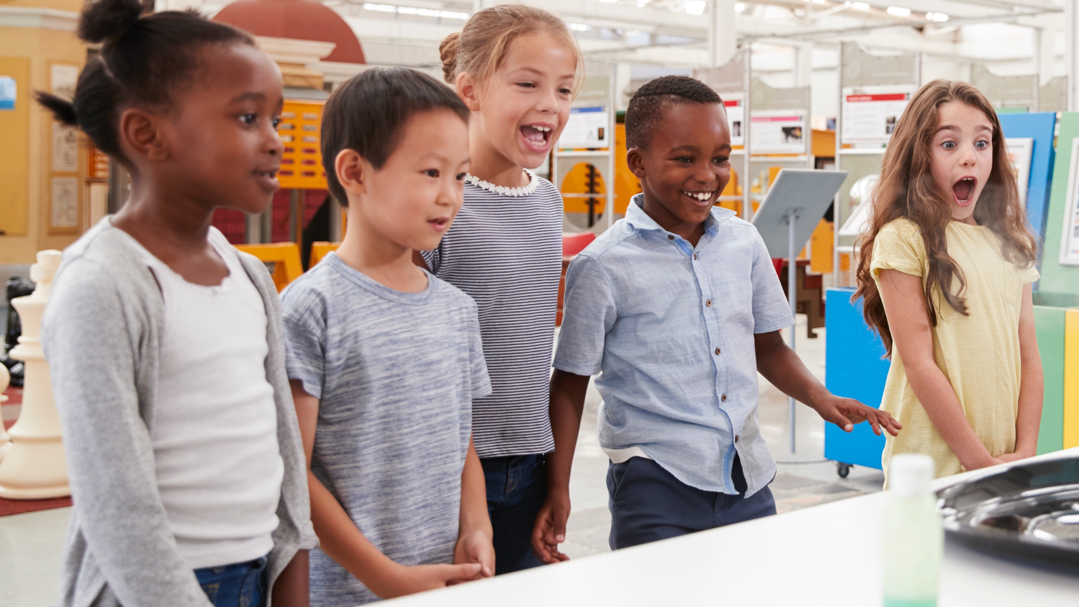
Aligning
Curricula
And
Assessments
Notes:
Objective
To orient participants to the focus of this section
What to say
One key to facilitating successful transitions is communication between programs and schools over alignment of curricula and assessments. This kind of coordination helps to ensure that children will be entering kindergarten prepared to meet the demands of their new setting.

Slide 66
Early Childhood–Kindergarten Similarities and Differences
Discuss:
  In what ways are early learning and kindergarten curricula and philosophies similar?
  In what ways they are different?
Notes:
Objective
To elicit thoughts on similarities and differences between early learning and kindergarten curricula and instruction and then discuss some of those similarities and differences.
What to do
Have participants volunteer thoughts about these questions. Then move on to talking about the differences between early learning and kindergarten settings.
What to say
Early childhood education curricula tend to be child-centered in that the development of the whole child (social emotional, cognitive, self-help) is emphasized through the use of child-selected activities that promote typical development.
Many early childhood programs attend to issues of nutrition, family support, and community services as well as education. Some programs serve children from very impoverished backgrounds, and the students enter the program far behind their typically-developing peers.
But kindergartens tend to be driven by the standards in place in any given district. The standards tend to focus heavily on academic skills. Many kindergarten teachers expect entering kindergarten students to be able to follow complex directions and to have large vocabularies and solid peer relationship skills.
Often the gap between expectations and reality is rather large. Kindergarten teachers wonder, “What were they doing in their early learning programs?”
These gaps in child behavior and educator expectations often lead to tension between kindergarten and early childhood educators. The partnership ideas we espouse address these tensions and propose ways to bridge these differences so early childhood programs and kindergartens can become allies in educating young children.

Slide 67
Head Start vs. Kindergarten
Head Start | Kindergarten
3.5+ hours/day | 6+ hours/day
1:10 staff-child ratio | 1:25 staff-child ratio
Play-based, implicit instruction | Explicit instruction
Child-directed | Teacher-directed
Developmental focus across the learning domains | Focus on academics
Notes:
Objective
To review key differences between early childhood settings and kindergarten settings
What to say
Basic differences between early childhood programs and kindergartens typically include structural differences (length of day, size of setting), the developmental levels of the children, expectations for independent behavior, curriculum focus, and instructional philosophy.
This graphic shows some examples of how these two settings might differ, but keep in mind that these variables can be different. For example, a Head Start program may have children in programming for 6 hours a day and then those children may move to a half-day kindergarten program where the hours are actually fewer. In either case, the point is that, more often than not, there are big changes when moving between settings.
Besides possible differences in the length of the school day, there are other important shifts. The decrease in the number of adults in the learning setting means children need to be more independent and competent in following group directions. There are also other, larger children in the schoolwide setting. Children are expected to behave more independently and to focus more on academics.
These differences are relatively significant for the children who make the transitions and for the educators that attempt to find ways to align curricula. There are many opportunities to disagree and to collaborate. Rather than to try to make early childhood programs look like elementary schools or vice a versa, we recommend that educators search for some common areas to align.

Slide 68
First Steps for Alignment
Get to know and understand each other’s practices.
Understand each other’s expectations.
Conduct visits of both settings.
Become colleagues and allies.
Notes:
Objective
To present the first steps to take toward creating alignment
What to say
The first phase of aligning the curricula is to provide multiple opportunities for educators from both settings to interact with one another, sharing their current practices, expectations, and hopes for their program and the children. Visiting each other’s settings is one very powerful early activity.
Sharing curriculum, assessment procedures, and teaching strategies also helps to build relationships and understanding.

Slide 69
Commonalities and Gaps
Share current assessment information.
Identify alignments and misalignments.
Align curricula and practices by building on commonalities and filling in gaps.
Notes:
Objective
To share steps for determining where curricula and practices already align and where they need to be modified to create alignment
What to say
As the relationship grows between the staff from the two programs, one possible activity is to start sharing assessment data from each program and look for commonalities and ways to expand them.
The next phase is to look at gaps in the data—for example misalignment between kindergarten entry preparedness and expectations.

Slide 70
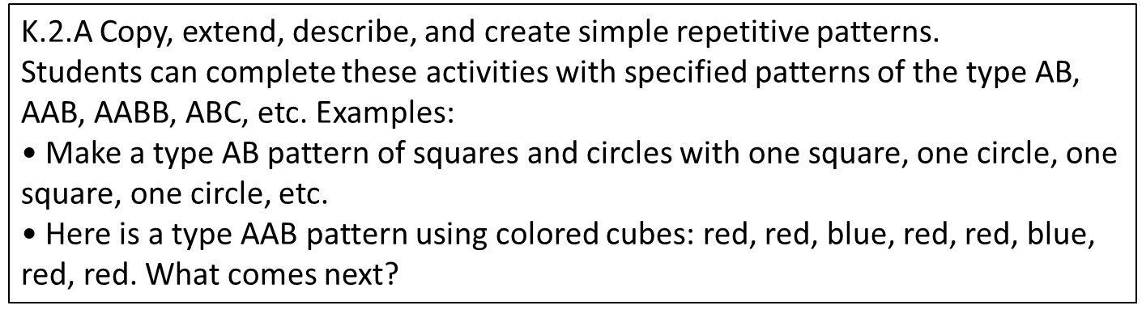
Curricular Alignment
September | December | March | Extension
Show interest in simple patterns in everyday life. | Copy simple repeating patterns. | Extend and create simple repeating patterns. | Recognize, create, explain, and extend more complex repeating patterns and simple growing patterns.
Notes:
Note to Presenter:
If audience members need clarification on growing patterns, the following definition comes from the High Five Mathematize: An Early Head Start and Head Start Math Resource Guide (2010): A pattern in which there is a predictable change in number or size. An example is the “plus one” pattern in which each unit in the sequence has one more element than the one preceding it (e.g., A, AA, AAA, AAAA).
Objective
To show an example of how a slight modification in one early learning standard can help align it with an upcoming kindergarten standard
What to say
Here is one example of how a small modification can foster alignment.
The top portion of the slide is an excerpt of an early childhood program’s curriculum map for mathematics. The “extension” section contains the “next step” skills—skills that are not expected to be mastered by the end of the early childhood program, but may be appropriate goals for children who are more advanced. The extension skill aligns very closely with the Washington State kindergarten standard, reproduced in the lower box, and the skills in the previous columns logically build up to the extension skill. This allows for a seamless transition to kindergarten. It also provides guidance for individualization for children who exceed expected skill levels.
In creating the kindergarten map, educators observed that entering students did well with repetitive patterns but that the students tended to have an overly narrow understanding of the concept of patterns as strictly repetitive in nature. The text in red shows that “simple growing patterns” was added to the extension. Though the concept of simple growing patterns remains outside the main early childhood curriculum, its inclusion in the extension alerts early childhood educators to broaden their definitions of patterns when teaching.

Slide 71
Creating Assessments
Common assessments include:
Key kindergarten readiness skills.
Embedded assessments.
Accessible instructions.
Notes:
Objective
To convey important points around creating common assessments
What to say
Some things to think about when creating common assessments:
If data are presented using the criteria of kindergarten entrance skills, the information will be immediately transferrable to the kindergarten classroom. Part of the collaboration effort should be aimed at developing an easy format to share these data.
Families are a great source of information about their children, who often behave differently in the school setting. The early childhood educator is frequently the best source of information about how a child does in a learning setting with skills more likely seen at home (e.g., transitioning with a group, rhyming skills). They may also have tips and suggestions to offer about working with individual students.
Kindergarten teachers share the entrance and exit kindergarten standards with the early childhood educators. This enables the early childhood educators to understand the kindergarten curriculum and the standards the kindergarten teachers are expected to meet. The purpose is not to make early childhood education programs a “boot camp” for kindergarten, but to provide the early childhood programs with information about kindergarten expectations. Both academic and social emotional goals should be included in this process.
Common assessments do not have to be formal or standardized assessments. Embedded assessments, in which data are collected within naturally occurring activities, can act as the common assessment instead. Educators from both settings can collaborate on identifying activities that are appropriate for both settings and embedding the assessment for key skills within them.

Slide 72
Alignment of Assessments
 | May
Demonstrates knowledge of patterns | Extends and creates simple repeating patterns; note pattern and tool used Beading: red-blue (create) Movement: clap-clap--stomp (extend) | 1 Does not create simple repeating patterns 2 Creates simple patterns 3 Creates and extends simple patterns across a variety of activities
Phonological awareness | Child identifies if a rhyme: Man/Pan Y N Bear/Chair Y N Cat/Dog Y N Pig/Wig Y N Bat/Ball Y N | 1 Does not identify whether or not word pairs rhyme 2 Correctly identifies whether or not 1–3 word pairs rhyme 3 Correctly identifies whether or not 4–5 word pairs rhyme
Notes:
Objective
To show an example of an aligned assessment
What to say
This table is an excerpt of a sample student progress data sheet from a preschool program. Data are taken on this sheet every quarter. The slide shows the last progress checkpoint (May). Items in red are exit data taken on a particular student that could be included in the student’s file and passed along to the kindergarten teacher.
Note that:
The data sheets contain only key kindergarten readiness skills. This helps keep information to both collect and access. For this particular early childhood program, each student has one progress data sheet for each curriculum area (e.g., literacy, math, social skills).
The assessments are embedded within naturally occurring activities, such as beading, movement activities, and songs and rhymes in contexts such as free play, circle time, meals, and transition.
The data sheet is designed to be very easy to use. Most of the data collection involves circling the appropriate selection.

Slide 73
Curricula and Assessments
To evaluate curricula and assessments:
Use child data.
Use data on academic entrance levels.
Use data on social entrance levels.
Conduct joint review of data and use for planning changes.
Notes:
Objective
To highlight how preschool programs and schools should evaluate their curricula and assessments to better meet each others’ needs
What to say
As preschool programs begin to collect data on the exit skill levels of their children, kindergarten teachers can compare these data with the desired entrance standards for kindergarten. Joint meetings between preschool and kindergarten teachers can use these data to talk about changes in the preschool and kindergarten curriculum. These meetings also provide an opportunity to share instructional ideas.
As the process continues, this group of preschool and kindergarten teachers can use data from their assessments to start revising curricula in ways that are appropriate for both programs.

Slide 74
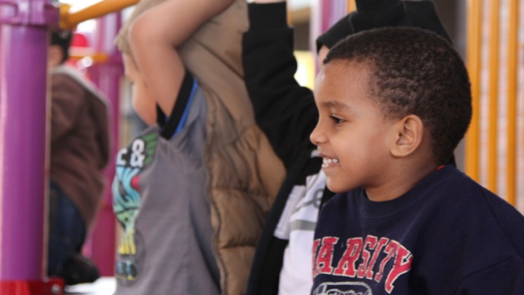
Building
Successful Transition Experiences
Notes:
Objective
To orient participants to the focus of this section
What to say
Now we will look at how to plan transition practices and carry them out.

Slide 75
Six Steps for Transition Planning
1. Assess your partnerships.
2. Identify the goals of the transition team.
3. Assess what is happening now.
4. Identify data to support practices.
5. Plan and prioritize.
6. Implement and evaluate.
Pianta & Kraft-Sayre, 2003
Notes:
Objective
To go over the steps of transition planning with participants
What to say
There are six steps to planning transitions successfully. These steps are taken from a very useful resource for transition planning: “Successful Kindergarten Transition: Your Guide to Connecting with Children, Families, & Schools” by Bob Pianta and Marcia Kraft-Sayre.
In the following slides, we will discuss each of the six steps in detail.

Slide 76
1. Assessing Your Partnerships
Who is involved?
  Educators (early childhood and kindergarten)
  Leaders (early childhood and kindergarten)
  Family representative(s)
  Community leaders
Pianta & Kraft-Sayre, 2003
Notes:
Objective
To convey who should be involved in the transition process and have participants evaluate who is on their team and who might be missing. Participants should also fill in Step 1 of their transition plans.
What to say
Who should be involved in your partnership or transition team? At a minimum, you will need:
The early childhood program represented–both educators and leaders
The kindergarten represented–both teachers and leaders
Families involved–for example, having a parent representative
The community represented–which could be a representative who works with a local initiative to support children and families
It is important to have all of these bases covered to get all perspectives.
Now I’ll give you a few minutes to fill in the first step on your transition plan and think about who might be missing from this group or who could be a valuable addition.
What to do
If desired, stop here for two to three minutes and have participants fill in the first step on their transition plan and think about who is represented.

Slide 77
2. Identifying Team Goals
Choose several goals that fit your program’s needs. Some examples are:
  Support children being ready for school
  Help families know more about how to support learning and school readiness at home
  Get your community more involved with children
Pianta & Kraft-Sayre, 2003
Notes:
Objective
To prompt teams to set goals and fill in Step 2 of their transition plans
What to say
Next, we will identify some goals that are appropriate for your program.
The slide shows a few example goals, but think about your individual program needs and create your own. Feel free to brainstorm with those around you. We’ll stop here for a few minutes while you come up with your own goals and fill in Step 2 in your transition plan.
What to do
If desired, stop here for three to four minutes for participants to fill in Step 2 of their transition plan.

Slide 78
3. Assessing What is Happening Now
Sort what you are currently doing into categories, for example:
  Fostering child–school connections
  Fostering family–school connections
  Fostering program–school connections
  Fostering community–school connections
Pianta & Kraft-Sayre, 2003
Notes:
Objective
To have participants think about their current transition practices
What to say
Now we want to think about what you are doing currently to promote successful kindergarten transitions in the areas we have talked about.
This will help you see where you need to focus more attention.

Slide 79
3. Assessing What is Happening Now
Take a few minutes to talk at your tables about transition practices that are going on in your programs.
Write these practices down on sticky notes and place them under the connection they best fit into.
Notes:
Note to presenter:
Print Activities By Connection signs and post these around the room. Have participants follow the above instructions and group their present transition activities under each sign. Afterwards, have a discussion about which connections seem to be getting the most attention and which seem to be lacking activities.
Objective
To have participants think about the connections they are currently fostering and those they may need to work on more
What to say
We’ll start with an activity to get you thinking.
What to do
Conduct activity.

Slide 80
4. Examining Data You Have
How do you know your current practices are working?
  Are children transitioning better because educators read them books about kindergarten?
  Are more families registering early for kindergarten because of community efforts?
  Are kindergarten educators better informed about individual students because of program–school collaboration?
Pianta & Kraft-Sayre, 2003
Notes:
Objective
To have participants examine evidence for what they are doing and fill in Step 4 on their transition plans
What to say
So how do you know if your current transition practices are working? You need to look for evidence in trends including increased parent participation, early registration, and/or children seeming more prepared as they enter kindergarten. You should also examine whether benefits or declines are also seen among subgroups of children and families, such as dual language learners or children who require special services.
Take a few minutes to review the data you can think of that might support what you’re currently doing. You can fill this in on Step 4 of your transition plan.
What to do
If desired, give participants five minutes to fill in data on their transition plans.

Slide 81
5. Planning and Prioritizing
Determine next steps—Reevaluate goals and formulate new ones.
Identify who is responsible for tasks—Assign roles within the transition team.
Decide when tasks should be implemented—Set deadlines and a timeline.
Anticipate barriers and make plans to overcome them.
Pianta & Kraft-Sayre, 2003
Notes:
Objective
To talk about what planning and prioritizing involves and the importance of this step
What to say
This is probably the most complex and challenging step of transition planning, but it is also the one that can potentially reap the most benefits.
During planning and prioritizing you need to decide what to add to your existing transition practices by reevaluating your current goals. Next you need to:
Plan steps to address new goals.
Assign tasks to individuals.
Decide when tasks should be done.
Set deadlines.
Anticipate barriers and plan how to overcome them.

Slide 82
Timeline Example
EARLY CHILDHOOD
PROGRAM
SUMMER
KINDERGARTEN
September
April
June
August
September
Family group
meetings
Inform parents about home literacy
activities
Research locations for K-camp
K-camp fundraising
Preschool & K educators
transition efforts
Class lists for K
Visit K
K-camp fundraising
Use community
resources to spread info about K-camp
Remind parents of home literacy
activities
School playground
nights
K-camp enrollment
Open houses
K educators and
parents meet
K screenings
K-camp
Back-to-school
nights
Foster family
connections
w/ educators
Notes:
Objective
To show a sample of what a timeline might look like and have participants fill in Step 5 of their transition plans
What to say
This is one example of a transition timeline that stretches across one year. As you can see, actions are being taken as far ahead as autumn one year before kindergarten to set up successful transitions, based on the example goals we mentioned earlier.
Now I’m going to give you time to brainstorm new transition practices. Think about who might be responsible for tasks, and create a rough timeline for when things can be done. This will be done in Step 5 of your transition plan. We’ll take about 10 minutes to do this here, but you can certainly continue to refine this later.
What to do
If desired, give participants 10 minutes to work on filling in Step 5 of their transition plans.

Slide 83
6. Implementing and Evaluating
Implement the plan you created.
Evaluate whether what you are doing is working and how you know.
Examine data on new practices to identify changes.
Modify practices as needed and define
new goals.
Pianta & Kraft-Sayre, 2003
Notes:
Objective
To prompt participants to implement their new plans and evaluate them afterward
What to say
Now that you have sketched out your new plans, it’s time to go out into the world and implement them.
Remember that you need to continuously evaluate what you’re doing to make sure your efforts are providing you with the desired results.
And finally, this process should be repeated each year to continually build and refine your transition plans and practices.

Slide 84
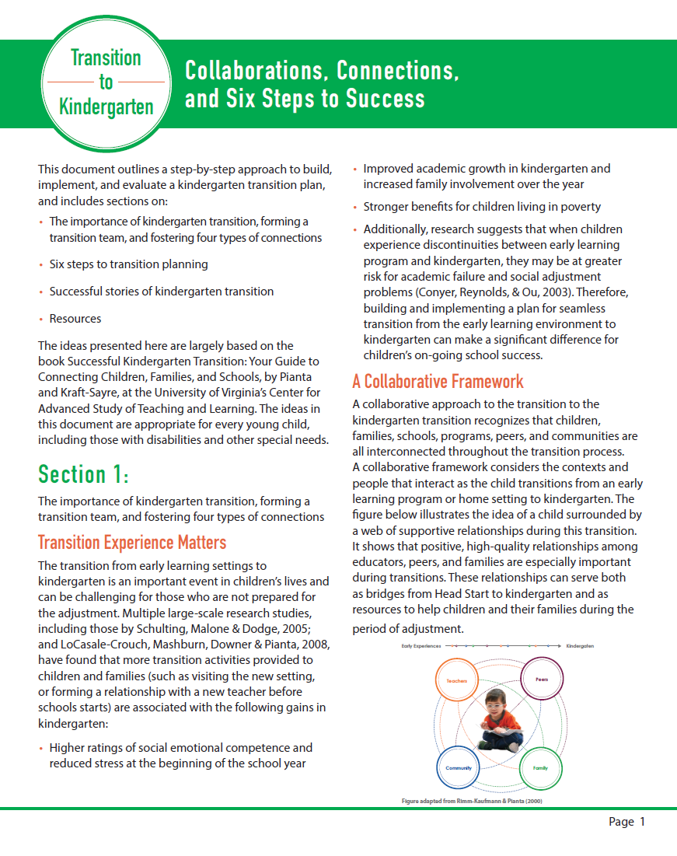
Planning the Transition: Six Steps
Notes:
Note to presenter:
If you present the previous slides on the six steps for transition planning, use this time to introduce the Planning the Transition to Kindergarten: Collaborations, Connections, and Six Steps to Success document. The document provides more detail on transition planning.

Slide 85
Presentation Summary
Today, we covered
1. The state of school readiness.
2. Why we are concerned about early transition experiences.
3. The nature of the kindergarten transition.
4. Conceptualizing effective transition.
5. Transition partnerships.
6. Building successful transition experiences.
Notes:
Note to presenter:
This is a sample presentation summary. Modify it to fit your presentation. This agenda follows the PPT presentation as it now stands.
Objective
To summarize and reflect on the content covered in this presentation.
What to say
In this session, we talked about:
The current state of school readiness, particularly in at-risk populations in the United States.
The importance of early childhood transitions and the effects of these experiences on success in school and life.
What we know from research and practice about children’s transition experiences and their adjustment to school.
Three major components for fostering successful adjustment: information, relationships, and alignment.
The goals and importance of each of the four types of transition connections.
6. The best practice, evidence-based framework for creating successful preschool to kindergarten transitions and examples of practices which use that framework.

Slide 86

Questions?
Questions?
Notes:
Objective
To provide participants an opportunity to ask any remaining questions and prompt discussion about the presentation content.
What to say
Let’s take a few minutes to reflect and address questions or thoughts that this presentation brought up for you. Would anyone like to share any lingering questions? Comments? Ideas?

Slide 87
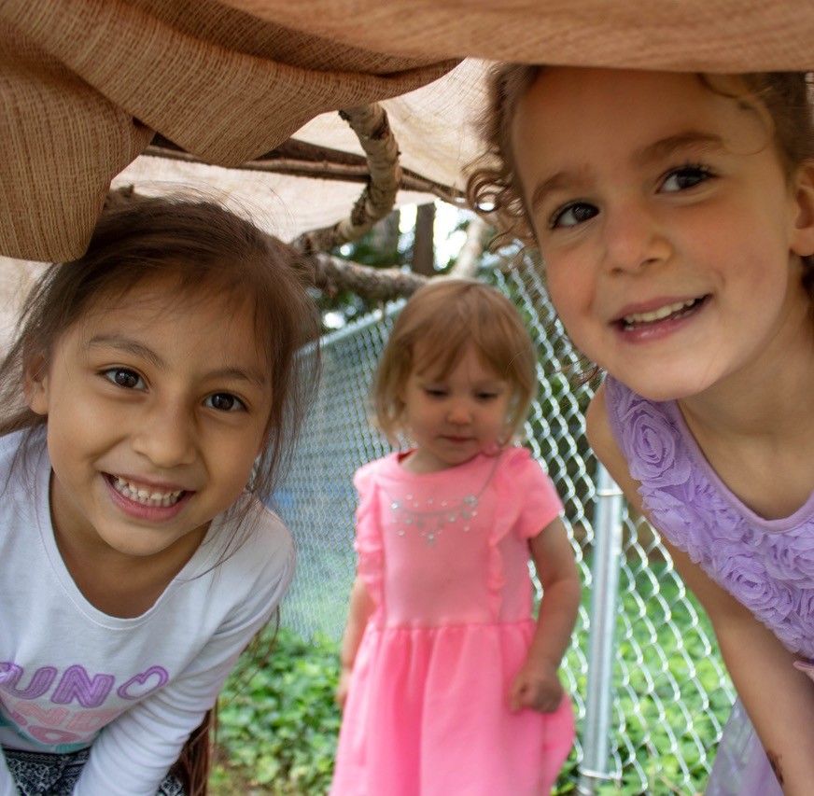
Thank you!
Notes:
Objective
To thank participants and close the presentation session.
What to say
Thank you so much for attending today. I hope that everyone leaves here today feeling inspired and motivated to implement smooth and successful transitions to kindergarten for all children and their families!

Slide 88

Notes:
Note to presenter:
The slides after this closing slide are optional and can be added into the presentation, in addition to or in substitution of earlier content. Please review the notes on the following slides to determine how and when you would like to include the remaining content.

Slide 89
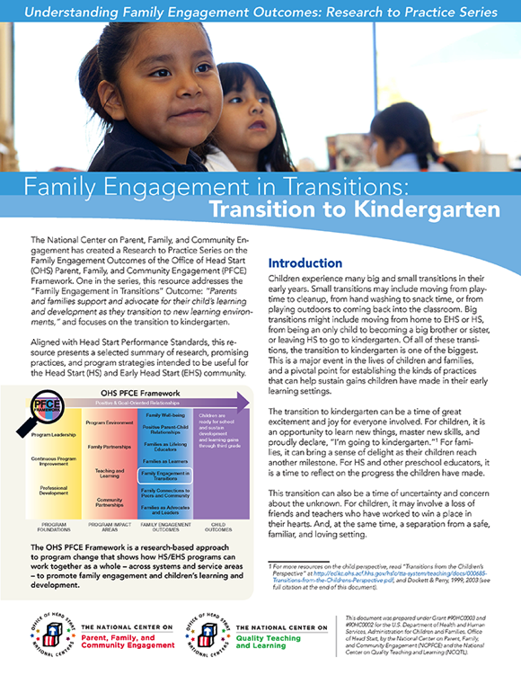
Strategies to Support School Readiness
Notes:
OPTIONAL SLIDE
Note to presenter:
Refer to the research brief from the NCPFCE Research to Practice Series, “Family Engagement in Transitions: Transition to Kindergarten” for case studies from places doing this work well. Some of the localities highlighted are: Orange, NJ; Newport, RI; Michigan; Pittsburgh, PA; and California. It will also be useful to contact NCPFCE for more information on these case studies.
Objective
To share some examples of places doing effective transition work
What to say
I’d like to now share an example(s) of places doing this work well.
What to do
Briefly highlight your choice of one or more of the case studies.

Slide 90
Planning the Transition
In your teams, discuss and fill out the Transition Plan Form.
Do your best to come to a consensus about what priorities are important to your team.
Notes:
OPTIONAL SLIDE
Note to presenter:
For this optional activity, have the participants fill out Transition Plan Form in groups that will be working together. You may provide them with the example form as well.
This activity is intended for participants who are in pre-formed teams that will be working together on transition planning. If this is not the case for your group, this activity may not be useful.

Slide 91
Transitions Connections
Child–School
To foster children’s familiarity with the kindergarten setting and people
Family–School
To foster family collaboration and engagement with the school
Program–School
To provide children with stable, high-quality early learning experiences
Community–School
To facilitate the transition process within the community
Notes:
OPTIONAL SLIDE
Note to presenter:
This slide can be used instead of including slides 40, 43, 48, 51 & 52 if these topics are not the focus of your presentation or if the presentation needs to be shorter.
Objective
To introduce participants to the four types of transition connections that should be fostered for successful transition planning
What to say
These are the four types of transition connections that should be fostered for successful transition planning. Some examples of each are:
Child-School
Making a video for children about kindergarten
Taking a field trip to a kindergarten classroom
Reading books about kindergarten
Family-School
Sending home learning activities to prepare for kindergarten
Having a kindergarten open house for families
Sending home transition information to families
Program-School
Educators and leaders in both settings talking about aligning curricula, expectations, and routines
Educators and leaders from both settings sharing child records, with the necessary family permissions, that will help inform kindergarten teachers
School personnel communicating about individual students
Community-School
“Getting the word out”
PSAs
Bulletins in community areas such as directors’ offices or libraries
Working with social services to get information to families
One key goal of the community-school relationship is disseminating information to populations who may be somewhat out of touch with school. This could be information on kindergarten registration, activities families can do to prepare their children for kindergarten, etc.

Slide 92
Notes:
Note to Presenter:
Refer participants to the remaining handouts: Transition Resources for Families, Transition Resources for Educators and Administrators, Transition Resources for Researchers, and References from Presentation Slides.
Objective:
To wrap up the day.
What to say:
Thank the participants for coming. Ask for questions or areas where clarification is needed.

